Slide 1

GIT BASICS

Slide 2
Need of version control & what it is?
Need of Version control:
Work in a team, probably on particular components
Integrate your code together.
Make copies of your files in case something you lose them.
What is Version control:
Version control is the management of changes to documents, primarily computer programs.
Also known as revision control or source control.
Examples: git, mercurial, subversion
Benefits of Version control:
Makes working in a team easy!
Code without interference.
Go back to a previous version (iOS 10 anyone?)
Integrate code of multiple developer’s easily.
Know who did what, when.
Keep your code secure.

Slide 3
What is GIT?
Git is a distributed version control system. A version control system is a tool that allows us to manage changes made to blobs.
It is a tool that allows you to track your code history. Allows you to peek into the past and see what a code looks like at any given point of development.
An important tool to collaborate with other fellow developers. As developers you can’t collaborate efficiently by sending pieces of code in a zip file, or sharing it over the folder.
Source of truth, it is important to track down developers who made the changes and what changes are done.

Slide 4
Installing GIT?
You need Git installed on your system, and you can access it in a UNIX Terminal, either the Terminal on the Mac or Git Bash on Windows.
Download Git from the following link:
https://git-scm.com/downloads

Slide 5
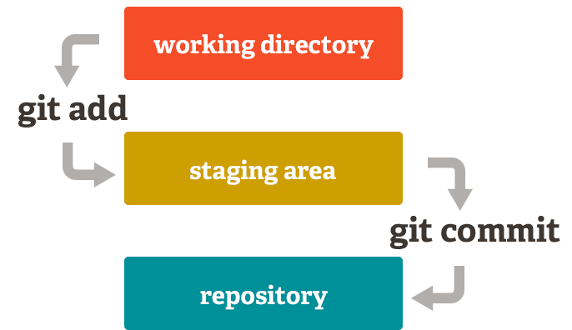
Basic Git model locally

Slide 6
WHAT IS Git hub
It’s a hosting medium/website for your Git repositories
Offers powerful collaborative abilities
A good indicator of what you code/how much you code/quality of your code

Slide 7





Alice
Bob
Joe
Who replaced the files? When ?

Slide 8
Collaboration with GitHub
Remote Repo
Master
C1
Alice
Bob
C2

Slide 9
Collaborate
Remote Repo
git clone
git clone
Master
Master
Master
C1
C1
C1
Alice
Bob
C2
C2
C2

Slide 10
Collaborate
Remote Repo
Master
Master
Master
C1
C1
C1
Alice
Bob
C2
C2
C2
CA
git add
git commit
CB
git add
git commit

Slide 11
Collaborate
Remote Repo
Master
Master
Master
C1
git push
C1
C1
Alice
Bob
C2
C2
C2
CA
C3
CB

Slide 12
Collaborate
Remote Repo
Master
Master
Master
C1
C1
git fetch
C1
Alice
Bob
C2
C2
C2
C3
CA
C3
CB

Slide 13
Collaborate
Remote Repo
Master
Master
Master
C1
C1
git merge
C1
Alice
Bob
C2
C2
C2
CA
C3
C3
CB

Slide 14
Collaborate
Remote Repo
Master
Master
Master
C1
C1
git push
C1
Alice
Bob
C2
C2
C2
CA
C3
C3
CB
CB

Slide 15
Collaborate
Remote Repo
Master
Master
Master
C1
git pull
C1
C1
Alice
Bob
C2
C2
C2
CA
C3
C3
CB
CB
CB

Slide 16
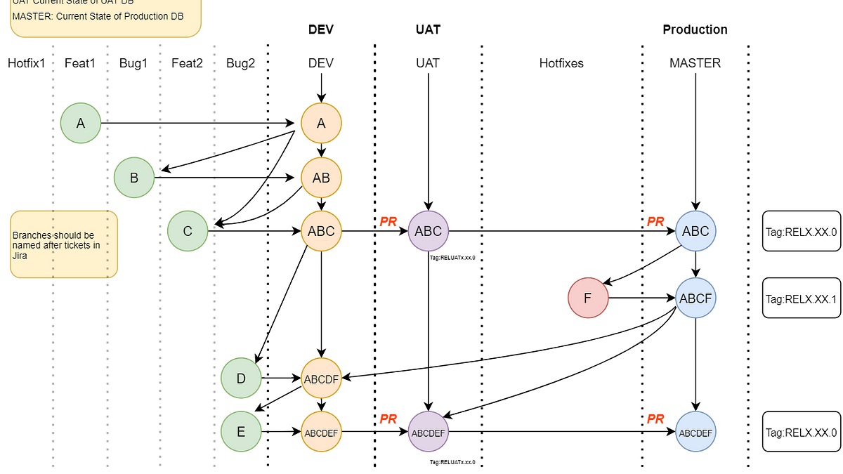
Git Branching strategy

