Slide 1
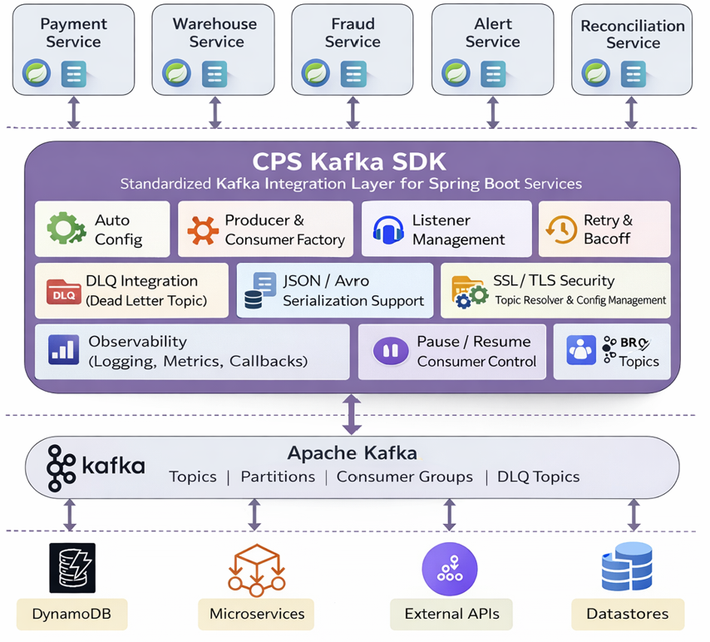
CPS Kafka SDK is a reusable, enterprise-grade abstraction built on top of Spring Kafka that standardizes producer and consumer integration across multiple Spring Boot microservices.
Without SDK
Repeated Kafka configuration in every service
Inconsistent retry & DLQ handling
High boilerplate code
Complex onboarding
Difficult governance & maintenance
With CPS Kafka SDK
Standardized integration across all services
Centralized retry, DLQ, and error handling
Minimal application code (focus on business logic)
Faster onboarding for new teams
Consistent security, serialization, and logging
Easier maintenance and upgrades

