Slide 1
SOCIETY MANAGEMENT SYSTEM
Member Portal
Features Available to Society Members
A self-service portal for flat owners to log in, view maintenance dues,
pay bills online, download receipts, and manage their profile.

Slide 2
OVERVIEW
What Members Can Do
Self Registration
OTP Login
Maintenance Dashboard
Online Payment
Register with unit, email & mobile, verified by OTP and approved by admin.
Passwordless sign-in using a one-time code sent to mobile and email.
See outstanding, paid, pending bills and recent payment activity.
Pay full or partial dues via Razorpay / Cashfree (UPI, card, netbanking).
Bills & Receipts
Profile & Requests
Register a Tenant
Apply for NOC
View full bill history and download bill and receipt PDFs.
View masked profile and request contact detail updates.
Submit tenant details for the unit; NOC emailed on approval.
Request, track and download No Objection Certificates.
Society Management | Member Portal
2

Slide 3
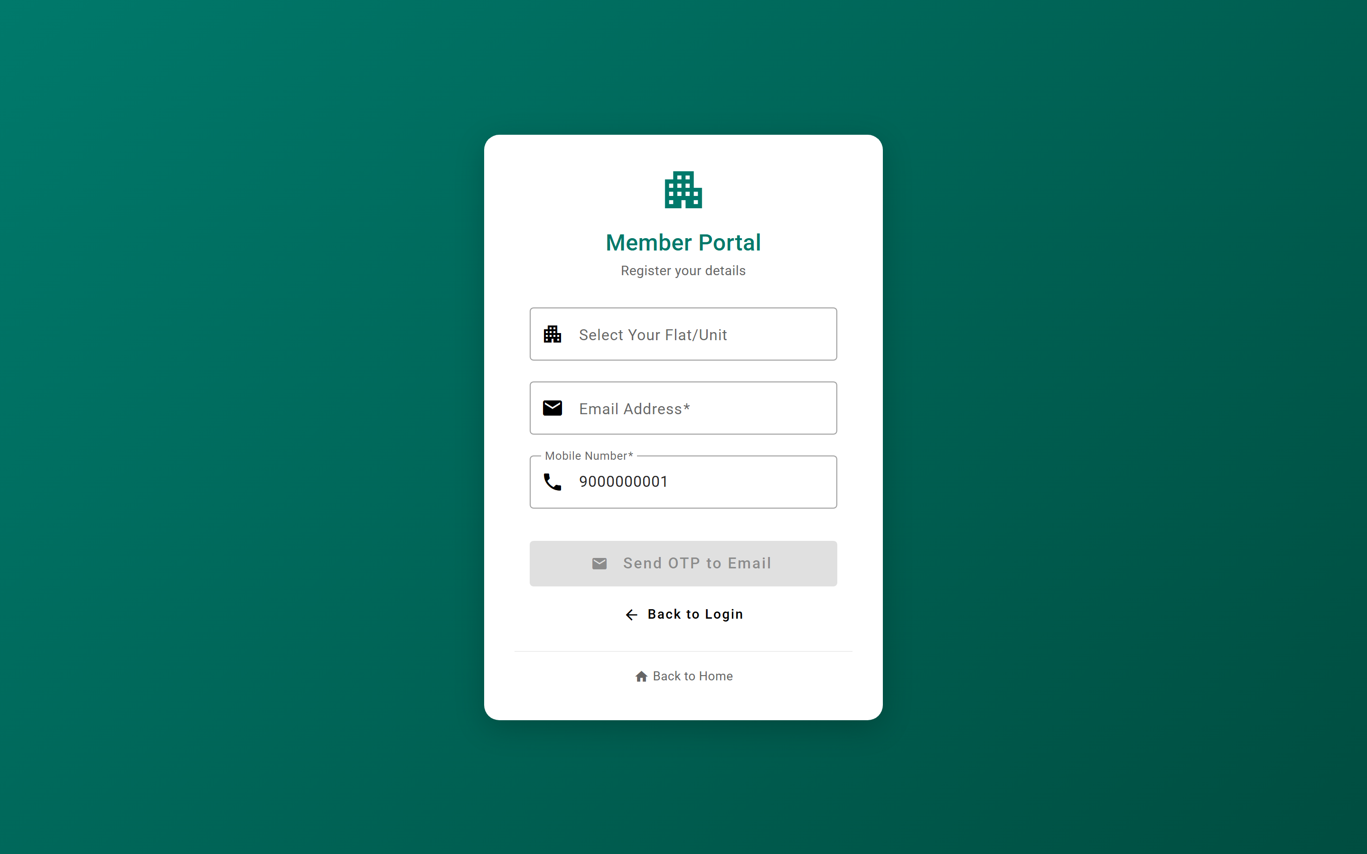
FEATURE 1
Self Registration
New members onboard themselves. They pick their unit, enter email and mobile, verify via OTP, and the request goes to the committee for approval.
Key capabilities
• Select flat/unit from a dropdown of all society units
• Enter email and mobile number to identify the member
• Receive an OTP on email to verify the request
• Request is created in a pending state after verification
• Committee (Chairman / Secretary) approves and links it to the owner record
• No account is active until an admin approves the request
Endpoints: /api/member/auth/register/send-otp, /verify-otp, /units
Society Management | Member Portal
3

Slide 4
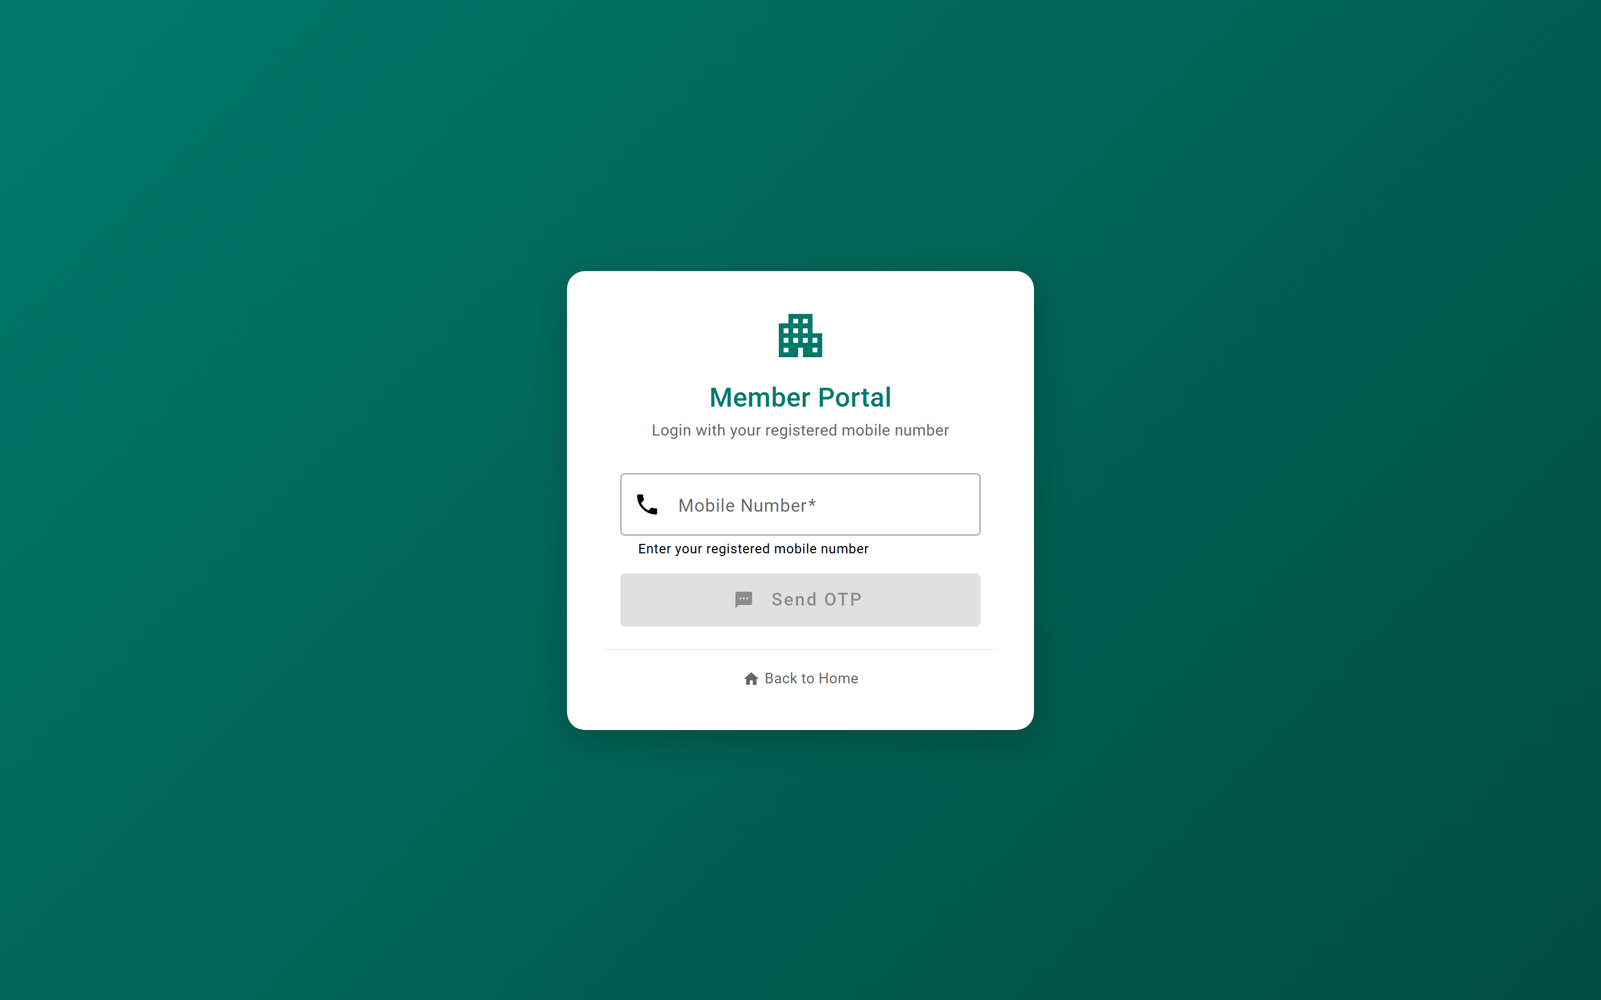
FEATURE 2
OTP Login (Passwordless)
Members sign in with just their registered mobile number. A one-time code is sent to their mobile and email — no password to remember.
Key capabilities
• Enter registered mobile number to request an OTP
• OTP delivered to email (and mobile via SMS integration)
• Code expires in 5 minutes for security
• Limited attempts and hourly rate limiting to prevent abuse
• On success, a secure JWT session is issued
• Login returns the member's linked unit(s)
Endpoints: /api/member/auth/send-otp, /verify-otp
Society Management | Member Portal
4

Slide 5
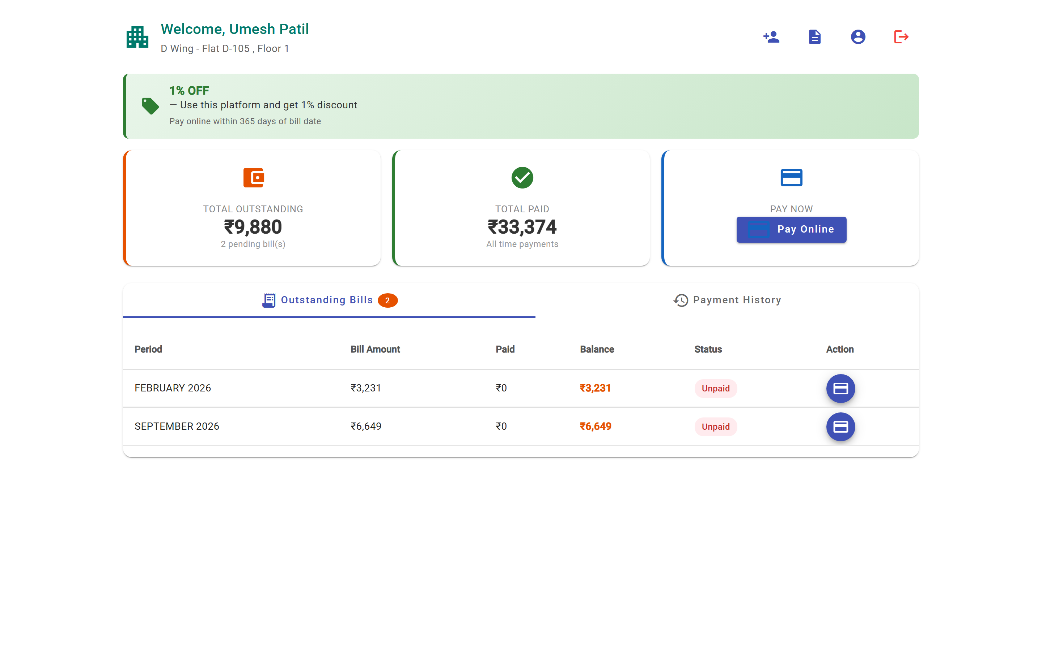
FEATURE 3
Maintenance Dashboard
After login, members land on a dashboard summarizing their financial standing with the society at a glance.
Key capabilities
• Total outstanding amount across all bills
• Total amount paid to date
• Count of pending / unpaid bills
• Recent payment activity feed
• Per-unit view for owners with more than one flat
• Live refresh after each successful payment
Endpoint: /api/member/maintenance/dashboard/{unitId}
Society Management | Member Portal
5

Slide 6
FEATURE 4
Bills & Payment History
Members get full transparency into every bill raised and every payment made against their unit, with downloadable documents.
Key capabilities
• View all maintenance bills for the unit
• Filter to only outstanding / unpaid bills
• Paginated payment history
• See payments made against a specific bill
• Download any bill as a PDF
• Download a payment receipt as a PDF
Endpoints: /bills, /outstanding, /payments, /bill-pdf, /receipt-pdf
Society Management | Member Portal
6

Slide 7
FEATURE 5
Online Payment
Members pay maintenance dues online in a few taps. The portal supports multiple gateways and both full and partial payments.
Key capabilities
• Pay full outstanding or a partial amount
• Razorpay and Cashfree payment gateways supported
• UPI apps, debit / credit card, and net banking
• Portal auto-detects the active gateway
• Payment is verified with a secure signature check
• Successful payment updates the bill and dashboard automatically
• Server-to-server webhooks confirm payment reliably
Endpoints: /payments/active-gateway, /create-order, /verify, /webhook/*
Society Management | Member Portal
7

Slide 8
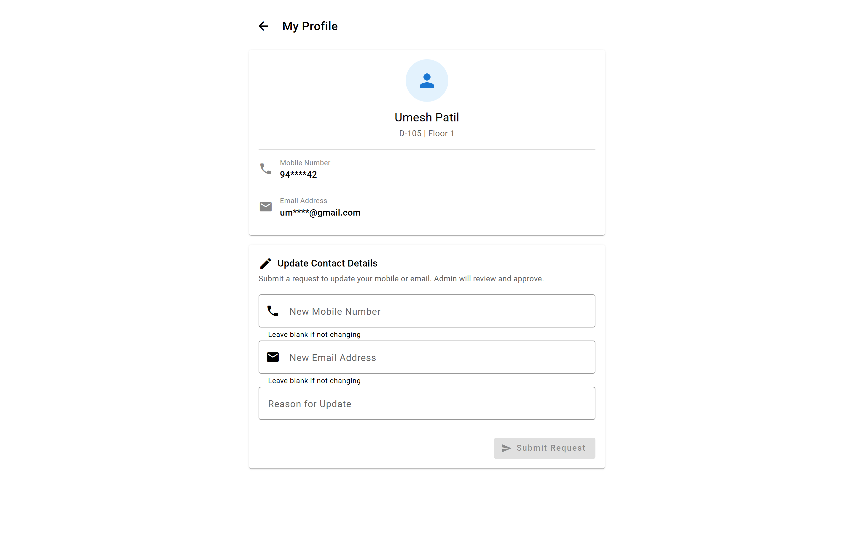
FEATURE 6
My Profile
Members view their own details with sensitive information masked, and can request changes to their contact info — approved by the committee.
Key capabilities
• View profile with unit, masked mobile and email
• Submit a request to update mobile / email
• Optional reason field for the change
• Changes are reviewed and approved by the committee
• No direct edits — keeps records controlled
Endpoints: /api/member/profile, /profile/update-request
Society Management | Member Portal
8

Slide 9
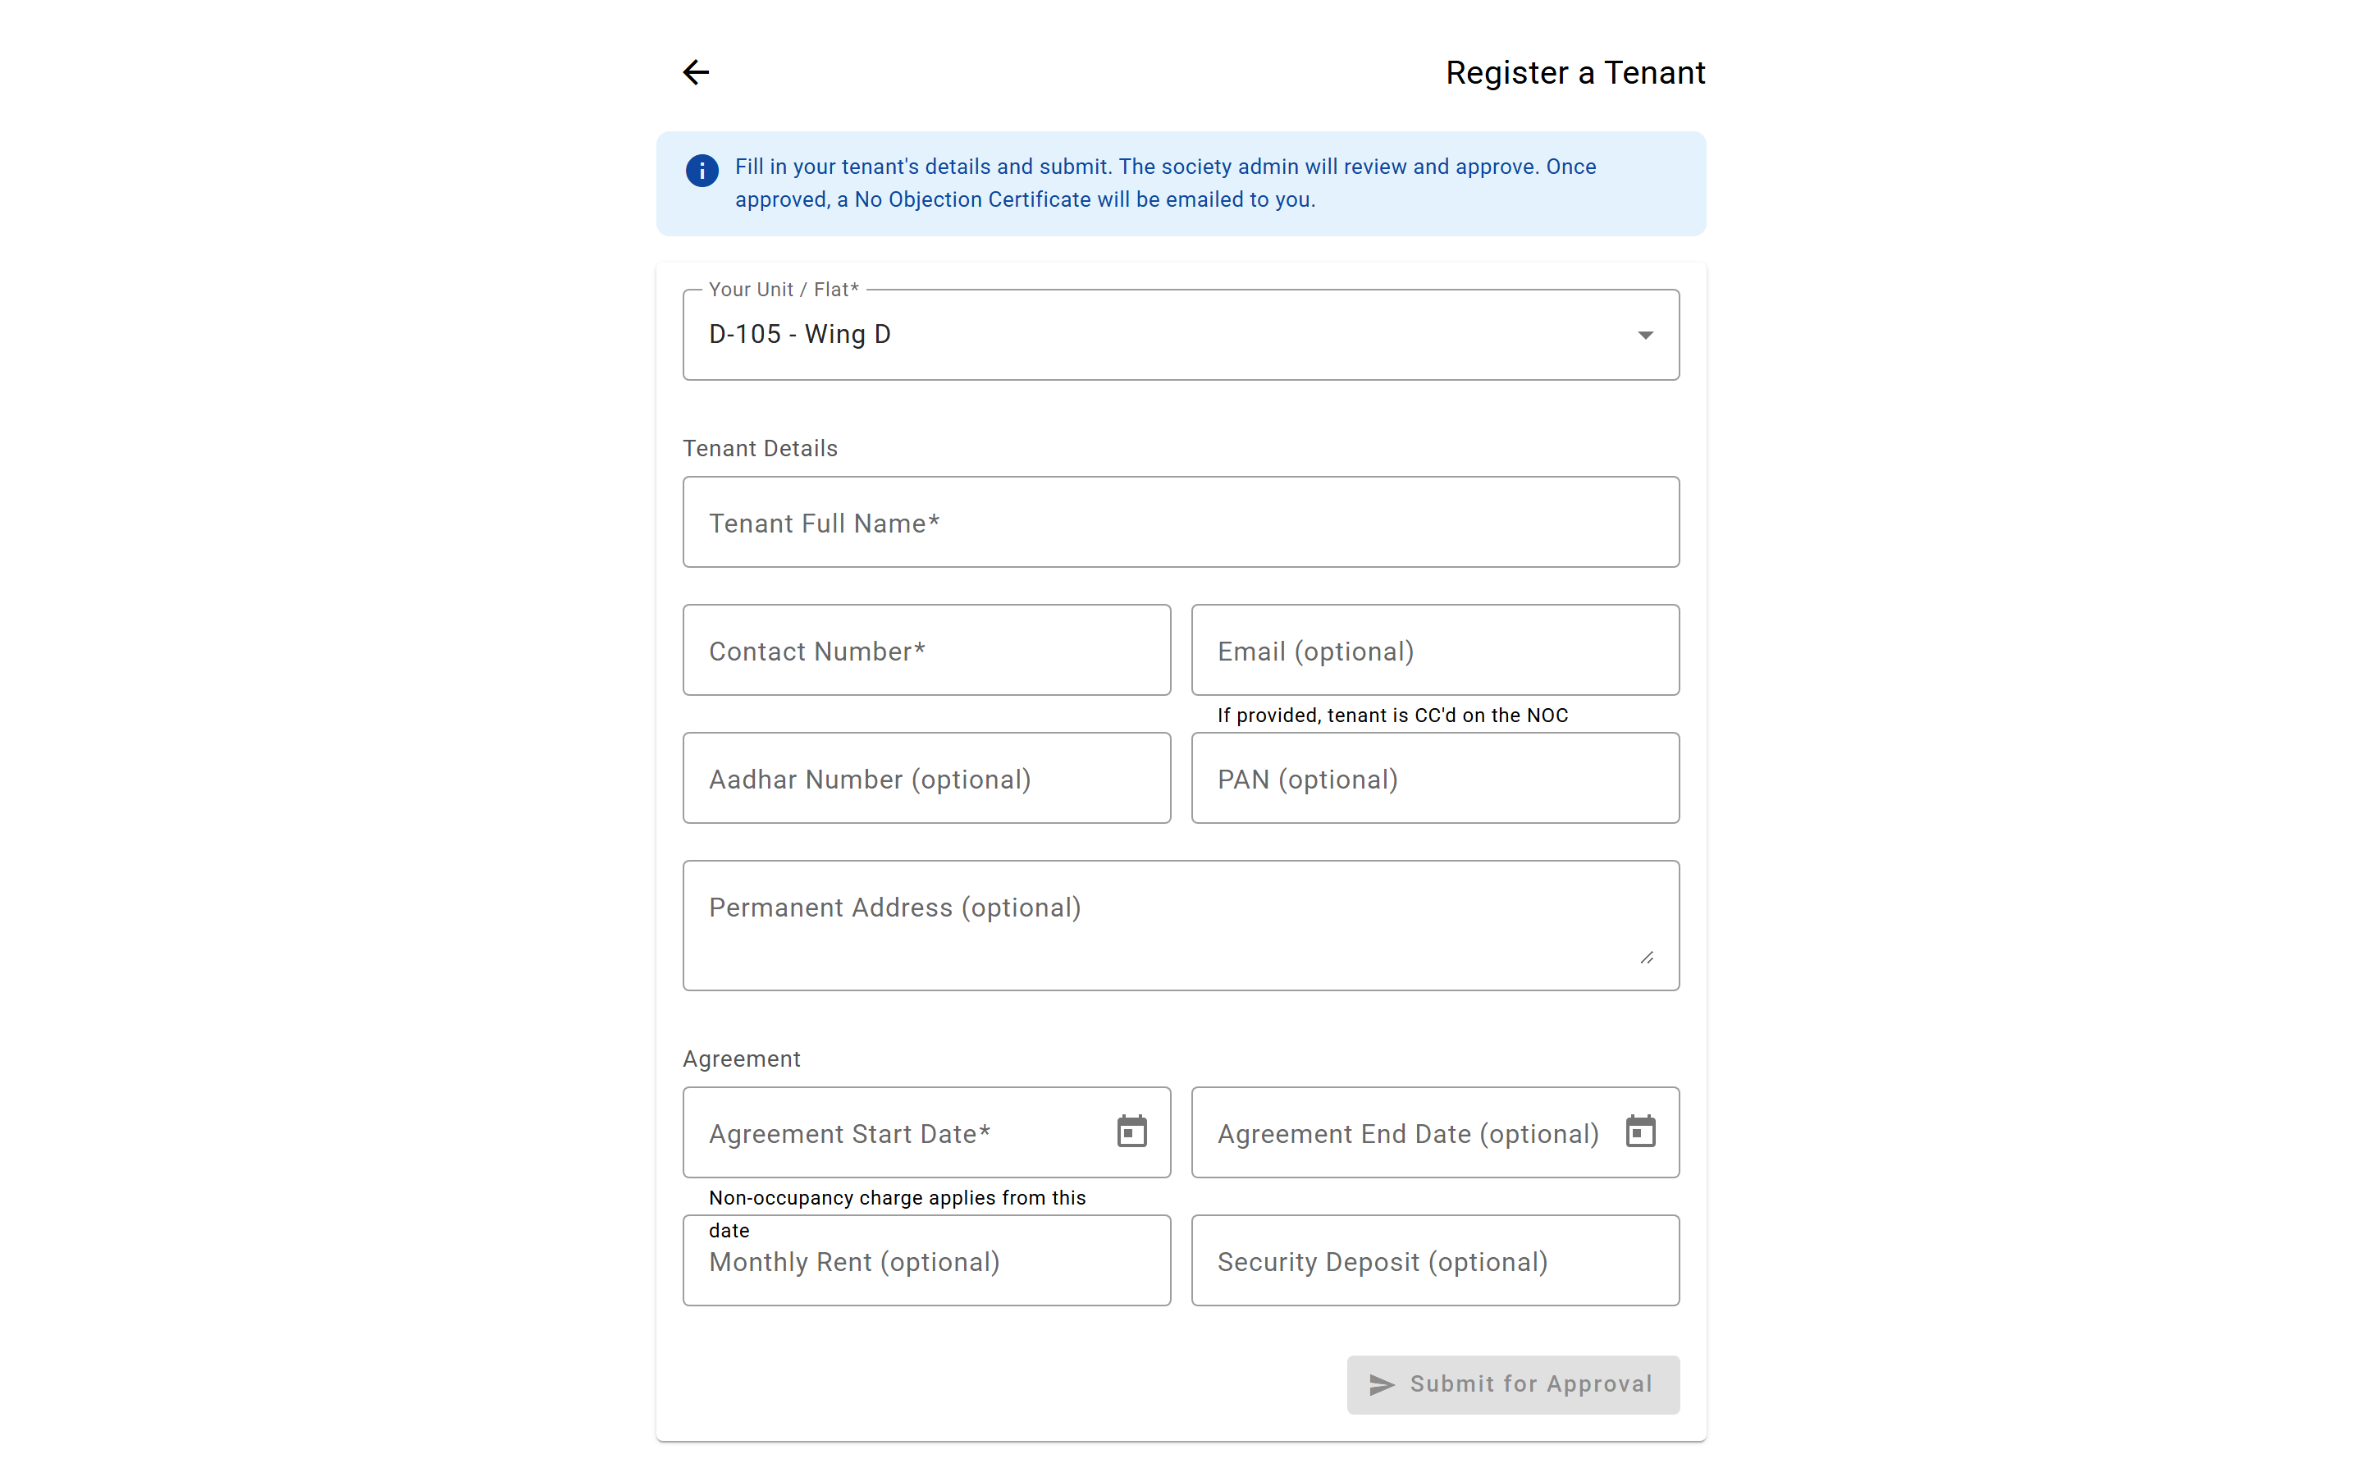
FEATURE 7
Register a Tenant
Owners register a tenant for their unit directly from the portal. On approval, a No Objection Certificate is generated and emailed automatically.
Key capabilities
• Select your unit and enter tenant details
• Capture agreement dates, rent and deposit
• Optional Aadhaar / PAN and permanent address
• Submit for society admin review and approval
• Approved tenant triggers an NOC by email
Endpoint: /api/member/tenants
Society Management | Member Portal
9

Slide 10
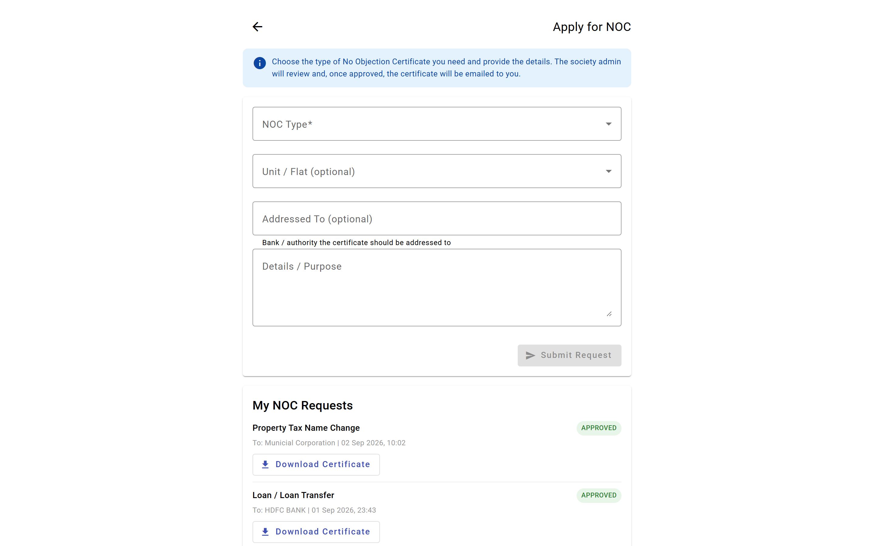
FEATURE 8
Apply for NOC
Members request a No Objection Certificate (for a bank loan, property tax name change, and more), track its status, and download the approved certificate.
Key capabilities
• Choose the NOC type and addressee
• Add purpose / details and target unit
• Submit for committee review
• Track status of all your NOC requests
• Download the approved certificate as a PDF
Endpoints: /api/member/noc-requests, /types, /{id}/certificate
Society Management | Member Portal
10

Slide 11
HOW IT FLOWS
The Member Journey
1
2
3
4
5
›
›
›
›
Register
Log In
Review
Pay
Receipt
Pick unit, verify OTP, await approval
Enter mobile, receive & confirm OTP
Check dashboard & outstanding bills
Pay full/partial via UPI, card, netbanking
Download PDF receipt, dashboard updates
Society Management | Member Portal
11

Slide 12
BUILT-IN SECURITY
Safe & Convenient for Every Member
Passwordless OTP login with 5-minute expiry
Attempt limits and hourly rate limiting on OTP
Secure JWT session tokens after login
Personal information masked in the profile view
Payment signatures verified before recording
Profile & registration changes require committee approval
Members stay informed and pay on time — the committee saves hours of manual follow-up.

