Slide 1

RISC-V Assembly Language Programming Using ESP32-C3 and QEMU
Presentation by Yi-Chih Tung

Slide 2
Chapters List
01. Introduction
02. ESP32-C3 Installation ESP-IDF
03. Installing and Setup of QEMU
04. Architecture
05. Write and run a simple assembly program
06. RISC-V operations used for loading and storing.
07. Calling Convention
08. Flow Control
09. Basic Opcodes
10. Multiply / Divide

Slide 3
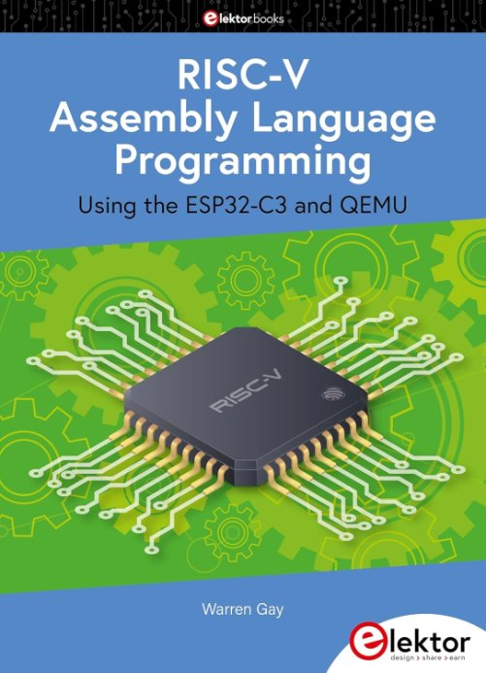
Text-Book Referred ​

Slide 4
RISC-V Assembly Language Programming using ESP32-C3 and QEMU
What is RISC-V?
Notes:
QEMU ON AND OFF –
Power on $ cd ~/riscv $ ./boot.sh
Power off - sudo /sbin/shutdown -h now
Disk image link : Download the disk image:
wget https://dl.fedoraproject.org/pub/alt/risc-v/archive/disk-images/fedora/rawhide/20190703.n.0/Developer/Fedora-Developer-Rawhide-20190703.n.0-sda.raw.xz
Download the Firmware (BIOS)
wget https://dl.fedoraproject.org/pub/alt/risc-v/archive/disk-images/fedora/rawhide/20190703.n.0/Developer/Fedora-Developer-Rawhide-20190703.n.0-fw_payload-uboot-qemu-virt-smode.elf

Slide 5
Why Learn RISC-V Assembly?
Open-source & widely adopted architecture
Used in embedded systems, IoT, and high-performance computing
Helps in understanding low-level hardware interaction

Slide 6
Hands-on with ESP32-C3 hardware
Using QEMU for RISC-V emulation
Writing, debugging, and optimizing assembly programs
Learning Approach

Slide 7
Setting Up the Development Environment
Hardware: ESP32-C3 development board
Software: ESP-IDF, GCC for RISC-V, QEMU Emulator
Operating System: Linux, MacOS, or Windows

Slide 8
Writing an Assembly Program
Writing a simple "Hello, RISC-V!" program
Introduction to assembly syntax and registers
Running code on ESP32-C3 and QEMU

Slide 9
RISC-V Architecture
Registers, Instruction Set, and Endianness
Stack and Memory Organization
Comparison with x86 and ARM

Slide 10
Instruction Set & Opcodes
Arithmetic & Logical Instructions
Load/Store and Branching
Call and Return Mechanisms

Slide 11
Debugging & Optimization Techniques
Using GDB for debugging
Analyzing compiled assembly with objdump
Writing efficient assembly code

Slide 12
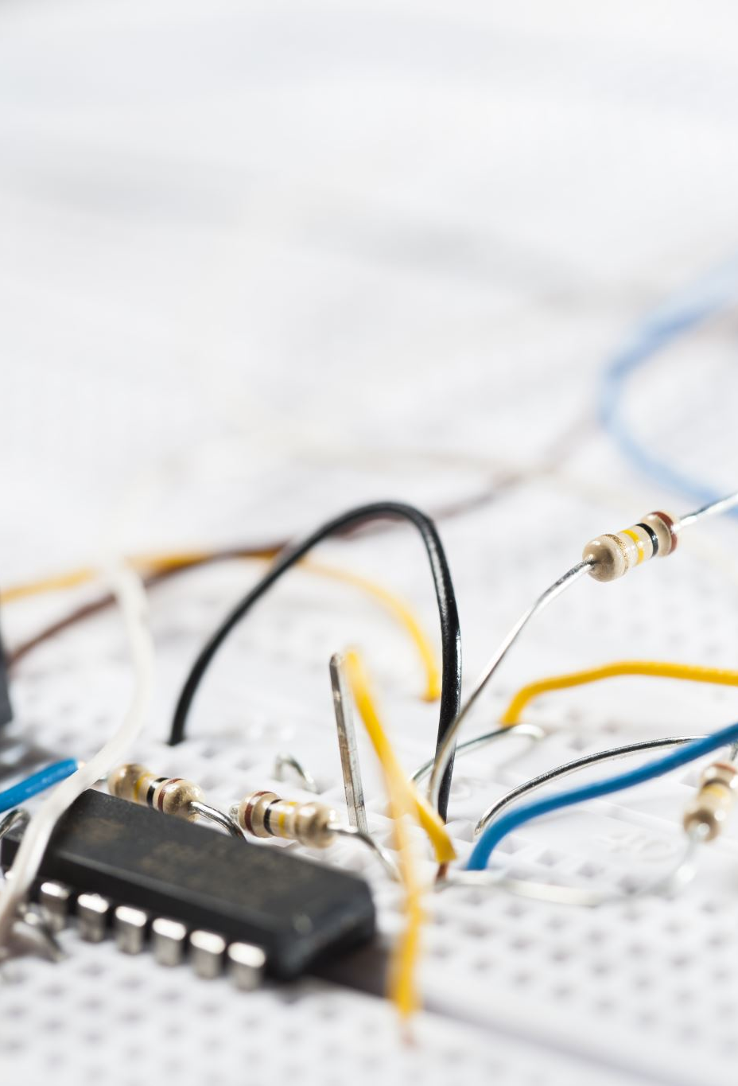
Interfacing with Peripherals (GPIO, UART, Timers)
Controlling LEDs and buttons using assembly
Serial communication with UART
Timers and interrupts in RISC-V

Slide 13
Advanced Topics – Floating Point & Multiplication/Division
Understanding
Understanding floating-point registers
Implementing
Implementing mathematical operations in assembly
Optimizing
Optimizing for speed and power efficiency

Slide 14
Summary & Key Takeaways
Understanding hardware-software interaction
Developing optimized low-level applications
Practical skills for embedded systems and IoT

Slide 15

Questions?

