Slide 1

RISC-V Assembly Language Programming Using ESP32-C3 and QEMU
Chapter 1
Presentation by Yi-Chih Tung

Slide 2
Chapter 1 - Introduction
At the assembly level, the programmer directs every step of the machine. You decide how the registers are allocated and apply every binary trick in your toolbox to make that process slick. While we don't have hardware debug consoles anymore, we do have powerful debugging tools like the GNU gdb debugger
The Intel and AMD instructions sets, for example, have been horribly extended in the name of compatibility. RISC-V allows the enthusiast to sweep all that clutter aside and start over with a clean slate.

Slide 3
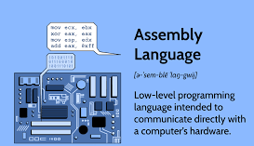
The Joy of the Machine
Assembler Language
It is a low-level programming language that directly interacts with a computer's hardware by using mnemonics (human-readable codes) to represent machine instructions, essentially acting as a bridge between high-level languages and the binary code the CPU understands; it allows programmers to write code that is closer to the hardware, enabling fine-grained control over operations but requiring a deeper understanding of the processor architecture.

Slide 4
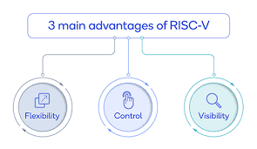
Why RISC-V?
Advantages of RISC-V architecture include its open-source nature, allowing for customization and flexibility, enabling designers to tailor processors for specific applications while maintaining software compatibility across different implementations, resulting in faster development cycles, lower costs, and greater control over the design process compared to proprietary architectures like ARM; additionally, its modular design facilitates easier software development and improved energy efficiency due to simplified instructions sets

Slide 5
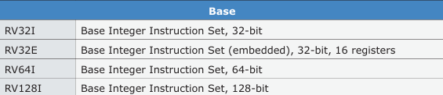
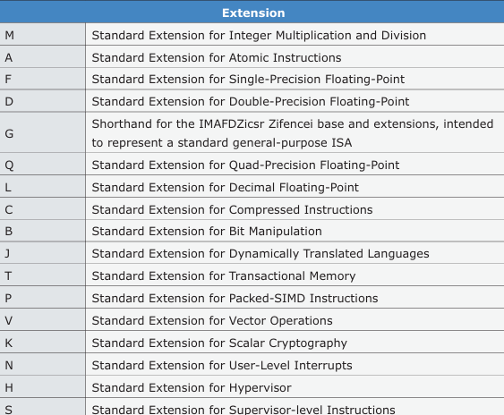
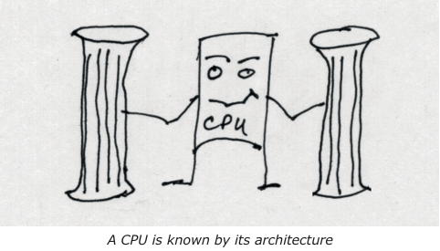
Base Instruction Sets Covered
RISC-V is now a large body of work,
In chapter 4, Architecture, we will discuss base instruction sets and extensions to RISC-V. Focus of this Course, however, will be on the RV32 and RV64 subsets of RISC-V.

Slide 6
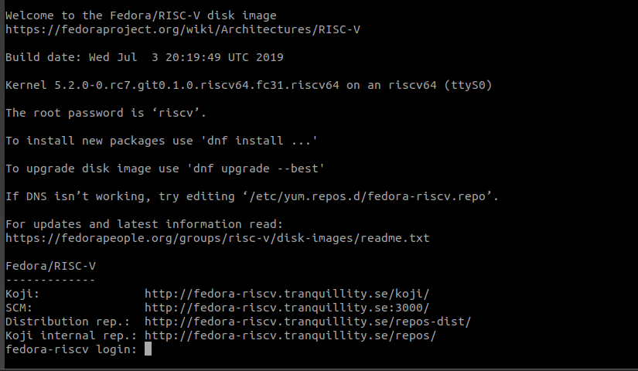
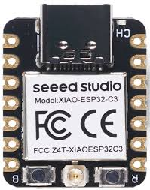
Study of the ESP32-C3 device (RV32) as well as Fedora Linux under QEMU (RV64).
ESP32-C3
Fedora Linux under QEMU (RV64).

Slide 7
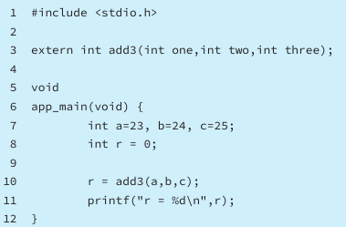
Projects in this Course
The projects in this Course are boiled down to the barest essentials to keep the assembly language concepts clear and simple.
The focus of this Course is on learning how to write RISC-V assembly language code without getting bogged down.
You'll build up small demonstration programs to be run and tested
Once you've mastered these basic concepts, you will be well equipped to apply assembly language in larger projects
ESP32-C3 main program

Slide 8
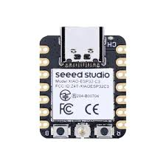

What do you need?
Espressif ESP32-C3 dev kit device for hardware.
RISC-V in 64-bit mode using the QEMU emulator on your desktop computer
The emulator requires that you have at least 20 GB of free disk space available. For both of the ESP-IDF (ESP Integrated Development Framework) and QEMU instances.
A computer is required to program the ESP32-C3 and to run the QEMU emulator, running Fedora Linux

Slide 9
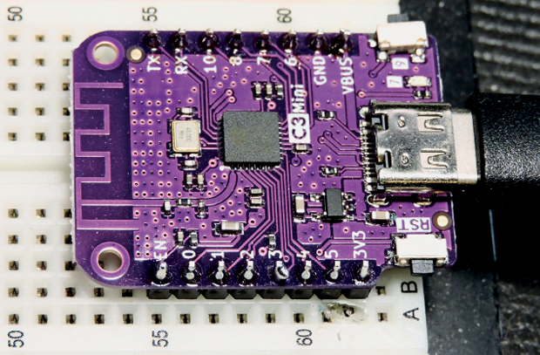
ESP32-C3 Hardware
The original ESP32 devices used the Xtensa processor and are not RISC-V devices.
• ESP32 (Xtensa dual-core and single-core 32-bit LX6 microprocessor)
• ESP32-S2 (Single-core Xtensa LX7 CPU)
• ESP32-S3 (Dual-core Xtensa LX7 CPU)
• ESP32-C3 Single-core 32-bit RISC-V (WiFi 2.4 Ghz IEEE 802.11b/g/n)
• ESP32-C6 Single-core 32-bit RISC-V
This course was developed specifically with the Espressif ESP32-C3 device

Slide 10
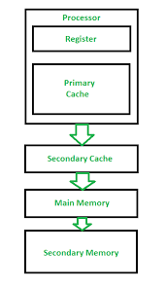
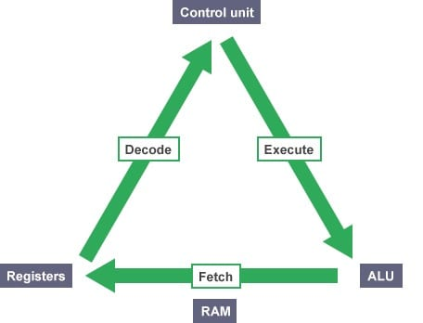
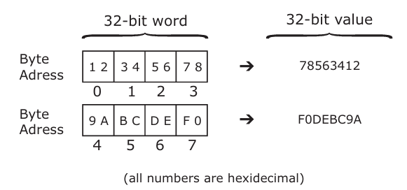

Prerequisites
Basic understanding of a CPU
Registers and computer memory.
Assembler language and debugging require knowledge of number systems, specifically binary and hexadecimal.
Knowledge of the C language
CPU
computer memory
number systems
C language

Slide 11

Summary
The next Class deals with installing ESP-IDF (ESP Integrated Development Framework) and the QEMU emulation software. This bit of work is necessary to let the good times roll. So gather your disk space and enable your internet access and begin!

Slide 12
Bibliography
[1] The_RISC-V_Reader_An_Open_Architecture_Atlas_by_David_Patterson_Andrew_ Waterman.pdf

Slide 13
Thank You !

