Slide 1

Presentation by Yi-Chih Tung
Chapter 2
ESP32-C3 Installation ESP-IDF

Slide 2
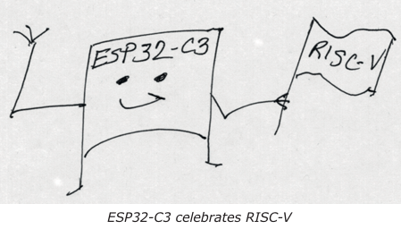
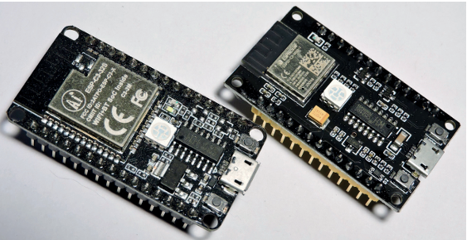
This Class we will learn the necessary steps to use ESP32 – C3 Device.
First lets focus on ESP-IDF Software installations – Manual Installation
Espressif also supports IDE installations for Eclipse and VSCode for more visit their online documentation

Slide 3
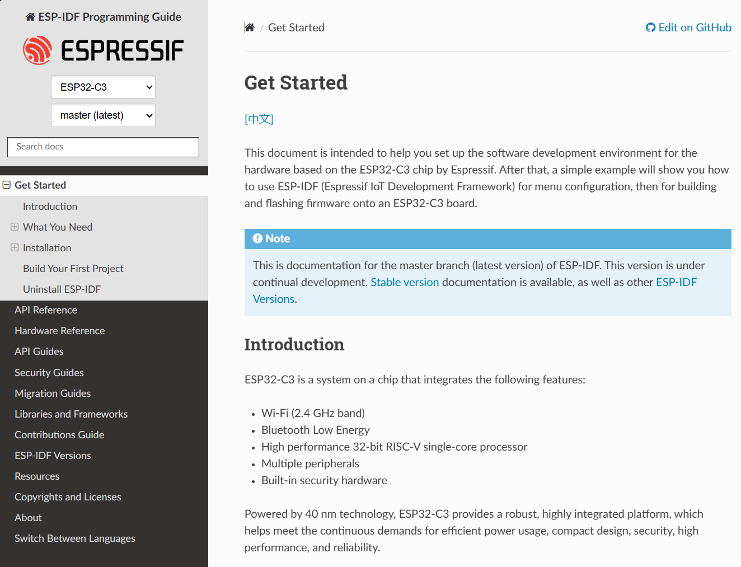
ESP-32-C3 Device
If the part says ESP32 but not C3, it is not the RISC-V version of the CPU.
Espressif "Get Started" web page https://docs.espressif.com/projects/esp-idf/en/latest/esp32c3/get-started/index.html
Install Prerequisites.
Get ESP-IDF.
Setup the tools.
Set up the environment variables.
First Steps for ESP-IDF.

Slide 4
Manual Installation (Ubuntu)
Install Prerequisites using below codes in terminal,
$ sudo apt install git wget
$ sudo apt flex bison
$ sudo apt gperf python3
$ sudo apt python3-pip python3-setuptools
$ sudo apt cmake ninja-build $ sudo apt ccache libffi-dev
$ sudo apt libssl-dev dfu-util libusb-1.0-0
Get ESP-IDF
create the subdirectory
$ mkdir -p ~/espc3
Move into the directory
$ cd ~/espc3

Slide 5
Access the files from GitHub
$ git clone --recursive https://github.com/espressif/esp-idf.git
After the git operation completes, you will have the Espressif software downloaded into the subdirectory ~/espc3/esp-idf.
Set up the Tools
we need to install some tools used by the ESP-IDF framework, like the compiler and Python packages.
$ cd ~/espc3/esp-idf
$ ./install.sh esp32c3
All done! You can now run:
$ . ./export.sh

Slide 6
Set up Environment Variables
To run the Espressif tools to build your projects some environment changes must be applied each time you log in. In a fresh terminal session, you would need to do the following.
Make sure that you type a space between the dot and the rest of the pathname:
$ . ~/espc3/esp-idf/export.sh
First Steps for ESP-IDF
Change to the example subdirectory using:
$ cd ~/espc3/esp-idf/examples/get-started/hello_world

Slide 7
Configure the Target Device
In order to build for the ESP32-C3 device, we need to tell the build framework about it:
$ idf.py set-target esp32c3
Build Example hello_world
This step adjusts the environment so that it knows that it is compiling for our RISC-V device (ESP32-C3).
Now test the build process:
$ idf.py build

Slide 8
Flash the Device
Before we can flash your RISC-V (ESP32-C3), we need to find out what port it appears on when you plug its cable into a USB port.
To flash the example program to your device, use
$ idf.py flash
Running hello_world
To see the hello_world program run, we monitor it as follows:
$ idf.py monitor

Slide 9
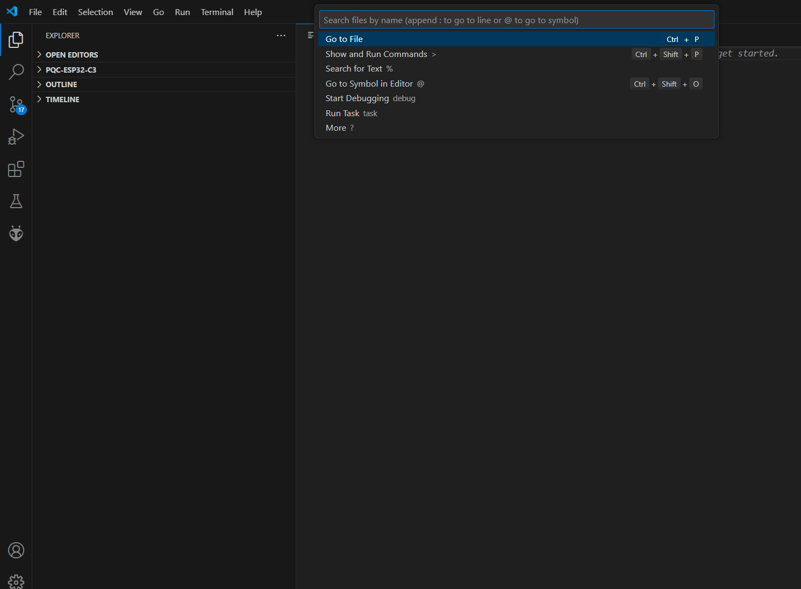

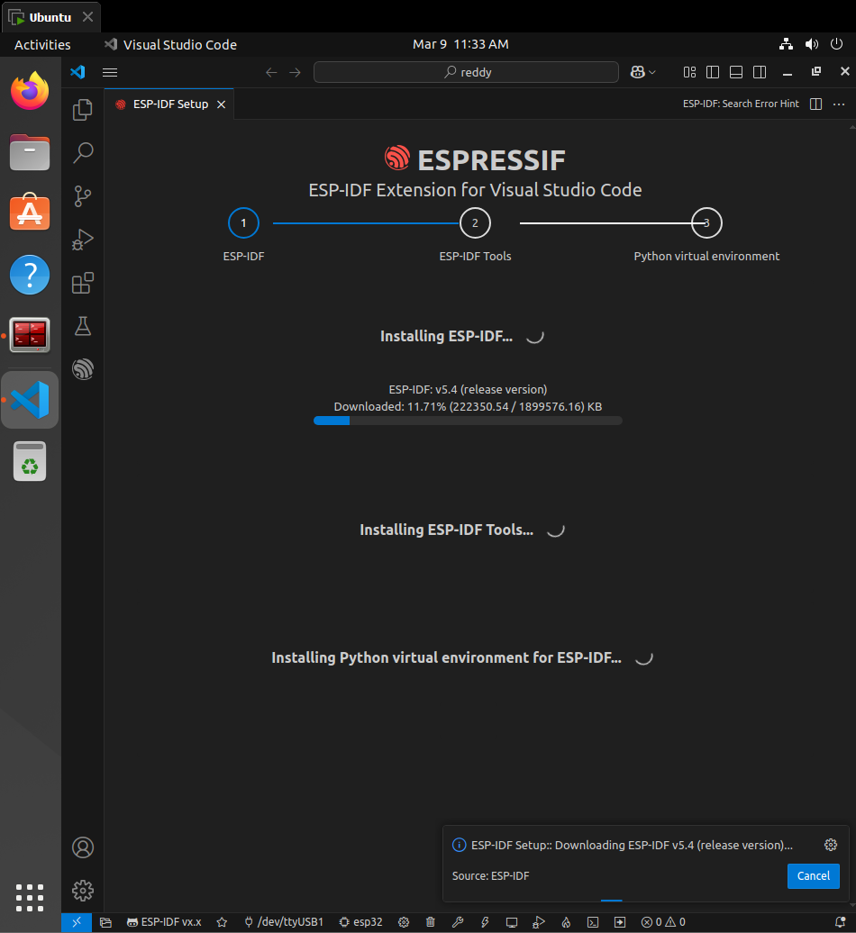
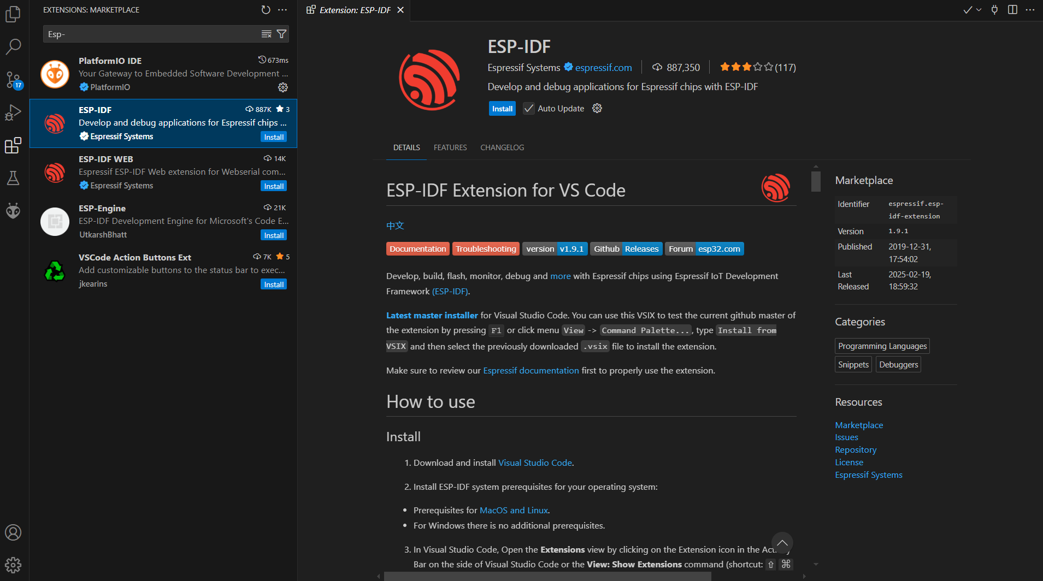

Windows Installation – Installing ESP-IDF through VSCode
Install VSCode
Espressif "Get Started" web page
Installing Esp-idf
Search for esp-idf extension

Slide 10
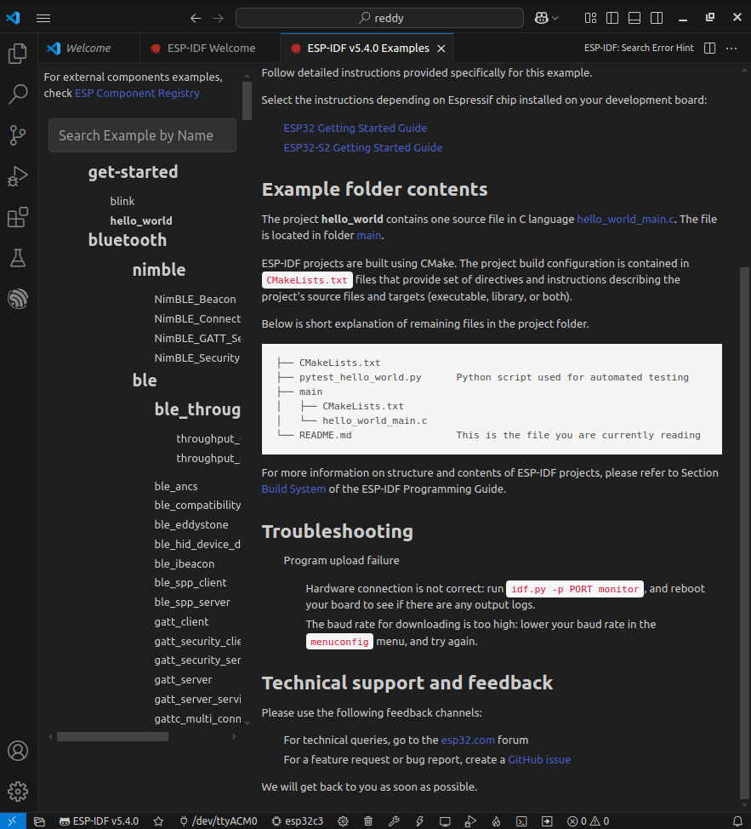
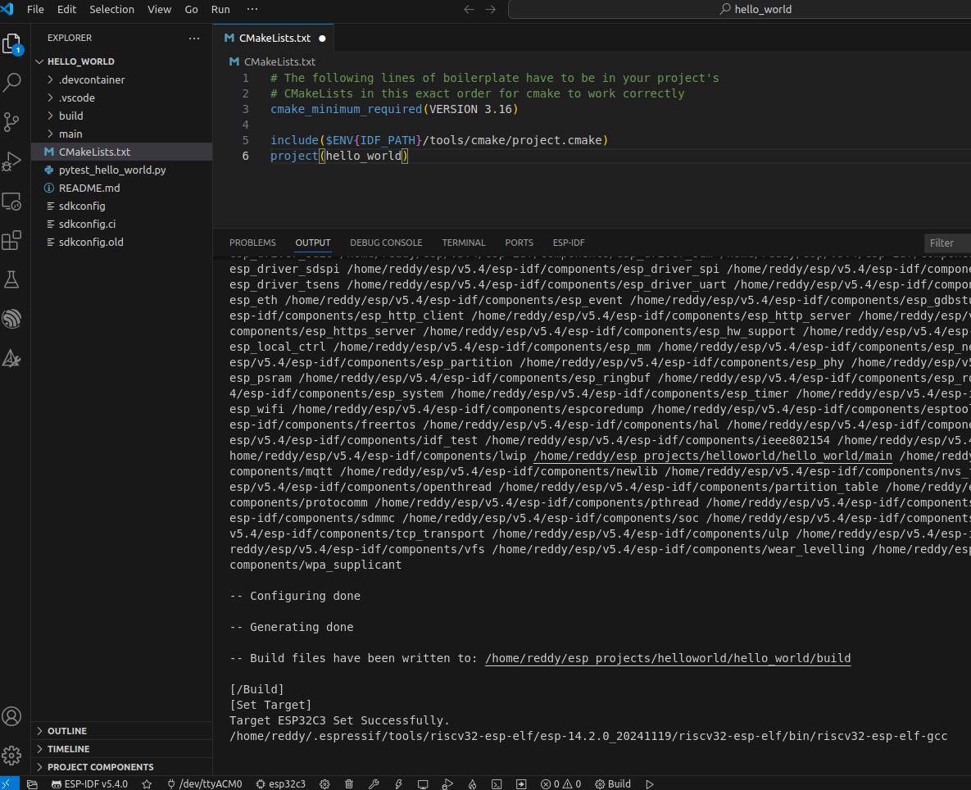
Move to Example Folder and select hello_world program and lets get started
Before Build process set ESP32C3 as Target

Slide 11
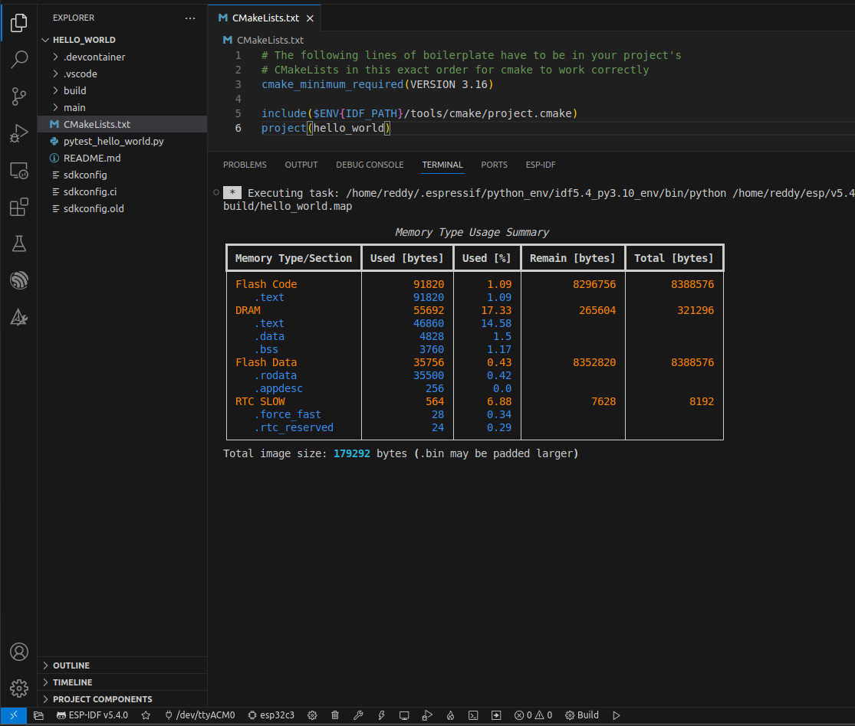
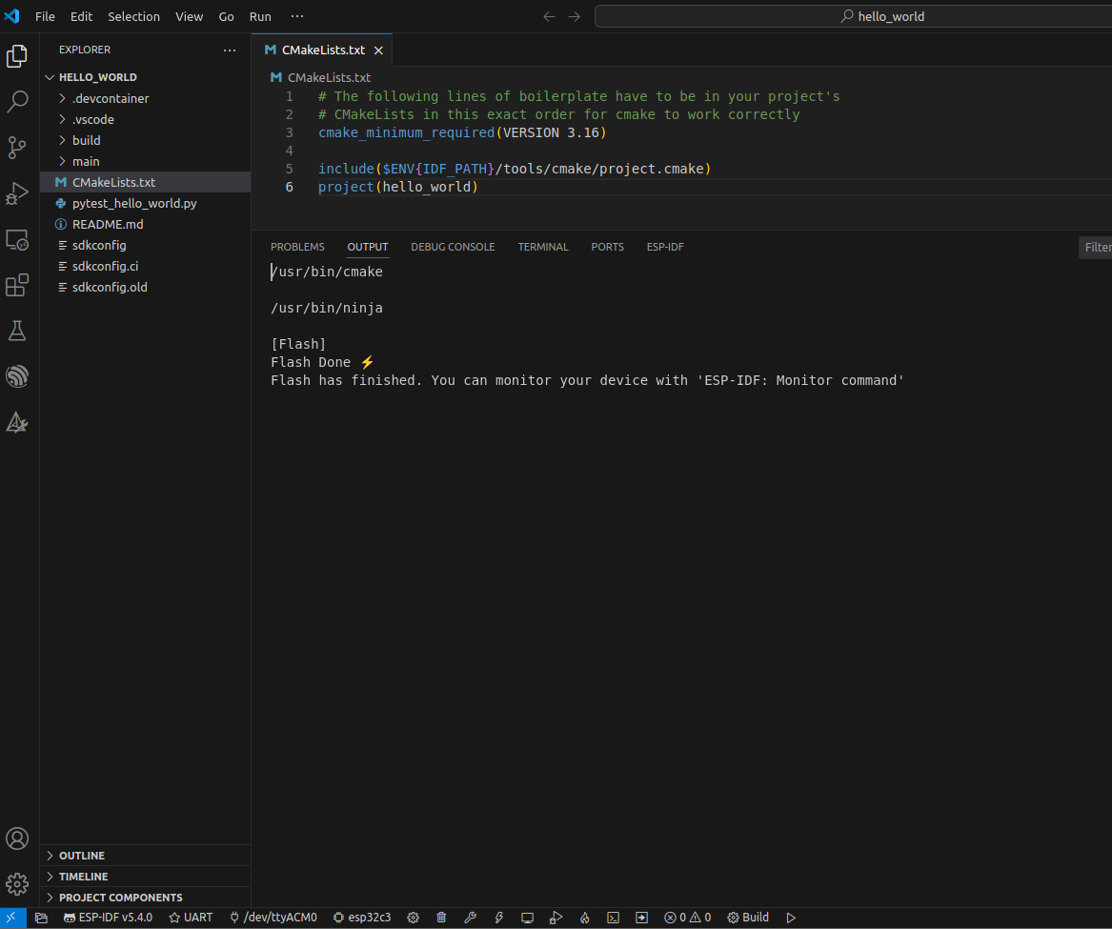
Now Build the project hello_world
Flash the project hello_world

Slide 12
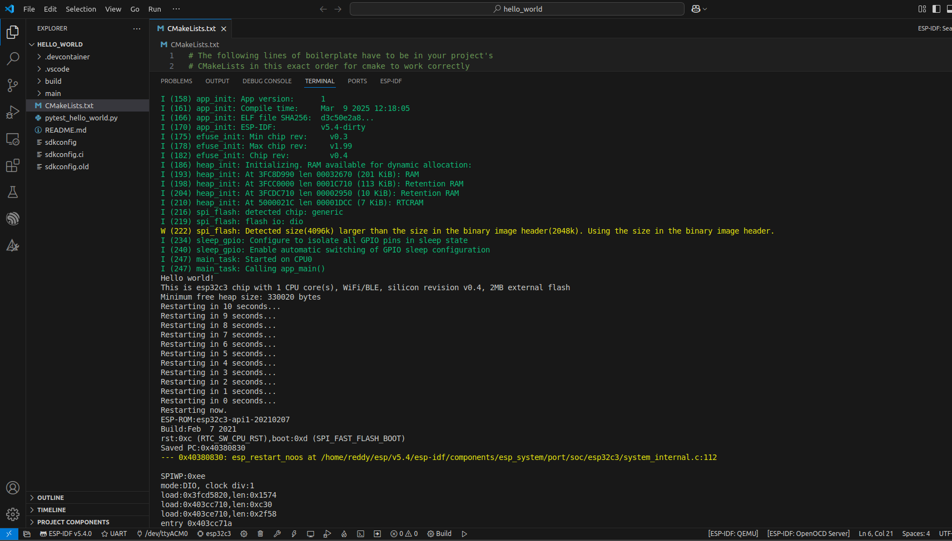
After successful Build and Flash now let's monitor the output of hello_world program

Slide 13
Summary
Congratulations, you have successfully compiled, flashed and ran your first RISC-V program!
This may have been a tedious chapter for getting your Espressif software ready. The good news is that the difficult part is over and that your ESP32-C3 is now at your beckon call.

Slide 14
Thank You

