Slide 1

Presentation by Yi-Chih Tung
Chapter 3
Installation and Setup of QEMU

Slide 2
In this chapter, instructions are provided for installing QEMU for the RISC-V emulator. Run ning the QEMU emulator allows us to explore the 64-bit RISC-V machine without having actual hardware for it. Additionally, it provides us debugger access to the machine in a friendly Linux environment.
Book Source Code
Check out the source code available for the book somewhere convenient. How and where you can download it will vary according to whether you are using Windows or others.
GitHub - ve3wwg/risc-v: RISC-V Assembly Language Programming: Using ESP32-C3 and QEMU

Slide 3
Linux/MacOS Platforms:
$ git clone https://github.com/ve3wwg/risc-v.git -b master ~/riscv/repo
Copy the file:
$ cp ~/riscv/repo/boot.sh ~/riscv/boot.sh
Windows
Windows makes the process a little more difficult, so follow these recommended steps:
Double-click your desktop ESP-IDF 4.4 CMD icon that was installed when you in stalled the ESP-IDF framework. Using this environment will give you instant access to the ESP-IDF installed git command.
Change to the C:\riscv after you create the directory.
Type the following git command using forward slashes to clone the repository.
C:> git clone https://github.com/ve3wwg/risc-v.git -b master /riscv/repo
After this is done, there should be files populated in your C:\riscv\repo subdirectory.

Slide 4
Basic Steps
There are two basic steps required to get our RISC-V system environment setup:
Install the QEMU RISC-V 64-bit emulator.
Install the Fedora Linux for RISC-V 64-bit (within the emulator)
Installing QEMU on MacOS
Detailed instructions for a MacOS binary installation can be found here:
https://www.qemu.org/download/#macos
Install QEMU on Devuan Linux
# apt install qemu-system-misc

Slide 5
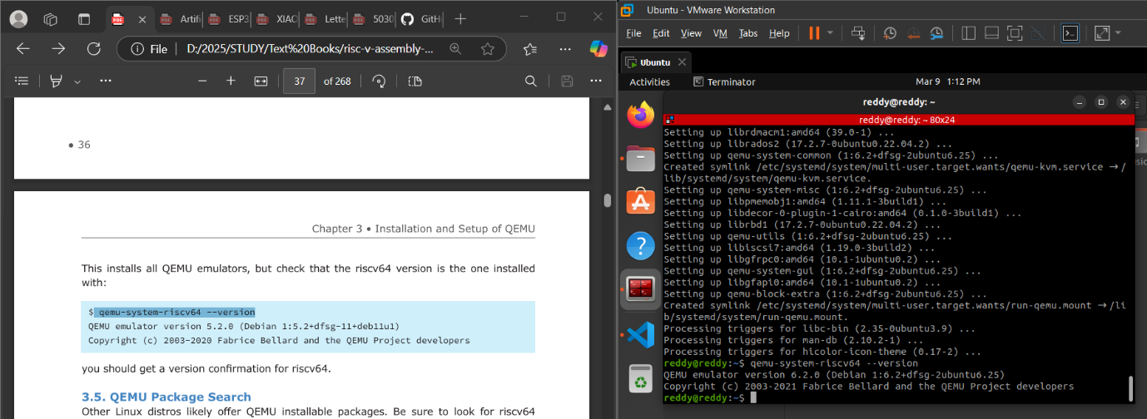
This installs all QEMU emulators, but check that the riscv64 version is the one installed with:
$ qemu-system-riscv64 --version QEMU emulator version 5.2.0 (Debian 1:5.2+dfsg-11+deb11u1) Copyright (c) 2003-2020 Fabrice Bellard and the QEMU Project developers

Slide 6
Building QEMU on Linux
Basic Build Steps:
Create a working directory with su cient disk space.
Check out the QEMU source code from gitlab.com.
Configure it (and check for prerequisites).
Build (compile) it.
Install it.
Create a Working Directory
Building QEMU from source code, you need to create a working directory on a file system with at least 2 GB of storage.
$ mkdir ~/work $ cd ~/work
Clone from gitlab.com
$ git clone https://gitlab.com/qemu-project/qemu.git

Slide 7
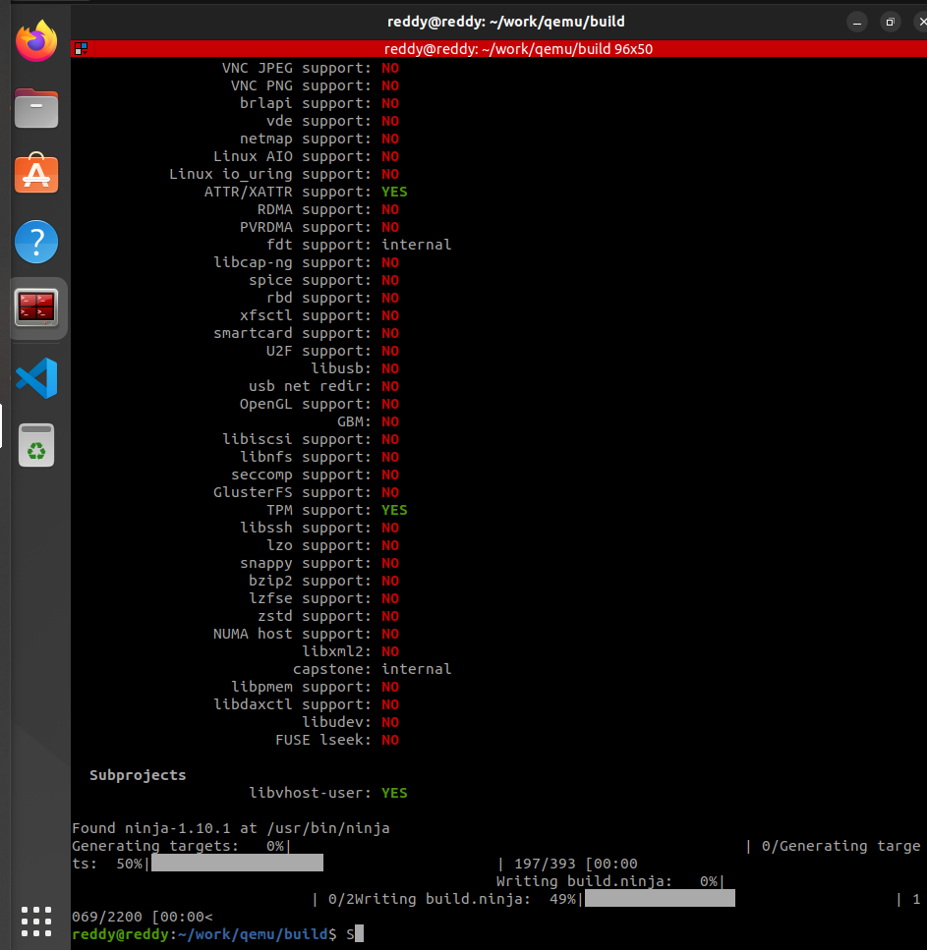
change to the checked-out source code directory:
$ cd ~/work/qemu
Configuration
$ mkdir -p ~/work/qemu/build
$ cd ~/work/qemu/build
$ ../configure --target-list=riscv64-softmmu

Slide 8
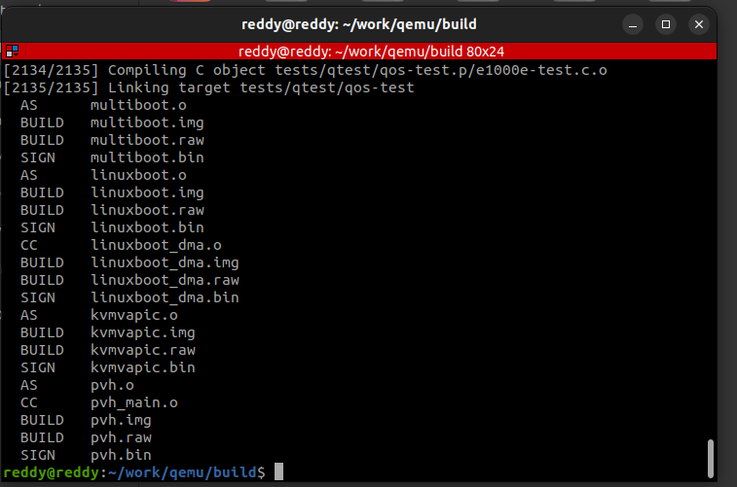
If any packages are missing configuration cannot be completed so install all the below packages,
# apt install ninja-build
# apt install pkg-config
# apt install libglib2.0-dev
# apt install libpixman-1-dev
Build QEMU
$ cd ~/work/qemu/build
$ make

Slide 9
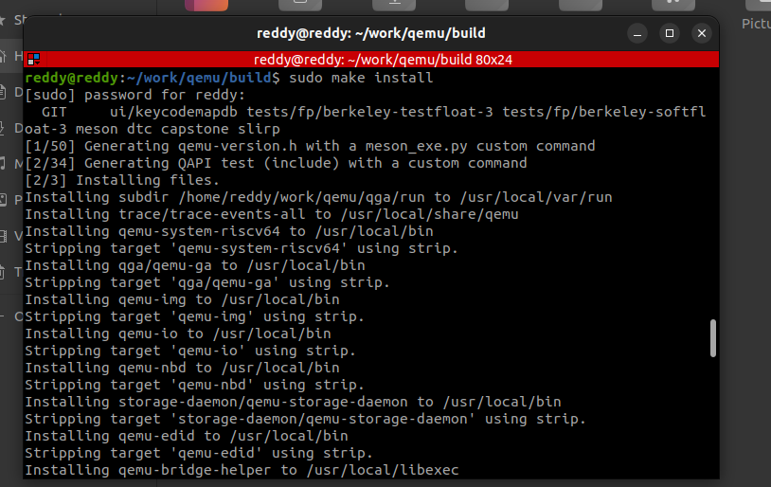
Install QEMU
$ cd ~/work/qemu/build
$ sudo make install
Congratulations! You have installed QEMU! Now verify that the emulator is available from the command line

Slide 10
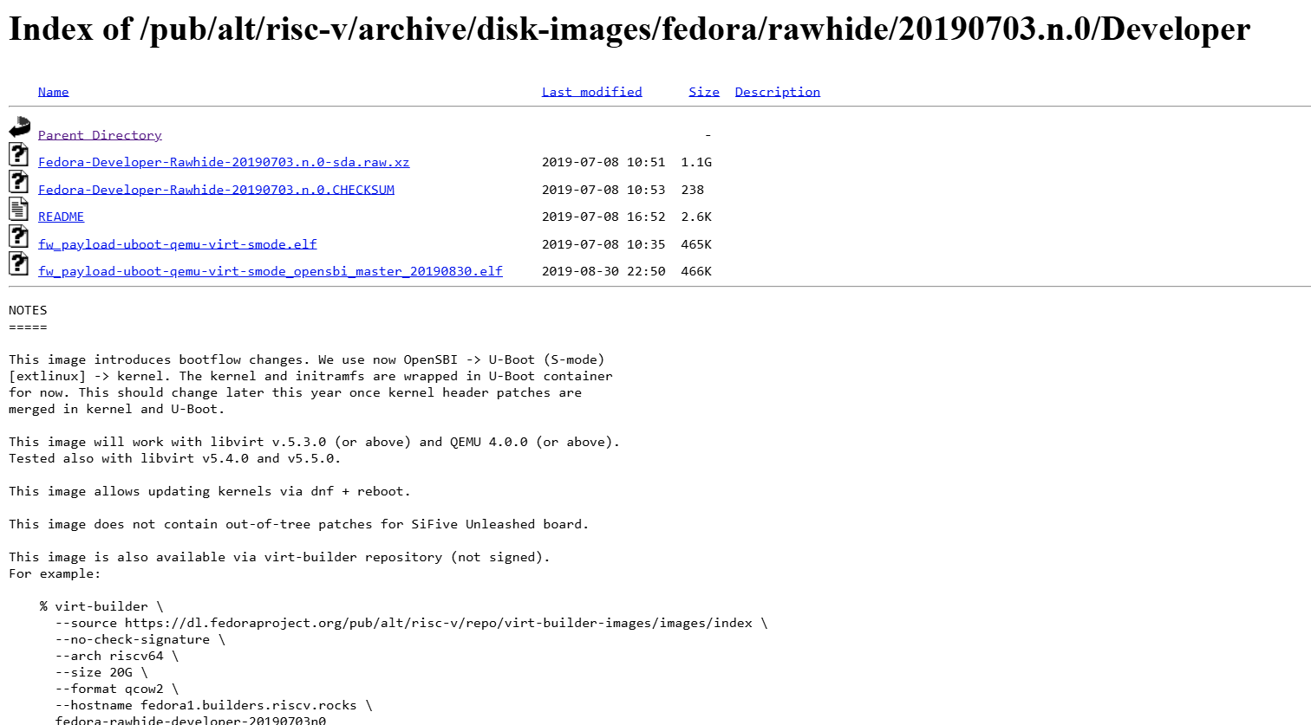
Linux/MacOS Setup of Fedora Linux
After successfully installing QEMU for RISC-V 64-bit, either from a binary package or from the source code, let's turn our attention to downloading and setting up the RISC-V 64-bit version of Fedora Linux. Here go to the working directory which is ~/riscv:
$ mkdir ~/riscv
$ cd ~/riscv
Download Image Files
The Fedora Linux for RISC-V file system images that we're going to work with are available for download from this site:
https://dl.fedoraproject.org/pub/alt/risc-v/archive/disk-images/fedora/rawhide/20190703.n.0/Developer

Slide 11
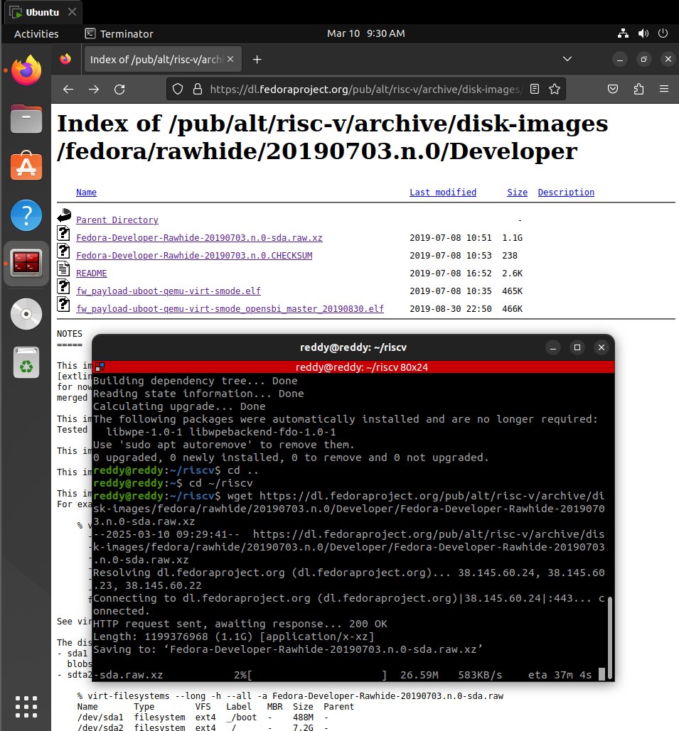
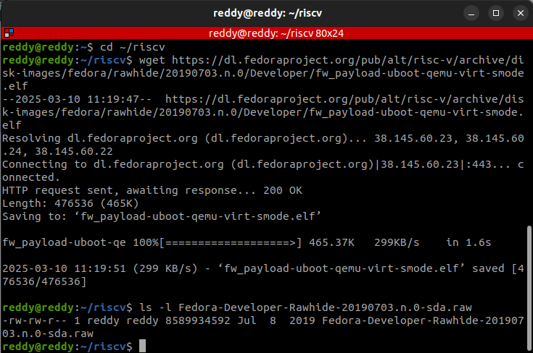
Download Files
Decompress the downloaded image file

Slide 12
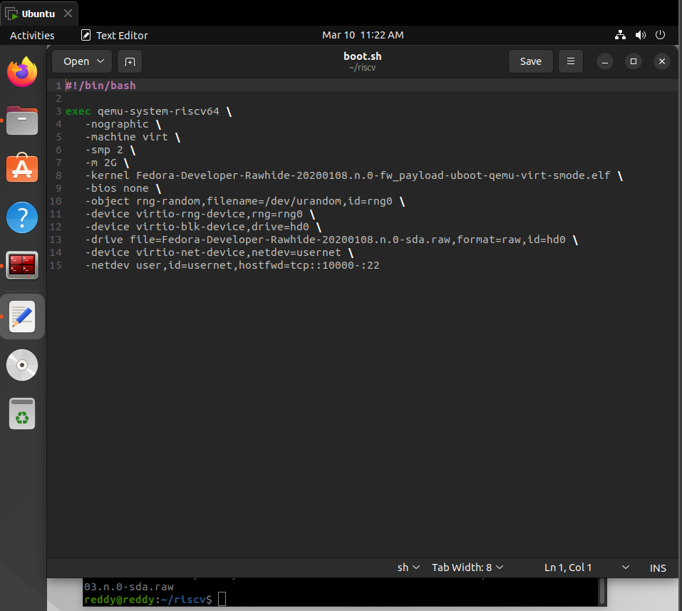
Linux/MacOS Boot Fedora Linux
Modify the text file, The contents of the ~/riscv/boot.sh script file should resemble this:
Modify the file path of images

Slide 13
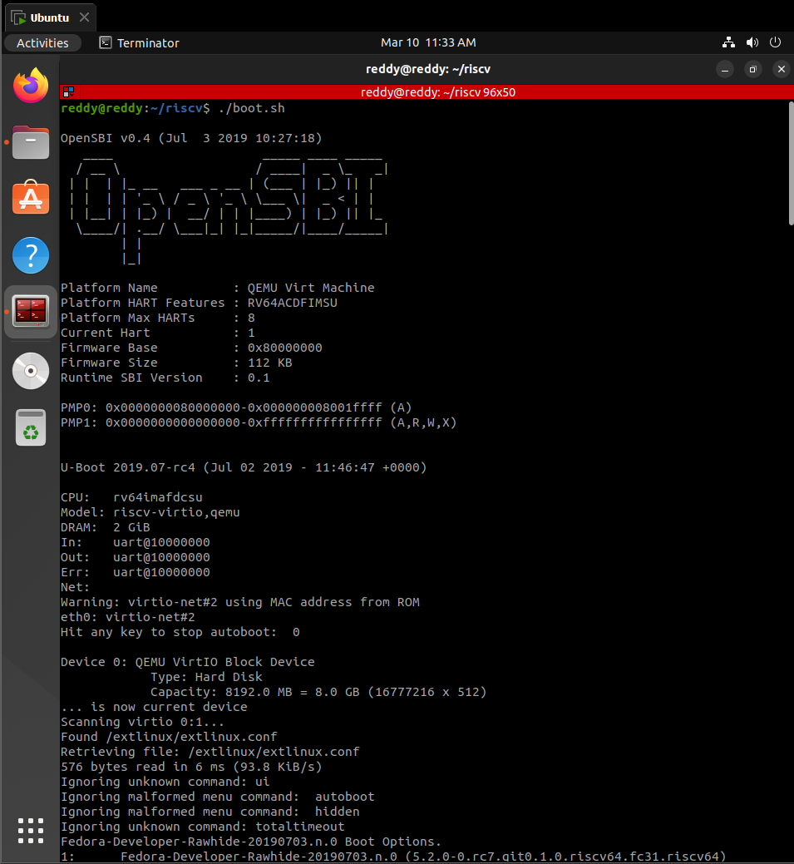
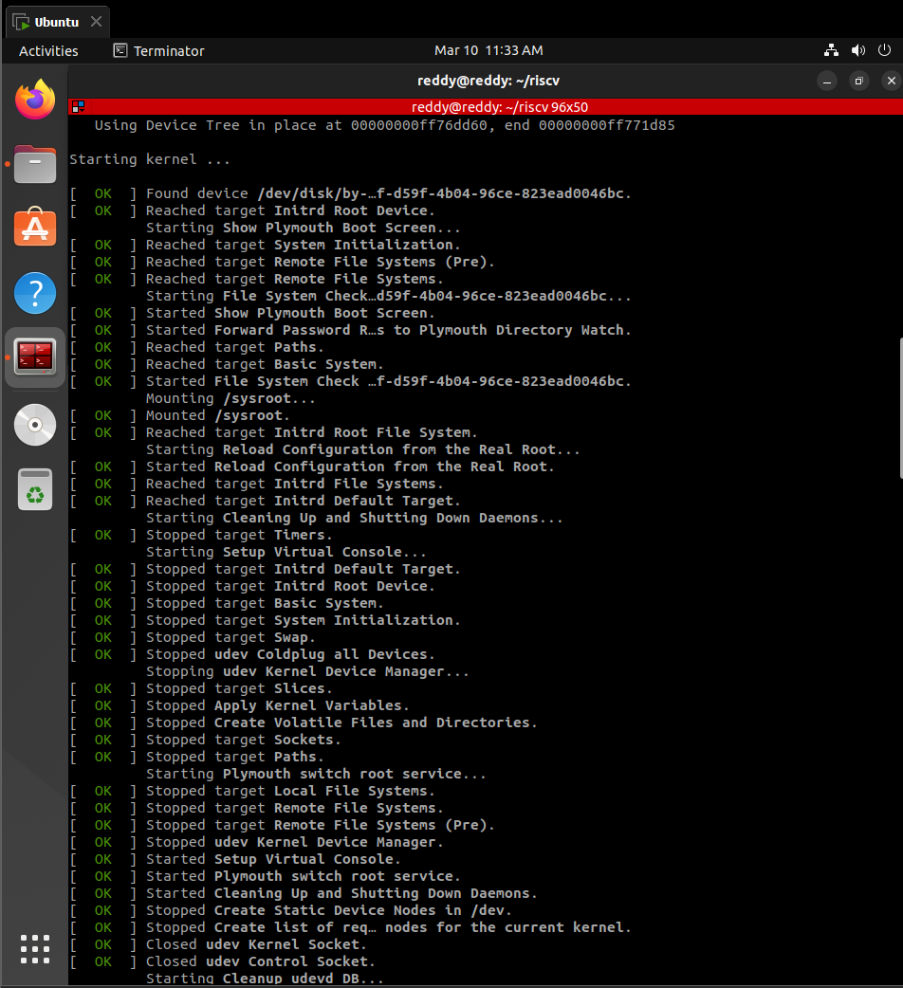
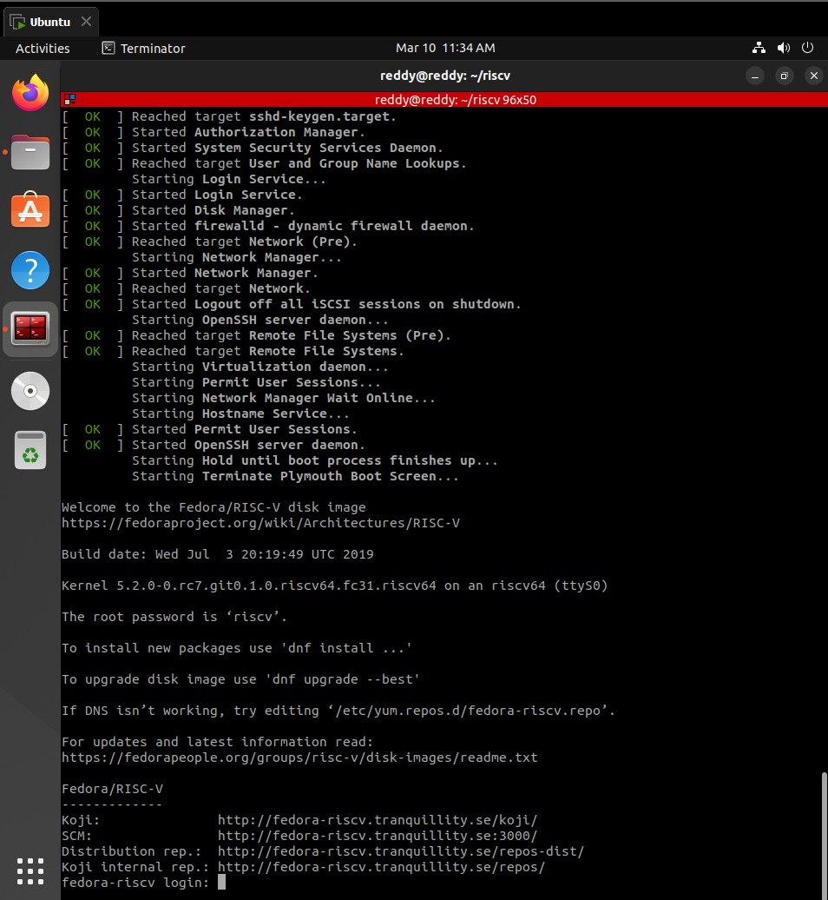
Linux/MacOS Boot Test
Start the boot by invoking the script:
$ cd ~/riscv
$ ./boot.sh

Slide 14
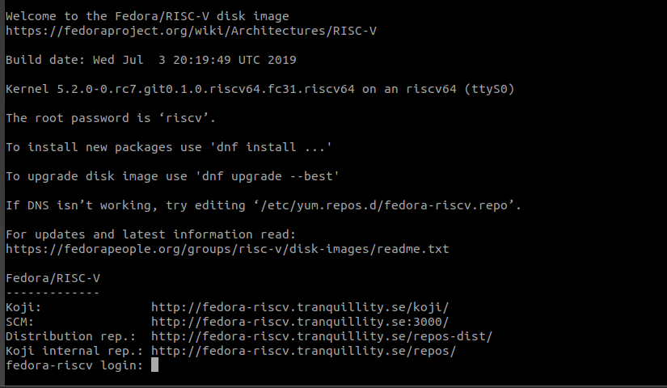
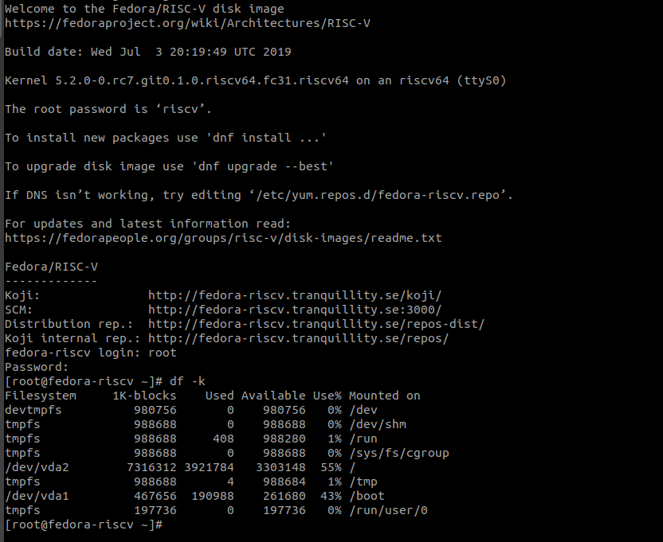
Login into fedora using login as root and password as riscv
Check the storage space left

Slide 15
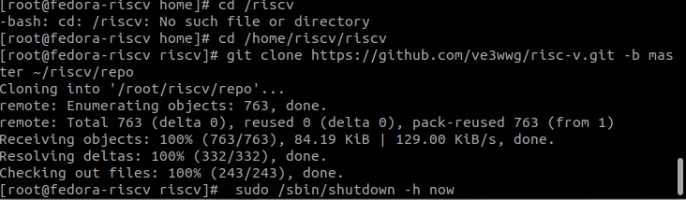
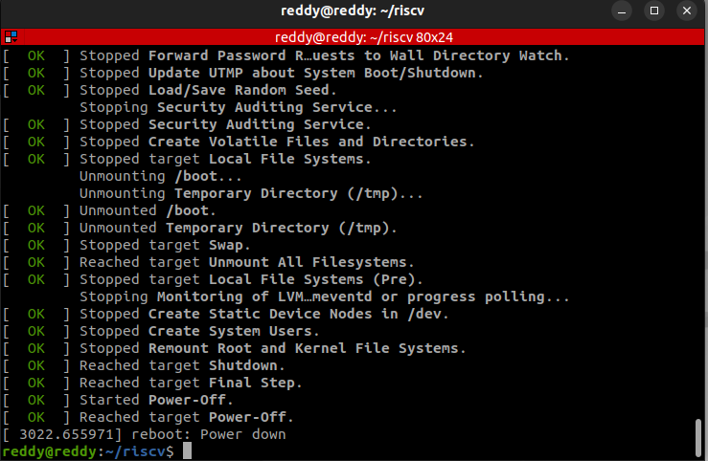
Shut down fedora
Sudo /sbin/shutdown -h now

Slide 16
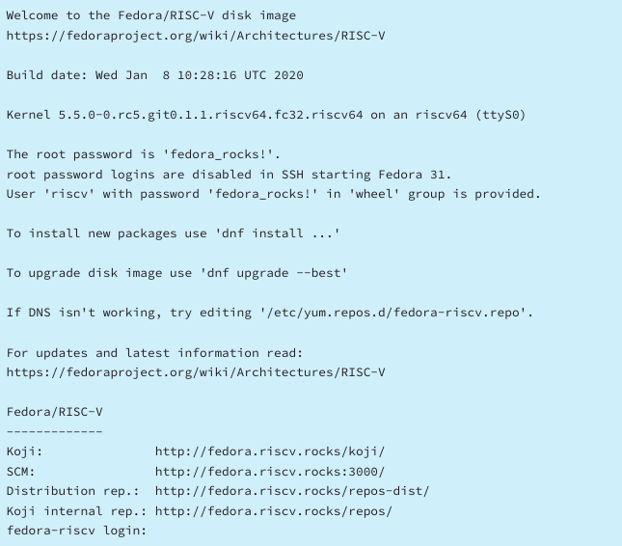
Installing QEMU on Windows
https://www.qemu.org/download/#windows
Download Fedora Linux
Configure The boot.bat script
Run Qemu

Slide 17
Thank You !

