Slide 1

Presentation by Yi-Chih Tung
Chapter 4
Architecture

Slide 2
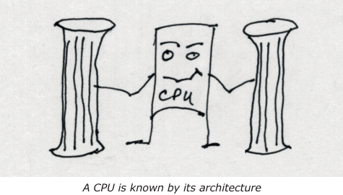
Before a programmer can program in assembly language, he/she needs to know something about the machine's architecture. What registers are available? What flag bits are evaluated? How is memory accessed? What are the available opcodes? In short, we need to know how the machine is organized

Slide 3
Welcome to the Machine!
The best part of assembly language is the fact that you have full control over "the machine". You're not specifying C language code that is indirectly re-interpreted by the compiler into the machine's native language. You're specifying to the machine exactly what you want it to do. But to do that, you need to know about the resources that you have available.
The RISC-V value of XLEN is the number of bits for the corre sponding architecture. For the ESP32-C3 for example, XLEN is 32 (for 32 bits). For the QEMU emulated RISC-V 64-bit CPU, XLEN is 64 bits. So let's start with the program counter register.

Slide 4
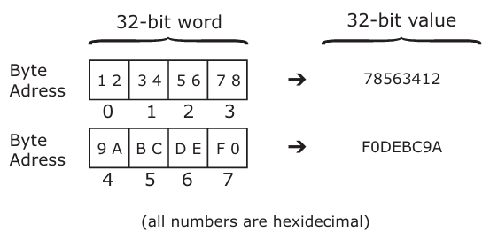
Program Counter Register
Every CPU includes a program counter (PC) register. Unless an instruction is branching, this counter increments to form the address of the next instruction to perform. Standard RISC-V instructions have a 32-bit word length and must be aligned on 32-bit boundaries. There is provision for extending the instruction set to include variable length instructions based upon parcels of half-words (16-bits), which then must be half-word aligned. This allows for compressed instructions.
Endianness
The RISC-V memory architecture is little endian based and is byte addressable. Little endian means that a word (of 4 bytes) orders the bytes with least significant bytes first (lowest addressable unit). The last (highest addressed) byte of the word is the most significant byte. Figure illustrates two 32-bit words with byte addresses and their word values at right.

Slide 5
General Purpose Registers
Most Central Processing Units (CPU) designs today include one or more operation registers. The operations occur between registers or between registers and memory. Registers are similar to memory words except that they are instantly available to the CPU and fast. Mem ory fetches or stores by contrast require more time to complete.
The width of the register is defined by constant XLEN in the given architecture. So, registers are 32-bits wide for the ESP32-C3 where XLEN=32. Registers are 64-bits wide for the QEMU emulated CPU where XLEN=64. For most architectural subsets have 32 general purpose registers available. These are known as registers X0 through X31
Introducing Subsets
The most basic architectural subset is RV32I. This defines the most basic opcodes, register set and memory operations as a "base architecture". The "32" indicates that the architec tural width, is 32 bits (XLEN=32). So, in RV32I we know that the register size is 32 bits wide.

Slide 6
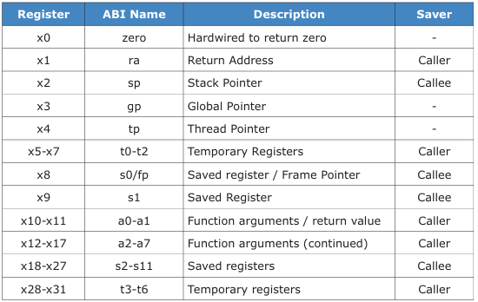
A minimal RISC-V 64-bit implementation is defined as the RV64I subset. This expands upon RV32I by widening the registers to 64 bits (XLEN=64). A few additional operations are add ed to allow for loading and storing of 64-bit register values. There also exists the RV32E subset for use in embedded processors where minimum cost and low power are the focus.
Register Specifics
There are 32 basic registers provided by RV32I and RV64I. These are known by symbolic names x0 to x31. The usage described in that table are according to the GNU compiler convention for RISC-V.

Slide 7
The register x0 (zero) is special to RISC-V in that it always returns the value zero when used as a source register or discards a value when it is used as a destination.
The remainder of registers, from x1 to x32 are each XLEN bits wide and can be used as source or destination.
The rightmost column of Table indicates who saves the register when saving is required, according to the GNU calling convention. Either the calling code (caller) or the called code (callee) must save the register, if it is modified. Registers marked with "-" like registers gp or tp, have no requirement for being preserved. The description field indicates how these registers are typically used.
1. No Flag Bits
One unique characteristic of the RISC-V architecture is that it does not define a status reg ister containing any "flag bits". Many architectures like Intel, define a Z (zero), C (carry) and other flag bits that are updated during the execution of some opcodes. The benefit of flag bits is that a ready computed state is made available.

Slide 8
2. Register x0 / Zero
When used as a source register, it always sup plies a binary value of zero. When used as a destination register, it discards the result. This is a hard-wired feature of the CPU and cannot be changed. This special talent of x0 will frequently allow creativity in the computed results.
3. Register x1 / ra - This register is traditionally used as the return address register.
4. Register x2 / sp - The x2 or sp register is used as the stack pointer
5. Register x3 / gp - This register serves as a global pointer.
6. Register x4 / tp - This register is used for thread local storage access.
7. Registers x5-x7 / t0-t2 – These are temporary registers
8. Register x8 / s0 / fp
The x8 register, has two basic purposes: s0 is the first saved register value, while fp rep resents a stack frame pointer. This value must be saved and restored by the called (callee) code if the register value is modified.

Slide 9
9. Register x9 / s1
Register x9 or s1, is similar to register s0. It is a second saved register value. The called (callee) code must save and restore this value when it is modified
10. Registers x10-x11 / a0-a1
When a function call has an argument, the first argument goes into register x10 / a0
11. Registers x12-x17 / a2-a7
Additional arguments are passed in registers a2 to a7, depending upon their size like reg isters a0 and a1.
12. Registers x17-x27 / s2-s11
These registers must be preserved by the called function (callee) if the register's content is modified in any way
13. Registers x28-x31 / t3-t6
Additional temporary registers t3 through t6 are available for temporary use.
Register Summary
For RISC-V, the only register with a hardwired talent is register x0. It can supply zero or discard a value. All other registers are general purpose and used as described only by convention.

Slide 10
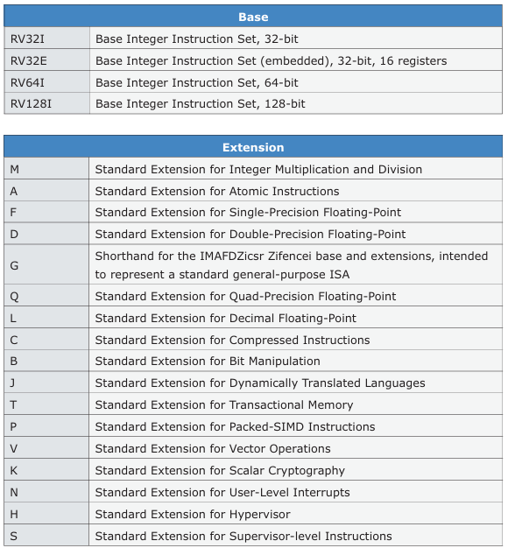
Instruction Set Base Subsets/Extensions
The most basic set of base instructions is the "I" Base Integer subset. This defines the most basic integer-type op erations that a programmer must have. Two examples include the RV32I (XLEN=32) and RV64I (XLEN=64) subsets. The instructions are normally fixed in size at 32-bits.
The Espressif ESP32-C3 device, supports the RV32IMC ISA. This indicates that the base integer subset "I", and the "C" compressed extensions apply. The "M" in the RC32IMC indicates that the "M" extension is also supported, providing hardware multiply and divide instructions. The "32" by way of review means that the registers are 32-bits wide (XLEN=32).

Slide 11
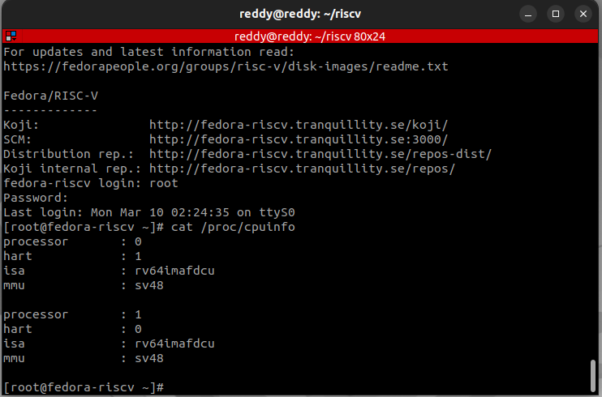
ESP32-C3 Hardware:
Focusing on the CPU resource, Espressif states that the ESP32-C3 device supports the RV32IMC ISA.
The following base and extensions are supported:
• I - Base Integer Instruction Set, 32-bit
• M - Standard Extension for Integer Multiplication and Division • C - Standard Extension for Compressed Instructions
QEMU RISC-V 64 Bit Emulator
Boot Fedora Linux under the emulator, Use
# cat /proc/cpuinfo
To discover the level of support.

Slide 12
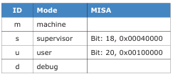
The following RISC-V base and extensions are supported:
• I - Base Integer Instruction Set, 64-bit
• M - Standard Extension for Integer Multiplication and Division • A - Standard Extension for Atomic Instructions
• F - Standard Extension for Single-Precision Floating-Point
• D - Standard Extension for Double-Precision Floating-Point
• C - Standard Extension for Compressed Instructions
• S - Standard Extension for Supervisor-level Instructions
RISC-V Privilege Levels
The RISC-V specification identifies four classes of privilege levels for a CPU.

Slide 13
The most basic of these privilege modes is the "m" for machine mode. Machine mode is the only mandatory privilege mode for RISC-V implementations. This mode is normally used on embedded systems with unrestricted access to all resources. The "m", "s" and "u" modes together will be used by hardware (and emulators) that sup port Unix/Linux/*BSD type systems.
Under Fedora Linux using the QEMU emulator, however,we will be running code in the "u" user mode. code will be restricted in what it can do, including the reading of the MISA register. If you try to read the MISA register, your code will fail. To determine the level of support available, you must rely on the Linux kernel's special file /proc/cpuinfo.
RISC-V is Huge
There has been an incredible amount of e ort put into the RISC-V specification and it con tinues to evolve. For this reason, we will be focusing on writing assembly language code for the machine and user modes for this course.

Slide 14
Thank You !

