Slide 1

RISC-V Assembly Language Programming Using ESP32-C3 and QEMU
Racharla Umesh Reddy
M14158104
Professor: Yi-Chih Tung​
Notes:
Good morning, esteemed committee members. My nam is Racharla Umesh Reddy, and my Advisor is professor yi chi tung, today we are thrilled to present our teaching module designed for the next era of computing: RISC-V Assembly Language Programming using the ESP32-C3 and QEMU."

Slide 2
Why Learn RISC-V Assembly?
Why Learn RISC-V Assembly?
Open-source & widely adopted architecture
Used in embedded systems, IoT, and high-performance computing
Helps in understanding low-level hardware interaction
Open-source & widely adopted architecture
Used in embedded systems, IoT, and high-performance computing
Helps in understanding low-level hardware interaction
Notes:
So. "Why RISC-V? Because the world is moving toward open-standard architectures. My curriculum addresses a critical gap: how to teach students to control the machine directly, without the barrier of proprietary licenses."

Slide 3
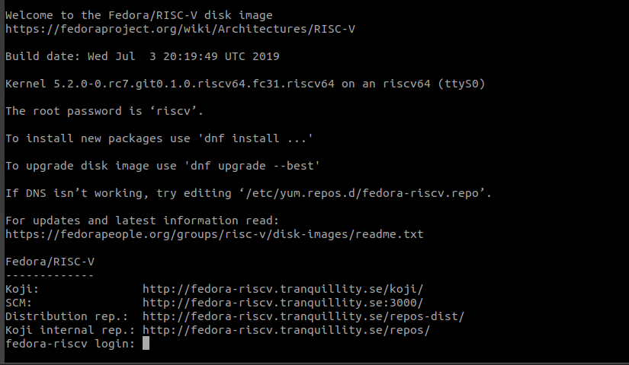
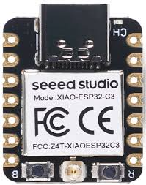
Study of the ESP32-C3 device (RV32) as well as Fedora Linux under QEMU (RV64).
ESP32-C3
Fedora Linux under QEMU (RV64).
Notes:
"What makes this material unique is its Dual-Platform Advantage. We don't just study one chip; we study the ESP32-C3 for 32-bit embedded systems and Fedora Linux under QEMU for 64-bit high-performance computing. This gives students a 360-degree view of modern architecture."

Slide 4
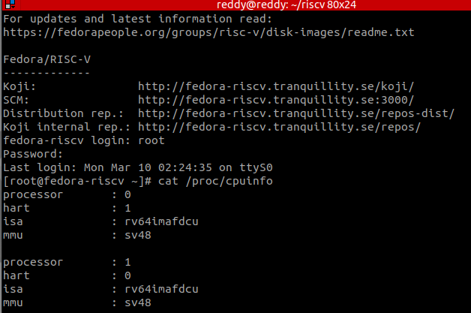
ESP32-C3 Hardware:
Focusing on the CPU resource, Espressif states that the ESP32-C3 device supports the RV32IMC ISA.
The following base and extensions are supported:
• I - Base Integer Instruction Set, 32-bit
• M - Standard Extension for Integer Multiplication and Division • C - Standard Extension for Compressed Instructions
QEMU RISC-V 64 Bit Emulator
Boot Fedora Linux under the emulator, Use
# cat /proc/cpuinfo
To discover the level of support.
Notes:
"We begin in the virtual world. Using QEMU, students boot a full Fedora Linux instance. By running simple commands like cat /proc/cpuinfo, they witness the power of a virtual 64-bit RISC-V heart beating inside their own PC. It makes 'invisible' hardware tangible."
(Slide 5: ESP32-C3 Hardware) "Then, we move to the physical. We utilize the ESP32-C3, which supports the RV32IMC ISA. Here, students learn the 'DNA' of the processor: I for base integers, M for multiplication, and C for compressed instructions—the key to memory efficiency in tiny devices."

Slide 5
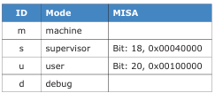
The following RISC-V base and extensions are supported:
• I - Base Integer Instruction Set, 64-bit
• M - Standard Extension for Integer Multiplication and Division • A - Standard Extension for Atomic Instructions
• F - Standard Extension for Single-Precision Floating-Point
• D - Standard Extension for Double-Precision Floating-Point
• C - Standard Extension for Compressed Instructions
• S - Standard Extension for Supervisor-level Instructions
RISC-V Privilege Levels
The RISC-V specification identifies four classes of privilege levels for a CPU.
Notes:
"To ensure they understand system security, we explore the four privilege levels: from Machine Mode for raw hardware control to User Mode for safe application execution. We teach them not just how to code, but how to architect safe systems."

Slide 6
First Exercise
The Main Program
Start writing RISC-V assembly with a practical example.
add3 function to add three integers.
Tools: ESP32-C3, QEMU, riscv32-esp-elf-gcc.
Notes:
"Now, for the 'heart' of the course: The add3 experiment.

Slide 7
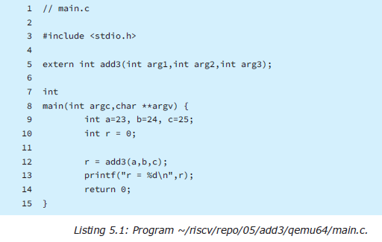
Adding three 32-bit integer numbers using assembly language, called from a C main program.
Notes:
We don't just write a calculator; we build a bridge. Students write a Main program in C and then craft a custom function in pure RISC-V Assembly to add three 32-bit integers. This is where the magic happens: high-level logic meets machine-level speed."

Slide 8
Running the Demonstration in QEMU
(in QEMU): Log into your QEMU in stance of Fedora
Linux
cd ~/riscv/repo/05/add3/qemu64
$ gcc -O0 -g main.c add3.S
$ ls -l a.out-rwxrwxr-x. 1 riscv riscv 13560 Apr 19 21:13
a.out
The C compiler will compile main.c as a C program and
add3.S as an assembler source module
To execute our program under Linux use:
$ ./a.out
r = 72

Slide 9
Output in QEMU instance of Fedora Linux
Notes:
) "First, we prove the logic in the Linux environment. Using the standard GCC compiler, students see their assembly code execute seamlessly on a virtual 64-bit processor. The result? A perfect sum of 72. Validation complete."

Slide 10
First Exercise on ESP32-C3
Initialize their ESP-IDF in a new terminal
$ . ~/espc3/esp-idf/export.sh
The ESP32 main program is somewhat different than
what is used on Linux.
#include <stdio.h>
extern int add3(int one,int two,int three);
void
app_main(void) {
int a=23, b=24, c=25;
int r = 0;
r = add3(a,b,c);
printf("r = %d\n",r);
}
ESP32-C3 main program
~/riscv/repo/05/add3/main/main.c
$ cd ~/riscv/repo/05/add3
$ idf.py fullclean
Executing action: fullclean
Done
Build your ESP32-C3 version of the add3 program.
$ idf.py build

Slide 11
Output for ESP32-C3 version of the add3 program
Notes:
"But we don't stop at a screen. We take that same logic, initialize the ESP-IDF framework, and flash it directly into the ESP32-C3 silicon.

Slide 12
When the program exits app_main, it just stalls within the ESP32 framework. Press Control- (Control right square bracket) to exit the monitor process. Notice that
the sum is reported correctly as 72.
First RISC-V instructions on the ESP32-C3!
Flash the program into esp32 c3 after build successful
Monitor the output after flashing the program
Notes:
When students see 'r = 72' appear in their hardware monitor, they aren't just students anymore—they are engineers who have successfully commanded a physical processor."

Slide 13
Thank You !
Notes:
This teaching material is more than a tutorial; it’s a career-ready foundation. It empowers students to master the open-source future of electronics. Thank you for your time and for supporting the next generation of RISC-V innovators."

