Slide 1

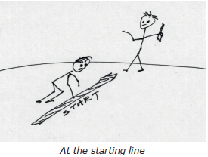
Presentation by Yi-Chih Tung
Chapter 5
Getting Started
Write and run a simple assembly program, integrate with C.
Assembly structure, add3 example, running on ESP32-C3/QEMU.

Slide 2
Memory Models & Data Types
• ESP32-C3 device, which is an RV32 (32-bit) device
• qemu-system-riscv64 (QEMU), a 64-bit emulator for RV64
RV32 Model
The int, long integers and pointers share the same bit width of 32-bits (4 bytes). This fits the RV32I architecture where the registers are 32-bits in width.
RV64 Model
QEMU is fun to experiment with because it uses the RV64 architecture, which is a superset of RV32.
The registers in this architecture are widened to 64-bits.

Slide 3
First Exercise
The Main Program
Start writing RISC-V assembly with a practical example.
add3 function to add three integers.
Tools: ESP32-C3, QEMU, riscv32-esp-elf-gcc.
The main program is written as if it were calling another C function. The C compiler doesn't even know that the function add3() in this example is written in assembler language. The main program for this example is illustrated in Listing 5.1 and will be run from Fedora Linux under QEMU.

Slide 4
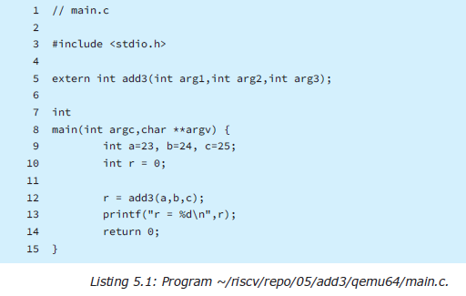
Adding three 32-bit integer numbers using assembly language, called from a C main program.

Slide 5
Running the Demonstration in QEMU
(in QEMU): Log into your QEMU in stance of Fedora
Linux
cd ~/riscv/repo/05/add3/qemu64
$ gcc -O0 -g main.c add3.S
$ ls -l a.out-rwxrwxr-x. 1 riscv riscv 13560 Apr 19 21:13
a.out
The C compiler will compile main.c as a C program and
add3.S as an assembler source module
To execute our program under Linux use:
$ ./a.out
r = 72

Slide 6
Output in QEMU instance of Fedora Linux

Slide 7
First Exercise on ESP32-C3
Initialize their ESP-IDF in a new terminal
$ . ~/espc3/esp-idf/export.sh
The ESP32 main program is somewhat different than
what is used on Linux.
#include <stdio.h>
extern int add3(int one,int two,int three);
void
app_main(void) {
int a=23, b=24, c=25;
int r = 0;
r = add3(a,b,c);
printf("r = %d\n",r);
}
ESP32-C3 main program
~/riscv/repo/05/add3/main/main.c
$ cd ~/riscv/repo/05/add3
$ idf.py fullclean
Executing action: fullclean
Done
Build your ESP32-C3 version of the add3 program.
$ idf.py build

Slide 8
Output for ESP32-C3 version of the add3 program

Slide 9
When the program exits app_main, it just stalls within the ESP32 framework. Press Control- (Control right square bracket) to exit the monitor process. Notice that
the sum is reported correctly as 72.
First RISC-V instructions on the ESP32-C3!
Flash the program into esp32 c3 after build successful
Monitor the output after flashing the program

Slide 10
ESP32-C3 Assembler Listing $ cd ~/riscv/repo/05/add3 $ ~/riscv/repo/listesp main/add3.S
3 0000 2E95
4 0002 3295
add3: add
a0,a0,a1
# a0 = a0 + a1
add
a0,a0,a2
# a0 = a0 + a2
The four hex digits after the line number indicate the
relative address of the assembled instruction.

Slide 11
Objdump The objdump takes many options, but in the ESP32-C3 environment, we can dump out the generated add3.o (this file was generated as part of producing the listing file) as follows:
Here we see that the object file is reverse engineered by
the objdump command, in a format similar to the listing
file (this one used -march=rv32im). We are reminded by
the output, that the format is little endian by the line :
add3.o: file format elf32-littleriscv

Slide 12
Thank You !

