Slide 1

Presentation by Yi-Chih Tung
Chapter 6
This chapter examines the
RISC-V operations used for loading and storing.

Slide 2
A Word About Word Sizes
Word Sizes
The smallest addressable memory unit in RISC-V is the 8-bit byte.
A list of the different word sizes:
• byte (1 byte, 8-bits, smallest addressable memory unit)
• half-word (2 bytes, 16-bits)
• word (4 bytes, 32-bits)
• double word (8 bytes, 64-bits)
Load Instructions
A value is loaded into memory with the "load" instruction.
• Destination register name (rd)
• The address (usually by assembler symbol
• The word (unit) size

Slide 3
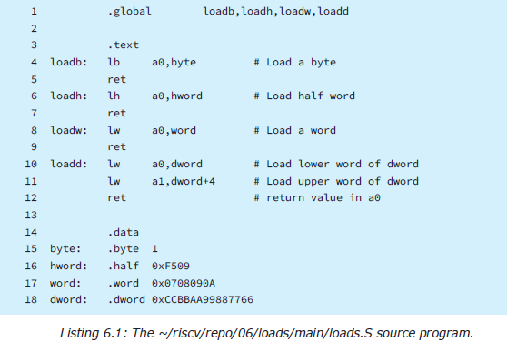
Load Program Example Change to the directory containing the 06/loads example: $ cd ~/riscv/repo/06/loads Build the program.

Slide 4
The loadb() function reported as 00000001 loadh() function however reported FFFFF509 rather than 0000F509 loadw() loaded and returned a 32-bit value loadd() function was designed to return a long long integer which is 64-bits in length

Slide 5
Let's now examine the assembler listing for the program: $ ~/riscv/repo/listesp main/loads.S
Let's now examine the assembler listing for the program:
$ ~/riscv/repo/listesp main/loads.S

Slide 6
Unsigned Values
we saw how the half-word value of F509 was sign extended to FFFFF509 when it was loaded into a 32-bit register. But what if you didn't want the value to be sign extended? To address that need, some unsigned load instructions can be used instead.
Notes:
Notice that RV32I does not have a "lwu" instruction
because there is no need for it. The register is only 32-
bits in size so there is no sign extension involved. But for
RV64I, there is indeed a need because its registers are 64
bits wide. Loading a 32-bit value can be sign extended
(lw) or not (lwu) for RV64I

Slide 7
Memory Alignment
Using the listesp script to generate a listing and object file:
riscv32-esp-elf-objdump -d loads.o

Slide 8
Experiment
Return and edit the program in:
~/riscv/repo/06/main/loads.S, so that instead of the "lh"
instruction, it uses the "lhu" instruction instead

Slide 9
Rebuild, flash, and run the program again

Slide 10
This time, the loadh() value was reported as 0000F509, without the sign extension. This is the special talent of the "lhu" opcode.

Slide 11
Immediate Values
The li Pseudo-Op
Often a small constant is needed, and it is considered tedious and ine cient to have to reach out to memory to fetch it. If instead, that small constant could be embedded inside the instruction word itself, the CPU would already have the data it needed when the instruction is decoded. This concept is known as "immediate data".
Immediate data allows us to eliminate the need to define
the data value of "one". For this, we use the assembler
pseudo-op "li" as follows:

Slide 12
The assembler in this case expands the "li" pseudo-op into two RISC-V opcodes: The first is generated as a "lui" opcode, with the upper portion of the constant (0xFEEDC). The second generated instruction uses an "addi" (add im mediate) instruction to add the signed value -273 to t1 (efectively subtracting 273). Let's check this in the gdb debugger Here we use the gdb "p" (print) command, "/x" to print the result in hexadecimal, subtract ing 273 (decimal) from FEEDBEEF (in hexadecimal). The result is displayed as 0xfeedbeef. The printed result confirms the computation is indeed correct.
Type : p /x 0xFEEDC000 – 273

Slide 13
The addi Opcode
Many instructions of the RV32I/RV64I have an immediate data counterpart instruction for incrementing a1 by 1:
addi a1,a1,1 # a1 += 1
Pseudo-Op mv
Register values sometimes need to be copied or moved from one register to another. The general form of this opcode is this:
mv rd, rs
The source register rs is copied to the destination register rd, where the destination reg ister is not x0 (zero).

Slide 14
Loads under RV64I
$ cd ~/riscv/repo/06/loads/qemu64
$ gcc -O0 -g loads.S main.c
$ ./a.out
For testing alignment

Slide 15
The .section Pseudo-Op
The full format for the pseudo-op is:
.section name[, "flags"[, @type] ]
• "a" – the section is allocatable
• "w" – the section is writable
• "x" – the section is executable
The @type argument, when present, may be one of the following values:
• @progbits – the section contains data
• @nobits – the section only occupies space and does not contain data

Slide 16
Storing Data
After a calculation or register manipulation is performed, there is normally a need to save that result into memory for later use or reference. This is done with the corresponding sb, sh, sw or sd opcode. The register "rs“ below is the source register in this case because the memory is the destination.

Slide 17
Example program
$ cd ~/riscv/repo/06/celcuius
The main program that is going to call upon our Fahrenheit to Celsius assembler conversion using integer arithmetic.
RV64I Run
Start up your Fedora Linux instance in QEMU:
$ cd ~/riscv/repo/06/celsius2/qemu64
$ gcc -O0 -g celcius2.S main.c
$ ./a.out

Slide 18
RISC-V Assembler Modifiers
In connection with memory accesses, the need frequently occurs for the evaluation of the 20-bit upper portion of a constant or address and the lower 12-bits of the same. We've already seen these two assembler
functions used in this chapter:
• %hi(symbol) – provides high order 20 bits of the symbol
• %lo(symbol) – provides the low order 12 bits of the symbol
There are two more useful functions for the programmer.
They are:
• %pcrel_hi(symbol) – the high 20 bits of relative address between pc and symbol
• %pcrel_lo(symbol) – the low 12 bits of relative address between pc and symbol
These functions are used to provide a relative address constant. When we examine branches, we will see more relative addresses from the current instruction counter (PC).

Slide 19
Summary
This chapter has introduced you to the critical operations of loading from and storing to memory. It was shown that immediate data can provide for more optimal code.

Slide 20

Thank You !

