Slide 1
2025 Marketing Strategy
Lead Generation & Brand Building
Marketing Department

Slide 2
Q4 2024 Campaign Performance
Strong Campaign Results
• Digital Marketing ROI: 4.2x
• Social Media Engagement: +35%
• Content Marketing Leads: 1,200 MQLs
• Event Marketing: 15 trade shows, 800 leads

Slide 3
Top Performing Campaigns
Best Campaign Results
• TechCrunch Disrupt: 150 leads, $2.1M pipeline
• Digital Transformation Webinar: 400 attendees
• LinkedIn Thought Leadership: 25K impressions
• Healthcare Industry Report: 1,800 downloads

Slide 4
Budget Performance vs. Target
Efficient Budget Utilization
• Total Spend: $285K (5% under budget)
• Cost per Lead: $89 (vs. $125 target)
• Customer Acquisition Cost: $12K (vs. $15K target)
• Marketing ROI: 325% (vs. 250% target)

Slide 5
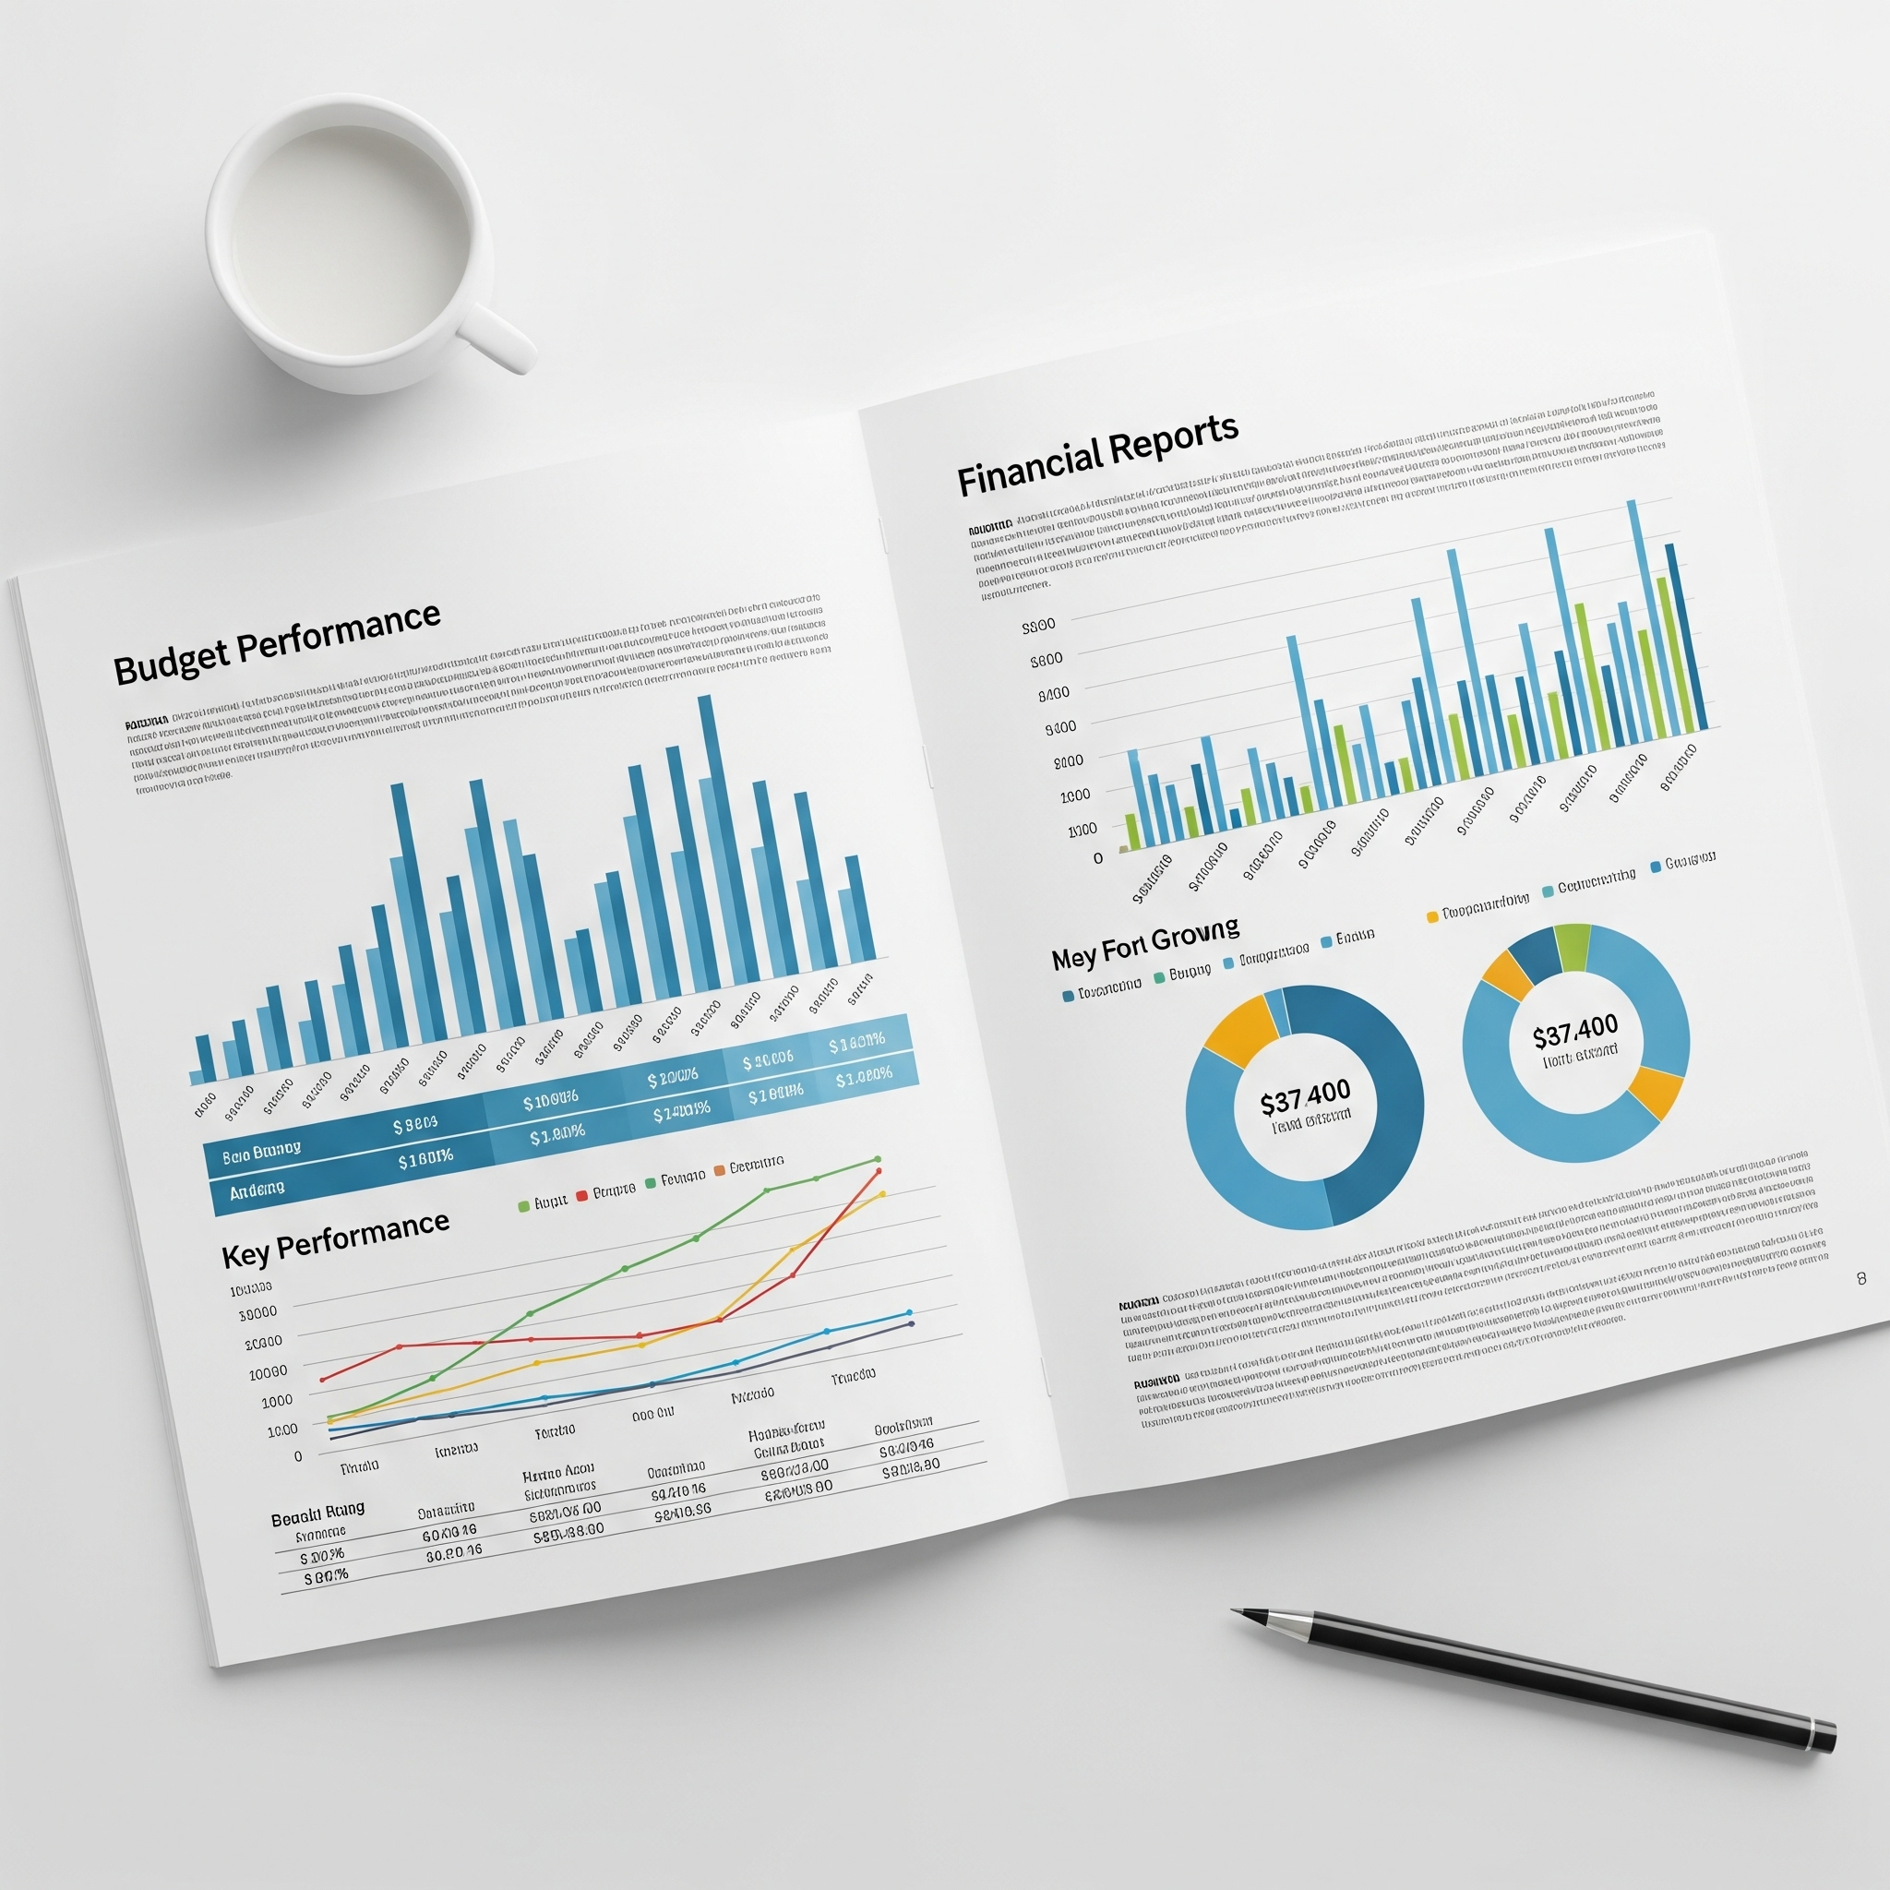
Summary
Reviewed Q4 2024 campaign results
Achieved strong digital marketing ROI
Exceeded lead generation and engagement goals
Maintained efficient budget utilization

