Slide 1
IBM University Engagement Project Submission
“Exploring the Power of Agentic AI with IBM Granite and LangFlow”

Slide 2

Project Tile – Nutrition Agent
Domain of Project – Health Care
Student Name | Recent Passport Photo | Email ID | Mobile number [WhatsApp]
Veeramreddy Umesh Reddy |  | 2200030145cseh@gmail.com | 7893829589

Slide 3
Problem Statement -
Problem Statement : Nutrition Agent
The Challenge - In an era where health awareness is growing, individuals increasingly seek personalized nutrition guidance. However, most existing tools provide generic diet plans, lack real-time adaptability, and fail to consider a person's holistic lifestyle, cultural preferences, allergies, and evolving health conditions. Furthermore, dieticians and nutritionists face limitations in scaling personalized consultations due to time and resource constraints. Generative AI presents a groundbreaking opportunity to revolutionize this space by enabling an intelligent, interactive, and adaptive virtual nutrition assistant. By leveraging natural language processing (NLP), multimodal understanding, and large-scale dietary databases, an AI-powered assistant can generate dynamic meal plans, recommend smart food swaps, and explain nutritional choices—all tailored to the individual.
This project aims to develop “The Smartest AI Nutrition Assistant” using state-of-the-art generative AI models that: • Understand user inputs via text, voice, or image (e.g., food photos, grocery labels) • Generate personalized meal plans based on health goals, medical conditions, fitness routines, and preferences • Offer contextual explanations (e.g., “Why is this food better?”) • Adapt suggestions dynamically with continuous feedback
By integrating health data, food databases, and LLM-powered reasoning, the solution will bridge the gap between one-size-fits-all diet apps and in-person nutrition counselling—delivering an AI that thinks, learns, and cares like a real nutrition expert.
Technology - Use of IBM cloud lite services /IBM Granity is mandatory.

Slide 4
Proposed Solution -
Proposed Solution: AI-Powered Nutrition Agent
We propose an AI-powered Nutrition Assistant that helps users understand and manage their daily nutrition in a simple and accessible way. Users can add foods to their daily meal log by specifying serving sizes. The application automatically calculates the total nutritional intake and displays progress toward daily calorie and macronutrient goals. Meal information, goals, and user preferences are stored locally using Browser LocalStorage, so users can use the application without creating an account or requiring a backend database.
The solution also includes an AI Nutrition Coach powered by IBM Watson Assistant and IBM Granite LLM. The AI assistant uses the user's current nutrition information, such as calories, protein, carbohydrates, and fats, to provide personalized and context-aware dietary guidance.
How the Solution Works
Food Search – The user searches for a food item, and the application retrieves its nutritional information from the Open Food Facts API.
Meal Logging – The user selects a food and enters the required serving size. The application calculates the corresponding nutrient values.
Nutrition Analysis – The application compares the user's intake with their daily goals and provides useful dietary tips.
AI Nutrition Coach – The user can interact with the AI assistant for questions related to diet plans, calories, protein, weight management, vitamins, and nutrition.

Slide 5
Technology Used
IBM Bob :Uses AI technologies, natural language processing (NLP), and software development tools to understand requirements and generate project components.
IBM Granite LLM : Used as the base LLM for generating personalized, context-aware nutrition responses through IBM Watson Assistant.
IBM Cloud : It provides the infrastructure to build, deploy, and scale the Nutrition Agent efficiently. IBM Cloud enables a reliable, secure, and scalable environment for deploying the Nutrition Agent.
IBM Watson Assistant : Used as the conversational AI platform to integrate the chatbot and deliver AI-powered nutrition guidance.

Slide 6
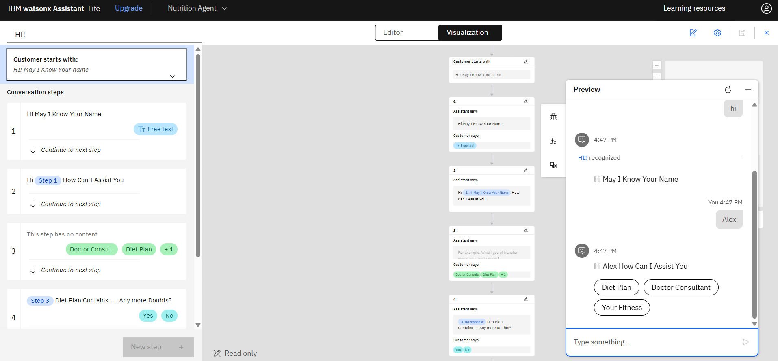
IBM Watsonx Assistant Used to create a Assisant

Slide 7
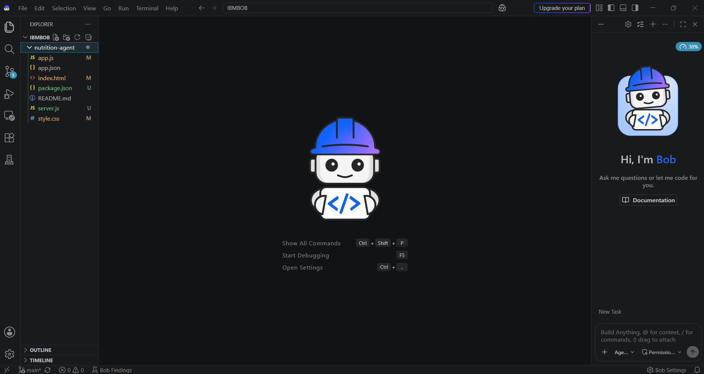
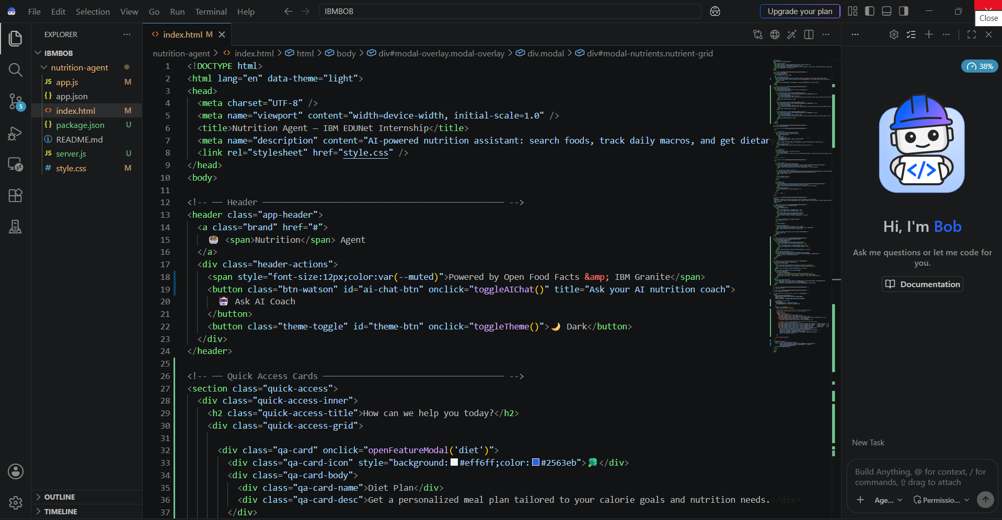
The files are the used to create the project in IBM BOB

Slide 8
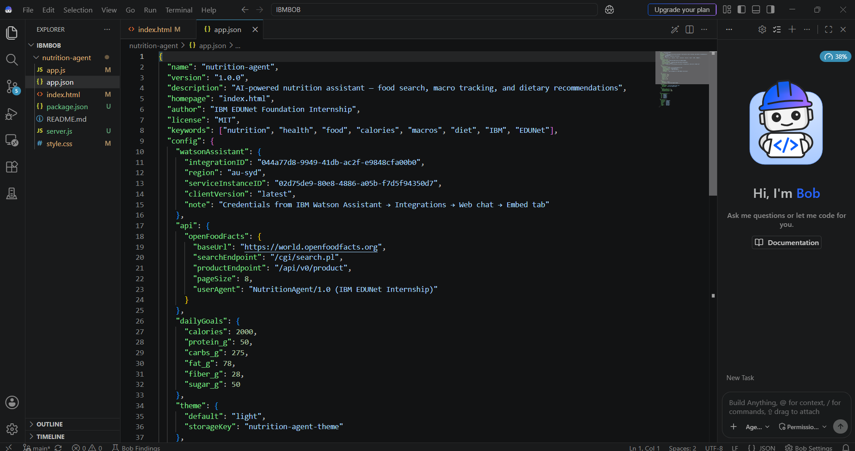
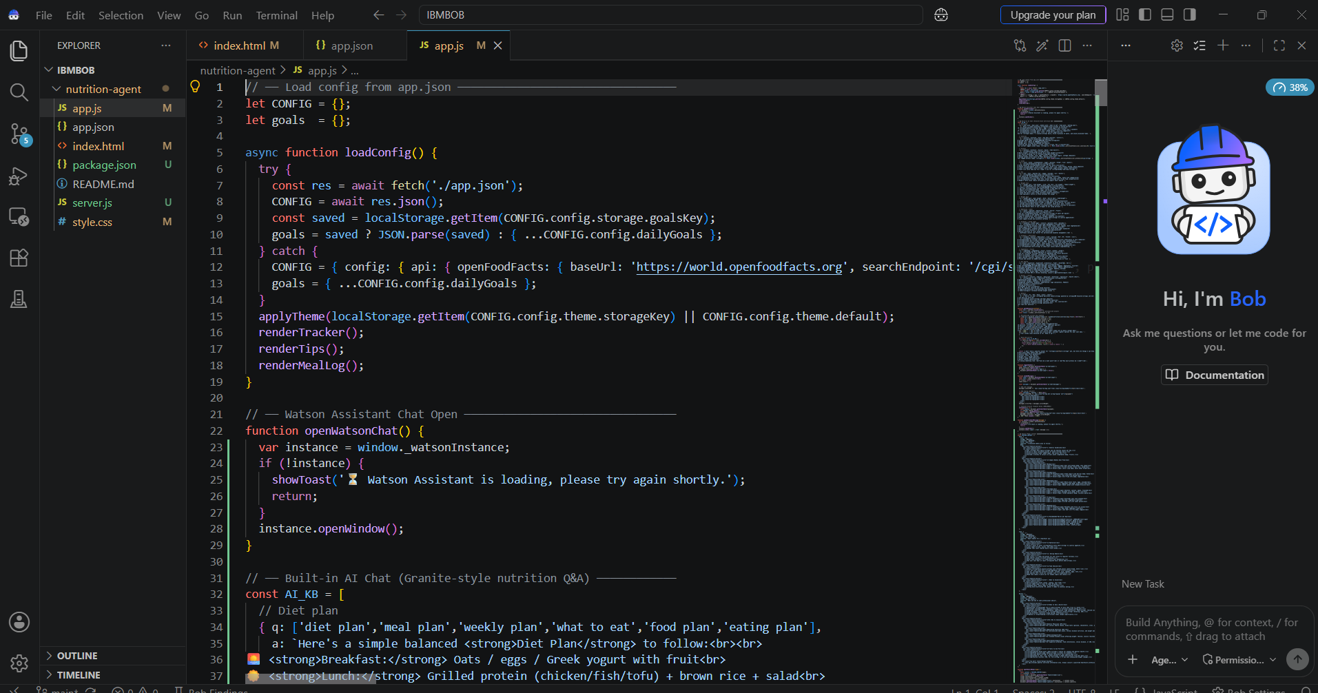

Slide 9
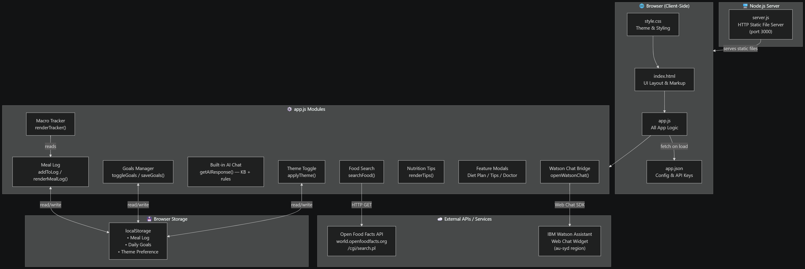
Architecture blueprint

Slide 10
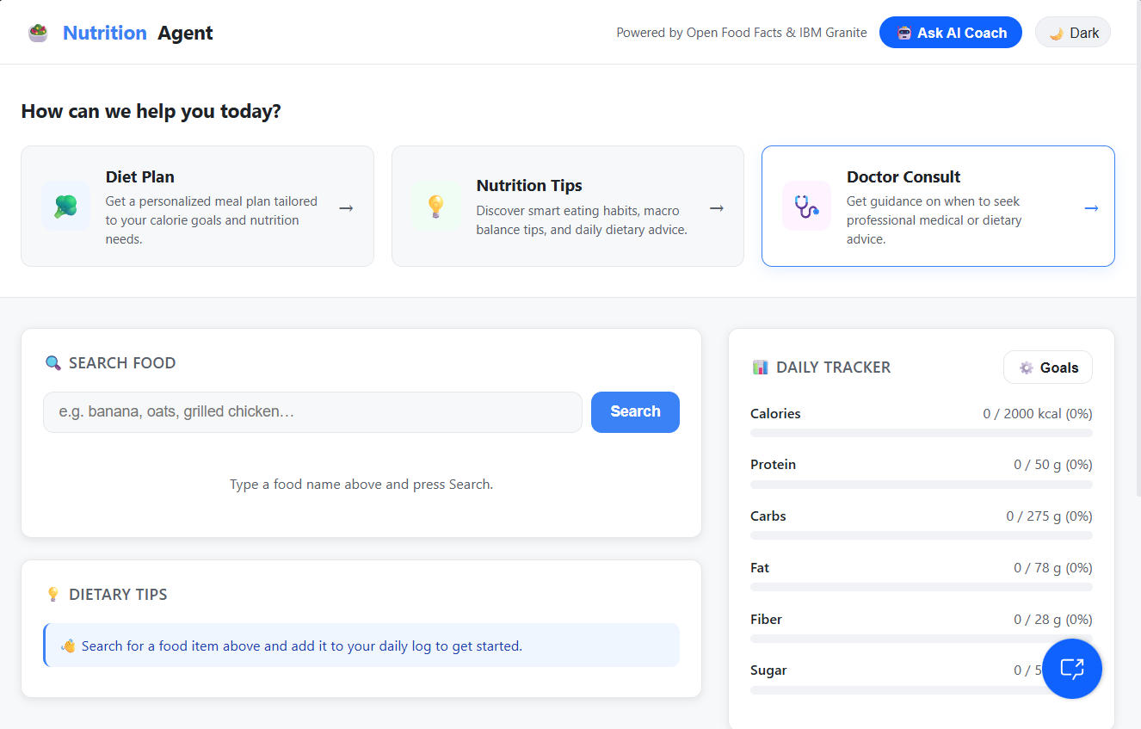
Project outputs:
The Nutrition Agent Project In IBM Bob And Using IBM Watsonx Assisant

Slide 11
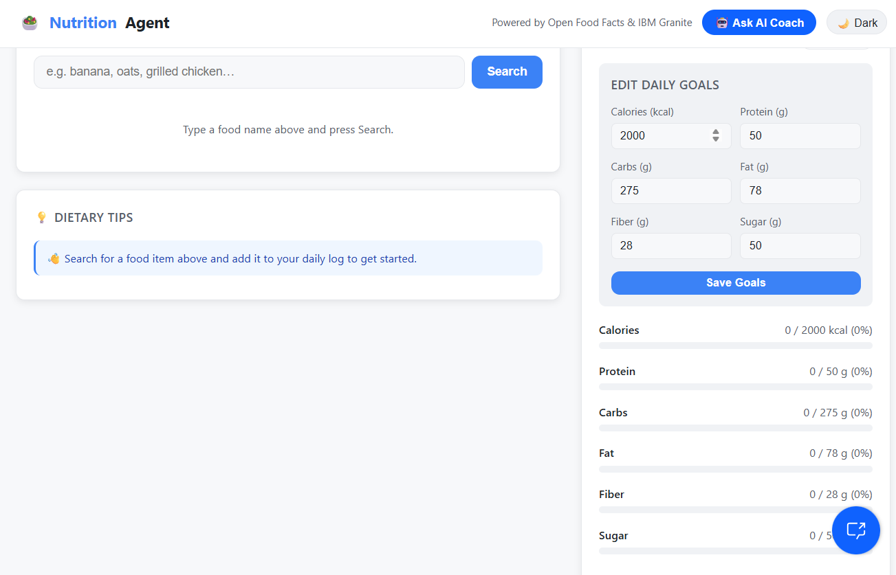
Here we can Save goals and we can track

Slide 12
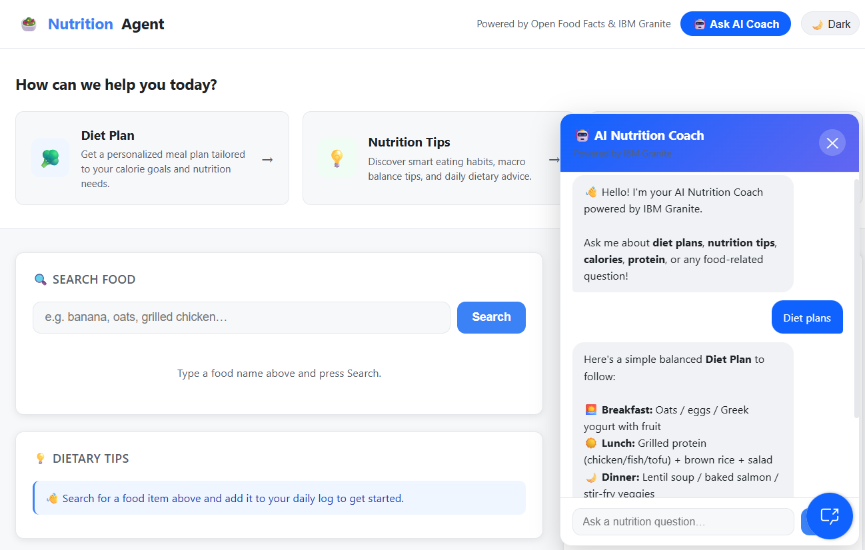
It is the AI Nutrition Coach Implemented in the Nutrion Agent Project

Slide 13
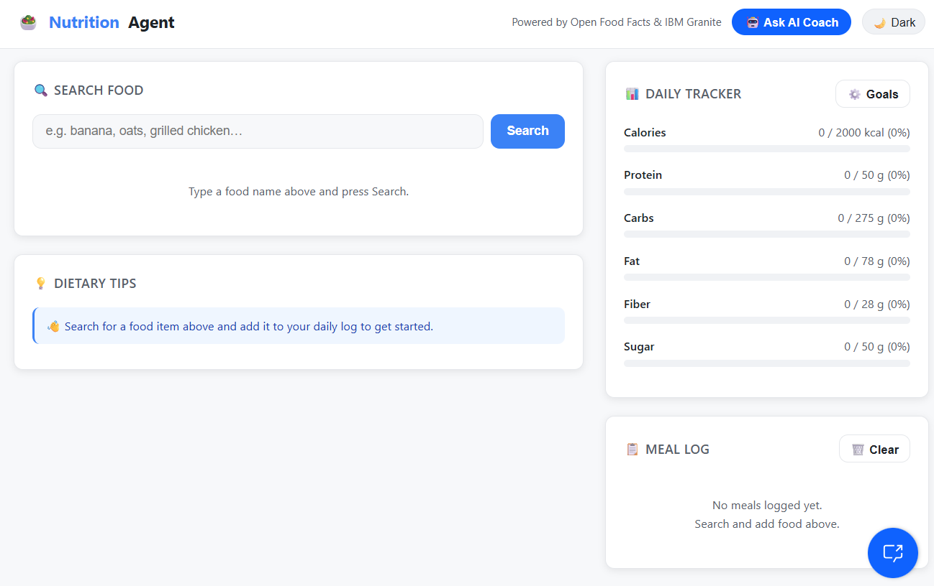
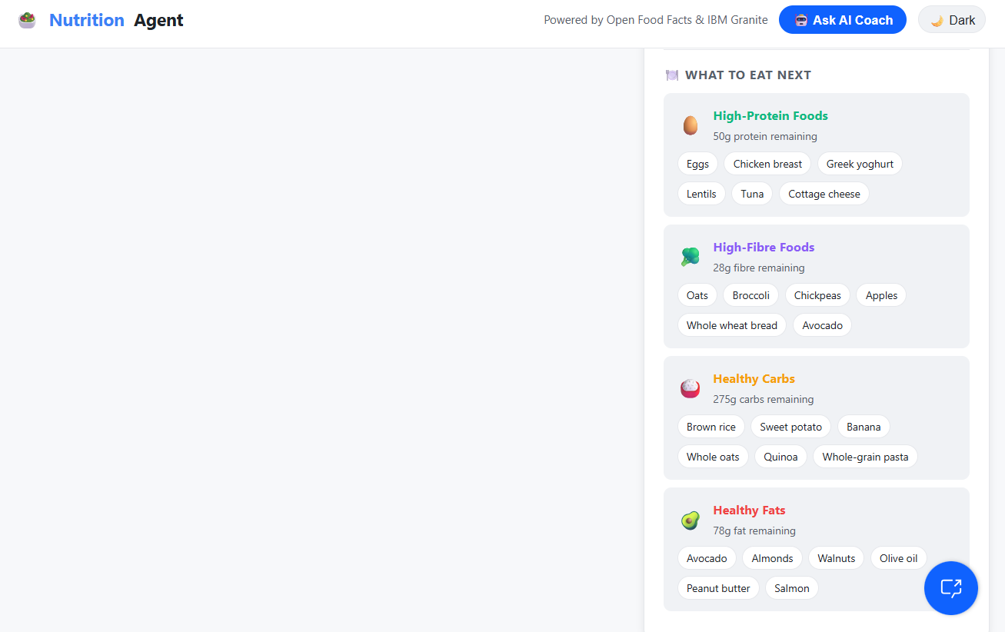
We can add Meal Log and we can track Our Goals

Slide 14
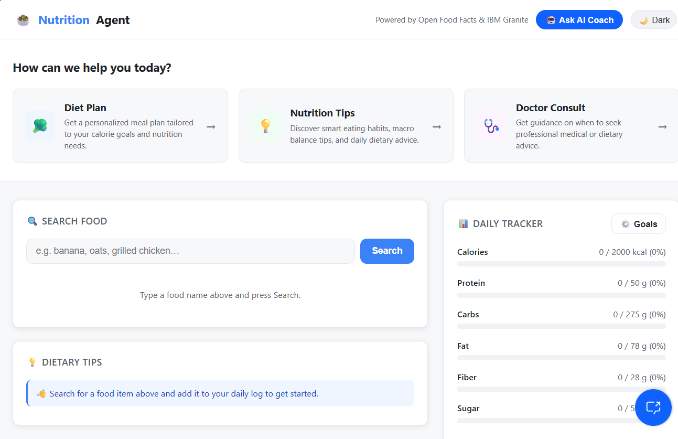
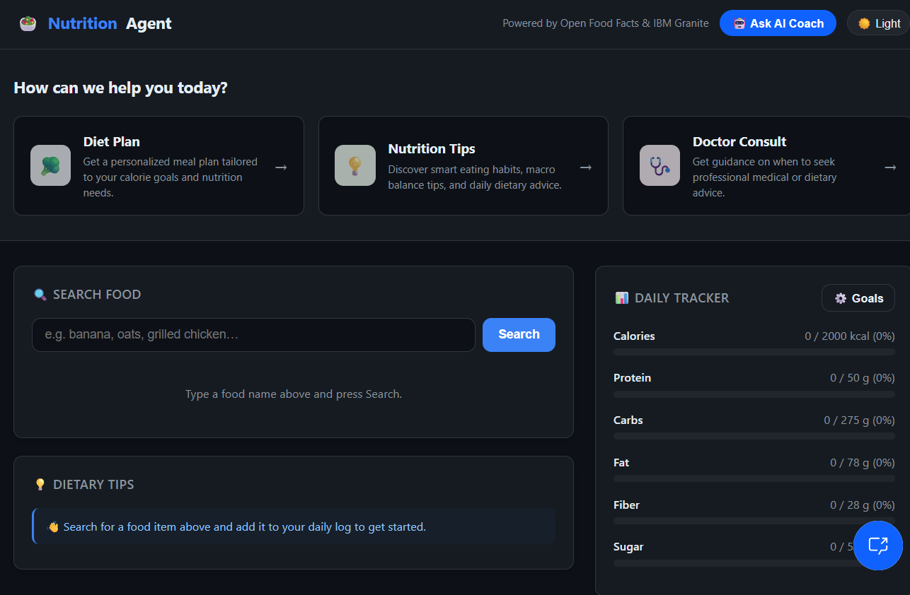
Implemented the Dark Theme and Light Theme

Slide 15

Role of Agentic AI in the solution
Role of Agentic AI in Nutrition Agent
Agentic AI enables the Nutrition Agent to function as an intelligent, autonomous system rather than a simple chatbot. Using IBM watsonx.ai and IBM Granite models, it coordinates multiple specialized agents to deliver personalized nutrition guidance.
Each agent performs a specific role—such as retrieving nutritional data, generating diet plans, providing health advice, and analyzing food logs—while working collaboratively. This multi-agent approach ensures efficient task execution and accurate results.
Agentic AI also brings context awareness, understanding user details like age, health conditions, and fitness goals to generate tailored recommendations. It supports real-time adaptation, continuously updating suggestions based on user inputs like daily meals.
Additionally, agents communicate with each other, enabling better decision-making and improved outcomes.
Overall, Agentic AI makes the system proactive, personalized, and goal-driven, acting like a smart digital nutritionist that helps users maintain a healthy lifestyle.
Overall, Agentic AI connects food search, meal logging, nutrition analysis, personalized recommendations, and conversational assistance into one solution. It helps users make better dietary decisions by providing timely information, monitoring their progress, and offering intelligent nutrition guidance in an easy-to-use application.

Slide 16
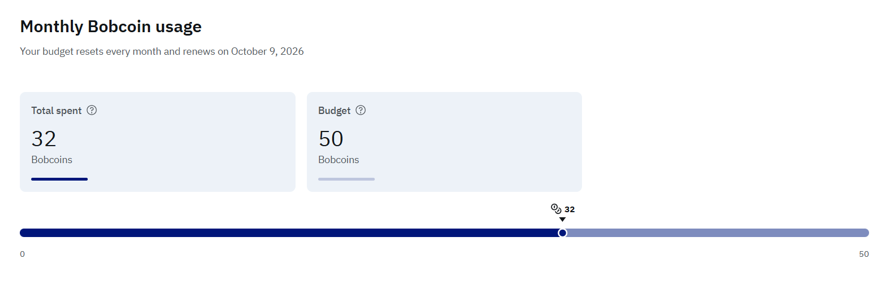
IBM BOB Points Used Before and After Doing Project

Slide 17
Git Hub Link
https://github.com/umeshv95/Nutrition_Agent

Slide 18
Future Scope
1.Integration with Wearables & Health Devices –
The system can be integrated with smartwatches and fitness trackers to collect real-time data such as steps, calories burned, heart rate, and sleep patterns. This will enable the Nutrition Agent to provide more accurate and dynamic diet recommendations based on actual user activity and health metrics.
2.AI-Powered Voice Assistant & Multilingual Support –
Enhancing the system with a voice-enabled assistant and support for multiple languages will improve accessibility. Users can interact naturally in their preferred language, making the solution more inclusive and suitable for diverse populations, especially in regions with varied linguistic backgrounds.
·
·

Slide 19
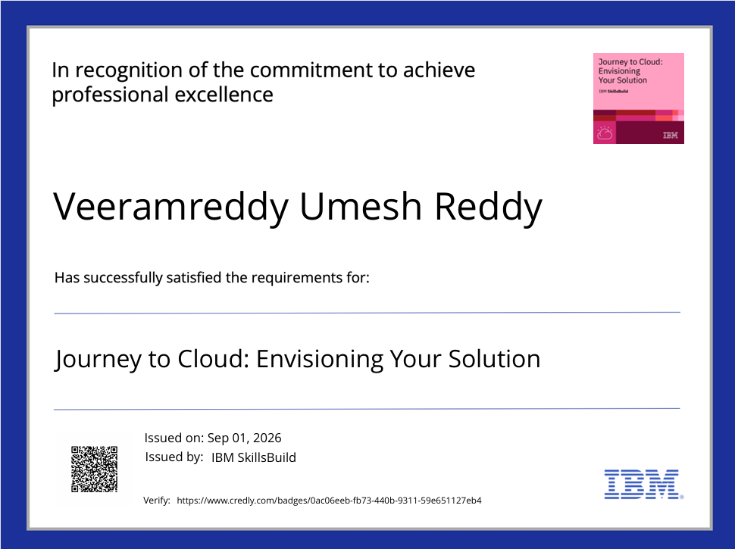
Certificates Earned:

Slide 20
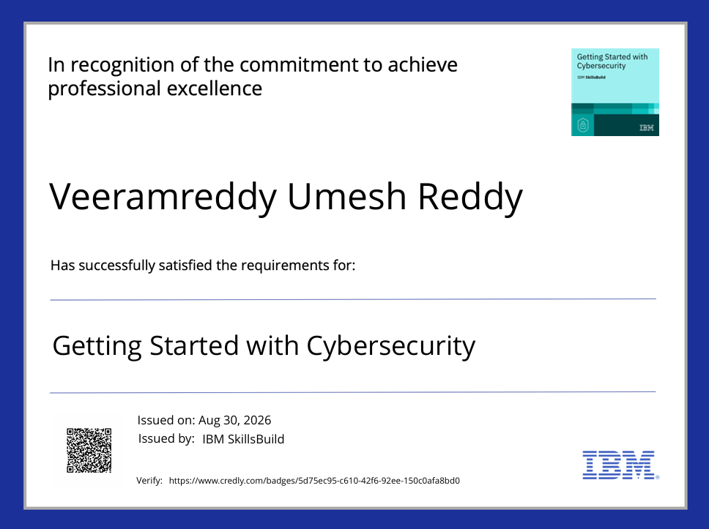

Slide 21
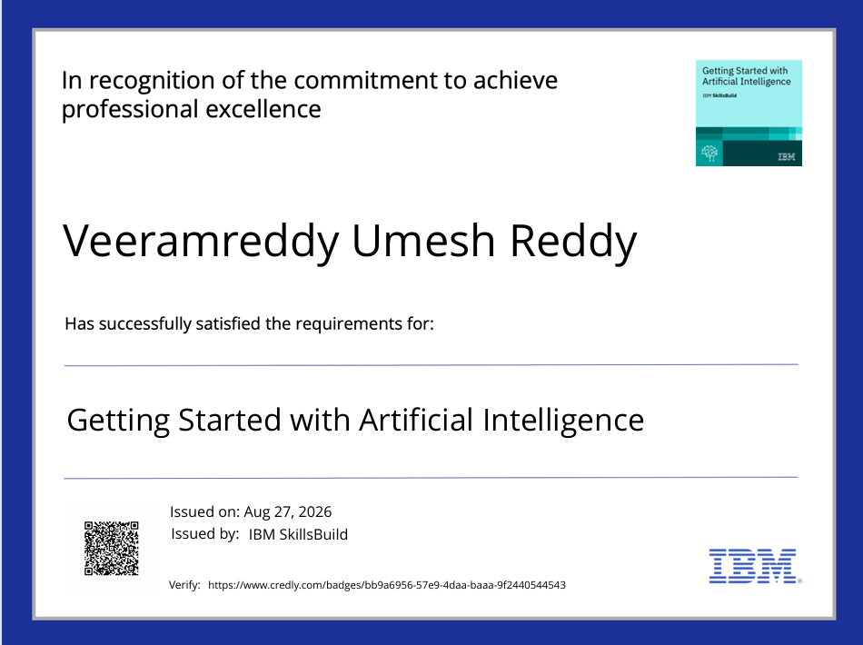

Slide 22
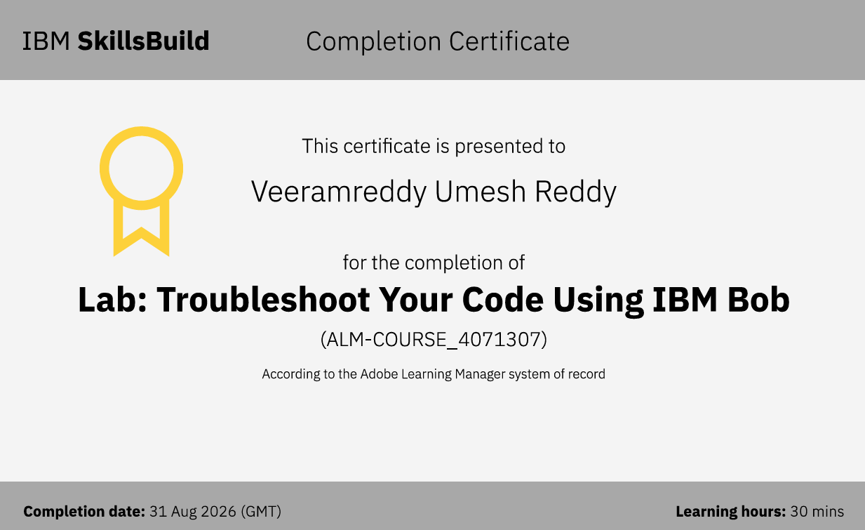

Slide 23


