Slide 1


Data manipulation with dplyr Documentation with Quarto
Mike Kleinsasser
BDSI 2025

Slide 2
About me
Mike Kleinsasser (please call me Mike)
Joined Biostatistics in 2019
Applications programmer/analyst senior
Support students and faculty in R package devel./maintenance

Slide 3



R workshop setup
Help! Place sticky note on corner of screen
Need our attention? Raise your hand
Helpers will be walking around to help you with questions
Type the code along with me! (Have RStudio open + a script)
Open the powerpoint to copy/paste code with me

Slide 4
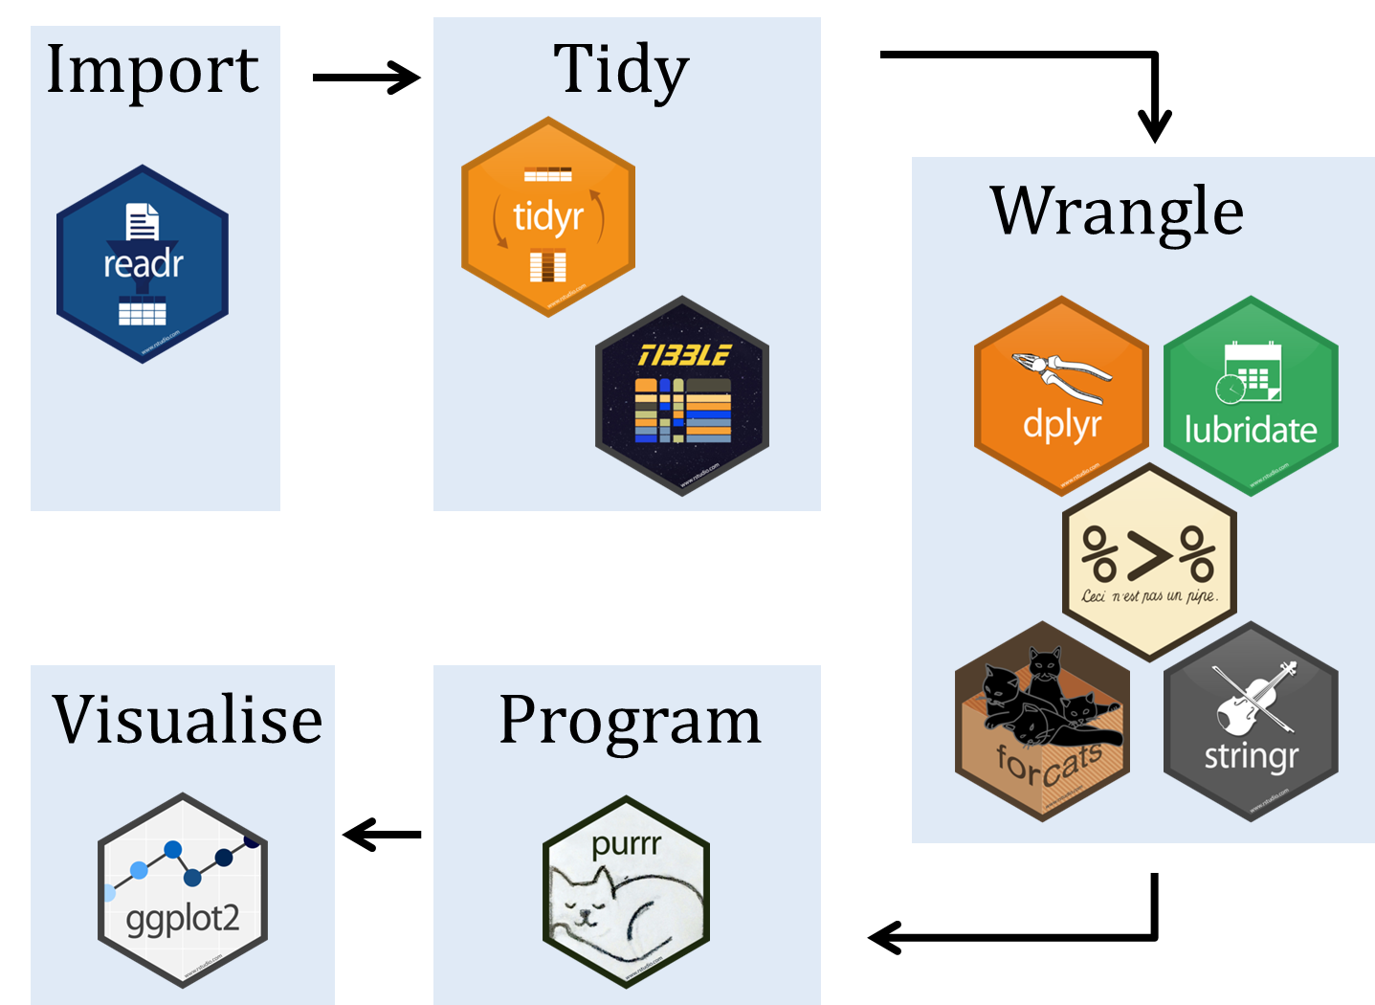
Roadmap
2 Data
manipulation
1 Quarto
3 Data
visualization

Slide 5
Roadmap
2 Data
manipulation
1 Quarto
3 Data
visualization

Slide 6
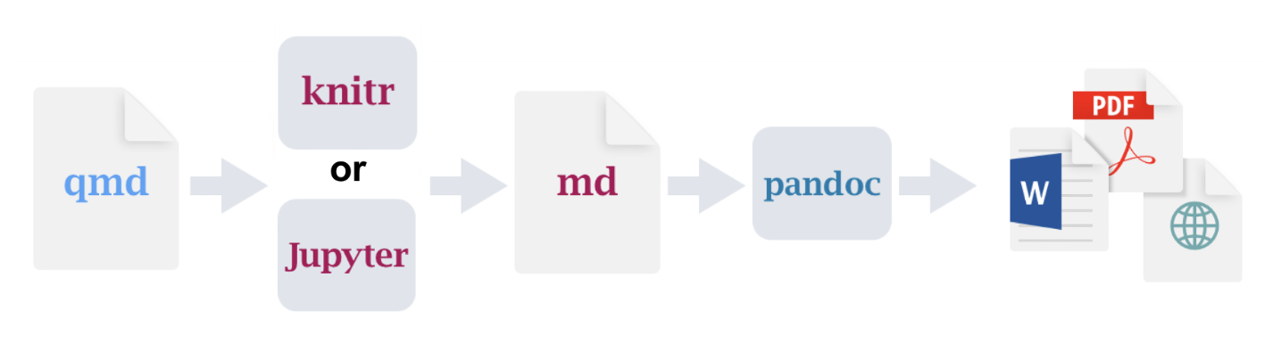
1 Quarto
Open-source scientific and technical publishing system.
Combine code, commentary, interactive plots, figures/tables into one document
Supports R, Python, Julia, and Observable JS.
https://bioinformatics.ccr.cancer.gov/docs/btep-coding-club/CC2024/Quarto/GettingStarted_with_Quarto_orig.html

Slide 7
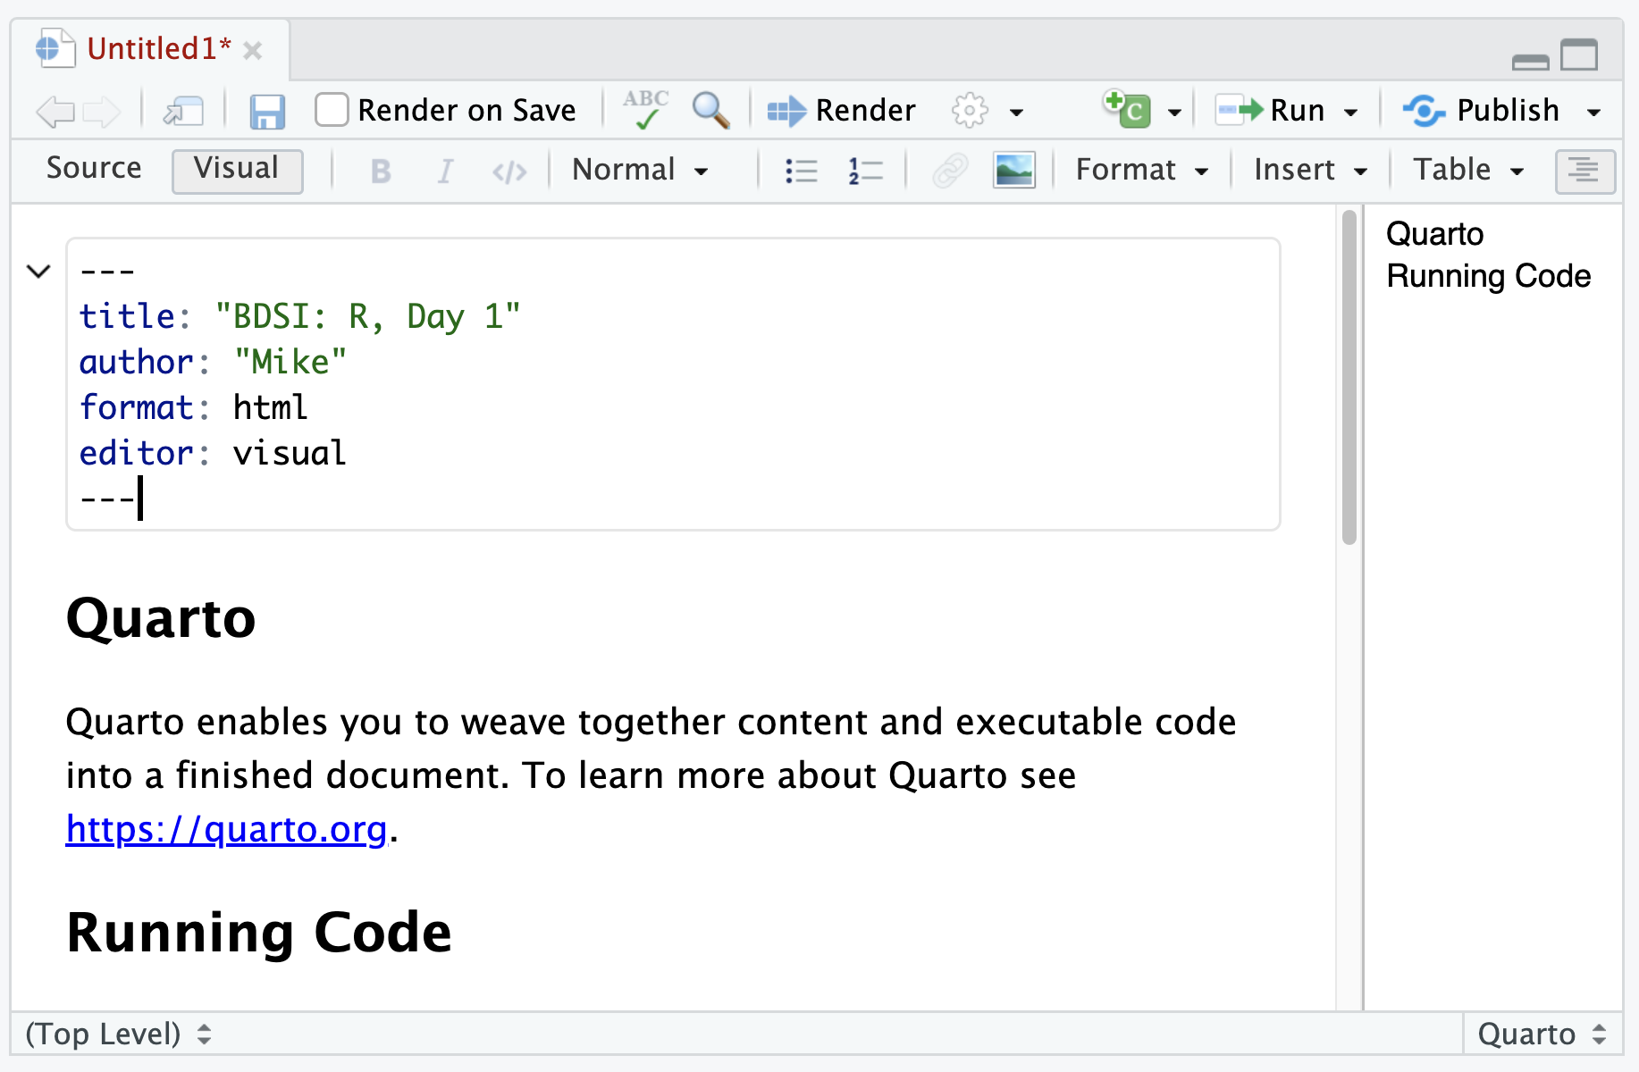
1 Quarto
In RStudio:
File -> New File -> Quarto Document
Choose: HTML, Knitr
Save the file
Click “Render”
Edit, repeat.

Slide 8



R packages
Packages add new functions and data into R
install.packages(“dplyr”)
Run once per machine
Downloads packages to your computer
library(dplyr)
Run each time you start R
Loads packages into current R session

Slide 9
Tidyverse
# run once
install.packages(“tidyverse”)
# run in new session
library(tidyverse)
Collection of R packages for reading data,
data wrangling, visualization, and programming
For now:
# run in new session
library(dplyr)
Image credit: http://www.seec.uct.ac.za/r-tidyverse

Slide 10
Roadmap
2 Data
manipulation
1 Quick R
3 Data
visualization

Slide 11
dplyr: motivation
Analysts spend a lot of time manipulating and summarizing data
Base R provides many functions for this, but
the syntax is sometimes overly verbose or ugly
the functions can be slow for large data sets
dplyr exists to make data manipulation code easier to read and faster

Slide 12
load dplyr
Either use
library(tidyverse)
Or, for now:
library(dplyr)
Let’s test it out with some data…

Slide 13
Sample data
We will be using a data set containing all out-bound flights from NYC in 2013
# Data come to us from an R package
install.packages(“nycflights13”)
library(nycflights13)

Slide 14
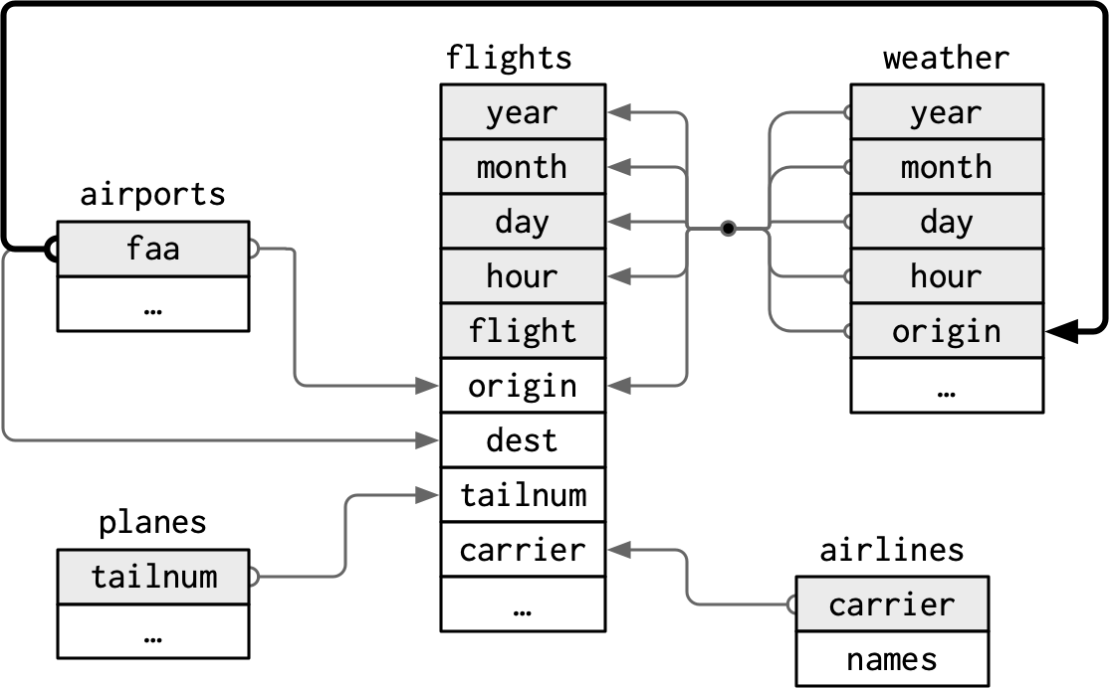
Sample data: flights
year, month, day – time of departure
dep_time, arr_time – actual departures and arrivals
sched_dep_time, sched_arr_time – scheduled departues and arrivals
dep_delay, arr_delay – delays for departures and arrivals

Slide 15
Sample data: flights
carrier – carrier abbreviations
flight – flight number
tailnum – plane tailnumber
origin, dest – origin and destination

Slide 16
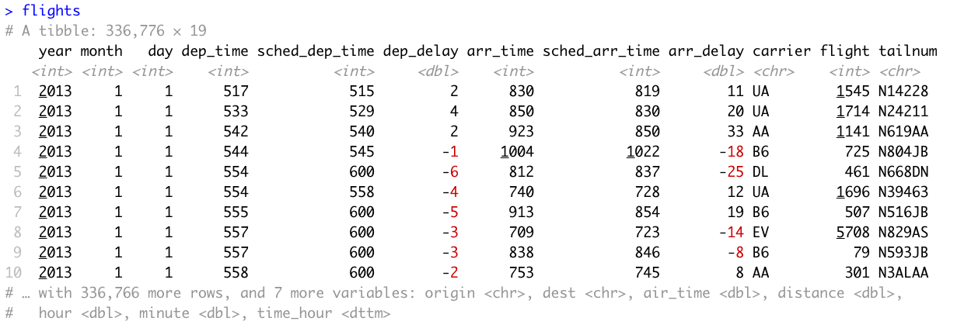
flights table
View(flights)

Slide 17
Basic dplyr verbs
Most of dplyr consists in five (or six) “verbs” that solve common data manipulation challenges:
filter() – keep rows matching desired properties
select() – choose which columns you want to extract
arrange() – sort rows
mutate() – create new columns (new variables)
summarize() – collapse rows into summaries
group_by() – operate on subsets of rows at a time

Slide 18
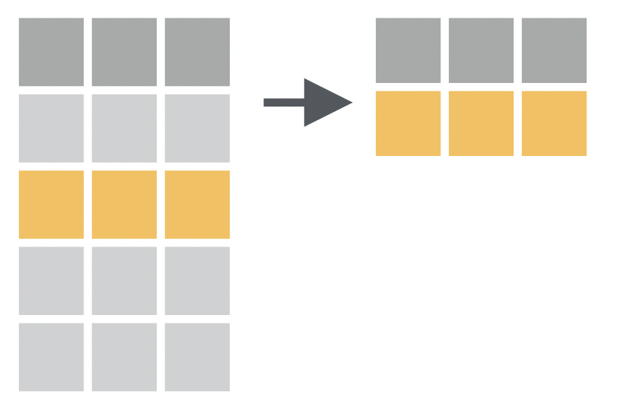
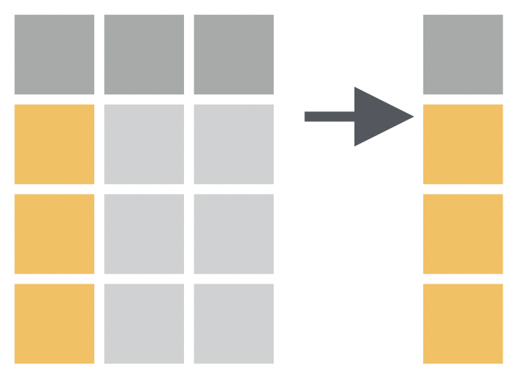
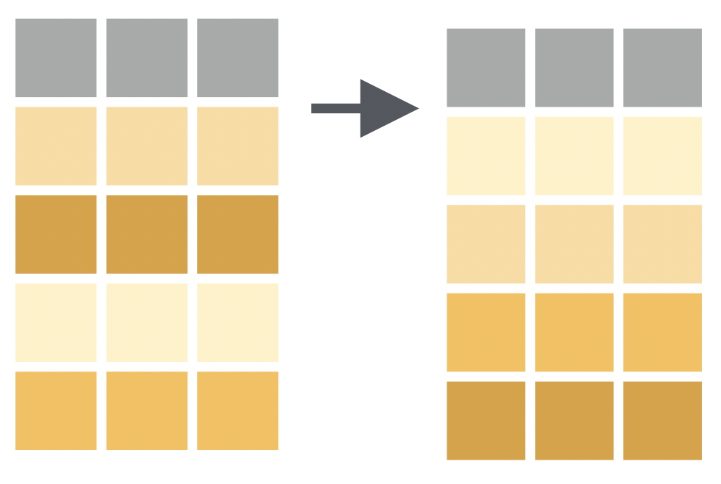
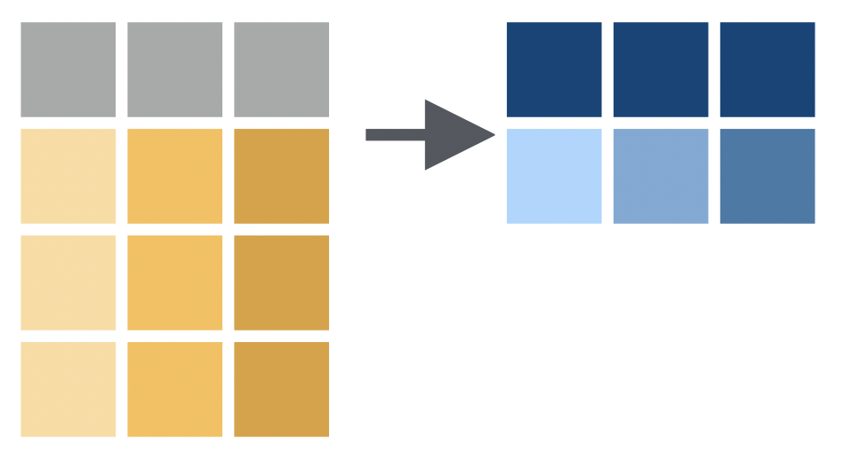
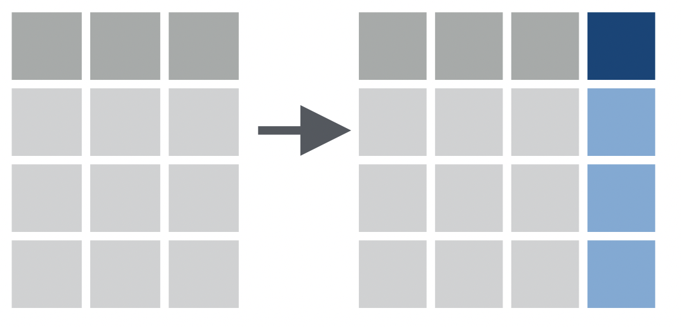
Basic dplyr verbs: pictorially
filter()
select()
arrange()
summarize()
mutate()
group_by()

Slide 19
dplyr verb properties
Always take a data source as the first argument
filter(data, …), select(data, …), arrange(data, …)
Return a new data object (never updates/replaces the original)
data2 = filter(data, …)
Specify columns as unquoted strings (symbols)
select(data, name), mutate(data, date = as.Date(time))

Slide 20
Filtering rows
1 filter()
Find all flights to Detroit (DTW) in June (2013):

Slide 21

Filtering rows
1 filter()
Find all flights to Detroit (DTW) in June (2013):
filter(flights, dest == “DTW” & month == 6)
Base R equivalent:
flights[flights$dest == “DTW” & flights$month == 6, ]
subset(flights, dest == “DTW” & month == 6)

Slide 22

How about your last connecting flight?
Many of you flew here.
How many flights came to your last connection from one of the NYC airports?
filter(flights, dest == “ “)
# ^ insert airport code here
Also, try these:
HLN (Honolulu, Hawaii)
SLC (Salt Lake City, Utah)

Slide 23
Comparisons when filtering
filter(flights, month ?? 6)
# ^ insert comparison here
== Equal month == 6
!= Not Equal month != 6
<, <= Less than (or equal)
>, >= Greater than (or equal)
& And month > 2 & month < 7
| Or month < 3 | month > 6
! Not
%in% Matches one of month %in% c(1, 12)

Slide 24
Selecting columns
2 select()
Select specific columns, excluding columns, select column ranges

Slide 25
Selecting columns
2 select()
Select specific columns
select(flights, dep_time, arr_time, carrier)
Excluding columns
select(flights, -year, -tailnum)
Select column ranges
select(flights, month:dep_delay)

Slide 26
Selecting columns… part 2
2 select()
select(flights, starts_with(“d”))
select(flights, ends_with(“time”))
select(flights, contains(“arr”))
select(flights, -starts_with(“d”))
select(flights, flight, everything()))
See “?select” for complete list of examples

Slide 27
Can we combine select and filter?
1 filter()
+
2 select()
# Temporary variables
fl_dtw = filter(flights, dest == “DTW”)
fl_dtw_sel = select(fl_dtw, carrier)
# Nested calls
select(filter(flights, dest == “DTW”), carrier)
# These get messy, fast

Slide 28
Verb composition with pipes
%>%
flights data “then”
filter destination to DTW “then”
select the carrier variable
flights %>% filter(dest == “DTW”) %>%
select(carrier)
%>% is the “pipe” operator (often read as “then”)
Keyboard shortcut cntr-shift-M (win). Cmd-shift-M (mac)

Slide 29
Verb composition with pipes
%>%
The %>% operator passes the result from the left side of the first argument of the right side:
a %>% x() %>% y() %>% z() <-> z(y(x(a)))
Keyboard shortcut cntr-shift-M (win). Cmd-shift-M (mac)
a %>%
x() %>%
y() %>%
z()
x(a) %>%
y() %>%
z()
y(x(a)) %>%
z()
z(y(x(a)))

Slide 30
Try using chains
%>%
round(exp(sin(0.5)), 2)
# find the answer using pipes and raise your hand to share the
# answer

Slide 31
Sort (arrange) data
3 arrange()
Use arrange() to sort your rows:

Slide 32
Sort (arrange) data
3 arrange()
Use arrange() to sort your rows
flights %>% arrange(sched_dep_time)
# default sort order is least to greatest
Use desc()to reverse the sort order of a column
flights %>% arrange(month, desc(day))
You can sort on functions of variables
flights %>% arrange(desc(dep_time–sched_dep_time))

Slide 33
Final flight using the sequence of verbs
What is the last day that flight 4401 arrived in
Detroit (DTW)?
flights %>%
filter( ) %>%
arrange( ) %>%
select( )

Slide 34
Create new variables
4 mutate()
mutate() allows you to create columns using existing columns

Slide 35
Create new variables
4 mutate()
Mutate allows you to create columns using existing values
flights %>%
mutate(speed = distance/(air_time/60)) %>%
arrange() %>%
select()
Mutate works as long as the function is vectorized (vector in, vector out)
Remember, changes are not saved to the flights data table. Be sure to save the results if you want to use them later:
fl_speed = flights %>% mutate()

Slide 36
Use new variables right away
4 mutate()
The arguments to mutate are run in the order they appear
flights %>%
mutate(
dist_km = distance * 1.61,
hours = air_time / 60,
kph = dist_km / hours
) %>%
select(flight, kph)
Be careful, you can overwrite existing variables without a warning

Slide 37
Summarize data
5 summarize()
You generally use summarize() to reduce the number of rows in your data by specifying summary functions for each of the columns

Slide 38
Summarize data
5 summarize()
You generally use summarize() to reduce the number of rows in your data by specifying summary functions for each of the columns
flights %>%
summarize(avg_dist = mean(distance))
Useful summary functions: mean(), median(), var(), sd(), min(), max(), first(), last(), n(), n_distinct()

Slide 39
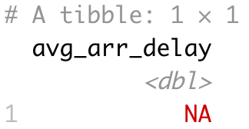
Something’s missing
5 summarize()
Why doesn’t this give a number?
flights %>%
summarize(avg_arr_delay = mean(arr_delay))
R has a special missing value: NA

Slide 40
Example (base R)
Add the numbers 1 to 10
x = 1:10
sum(x)
x[4] = NA
x
sum(x)

Slide 41
Example (base R)
Add the numbers 1 to 10
x = 1:10
x[4] = NA
sum(x)
is.na(x) # find missing values
sum(is.na(x)) # count missings
sum(x, na.rm = TRUE) # ignore missing values

Slide 42
Average delay (for those with a delay)
Recall that “!”
means “not”
Filter out missing values
flights %>%
filter(!is.na(arr_delay)) %>%
summarize(avg_arr_delay = mean(arr_delay))
Ignore missing values in mean()
flights %>%
summarize(avg_arr_delay = mean(arr_delay, na.rm=TRUE))

Slide 43
Try your own summary
Create one statement to calculate the minimum (min) and maximum (max) departure delay (dep_delay). Be sure to remove rows that have missing values.
flights %>% filter( ) %>%
summarize( , )

Slide 44
Grouping data
6 group_by()
Often you want to perform summaries for groups of rows at a time
The group_by() function allows you to specify columns that define groups
Functions like mutate() and summarize() are performed on each group

Slide 45
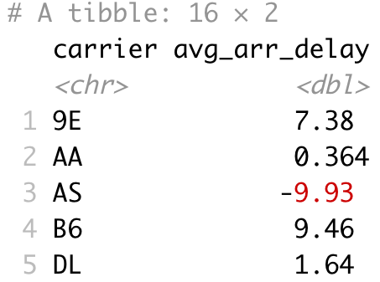
group_by() + summarize() example
flights %>%
filter(!is.na(arr_delay)) %>%
group_by(carrier) %>%
summarize(avg_arr_delay = mean(arr_delay))
16 rows returned

Slide 46
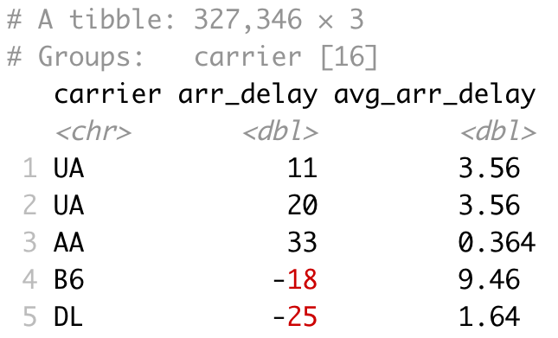
group_by() + mutate() example
flights %>%
filter(!is.na(arr_delay)) %>%
group_by(carrier) %>%
mutate(avg_arr_delay = mean(arr_delay)) %>%
select(carrier, arr_delay, avg_arr_delay)
327,346 rows returned

Slide 47
Combine group_by() with transformations
mutate()
Will not change the number of rows
Collapsing functions like max() will return the max() for each group
Keep all existing columns and add new ones
summarize()
Returns one row per group
Only returns columns that are used as groups and those new values created from collapsing functions

Slide 48
Summarization exercise
Calculate the longest arrival delay
for each carrier over the whole year.
Which carrier’s longest arrival delay
was the shortest compared to all
other carriers?
flights %>%
filter( ) %>%
group_by( ) %>%
summarize( ) %>%
arrange()

Slide 49
Multiple columns, same function
across(<columns>, <functions>)
apply a function to many columns
Use the same selectors you use with select()
Fund means for all the columns that end in “time”
flights %>%
summarize(across(ends_with(“time”),
~mean(.x, na.rm = TRUE)))
“~” creates a one-line function

Slide 50
The five (six?) verbs
1 filter()
Most of dplyr consists in five “verbs” that solve common data manipulation challenges
Manipulate data from a single source
What if data come from multiple sources?
+
2 select()
+
3 arrange()
+
4 mutate()
+
5 summarize()

Slide 51
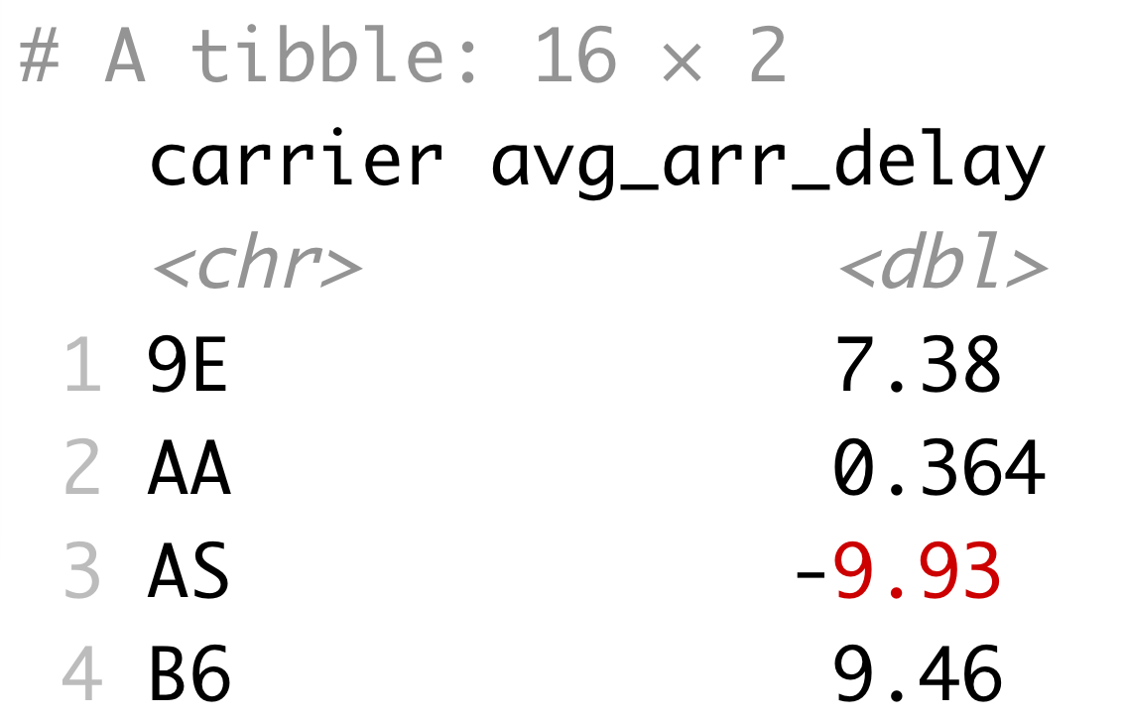
Merging data
What are these carrier codes?
flights %>%
filter(!is.na(arr_delay)) %>%
group_by(carrier) %>%
summarize(avg_arr_delay = mean(arr_delay))

Slide 52
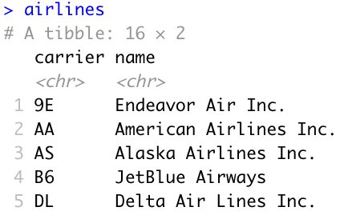
”airlines” table

Slide 53
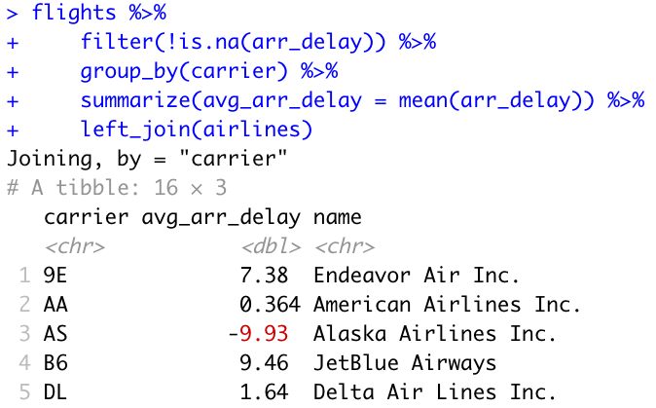
Join flights to airlines

Slide 54
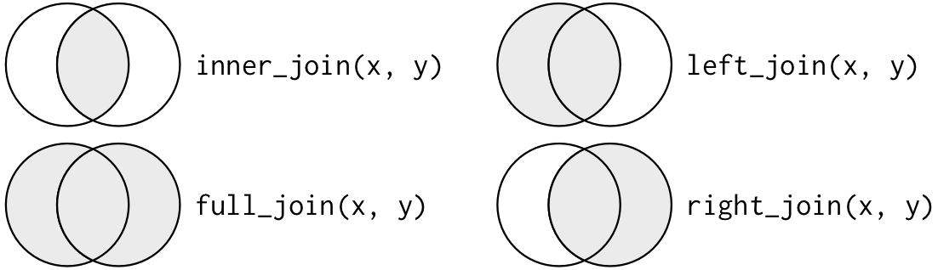
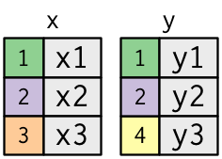
Types of joins (merges)
Image source: https://r4ds.had.co.nz/relational-data.html

Slide 55
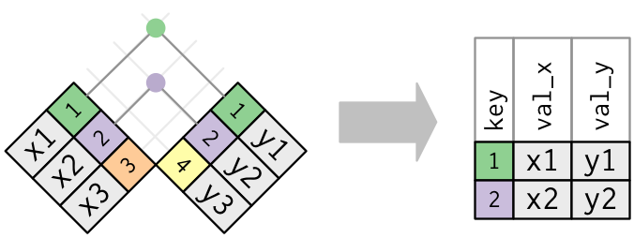
Types of joins (merges)
Image source: https://r4ds.had.co.nz/relational-data.html

Slide 56
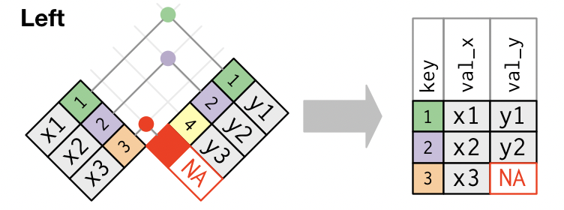
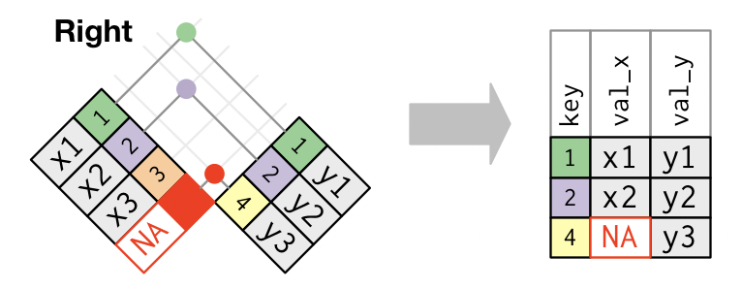
Types of joins (merges)
Image source: https://r4ds.had.co.nz/relational-data.html

Slide 57
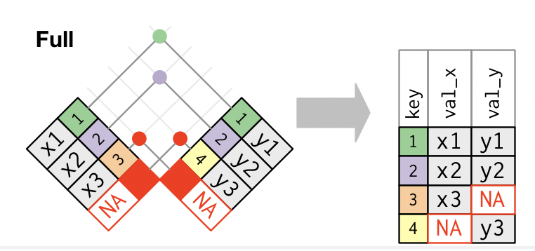
Types of joins (merges)
Image source: https://r4ds.had.co.nz/relational-data.html

Slide 58
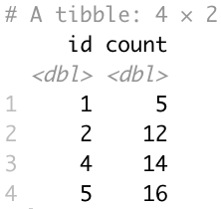
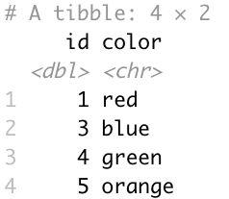
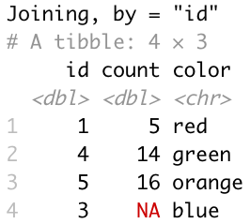
Types of joins (merges)
x
y
??
left_join(x, y)
right_join(x, y)
full_join(x, y)
inner_join(x, y)

Slide 59
Non-merging joins
These “joins” do not add any new columns to your data but are subsetting with multi-column matches
(Like a multi-column %in%)
semi_join()
only keep rows in left table with matches in right
anti_join()
drop rows in left table with matches in right

Slide 60
Join by
By default, the join commands will join two tables based on all matching column names
flights %>% inner_join(planes)
# returns many fewer rows!
You can control the joining by specifying the column names
flights %>% inner_join(planes, by = “talinum”)

Slide 61
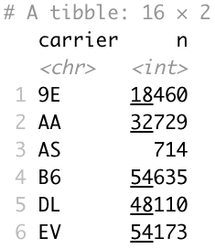
Other useful dplyr functions
count()
The count function is a special combination of summarize() + group_by() to see how often certain values are repeated
flights %>%
count(carrier)

Slide 62
More counting functions
count(), n() and n_distinct()
Number of distinct values in a column
Can only be used with summarize(), mutate(), and filter()
flights %>%
group_by(tailnum) %>%
summarize(routes = n_distinct(flight),
flights = n())

Slide 63
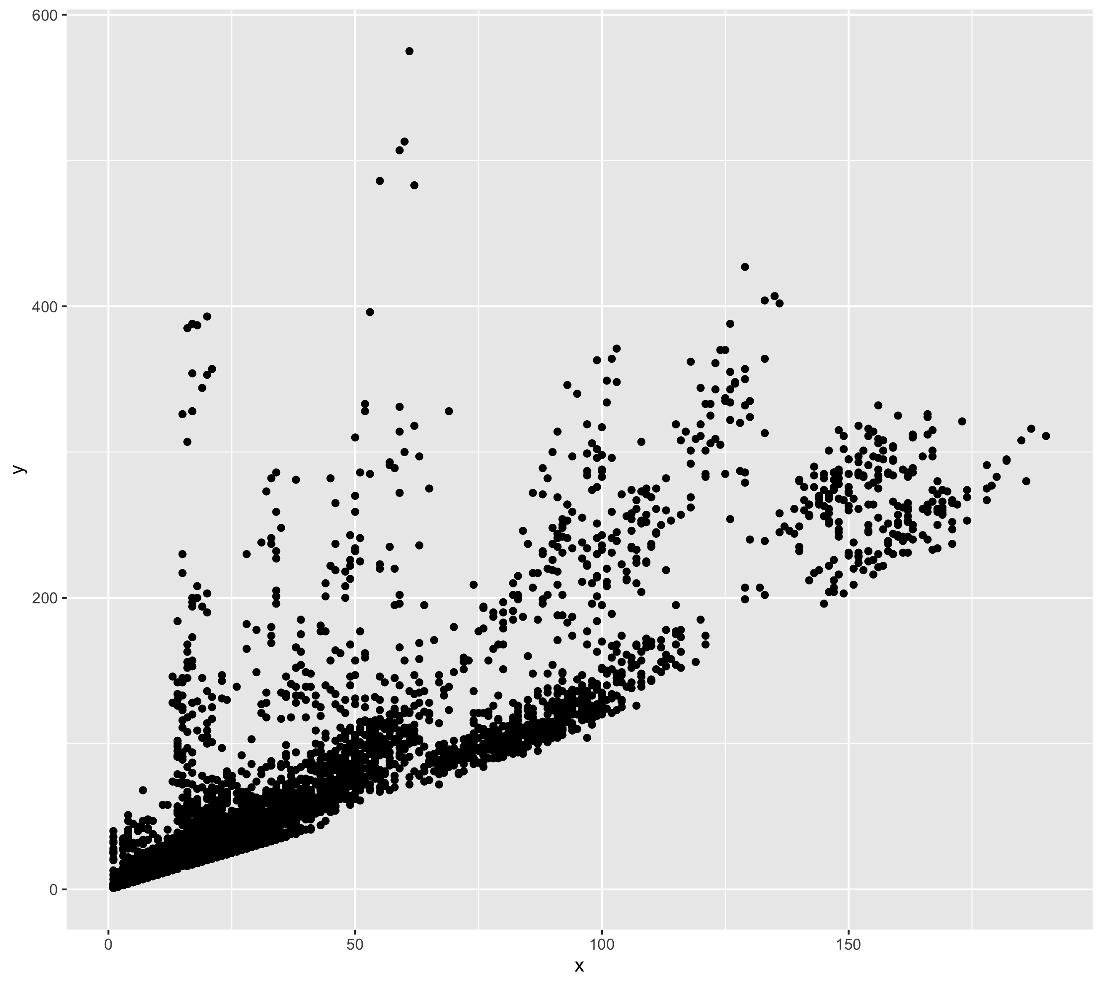
What values make up this plot?
flights %>%
filter(!is.na(tailnum)) %>%
group_by(tailnum) %>%
summarize(x=??,
y=??)
x=
n()
n_distinct(talinum)
n_distinct(flight)
n(flight)
y=
n_distinct(flight)
n()
n()
n(talinum)

Slide 64
Subsetting observations
slice_max()/slice_min()
return top or bottom entries
flights %>% slice_max(air_time, n = 3)
sample_n()
Randomly choose n rows
flights %>% sample_n(4)
distinct()
Returns unique combinations of values (like count() but without the row count)
flights %>% distinct(year, month)

Slide 65
Lead/lag functions
”Shift” values so you can compare current value to a previous or following value
Growth = tibble(
age = 2:9,
height = c(33.7, 37.0, 39.4, 42.2, 45.5, 47.7,
50.6, 52.7))
growth %>% mutate( prevh = lag(height), nexth = lead(height), growth = height-prevh)

Slide 66
Conditional replacement
The if_else() function helps to change values in certain cases
if_else(<condition>, <if true>, <if false>)
flights %>% mutate(
real_delay = if_else(arr_delay<0, 0, arr_delay))
If have more cases than TRUE/FALSE, check out the case_when() funciton

Slide 67
Programming with dplyr
Calculate average arrival delay:
flights %>%
group_by(carrier) %>%
summarize(delay=mean(arr_delay, na.rm=T))
Calculate average departure delay:
flights %>%
group_by(carrier) %>%
summarize(delay=mean(dep_delay, na.rm=T))
Bad form to repeat code
Solution is to write a function

Slide 68
Programming with dplyr
Calculate average arrival delay:
avg_delay = function(x) {
flights %>%
group_by(carrier) %>%
summarize(delay = mean({{x}}, na.rm=T))
}
avg_delay(arr_delay)
avg_delay(dep_delay)
Use {{}} around parameters for column names you pass to your function

Slide 69
Renaming output :=
Calculate average arrival delay:
avg_delay = function(data, x) {
data %>%
group_by(carrier) %>%
summarize("{{x}}" := mean({{x}}, na.rm=T))
}
avg_delay(arr_delay)
avg_delay(dep_delay)
Use {{}} around parameters for column names you pass to your function

Slide 70
Renaming output :=
Calculate average arrival delay:
avg_delay = function(x) {
flights %>%
group_by(carrier) %>%
summarize("{{x}}" := mean({{x}}, na.rm=T))
}
avg_delay(arr_delay)
avg_delay(dep_delay)
Use {{}} around parameters for column names you pass to your function

Slide 71
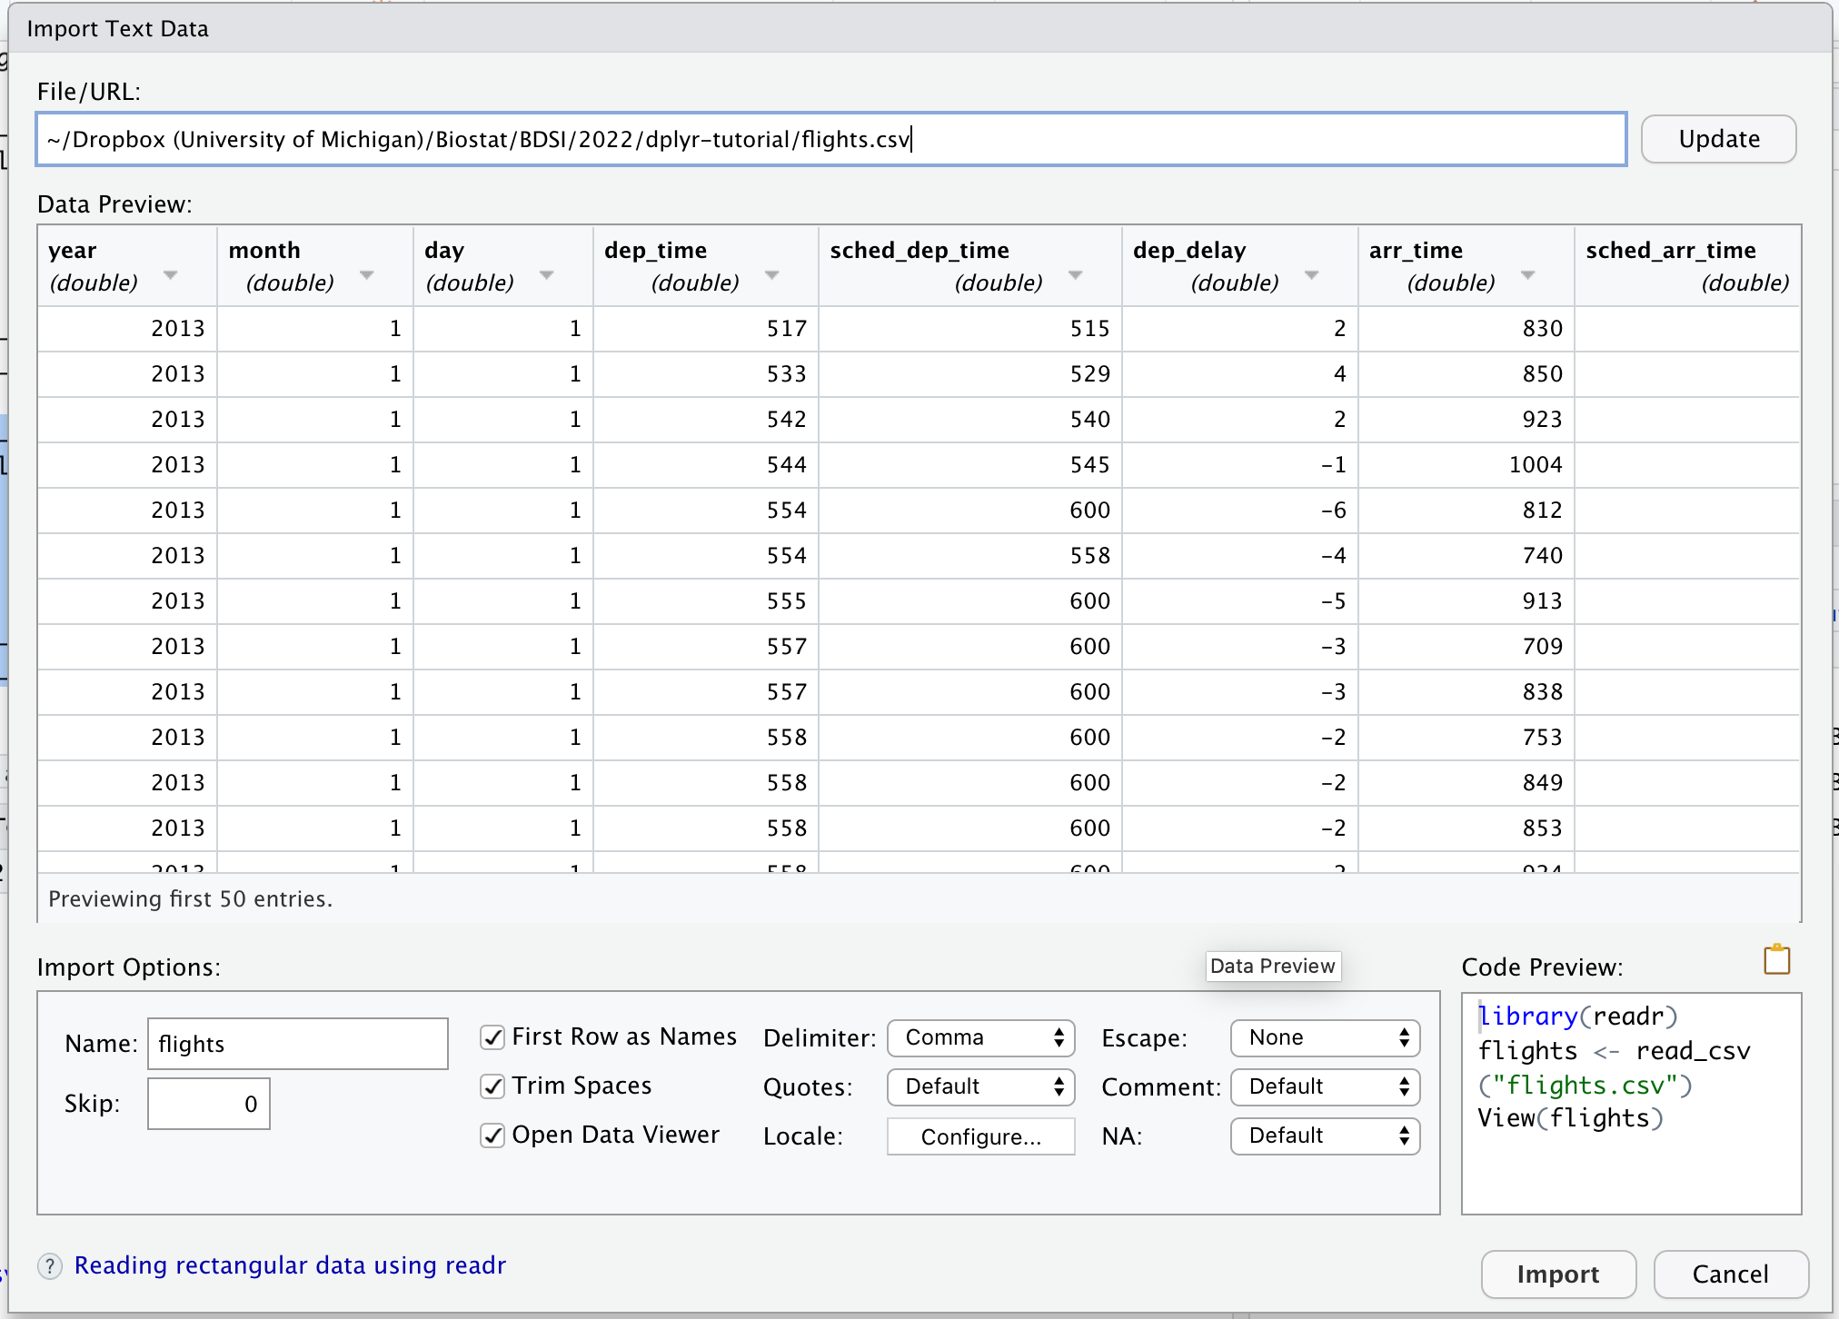
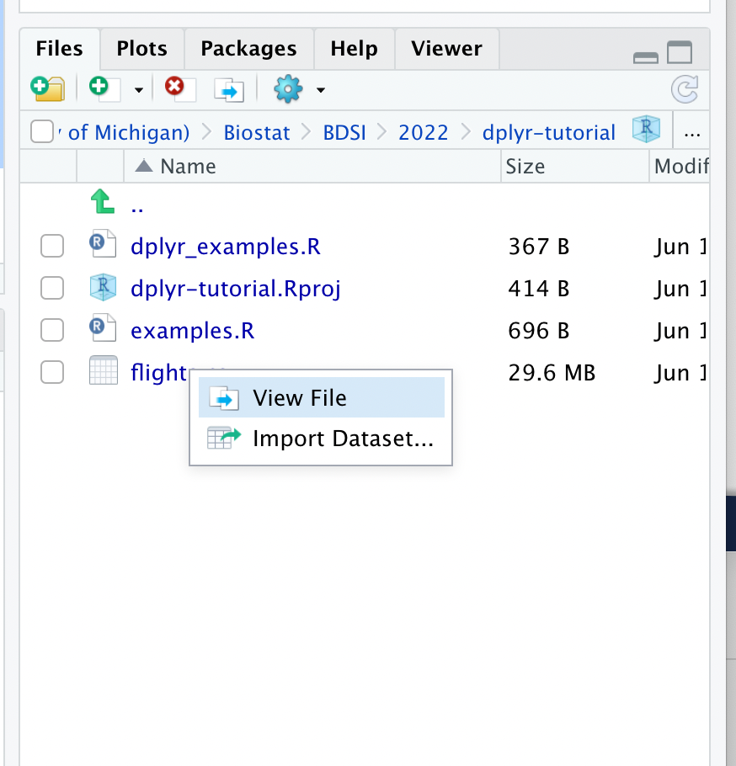
Loading data
Either use readr from Tidyverse
Or.. point and click from RStudio

Slide 72
Flights exercises

