Slide 1

Data visualization with ggplot2
Mike Kleinsasser
BDSI 2023

Slide 2
About me
Mike Kleinsasser (call me Mike)
Joined Biostatistics in 2019
R programmer
Support students and faculty in R package devel./maintenance

Slide 3



R workshop setup
Help! Place sticky note on corner of screen
Need our attention? Raise your hand
Helpers will be walking around to help you with questions
Type the code along with me! (Have RStudio open + a script)
Open the powerpoint to copy/paste code with me (see PP Notes)

Slide 4
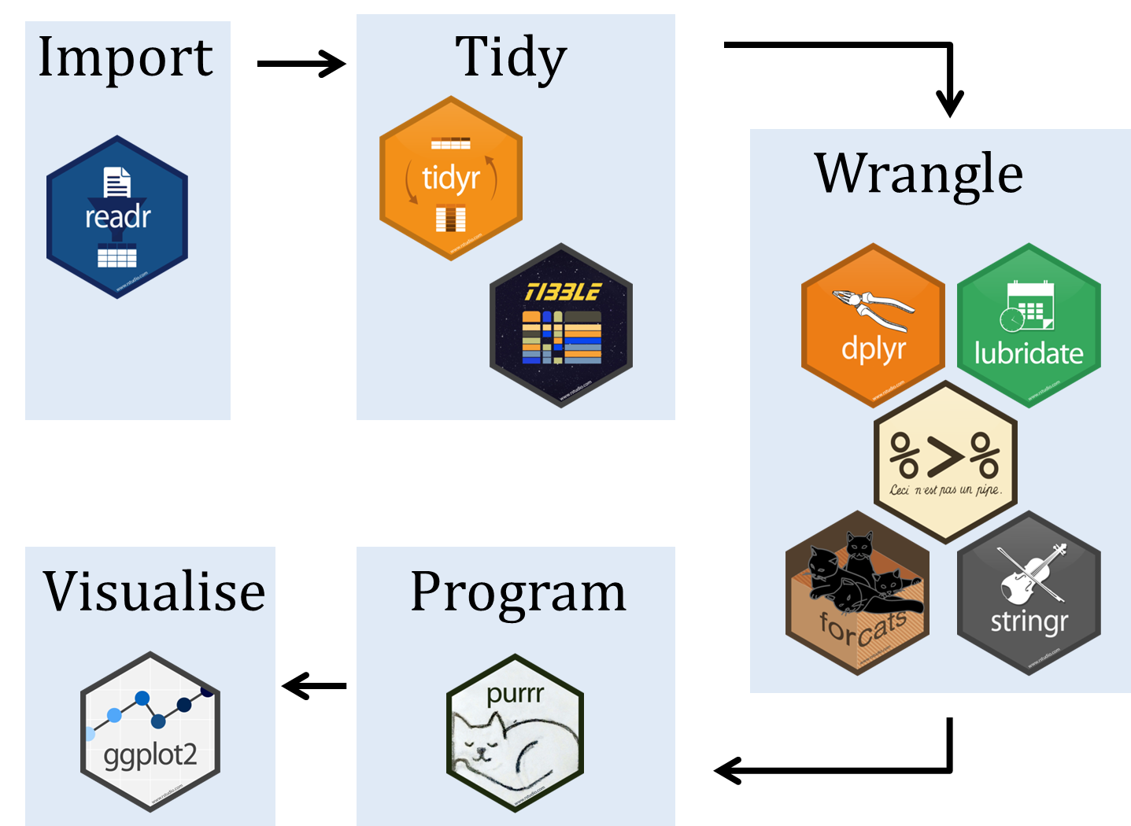
Roadmap
2 Data
manipulation
1 Quick R
3 Data
visualization

Slide 5
Roadmap
2 Data
manipulation
1 Quick R
3 Data
visualization

Slide 6

Tidyverse: dplyr and ggplot2
2 Data
manipulation
3 Data
visualization
Last segment we learned the basic data transformation verbs and how to combine them into complex statements using the pipe
ggplot2 follows a similar paradigm for plotting:
a ‘pipe’ for building more complex objects from the fundamental plotting ‘verbs’
data
%>%
1 filter()
%>%
2 select()
%>%
3 arrange()
%>%
4 mutate()
%>%
5 summarize()

Slide 7

Why plot?
datasaurus_dozen %>%
group_by(dataset) %>%
summarize(
mean_x = mean(x),
mean_y = mean(y),
std_dev_x = sd(x),
std_dev_y = sd(y),
) %>%
head(5)

Slide 8
Why plot?
# A tibble: 5 × 5
dataset mean_x mean_y std_dev_x std_dev_y
<chr> <dbl> <dbl> <dbl> <dbl>
1 away 54.3 47.8 16.8 26.9
2 bullseye 54.3 47.8 16.8 26.9
3 circle 54.3 47.8 16.8 26.9
4 dino 54.3 47.8 16.8 26.9
5 dots 54.3 47.8 16.8 26.9

Slide 10
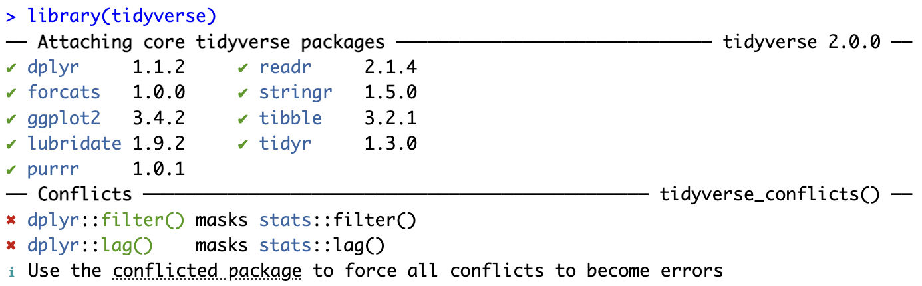
Install/library() the package
library(tidyverse)

Slide 11
Gapminder Data
Data set tracking life expectancy and per-capita GDP of 142 countries
Data reported every five years from 1952-2007
install.packages(‘gapminder’)
library(gapminder)
View(gapminder)

Slide 12
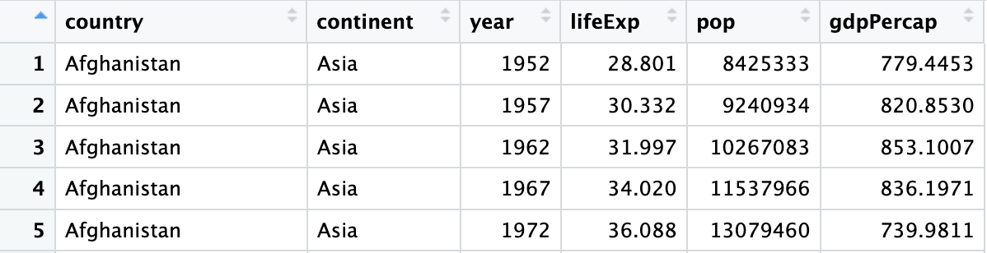
Gapminder Data
View(gapminder)

Slide 13
Gapminder Data
What’s the relationship between per capita GDP and life expectancy?
gapminder %>%
+ summarise(mean_gdp = mean(gdpPercap),
+ mean_life = mean(lifeExp),
+ cor_gdp_life = cor(gdpPercap, lifeExp))
# A tibble: 1 × 3
mean_gdp mean_life cor_gdp_life
<dbl> <dbl> <dbl>
1 7215. 59.5 0.584

Slide 14
Start Plot
ggplot(gapminder)

Slide 15
Add x variable
ggplot(gapminder) +
aes(x = gdpPercap)

Slide 16
Add y variable
ggplot(gapminder) +
aes(x = gdpPercap) +
aes(y = lifeExp)

Slide 17
Draw points
ggplot(gapminder) +
aes(x = gdpPercap) +
aes(y = lifeExp) +
geom_point()

Slide 18
Color by variable
ggplot(gapminder) +
aes(x = gdpPercap) +
aes(y = lifeExp) +
geom_point() +
aes(color = continent)

Slide 19
Size by population
ggplot(gapminder) +
aes(x = gdpPercap) +
aes(y = lifeExp) +
geom_point() +
aes(color = continent) +
aes(size = pop)

Slide 20
Small plots by year
ggplot(gapminder) +
aes(x = gdpPercap) +
aes(y = lifeExp) +
geom_point() +
aes(color = continent) +
aes(size = pop) +
facet_wrap(vars(year))

Slide 21
Filter years (dplyr)
gapminder %>%
filter(
year %in% c(1952, 2007)
) %>%
ggplot() +
aes(x = gdpPercap) +
aes(y = lifeExp) +
geom_point() +
aes(color = continent) +
aes(size = pop) +
facet_wrap(vars(year),
nrow = 2)

Slide 22
Syntax Breakdown
ggplot(gapminder) +
aes(x = gdpPercap) +
aes(y = lifeExp) +
aes(color = continent) +
aes(size = pop) +
geom_point() +
facet_wrap(vars(year),
nrow = 2)
Base plot object (requires data set)
Aesthetics (aes)
Geometry (geom_)
Faceting

Slide 23
Aesthetics, aes()
Mapping between a column of your data and some property of the
geometry being drawn
ggplot(gapminder) +
aes(x = gdpPercap,
y = lifeExp,
color = continent,
size = pop)
aes(x = gdpPercap)+
aes(y = lifeExp) +
aes(color = continent) +
…

Slide 24
Aesthetics, aes()
Mapping between a column of your data and some property of the
geometry being drawn
aes(<PROPERTY> = <VARIABLE>)
ggplot(gapminder) +
aes(x = gdpPercap,
y = lifeExp,
color = continent,
size = pop)
aes(x = gdpPercap)+
aes(y = lifeExp) +
aes(color = continent) +
…

Slide 25
Aesthetics, aes()
Aesthetics available depend on the geometry being used
?geom_histogram
?geom_boxplot
Aesthetics
geom_point() understands the following aesthetics (required aesthetics are in bold):
x
y
alpha
colour
fill
group
shape
size
stroke
Aesthetics
geom_boxplot() understands the following aesthetics (required aesthetics are in bold):
x or y
lower or xlower
upper or xupper
middle or xmiddle
ymin or xmin
ymax or xmax
alpha
colour
fill
group
linetype
linewidth
…
?geom_histogram

Slide 26

Aesthetics, aes()
gapminder %>%
filter(year == 2007) %>%
ggplot() +
aes(x = gdpPercap,
y = lifeExp,
<??> = <??>) +
geom_point()
Can you get a different shape for each
continent?

Slide 27
Aesthetics, common mistakes
ggplot2 syntax, like dplyr, meant to replace much of base R syntax
X
gapminder %>%
filter(year == 2007) %>%
ggplot() +
aes(x = gdpPercap,
y = lifeExp,
color = continent) +
geom_point()
d = gapminder[gapminder$year == 2007, ]
ggplot(d) +
aes(x = d$gdpPercap,
y = d[[“lifeExp”]],
color = d$continent) +
geom_point()
X
No more $, [ operators, or “name”

Slide 28
Geometries: geom_<>()
geom_point() just one of many geometries
Used to make scatter plots
Works if you have two continuous variables
What if we wanted to study the distribution of a single variable?
Or the distribution of a single variable by groups?

Slide 29
geom_<>() Single variable plots
Plot the distribution of a single continuous variable from gapminder
gapminder %>%
filter(year == 1952) %>%
ggplot() +
aes(x = lifeExp) +
geom_histogram()

Slide 30
geom_<>() Single variable plots
Plot the distribution of a single continuous variable from gapminder
gapminder %>%
filter(year == 1952) %>%
ggplot() +
aes(x = lifeExp) +
geom_density()
Kernel density estimate =
Smoothed version of a histogram

Slide 31
geom_<>() Single variable plots by group
Plot the distribution of a single continuous variable from gapminder
gapminder %>%
filter(year == 1952) %>%
ggplot() +
aes(x = lifeExp,
color = continent) +
geom_density()

Slide 32
geom_<>() Single variable plots by group
Plot the distribution of a single continuous variable from gapminder
gapminder %>%
filter(
year == 1952,
continent != ‘Oceania’) %>%
ggplot() +
aes(x = lifeExp,
color = continent) +
geom_density()

Slide 33
geom_<>() Single variable plots by group
Plot the distribution of a single continuous variable from gapminder
gapminder %>%
filter(
year == 1952,
continent != 'Oceania') %>%
ggplot() +
aes(x = lifeExp,
fill = continent) +
geom_density(alpha = 0.2)

Slide 34
geom_<>() Single variable plots by group
Plot the distribution of a single continuous variable from gapminder
gapminder %>%
filter(
year == 1952,
continent != 'Oceania') %>%
ggplot() +
aes(x = lifeExp,
fill = continent) +
geom_boxplot()

Slide 35
geom_<>() Single variable plots by group
Plot the distribution of a single continuous variable from gapminder
gapminder %>%
filter(
year == 1952,
continent != 'Oceania') %>%
ggplot() +
aes(x = lifeExp,
y = continent) +
geom_boxplot()

Slide 36
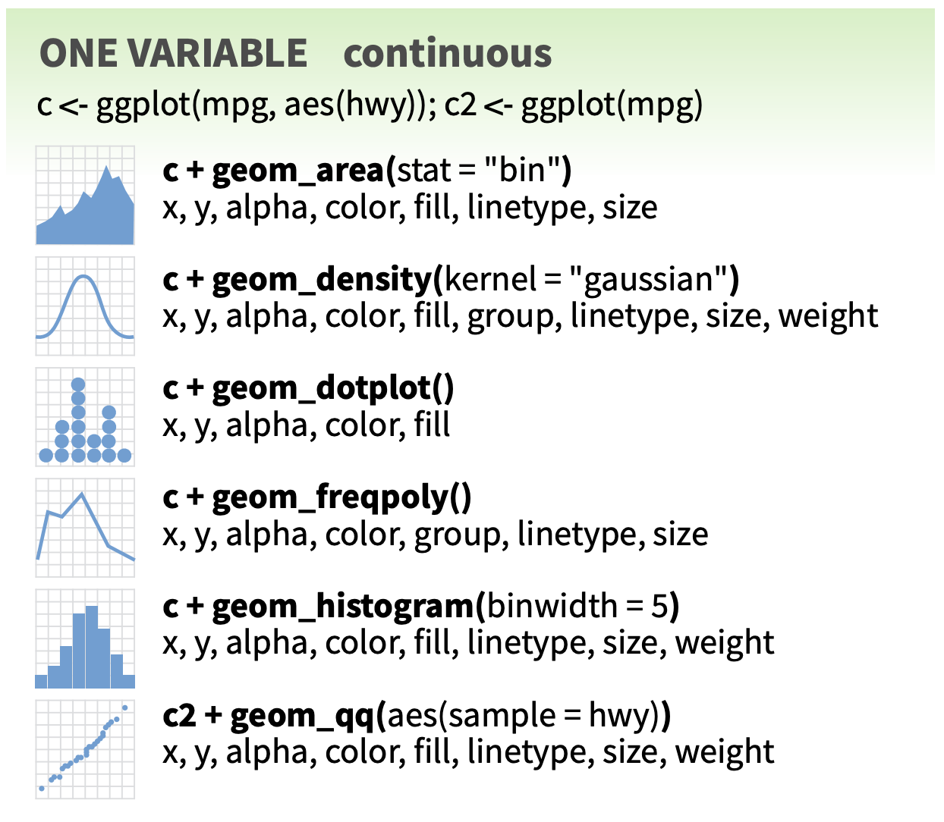
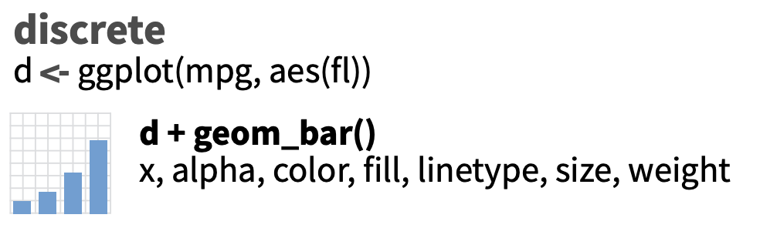

Slide 37
geom_<>() Change across time
Make a lineplot displaying trend in life expectancy over time using gapminder
gapminder %>%
ggplot() +
aes(x = year,
y = lifeExp) +
geom_point()

Slide 38
geom_<>() Change across time
Make a lineplot displaying trend in life expectancy over time using gapminder
gapminder %>%
ggplot() +
aes(x = year,
y = lifeExp) +
geom_line()

Slide 39
geom_<>() Change across time
Display a lineplot displaying trend in life expectancy over time using gapminder
gapminder %>%
ggplot() +
aes(x = year,
y = lifeExp,
group = country) +
geom_line()

Slide 40
geom_<>() Change across time
Display a smoothing line displaying trend in life expectancy over time using
gapminder
gapminder %>%
ggplot() +
aes(x = year,
y = lifeExp,
group = country) +
geom_smooth()

Slide 41
geom_<>() Change across time
Display a smoothing line displaying trend in life expectancy over time using
gapminder
gapminder %>%
ggplot() +
aes(x = year,
y = lifeExp,
group = country) +
geom_smooth(
method = 'lm',
se = FALSE)

Slide 42
geom_<>() Change across time
Compare trends in per capita GDP over time by continent
How can we plot the
trend line per continent?

Slide 43
geom_<>() Change across time
Compare trends in per capita GDP over time by continent
How can we plot the
trend line per continent?
gapminder %>%
ggplot() +
aes(??) +
geom_??(??)

Slide 44
Bar charts (for counts)
Plot the number of countries in each continent in 2007
gapminder %>%
filter(year == 2007) %>%
ggplot() +
aes(x = continent) +
geom_bar()

Slide 45
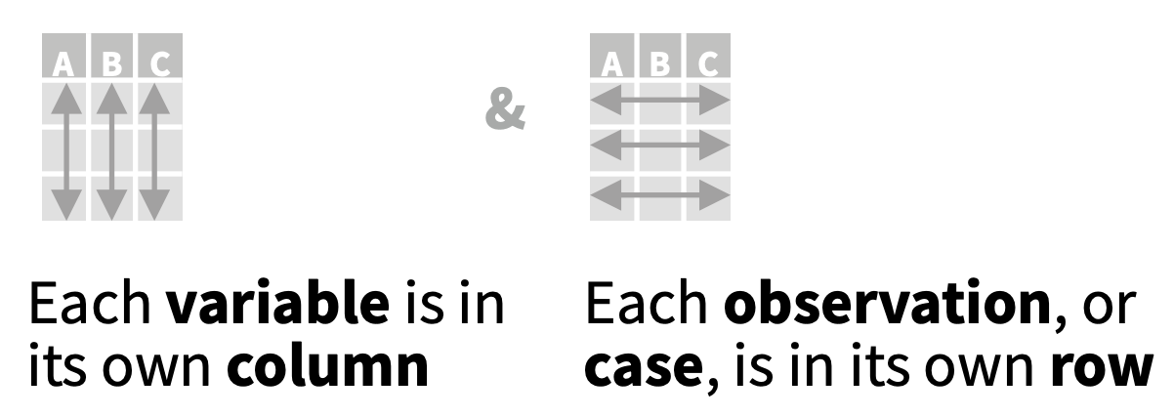
Tidy data
ggplot works best with tidy data
Rules for tidy data
Each variable in the data set is placed in its own column
Each observation is placed in its own row
Each value is placed in its own cell
Your data (usually) should be in a single data table (tibble, data.frame)
You may need to transform data prior to plotting
Some geoms will do basic summarization for you, as in the case of bar charts

Slide 46
Tidy data for column chart
Can you create the same bar chart using dplyr to tidy the data?
gapminder %>%
filter(year == 2007) %>%
group_by(continent) %>%
summarize(count = n()) %>%
ggplot() +
aes(x = continent,
y = count) +
geom_col()

Slide 47
Column charts (for multiple groups)
Plot the average life expectancy for each continent for the years 1952 and 2007
gapminder %>%
filter(year == 2007 | year == 1952) %>%
group_by(continent, year) %>%
summarize(avglife = mean(lifeExp)) %>%
ggplot() +
aes(x = continent,
y = avglife,
fill = year) +
geom_col()

Slide 48
Column charts (for multiple groups)
Plot the average life expectancy for each continent for the years 1952 and 2007
gapminder %>%
filter(year == 2007 | year == 1952) %>%
group_by(continent, year) %>%
summarize(avglife = mean(lifeExp)) %>%
ggplot() +
aes(x = continent,
y = avglife,
fill = factor(year)) +
geom_col()

Slide 49
Column charts (for multiple groups)
Plot the average life expectancy for each continent for the years 1952 and 2007
gapminder %>%
filter(year == 2007 | year == 1952) %>%
group_by(continent, year) %>%
summarize(avglife = mean(lifeExp)) %>%
ggplot() +
aes(x = continent,
y = avglife,
fill = factor(year)) +
geom_col(position = 'dodge')

Slide 50
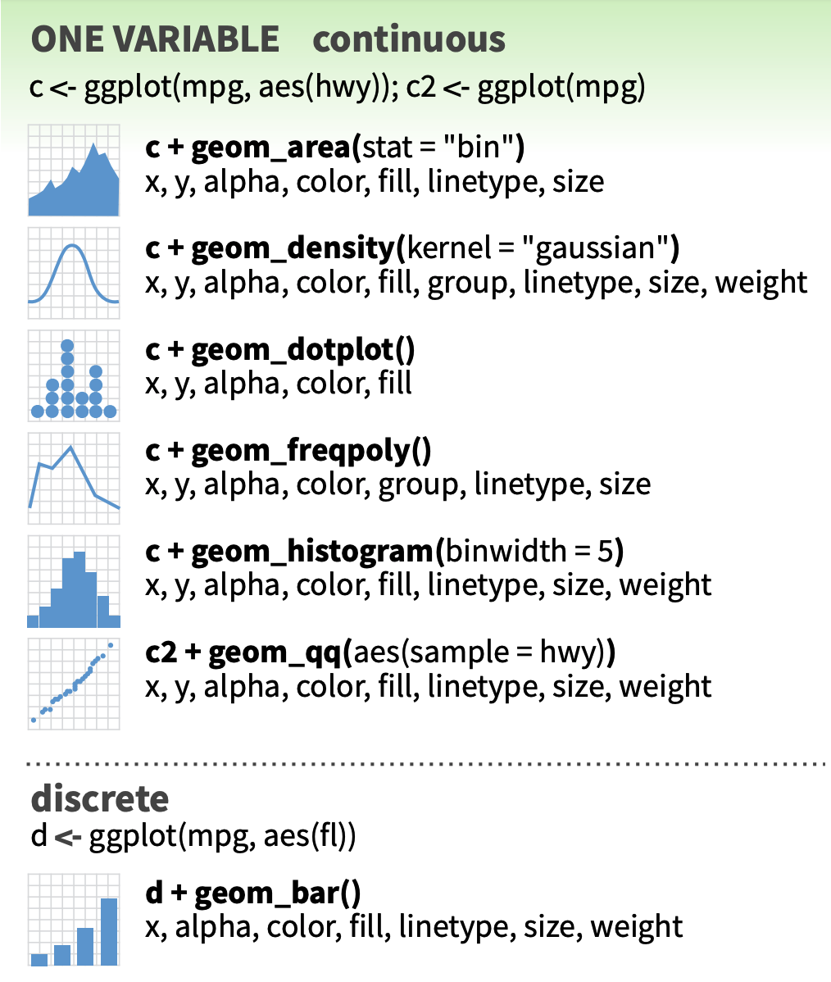
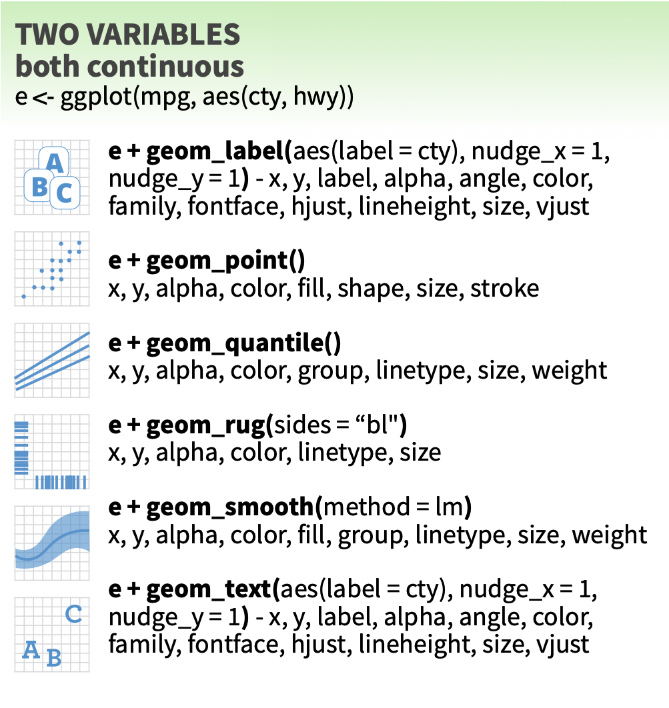

Slide 51
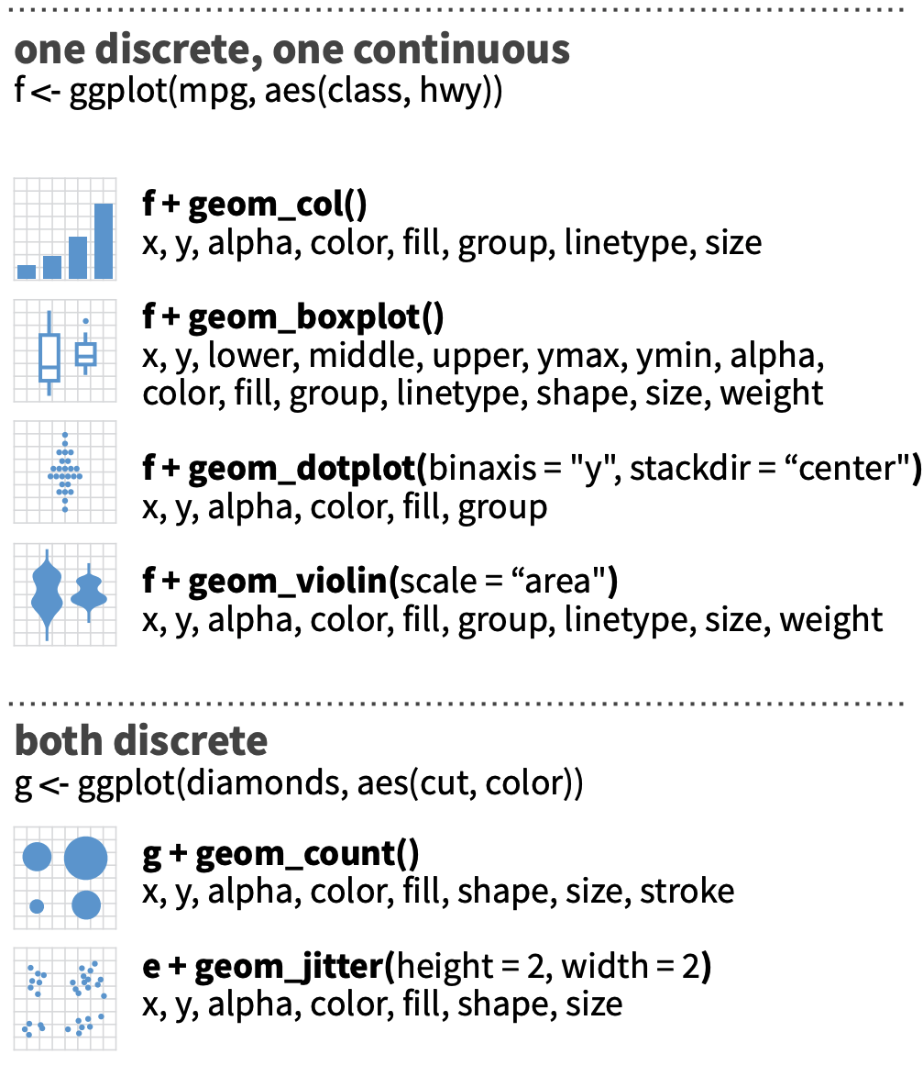


Slide 52
tibble(x = 1, y = 1,
status = 'break’
) %>%
ggplot() +
aes(x, y,
label = status) +
geom_text(size = 50) +
theme(axis.text =
element_blank())

Slide 53
What does ggplot() do?
The ggplot() function creates a ‘’gg/ggplot” object (a plot object)
You use the plotting pipe (+) to add addition instructions to the object to build your plot (Note: do not use %>% to add layers)
Can be saved to a variable
Doesn’t actually “draw” the plot, that only happens until you try to print
p =
gapminder %>%
ggplot() +
aes(gdpPercap, lifeExp) +
geom_point()
p
print(p)

Slide 54
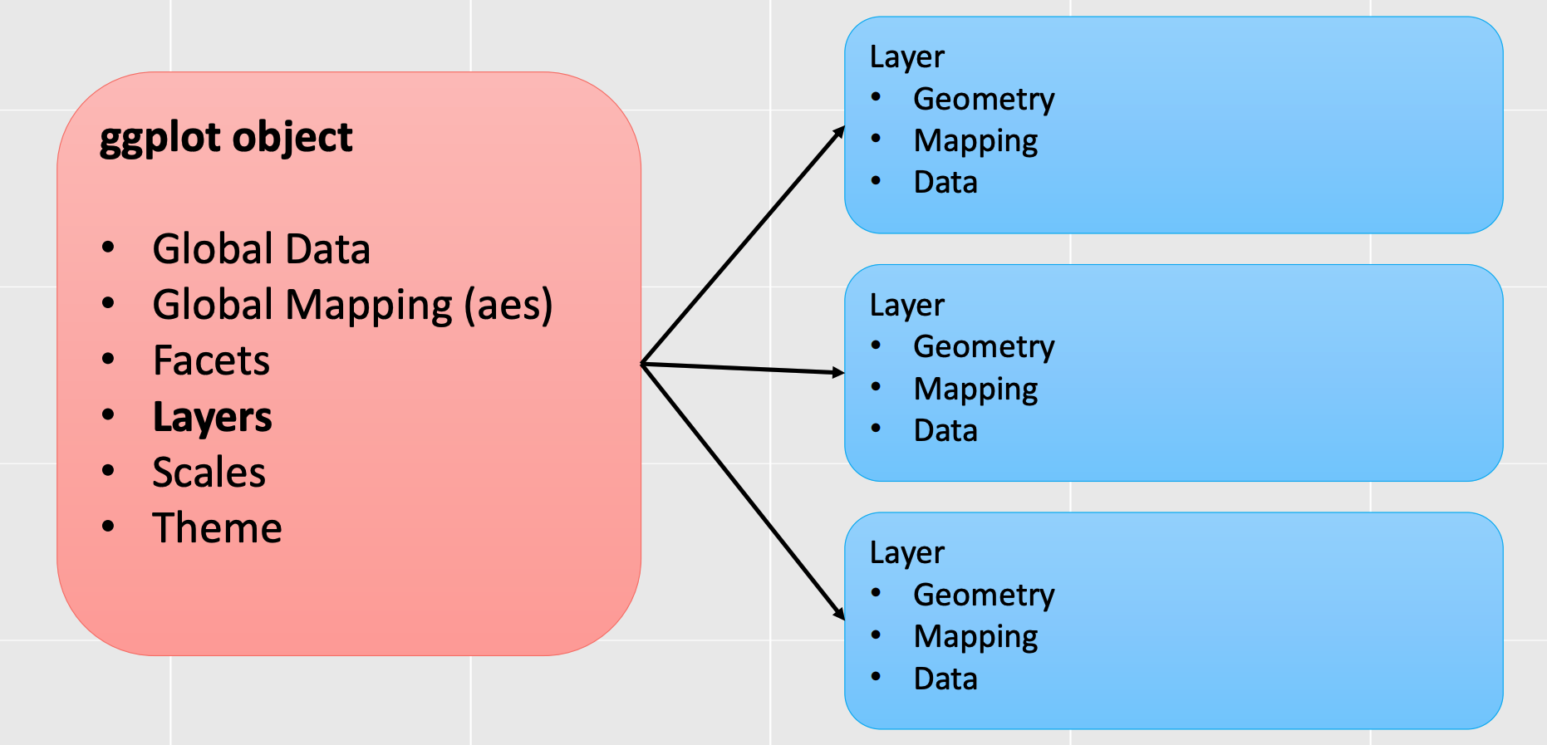
Global options vs layer options

Slide 55
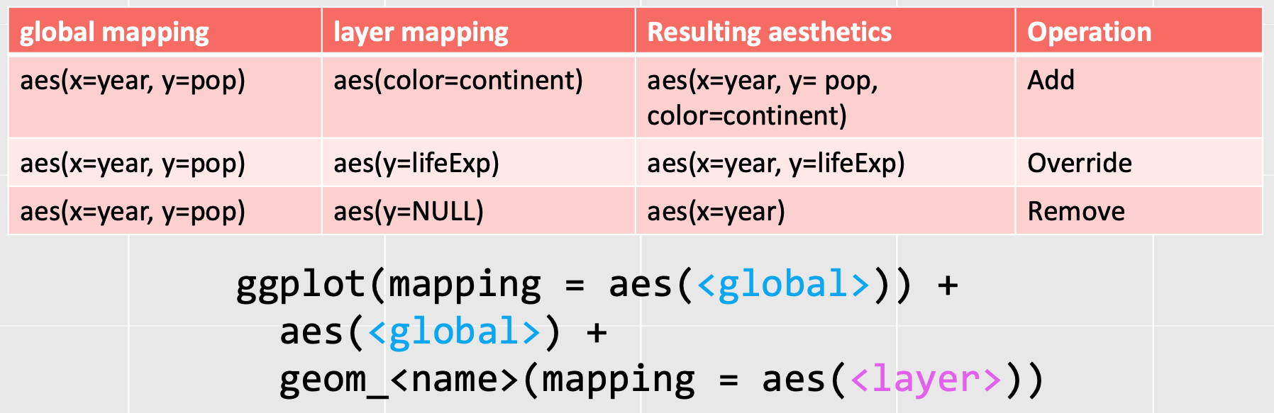
More about aes()
By default, layer aes() values are inherited from ggplot()
Disable inheritance with geom_<name>(…, inherit.aes = FALSE)
You may also add, override, or remove aes() values

Slide 56
What is the final mapping?
gapminder %>%
ggplot() +
aes(year, pop) +
geom_point(aes(y = gdpPercap)) +
aes(y = lifeExp)
a) aes(x = year, y = pop)
b) aes(x = year, y = country)
c) aes(x = year, y = gdpPercap)
d) aes(x = year, y = lifeExp)
What will be the final mapping of the points?

Slide 57
Different data for different layers
gap2007 = gapminder %>%
filter(year == 2007)
dlab = gap2007 %>%
filter(pop > 2e8)
gap2007 %>%
ggplot() +
aes(gdpPercap, lifeExp) +
geom_point(aes(size = pop, color = continent)) +
geom_text(aes(label = country), data = dlab)

Slide 58
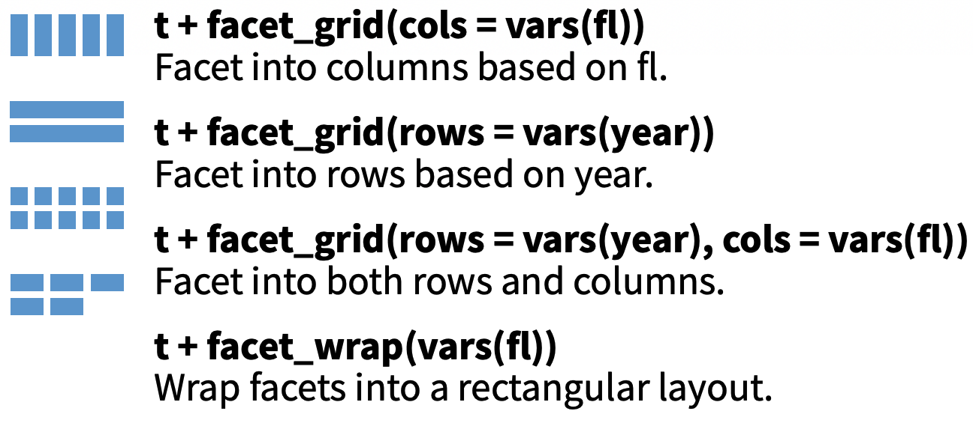
Faceting
Divide plot into subgroups and draw layers for each set
Two primary options:
Grid – up to two variables: one for rows, other for columns
Wrap – no panel structure
Each facet gets all layers
Each layer’s data split on
same variables

Slide 59
facet_wrap()
Requires list of column names wrapped in vars()
Each combination of columns gets its own panel
scales = options
”fixed” scales same in all
“free_x” x range can vary
“free_y” y range can vary
“free” domain and range can change for each panel
ncol = number of columns
gapminder %>%
filter(year == 2007) %>%
ggplot() +
aes(lifeExp) +
geom_density(fill = 'grey') +
facet_wrap(vars(continent))

Slide 60
facet_grid()
You can specify a list of column names wrapped in vars() to map to rows, cols, or both
Shares axis across panels
Results in “rectangular” output
p =
gapminder %>%
mutate(decade = year %/% 10 * 10) %>%
select(-year) %>%
group_by(continent, country, decade) %>%
summarize_all(mean) %>%
ggplot() +
aes(gdpPercap, lifeExp) +
geom_point()
p
p + facet_grid(vars(decade), vars(continent))
p + facet_grid(vars(decade))

Slide 61
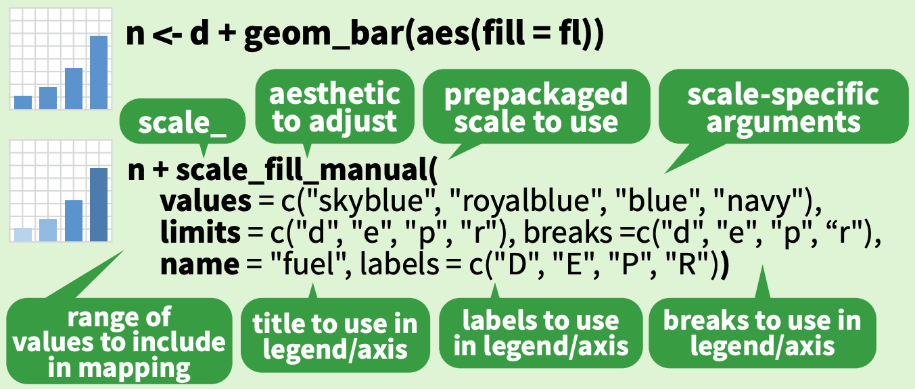
Scales
Scales describe how raw data values should be converted to aesthetic values
Default scales are determined by the class of the variables in your data
Each aesthetic (eg, color, fill, size, shape) can have at most one scale
Scales can have guides
Axes for positions
Legends for everything
else

Slide 62
Scales based on type
p = gapminder %>%
filter(country == 'United States') %>%
ggplot() +
aes(gdpPercap, lifeExp) +
geom_point()
p
p + aes(color = year)
p + aes(color = factor(year))

Slide 63
Manual scales
How can you manually scale the levels of the factor year to plot your own colors?
p = gapminder %>%
filter(country == 'United States', year > 1990) %>%
ggplot() +
aes(gdpPercap, lifeExp) +
geom_point()
p
p + aes(color = factor(year)) +
scale_<??>_<??>(values = ??)

Slide 64
Manual scales
How can you manually scale the levels of the factor year to plot your own colors?
p = gapminder %>%
filter(country == 'United States', year > 1990) %>%
ggplot() +
aes(gdpPercap, lifeExp) +
geom_point()
p
p + aes(color = factor(year)) +
scale_<??>_<??>(values = c('1992' = 'green', '1997' = 'red', '2002' = 'blue', '2007' = 'purple'))

Slide 65
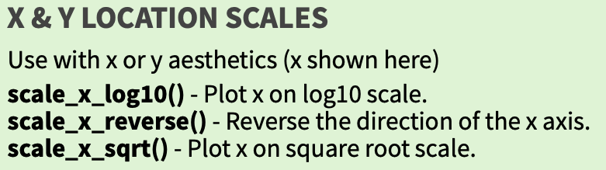
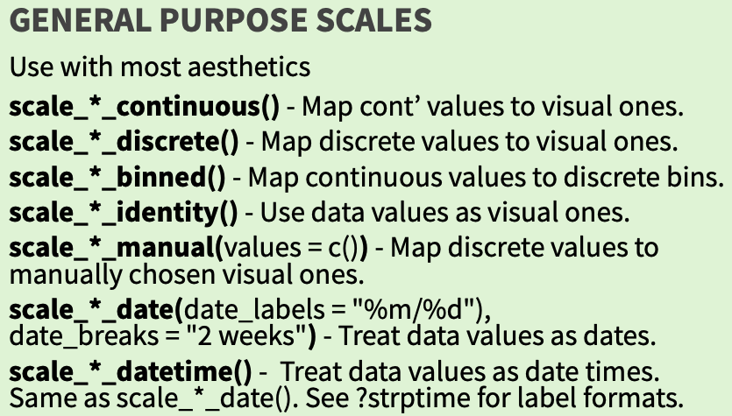
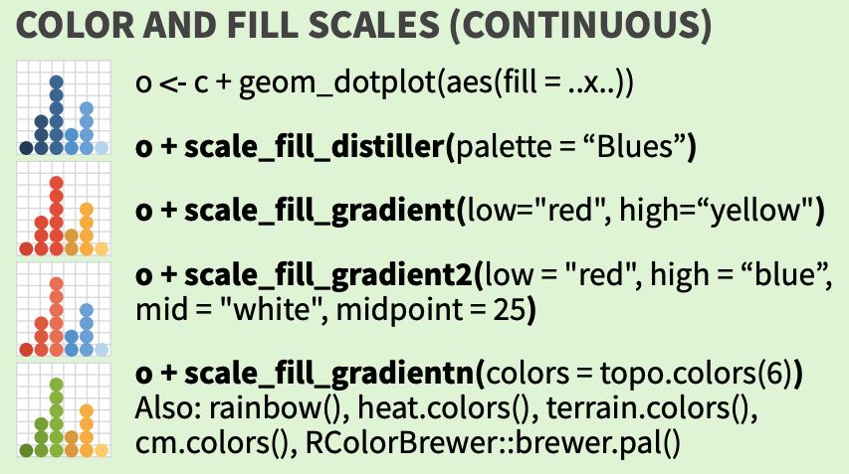
Some common scales

Slide 66
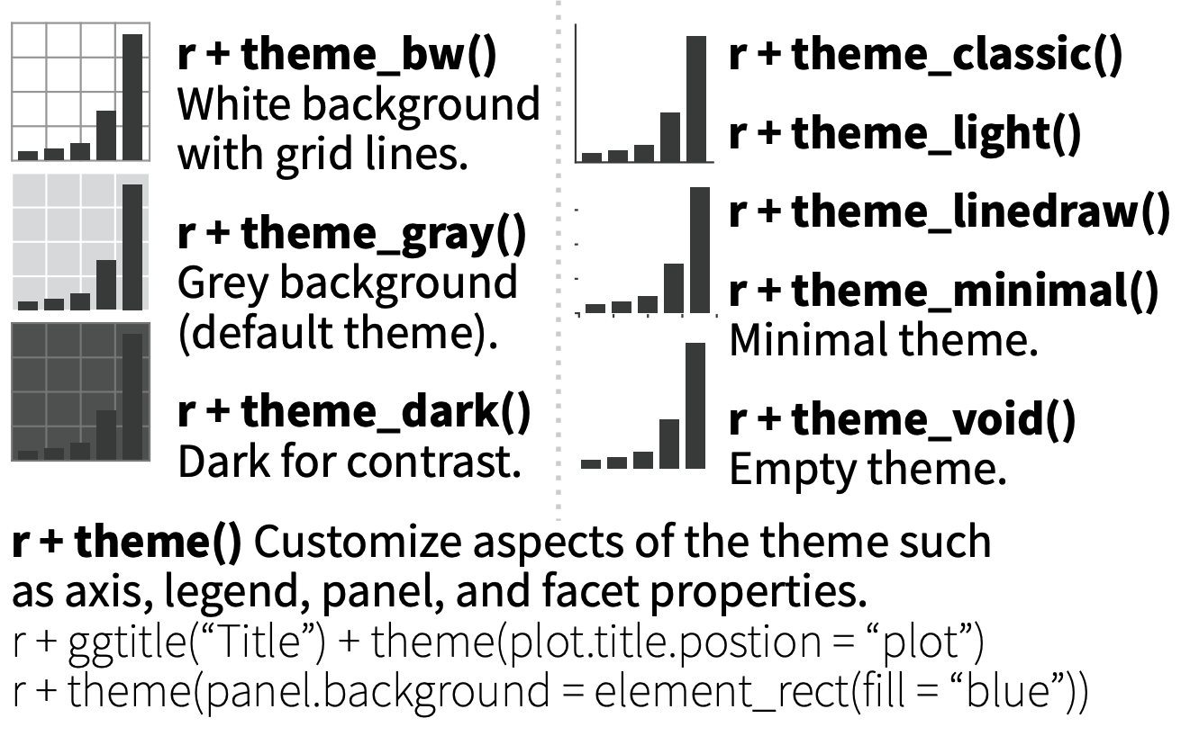
Themes

Slide 67
ggsave()
Once you’ve made your masterpiece, use ggave() to save it
Creates file in your current working directory (getwd()/setwd())
Saves last plot printed
Looks at filename to determine type
ggsave(‘plot.pdf’); ggsave(‘plot.jpg’)
Can also pass plot objects to save any plot:

Slide 68
Syntax Breakdown
Data set
ggplot(gapminder) +
aes(x = gdpPercap,
y = lifeExp,
color = continent,
size = pop) +
geom_point(.,
stat=STAT, position=POSITION) +
facet_wrap(vars(year)) +
coord_<>()
scale_<>_<>()+
theme()
Aesthetics (aes)
Required
Geometry (geom_)
Faceting
Coordinate system
Scales
Themes

