Slide 1
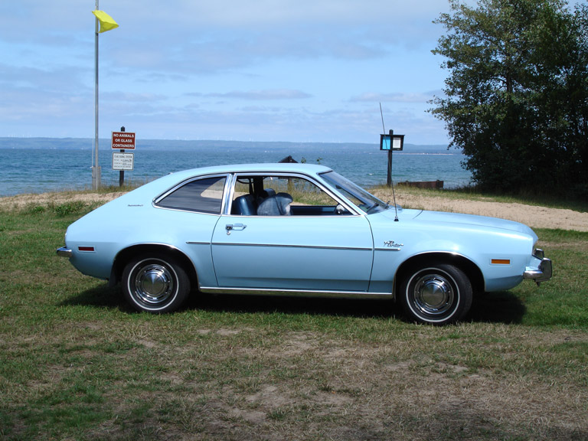
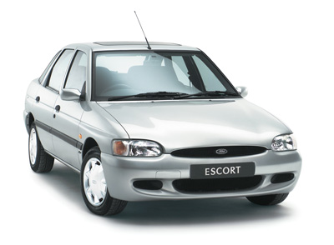

Watermelon 0.1
Purpose of this release
Change everything under the hood; recapitulate the old pipeline
Learn the old pipeline
Learn the new technologies
Implement sustainable development practices
Notes:
abhasi

Slide 2
Legacy -> Watermelon did change some things
 | Legacy | Watermelon
# scripts | 26 | 15
~ Lines of Code “main” | 2400 | 600
~ Lines of Code total | 6400 | 3200
Automated tests | 0 | 150
More modularity in implementation and results
Better parallelization
Better restartability (errors, crashes)
Simpler config for multiple analyses
(Slightly) better reports [flipped comparisons, run details]
Version control, automated tests, paired development
Positioned to add new capabilities
Notes:
cgates

Slide 3
Release
Functionality
Genomes
SE analysis
QC (Fastqc)
Quality and end trimming (Cutadapt)
Genome + Transcriptome alignment (Tophat)
ReadCounts (HTSeq)
Gene and isoform differential expression (Cuffdiff, Cummerbund)
Cuffdiff Excel files (now flipped!)
Testing and release
Stranded
Multiple phenotypes support
Version 0.1
hg19
mm10
Comp3
Comp5
Release:
2/6/2017
Gene differential expression(DESeq2)workflow (in progress)
DESeq2 report/plots (in progress)
Support for concat reads
Paired-end analysis
Bug fixing
iPathwayGuide results
GRCh37
GRCm38
Rn7, Rnor_6.0
Version 0.2
Release: TBD
Legacy retired
Module-based genome references/annotations
Continued support for cuffdiff
Research alternate isoform diffex
Adjusted intron length
Spec comprehensive experiment report
Extended support for multiple runs
Updated deliverable doc
Maintenance doc
ce10
WS195, Zv9
GRCz10, dm6
Version x
Flux
Other genomes
Better QC (FastQScreen,MultiQC)
Better alignment( STAR,HISAT2)
Better diffex (EdgeR, Limma, VOOM)
Better reporting (MultiQC, Comprehensive experiment report)
Version y
Notes:
abhasi

Slide 4
Lessons learned
It’s good that …
We are using Snakemake
We addressed multiple phenotype analyses
We deferred DESeq2
We hired CJ
Given hindsight, next time …
Shorter release cycle
More interim show & tells
More feedback from “Bridget”
Plan for unanticipated problems/opportunities
Notes:
cgates

Slide 5
Next steps & Questions
Rollout
Soft launch to Becky (and CJ, Rich)
Orientation next week
SE, human/mouse project in Watermelon
Continuing development
Add PE, DESeq2
Better setup (e.g. multiples seq runs)
Better progress monitoring
Support and bug fixes
General release March
Legacy retired
Notes:
abhasi

Slide 7
legacy
FastQ
samples.txt
comparisons.txt
config.ini
Command-line options
trimming
genomic/transcriptome alignment
watermelon-init
watermelon
FastQ
config.yaml

