Slide 1
Watermelon RNA-Seq Analysis
Watermelon interprets fastqs and configuration to produce alignments and diffex results.
Watermelon wraps Snakemake, which in turn wraps calls to the various bioinformatic tools in the pipeline (e.g. cutadapt, tophat, etc.).

Slide 2
Watermelon
Path to raw fastq
genome build name
watermelon-init
config.yaml
Watermelon

Slide 3
Dependencies
Path to raw fastq
genome build name
legacy
FastQ
samples.txt
comparisons.txt
config.ini
Command-line options
trimming
genomic/transcriptome alignment
watermelon-init
config.yaml
Watermelon

Slide 4
Watermelon tasks

Slide 5
Watermelon set-up
Load the watermelon module
$ module load watermelon
loaded watermelon/0.1
$ cd /ccmb/BioinfCore/SoftwareDev/projects/Watermelon_Demo/ActiveProjects
$ mkdir Tuttle_ctuttle_RS1_cgates_HI_1592
$ cd Tuttle_ctuttle_RS1_cgates_HI_1592

Slide 6
Run watermelon-init
Setup your analysis using: watermelon-init
$ watermelon-init –help
usage: watermelon-init [-h] --genome_build {hg19,mm10,rn5}
[--job_suffix JOB_SUFFIX]
source_fastq_dir
$ watermelon-init --genome mm10 ../../Run_1592/
$ tree
--------------------------------
. .
├── analysis_02_10
│ └── config_02_10.yaml
├── inputs
│ └── 00-multiplexed_reads
│ ├── Sample_61483 -> /ccmb/BioinfCore/SoftwareDev/projects/Watermelon_Demo/Run_1592/Sample_61483
│ ├── Sample_61484 -> /ccmb/BioinfCore/SoftwareDev/projects/Watermelon_Demo/Run_1592/Sample_61484
│ ├── Sample_61485 -> /ccmb/BioinfCore/SoftwareDev/projects/Watermelon_Demo/Run_1592/Sample_61485
│ ├── Sample_61486 -> /ccmb/BioinfCore/SoftwareDev/projects/Watermelon_Demo/Run_1592/Sample_61486
│ ├── Sample_61487 -> /ccmb/BioinfCore/SoftwareDev/projects/Watermelon_Demo/Run_1592/Sample_61487
│ ├── Sample_61488 -> /ccmb/BioinfCore/SoftwareDev/projects/Watermelon_Demo/Run_1592/Sample_61488
│ ├── Sample_61489 -> /ccmb/BioinfCore/SoftwareDev/projects/Watermelon_Demo/Run_1592/Sample_61489
│ └── Sample_61490 -> /ccmb/BioinfCore/SoftwareDev/projects/Watermelon_Demo/Run_1592/Sample_61490
└── watermelon.README
11 directories, 2 files

Slide 7
Run watermelon until cutadapt
alignment_results
$ watermelon --until cutadapt
diffex_results

Slide 8
Dry run watermelon
Gives you an overview of the job you will be running:
Validation
snakemake command
Tasks
Job counts
Conclusion
$ cd analysis_02_10
$ watermelon –c config_02_10.yaml --dryrun --until cutadapt
Notes:
Run cutadapt (-np) show the components
Run again –show nothing to be done

Slide 9
Run --until cutadapt
$ watermelon -c config_02_10.yaml --until cutadapt

Slide 10
Run the entire project
Edit config.yaml
The yaml file is not complete.
See watermelon.README (generated by watermelon-init)
Check if everything is set up right with --dryrun
Run watermelon

Slide 11
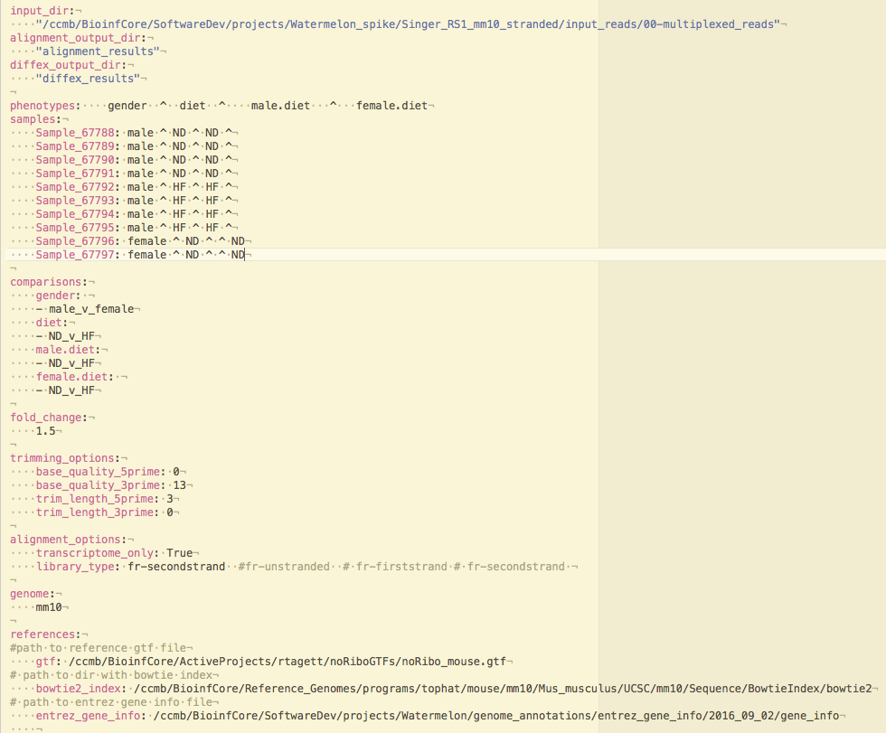
Edit config.yaml
For this workshop, use this edited config: /ccmb/BioinfCore/SoftwareDev/projects/Watermelon_Demo/example_config.yaml
Review/adjust phenotype names
Review and adjust samples names (Note: if you change names in config, also change the sample dir names in the input dir)
Add a phenotype group(s) for each sample
Add comparisons
Review genome and references
Review alignment options
Review trimming options

Slide 12
Run the entire project
Edit config.yaml
Check if everything is set up right with --dryrun
Run watermelon

Slide 13
Do the full analysis
From the analysis directory, start a screen session
$ screen -S ctuttle_rs1_02_01
Run watermelon with the --dryrun option to validate the config and check the execution plan.
$ watermelon --dryrun -c config_02_01.yaml
Run watermelon
$ watermelon -c config_02_01.yaml --cores 30
Detach from the screen (ctrl-A D) to ensure connectivity issues do not affect your analysis job.
You should receive an email when watermelon completes.

Slide 14
Review Results
Once the analysis is complete, you will get an email to your umich.edu account with the analysis status.
For a successful analysis:
--------------------------------
Watermelon complete: test_run_watermelon/analysis_02_01/config_02_01.yaml (No errors)
For a failed analysis:
--------------------------------
ERROR: Watermelon failed: test_run_watermelon/analysis_02_01/config_02_01.yaml
See logs for details: test_run_watermelon/analysis_02_01/logs/watermelon.log

Slide 15
Analysis Results
Results are in specific sub-directories.
‘alignment_results’ contains results for the following analysis steps:
Concat raw reads
Trimming
FastQC (before and after alignment)
Tophat
‘diffex_results’ contains results for the following analysis steps:
HTSeq
Cuffdiff
Excel files of differentially expressed genes and isoforms
CummeRbund
Deliverables

Slide 16
Logs
Timestamped logs are in the logs dir.
Watermelon.log contains the stdout and stderr of each step of the pipeline.
You can tail watermelon.log to view progress of the job. N.B. Snakemake parallelizes samples tasks where it can, so results from samples may be interleaved in this log.
Additional logs are available in each analysis sub-directory

Slide 17
Phased run with --until
To run watermelon only till alignment
Option 1 in Legacy
$ Watermelon --until alignment_deliverables
To run:
Option 2 (only diffex)
Option 3 (alignment + diffex)
Simply run watermelon
No specific arguments needed
Watermelon is intelligent enough to figure out the incomplete jobs and run them.

Slide 18
Troubleshooting
Lock error
use ‘--unlock’
incomplete run error
Delete the parent directory (e.g. diffex_results) that is showing incomplete files and re-run

Slide 19
Troubleshooting
Locking
Happens (sometimes) when you quit (Ctrl-C) in the middle of a job
Use --unlock
[abhasi@bfx-comp3 analysis_fewer_replicates]$ watermelon -c config_fewer_replicates.yaml
======================================================================
config validation: OK
======================================================================
Logging to logs/20170210_101308/watermelon.log
watermelon (v0.1) begins
snakemake --configfile config_fewer_replicates.yaml --snakefile /nfs/med-bfx-common/pipelines/Watermelon/Watermelon/rnaseq.snakefile --cores 40 -T
[Fri Feb 10 10:13:10 2017] Error: Directory cannot be locked. Please make sure that no other Snakemake process is trying to create the same files in the following directory:
/ccmb/BioinfCore/SoftwareDev/projects/Watermelon_spike/Tronson_RS1_tests/test_data/outputs/012017/test_run_watermelon/Demo_test1/test/analysis_fewer_replicates
If you are sure that no other instances of snakemake are running on this directory, the remaining lock was likely caused by a kill signal or a power loss. It can be removed with the --unlock argument.
Error: Directory cannot be locked. Please make sure that no other Snakemake process is trying to create the same files in the following directory:
/ccmb/BioinfCore/SoftwareDev/projects/Watermelon_spike/Tronson_RS1_tests/test_data/outputs/012017/test_run_watermelon/Demo_test1/test/analysis_fewer_replicates
If you are sure that no other instances of snakemake are running on this directory, the remaining lock was likely caused by a kill signal or a power loss. It can be removed with the --unlock argument.
elapsed seconds: 3
elapsed time: 0h:0m:3s
ERROR: Watermelon failed: /ccmb/BioinfCore/SoftwareDev/projects/Watermelon_spike/Tronson_RS1_tests/test_data/outputs/012017/test_run_watermelon/Demo_test1/test/analysis_fewer_replicates/config_fewer_replicates.yaml.
See logs for details: /ccmb/BioinfCore/SoftwareDev/projects/Watermelon_spike/Tronson_RS1_tests/test_data/outputs/012017/test_run_watermelon/Demo_test1/test/analysis_fewer_replicates/logs/20170210_101308/watermelon.log

Slide 20
Troubleshooting
--rerun-incomplete
Happens (rarely) when you quit (Ctrl-C) in the middle of a job and after you have unlocked your dir
Best practice (for now) : Delete the parent dir and restart watermelon
[abhasi@bfx-comp3 analysis_fewer_replicates]$ watermelon -c config_fewer_replicates.yaml --unlock
======================================================================
config validation: OK
======================================================================
Logging to logs/20170210_101553/watermelon.log
watermelon (v0.1) begins
snakemake --configfile config_fewer_replicates.yaml --snakefile /nfs/med-bfx-common/pipelines/Watermelon/Watermelon/rnaseq.snakefile --cores 40 -T --unlock
[Fri Feb 10 10:15:54 2017] Unlocking working directory.
IncompleteFilesException:
The files below seem to be incomplete. If you are sure that certain files are not incomplete, mark them as complete with
snakemake --cleanup-metadata <filenames>`
To re-generate the files rerun your command with the --rerun-incomplete flag.
Incomplete files:
alignment_results/03-fastqc_reads/reads_fastq.done
alignment_results/03-fastqc_reads/Sample_61492_trimmed_R1_fastqc.html
elapsed seconds: 3
elapsed time: 0h:0m:3s
Watermelon complete: /ccmb/BioinfCore/SoftwareDev/projects/Watermelon_spike/Tronson_RS1_tests/test_data/outputs/012017/test_run_watermelon/Demo_test1/test/analysis_fewer_replicates/config_fewer_replicates.yaml (No errors)
Delete ‘alignment_results’
Restart watermelon

Slide 21
Watermelon vs Legacy

Slide 22
Dependencies
Path to raw fastq
genome build name
legacy
FastQ
samples.txt
comparisons.txt
config.ini
Command-line options
trimming
genomic/transcriptome alignment
watermelon-init
config.yaml
Watermelon

Slide 23
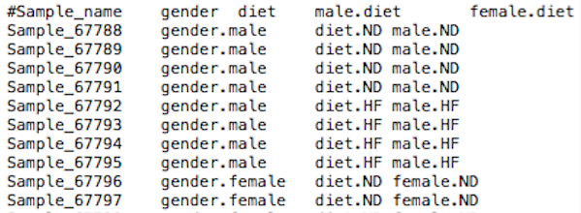
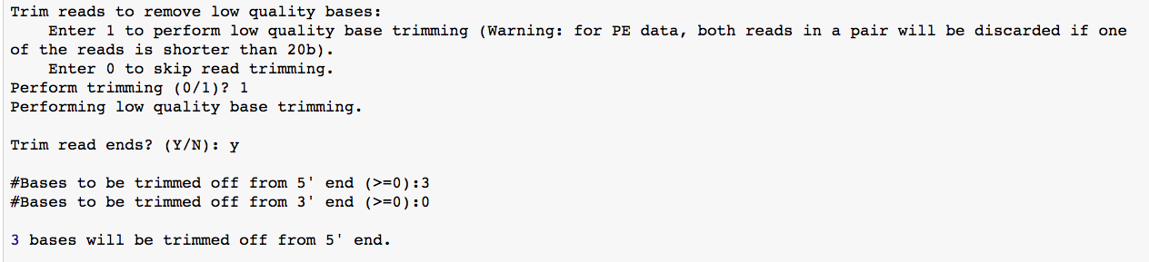
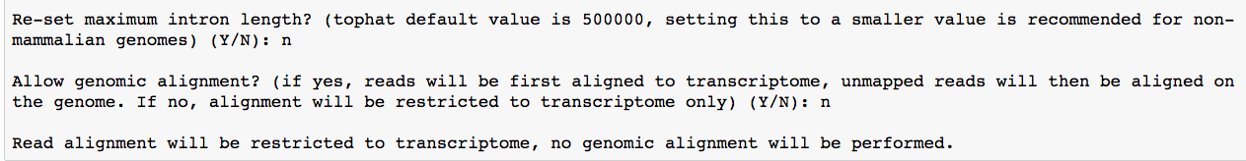
directory paths
samples.txt
comparisons.txt
#Label1 Label2
gender.male gender.female
diet.ND diet.HF
male.ND male.HF
female.ND female.HF
Legacy STDIN
Watermelon STDIN
[abhasi@bfx-comp5]$ watermelon –-cores 40
config.ini
baseDir =
projectName =
seqDir =
alnDir =
nProc = 30
genome =
refGenomeBTindex =
refGenomeSeq =
gtfFile =
novelTranscripts = 0
libraryType = 2
sampleInfoFile =
sampleCompFile =
collaborator =
Legacy STDIN
directory paths
reference
file paths
reference
file paths

Slide 24
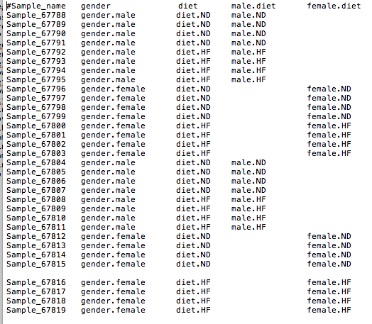

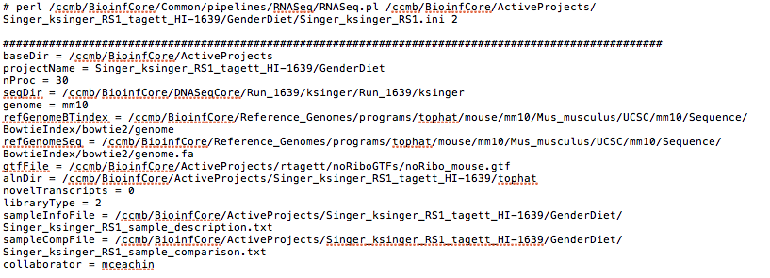
legacy
watermelon
samples.txt
comparisons.txt
config.ini
config.yaml

