Slide 1
Read/Split/Walk
Second Incarnation
Client: Justin Hassler

Slide 2
Agenda
Background
Conceptual approach
Implementation approach
Next Steps/Questions

Slide 3
Project Structure
Overall goal is to identify novel targets of the Ire1α ribonuclease by detecting deletion events that would be missed by an (ungapped) aligner.
Known target: Xbp1
Mouse model
RNA Seq, 109bp PE reads

Slide 4
Experimental Design
Replicate | Wildtype | Ire1α -/- | DTT-treated | Xbp1 -/-
1 | 21786 | 21788 | - | -
1 | 21787 | 21789 | + | -
2 | 21790 | 21792 | - | -
2 | 21791 | 21793 | + | -
3 | 21794 |  | - | -
3 | 21795 |  | + | -
4 |  |  |  | 21796
4 |  |  |  | 21797

Slide 5
Pipeline
Align original
reads
Bowtie1 on transcriptome
Unmapped Reads
Bowtie1 on genome
Unmapped Reads
Split
rejected reads
and re-align
split_read.py
Split Reads
Bowtie1 on transcriptome
Mapped Split Reads
Identify aligned
pairs and define
consensus gaps
identify_pairs.py
Mapped Split Read Pairs
cluster_gaps.py
Sample-Sample Mapped Split Read Pair Clusters

Slide 6
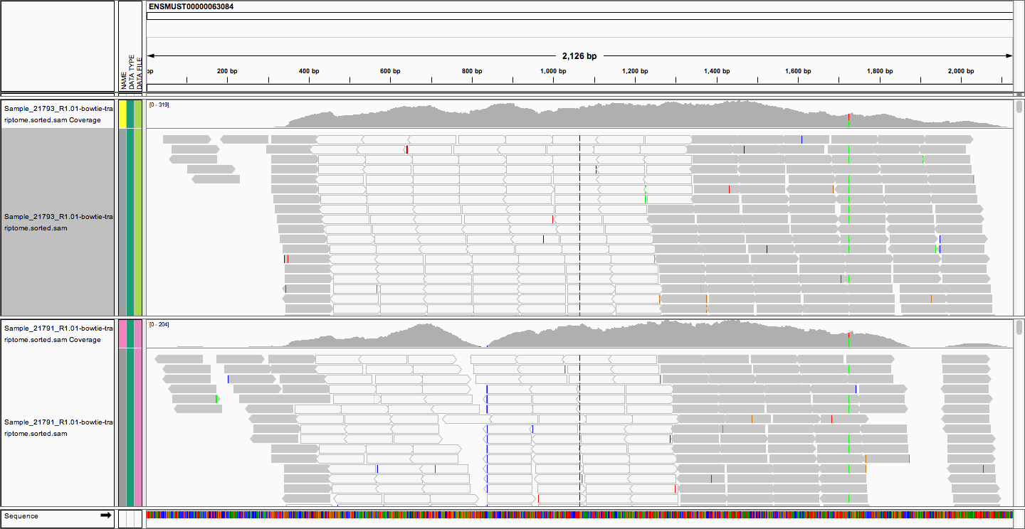
Most reads align – but some do not

Slide 7
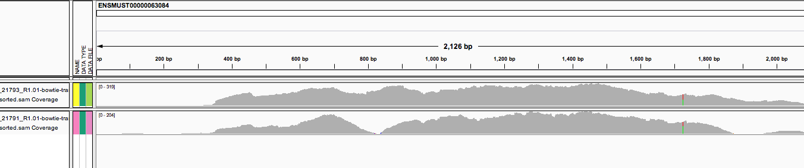
Reads that don’t align are cut into “split reads”
DNA
“Split” read in silico
Some “split reads” do align
mRNA (missing region)

Slide 8
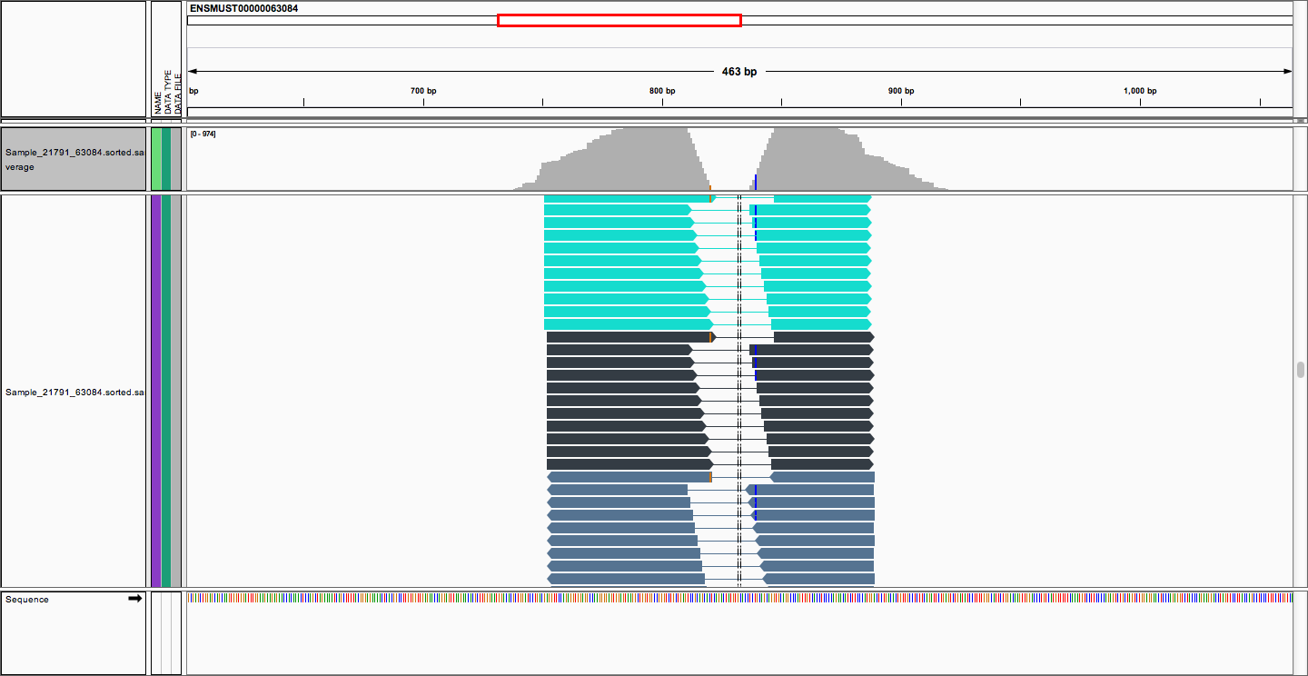
Some “split reads” align around gaps
Notes:
Note volcano coverage.
Note undulating gaps.

Slide 9
Identify_pairs: Sam format
…
@RG ID:Sample_21796 SM:Sample_21796
@RG ID:Sample_21797 SM:Sample_21797
@HD VN:1.0 SO:unsorted
HWI-D00196:21:H0DC6ADXX:1:1101:11217:4035_1:N:0:TAGCTT-L-33 147 ENSMUST00000034774 4489 255 76M = 4573 84 CCCTGGTAGATGCACTGTGATAGGGAGCCTCTGTTTCTTACATCAGCACCTACACACACACACACACACACACACA 3BCA@>>ADC@:C@C>>CC>:C?8BA?1::CC:C@C@B;-@C>C@>;;EA?;EBFHHHHEGEHFIHHHHHIHHGGF XA:i:0 MD:Z:76 NM:i:0 RG:Z:Sample_21786 XC:i:1 XR:Z:HWI-D00196:21:H0DC6ADXX:1:1101:11217:4035_1:N:0:TAGCTT
HWI-D00196:21:H0DC6ADXX:1:1101:11217:4035_1:N:0:TAGCTT-L-33 115 ENSMUST00000034774 4573 255
33M = 4489 -84 CACACACACACACACACGCACGCACCTCCCAAC HHIHHGHHIHHGHHIHIGIHHHHFHFFFFFCCC XA:i:0 MD:Z:33 NM:i:0 RG:Z:Sample_21786 XC:i:1 XR:Z:HWI-D00196:21:H0DC6ADXX:1:1101:11217:4035_1:N:0:TAGCTT
-HWI-D00196:21:H0DC6ADXX:1:1101:11217:4035_1:N:0:TAGCTTL-34 147 ENSMUST00000034774 4489 255 75M = 4572 83 CCCTGGTAGATGCACTGTGATAGGGAGCCTCTGTTTCTTACATCAGCACCTACACACACACACACACACACACAC 3BCA@>>ADC@:C@C>>CC>:C?8BA?1::CC:C@C@B;-@C>C@>;;EA?;EBFHHHHEGEHFIHHHHHIHHGG XA:i:0 MD:Z:75 NM:i:0 RG:Z:Sample_21786 XC:i:1 XR:Z:HWI-D00196:21:H0DC6ADXX:1:1101:11217:4035_1:N:0:TAGCTT
HWI-D00196:21:H0DC6ADXX:1:1101:11217:4035_1:N:0:TAGCTT-L-34 115 ENSMUST00000034774 4572 255 34M = 4489 -83 ACACACACACACACACACGCACGCACCTCCCAAC FHHIHHGHHIHHGHHIHIGIHHHHFHFFFFFCCC XA:i:0 MD:Z:34 NM:i:0 RG:Z:Sample_21786 XC:i:1 XR:Z:HWI-D00196:21:H0DC6ADXX:1:1101:11217:4035_1:N:0:TAGCTT

Slide 10
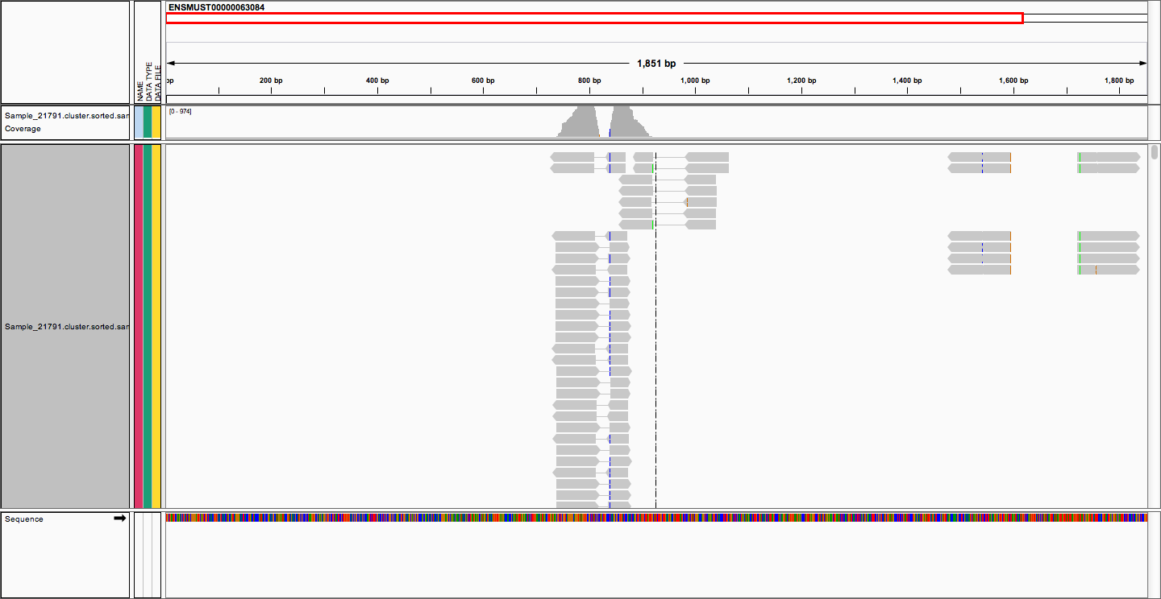
How many gaps can you find?

Slide 11
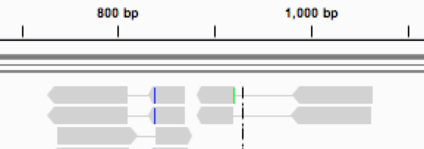
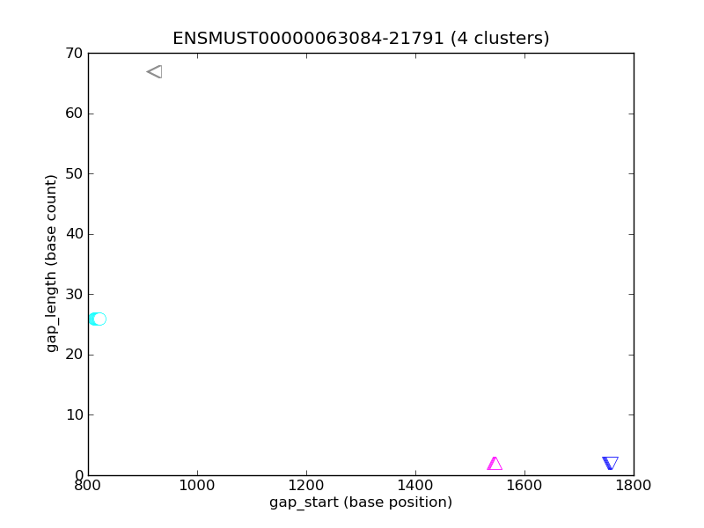
Unsupervised density cluster by gap start, gap length

Slide 12
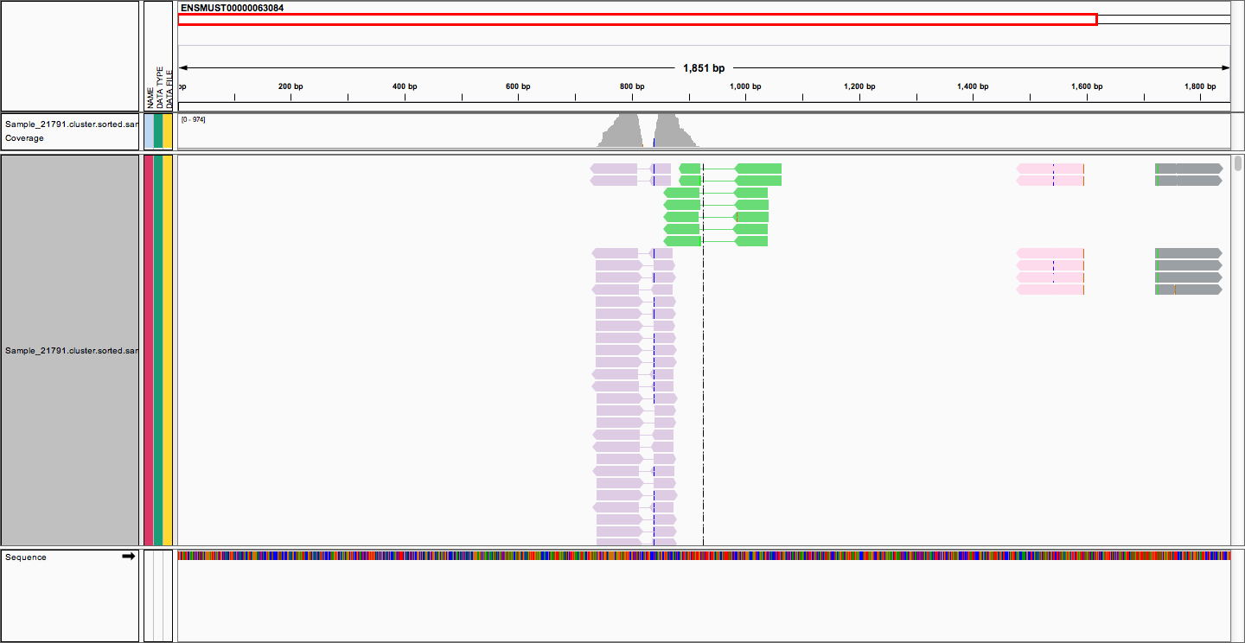
Unsupervised clusters define the gaps
Notes:
ENSMUST00000012259
ENSMUST00000000305
ENSMUST00000063084

Slide 13
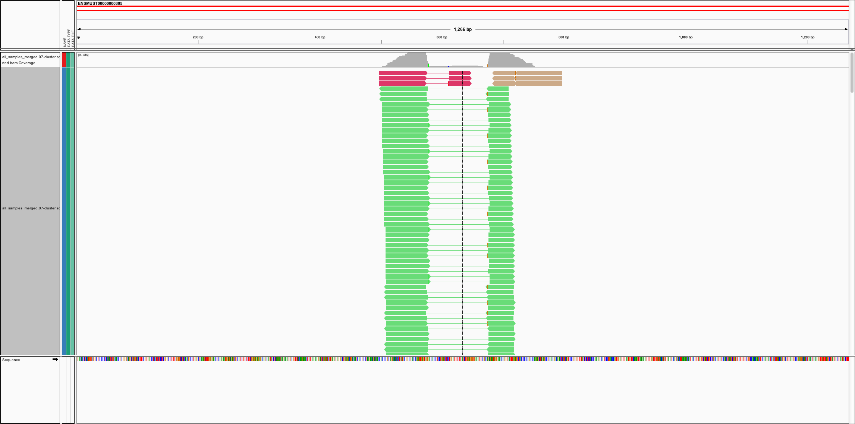
New candidate

Slide 14
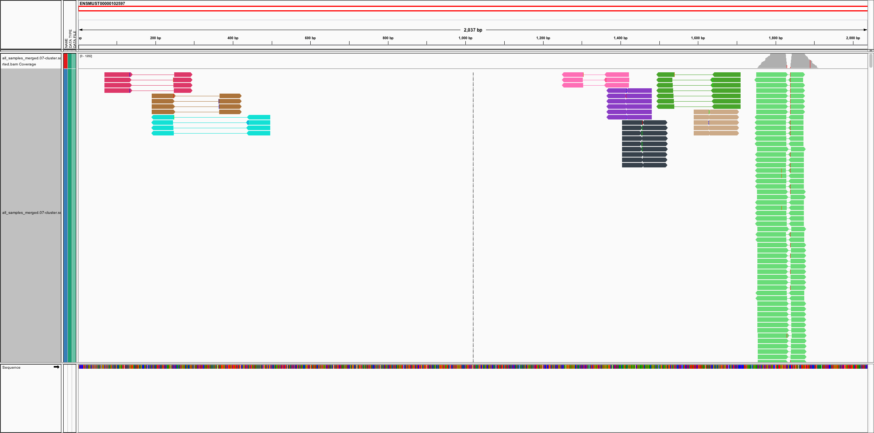
New Candidate, Color by Cluster

Slide 15
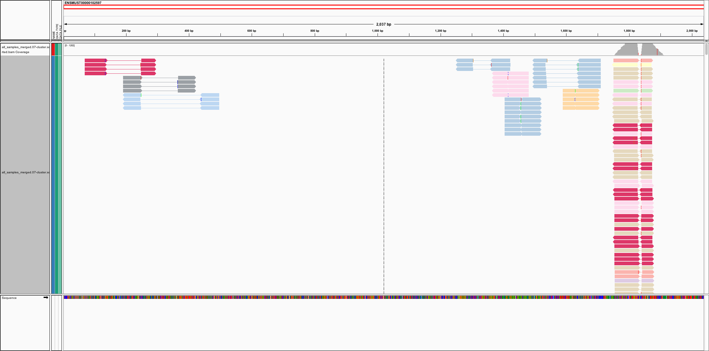
New Candidate, Color by Sample

Slide 16
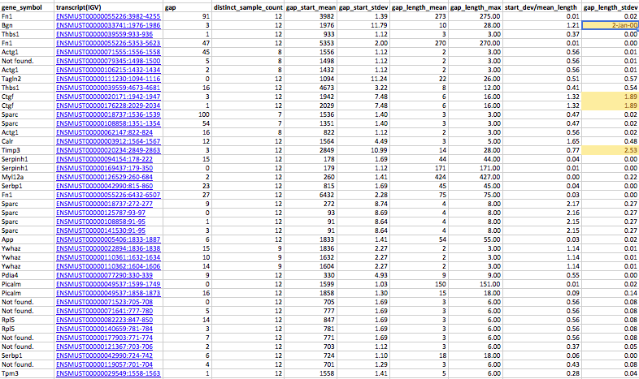
Gap details

Slide 17
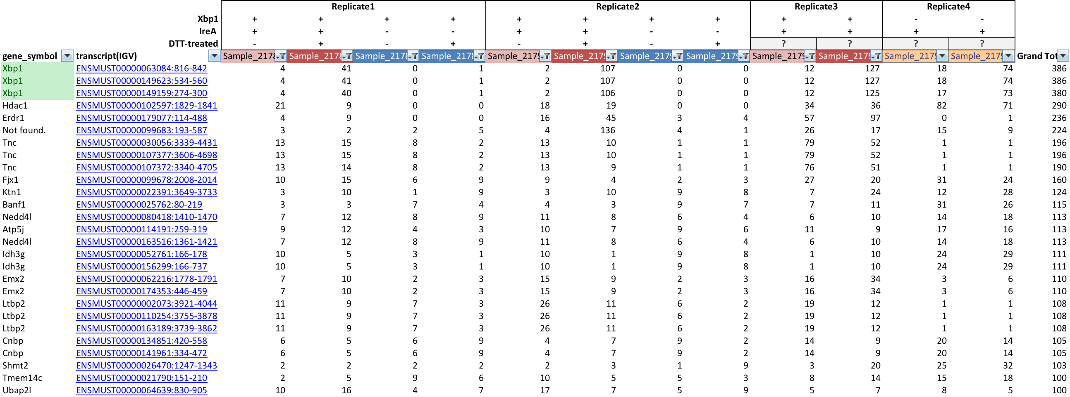
Simple sorting/filtering surfaces candidates

Slide 18
Implementation
Bash/Python
bowtie1
bedtools
SAMTools
DBSCAN clustering
TDD
Github/TravisCI
SAM/BAM files, IGV

Slide 19
Next Steps
Deliver data
Orientation on new data, methods, tools
Application note?
Considerations:
Tophat does something similar
There are pair-aware indel callers that would also do something similar

Slide 20
Questions/Reflections

