Slide 1
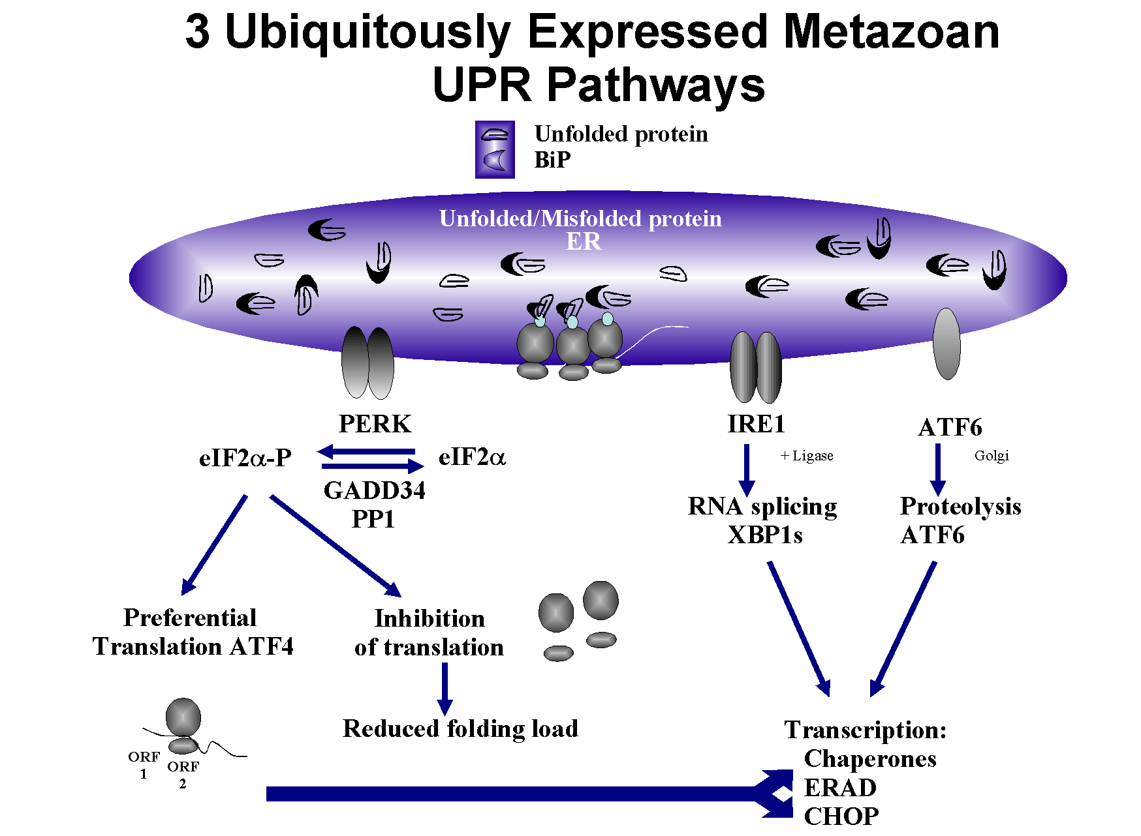

A Novel Algorithm for Identifying Non-canonical
Splicing Regions Using RNA-Seq Data
Yongsheng Bai¹, Zach Wright¹, Justin Hassler², Randal J. Kaufman^{2,3}, Maureen Sartor^{1,4}, and James D. Cavalcoli¹
¹ National Center for Integrative Biomedical Informatics, and Center for Computational Medicine and Biology,
² Department of Biological Chemistry, ³ Department of Internal Medicine, ⁴ Department of Biostatistics, University of Michigan, Ann Arbor, MI 48109
Abstract
During ER (endoplasmic reticulum) stress, the RNase Ire1α is known to splice out a short 26nt region from the mRNA of the transcription factor Xbp1, causing an open reading frame-shift that leads to the alteration of many downstream genes in reaction to ER stress. With the aim of identifying additional Ire1 targets, we developed an algorithm/pipeline to identify non-canonical splicing regions using RNA-Seq data from ER stress induced (using 2 alternative ER stress inducing treatments) Ire1α heterozygote (Het) and knockout (KO) mouse embryonic fibroblast cell lines.
Results
2. Comparison of different statistical
methods for testing differential
Expression
Change in coverage at Xbp1's unconventional intron
Xbp1 “grep” results for unmapped reads
Thapsigargin treated sample
Our algorithm first creates the splice junction file using the UCSC mouse “known genes” model and ERANGE custom Python scripts. The expanded genome is then built and aligned for original read sequences generated from Illumina GAII pipeline by Bowtie. The original reads deposited in Bowtie’s unmapped read data set are split and realigned to the same expanded genome. Our algorithm only chooses split read halves if they are mapped onto the same gene structure and/or within a certain distance. Finally, all of the selected read halves for each single read are consolidated into a unique “splice region”. Our algorithm additionally reports whether the detected splice site falls into a known junction region or it belongs to a novel candidate.
Het
Fo/+ - 500nM Thapsigargin 4hrs.
MEFS
Fo/Fo : 500nM
Thapsigargin 4hrs.
KO
Dithiothreitol treated sample
Region Displayed
Novel splice junction detection result for Xbp1 detected by our “RSW” algorithm
Xbp1’s 26 bp non-conventional splice site was detected in heterozygote samples from both treatment cases but not in the negative control Ire1α knock-out samples. We believe our algorithm/pipeline can detect novel splicing sites in RNA-seq data generated under similar conditions.
Methods
Experimental design
Criteria used
Two RNA-Seq experiments:
Ire1(+/-) vs Ire1(-/-) in Thapsigargin treated MEF (mouse embryonic fibroblast) cells
Single read with 35 bp read length
Ire1(+/-) vs Ire1(-/-) in Dithiothreitol treated MEF (mouse embryonic fibroblast) cells
Single read with 79 bp read length
Thapsigargin and/or Dithiothreitol are expected to cause a stronger unfolded protein response (UPR) due to inhibition of the endoplasmic reticulum (ER) in the Ire1(+/-) treated cells.
A total of 4 lanes were used. No biological replicates were performed.
Trim off the last 2 bases of every read before split
Require two split halves mapped within 40kb distance, and their mappings match on the same same chromosome together with matched gene
Bowtie (version 0.12.7) parameters: -k 11, -m 10, -v default or 2 (0 in the split read alignment step), --best
For split read pairs, we keep reads having their mappings less than a certain number of locations (i.e. <=10) given current bowtie input criteria
For the criteria of reporting a gene whether it is “present” in Het but “absent” in KO, we:
Prioritize genes having > 1 split pairs mapped in Het
No split read pair mapped at all for this gene, or having some split read(s) mapped in KO but not in the same splice region with Het sample
“READ SPLIT WALK (RSW)” ALGORITHM
Step 2
Step 1
Sequence read files generated from Illumina GAII pipeline (s_*_sequence.txt AND s_*_sequence.txt)
Select mapped split pairs meeting the criteria of within 40kb range and on the same chromosome/strand (done by SQL query)
Remove inversely mapped pairs which are false positives and filter out adjacent read pairs (splice region length < 2 bp). The splice region is defined as the interval between the nearest ends of two split halves from the same read
Align the original reads against reference genome + known splice junctions
Unmapped reads
Bowtie
Split reads into halves and realign split pairs with no mismatch allowed
Read 2
L18
R15
Read 2
L17
R16
Read 2
Read 2
L16
R17
L18
R15
Read 2
L17
R16
Read 1
Read 2
L18
R15
L16
R17
Read 1
L17
R16
Read 1
Read 1
L16
R17
L18
R15
Read 1
Read 1
L15
R18
Alignable reads
L17
R16
Read 1
L16
R17
Read 5
Read 1
L15
R18
Read 5
L15
R18
EXON 1
> > > > > >
EXON 2
EXON 1
> > > > > >
L15
R18
Gene A
EXON 2
Read 4
R16
L19
L17
R14
Read 3
Read 4
Gene A
Cluster/consolidate “equivalently” mapped reads into unique splice regions
L19
R14
Check/map whether identified regions are from known junctions or they belong to novel ones
Merge both of results from treated and control samples side-by-side for visual comparison if their splice boundaries are similar (allows 5bp shift from both directions)
Step 3
R16
L17
Read 3
Step 4
Splice Region
approximated from both reads
Read 2
L18
R15
Read 2
L17
R16
Read 2
Supported by two reads
L16
R17
Read 1
Region determined in the Het sample
L18
Splice Length
R15
Read 1
L17
Splice Region
determined from Read 1
R16
Read 1
Considered as the same region
Max 5bp
L16
R17
Read 1
Region determined in the KO sample
L15
Max 11bp
Max 11bp
R18
EXON 1
> > > > > >
EXON 2
EXON 1
> > > > > >
EXON 2
Gene A
R16
L17
Read 3
Gene A
Conclusion
Xbp1’s 26 bp non-conventional splice site was detected in heterozygote samples from both treatment cases but not in the negative control samples.
References
1. Langmead B, Trapnell C, Pop M, Salzberg SL. Ultrafast and memory-efficient alignment of short DNA sequences to the human genome. Genome Biol 10:R25.
Acknowledgements
This work was supported by National Institutes of Health: Grant #U54 DA021519 and CCDU funds

