Slide 1
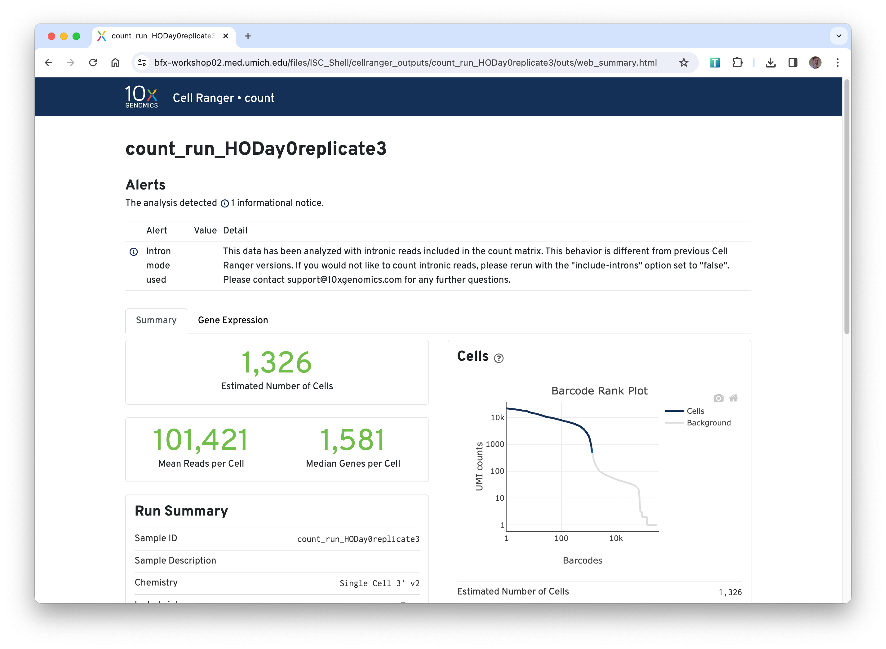





(10x) FASTQs
cellranger
Reference
Files
Supporting
output files

Slide 2
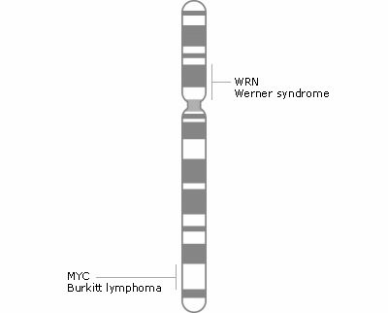

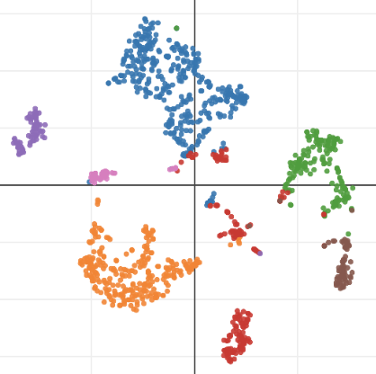
A
B
STAR*
Cell
Barcode
UMI
C
F
E
 | c1 | c2 | c3 | c4
g1
g2 |  | 25
g3
g4
✅
D
❌
Notes:
1. For each sequence in the FASTQ, read the barcode and UMI, and the transcript sequence.
1. Align the transcript sequence to a genome reference.
1. For each transcript that falls in a gene, count the pile-up of sequences
aligned to each gene.
1. Uses a cell-calling algorithm to distinguish putative cells from background [[3,4]](#References)
1. Combine sample-gene counts into a matrix of feature x barcode x counts (AKA the
count table or the count matrix).
1. Clusters the called cells based on differential expression patterns.

Slide 3
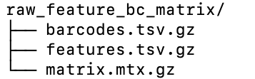
barcodes.tsv.gz
CCTGAGAGAACAG | CCTGGTCATGCAT | CCTGTCAGAGCTT | GGGAGAGACTTA | … | GTCACATGACATC
gene1
gene2
gene3
…
gene X
matrix.mtx.gz
features.tsv.gz
Notes:
The feature barcode matrix

Slide 4
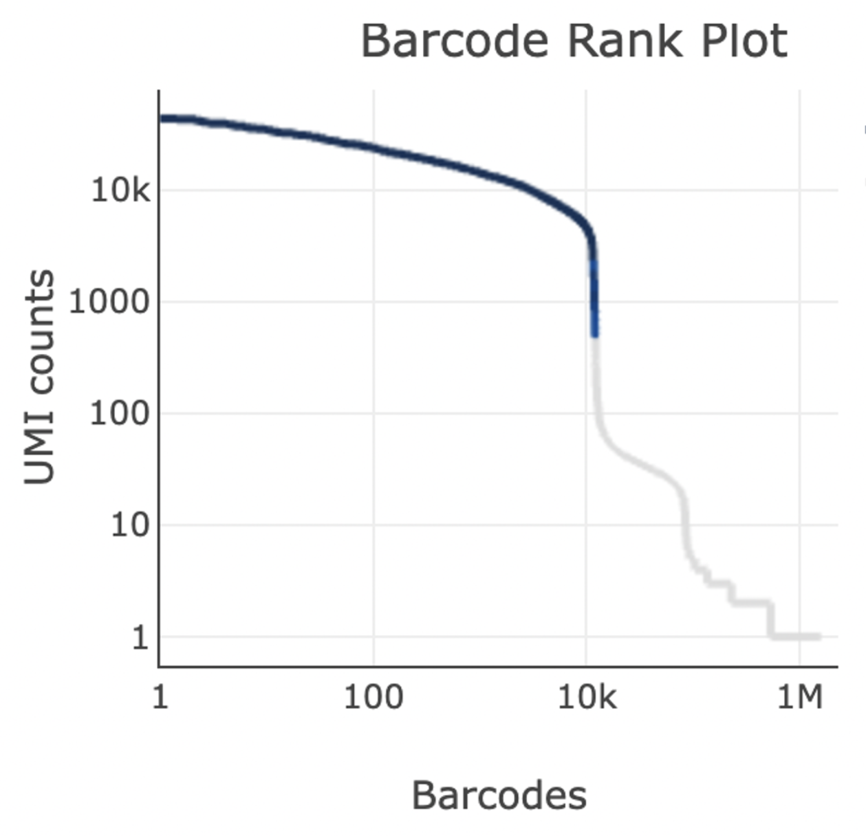
Filtered matrices
Unfiltered matrices

