Slide 1

Making Database Systems Usable
H.V. Jagadish
Univ. of Michigan
with Adriane Chapman, Aaron Elkiss, Magesh Jayapandian, Yunyao Li, Arnab Nandi and Cong Yu

Slide 2
What DBMS Can Do
Manage very large data.
Run complex queries efficiently.
Support sharing and consistency.
Provide durable storage.
Triggers
Integration
…

Slide 3
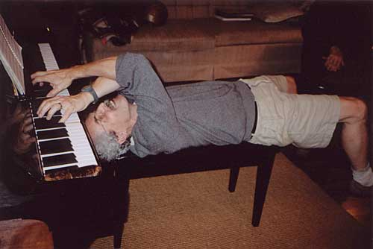
But they are very hard to use

Slide 4
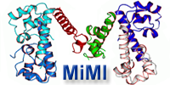
Context
We have been working with biologists in recent years, helping them to integrate, model, and query data.
Specifically, we have developed MiMI, an integrated database of protein interactions.
http://mimi.ncibi.org
Nucleic Acids Research 07

Slide 5
Outline
Some challenges we have tackled
A research agenda for the future

Slide 6
Challenges
Unknown Query Language
Unknown Schema
Complex Schema
Unknown Data Values
Unknown Provenance

Slide 7

Challenge: Unknown Query Language
for $a in doc()//author,
$s in doc()//store
let $b in $s/book
where
$s/contact/@name = “Amazon” and $b/author = $a/id
return { $a/name, count($b) }
$a ??
What is let?
Do I need a semi-colon?
How do I start writing a query?

Slide 8
Challenge: Unknown Query Language
Solutions:
  Forms
  Natural Language Query

Slide 9
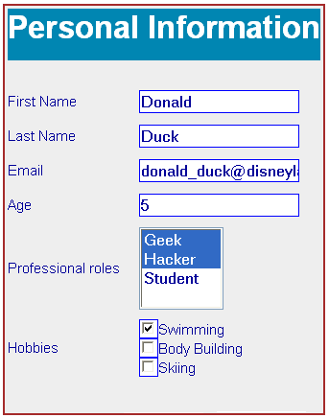
Forms: Magesh Jayapandian
Simple, but limited.
How to create a good set of query forms?
Can we let a user modify a form that “almost” does the desired thing?
ICDE 06
Tech report

Slide 10
Natural Language Query:
Yunyao Li
A generic interface supporting English queries to a database.
Follow Up Queries: conversational iterative specification of queries.
Add Domain Knowledge learning component to improve the generic interface.
SIGMOD 05
(Best Demo)
EDBT 06
TODS 07
SIGMOD 07
(Demo)
AAAI 07

Slide 11
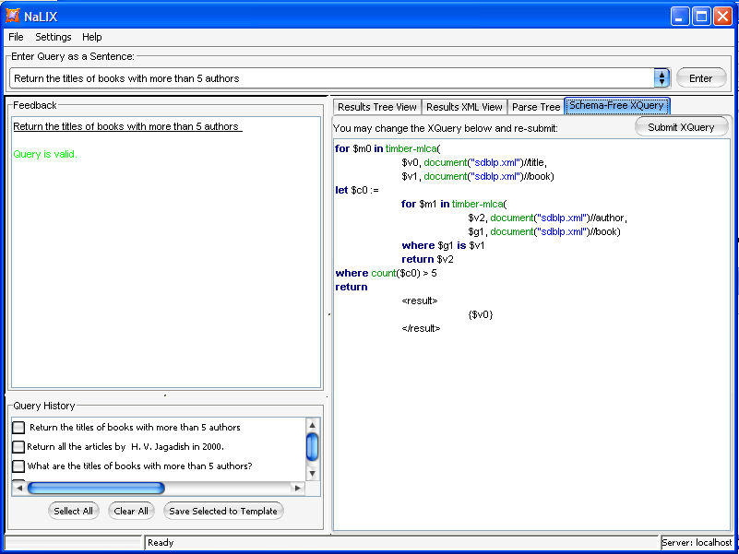
Example – Nesting
Q: Return the titles of books with more than 5 authors.

Slide 12
Challenges in Natural Language Querying
• Challenge 1:
Understand user intent given an arbitrary natural language query.
• Challenge 2:
Map user intent to database schema.
  Is “Gone with the wind” a book or a movie (or a person)?
  Are books grouped by year or by author in the bibliography?

Slide 13

Challenge: Unknown Schema
Aaron Elkiss, Yunyao Li, Cong Yu
warehouse
state*
for $a in doc()//author,
$s in doc()//store
let $b in $s/book
where
$s/contact/@name = “Amazon” and $b/author = $a/id
return { $a/name, count($b) }
authors
@name
store*
warehouse
author*
contact
book*
@id
@name
@name
isbn
price
@address
title
author*

Slide 14
Schema-Free XQuery
  Enable users to query XML data by exploiting whatever partial knowledge of the schema they have: support wide range of queries - from regular XQuery to keyword search.
  Extended from Boolean notion of correctness to a notion of “ranked relatedness”, permitting seamless transition to IR-style querying.
VLDB 04
VLDBJ 06
Tech Report

Slide 15
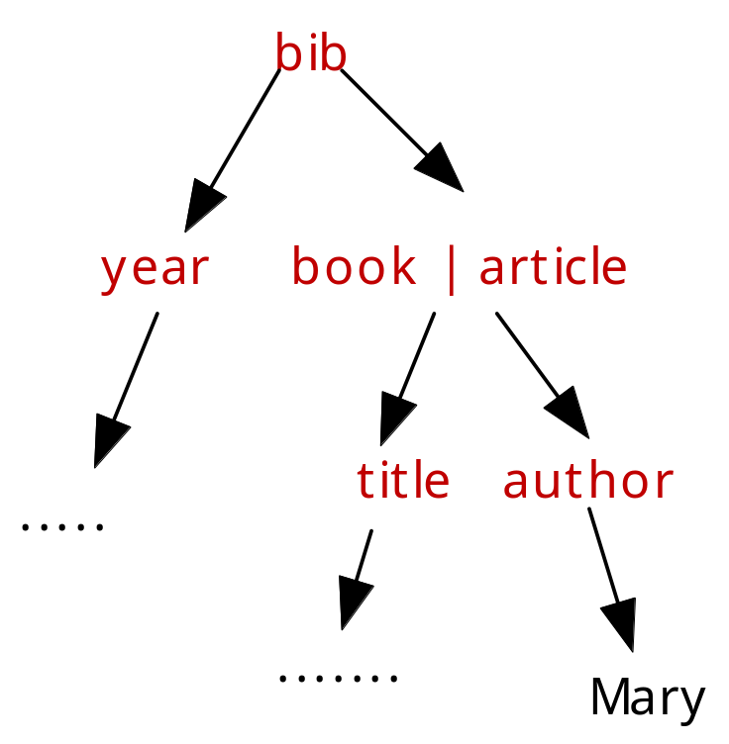
Traditional Query Focus
Knowing the document structure, the user can specify in XQuery HOW the nodes are related in terms of structural relationship:
for $b in doc(“bib.xml”)/bib
for $c in $b/book or $b/article
where $c/author = “Mary”
return {
<result>
$c/title
$b/year
</result>
}

Slide 16
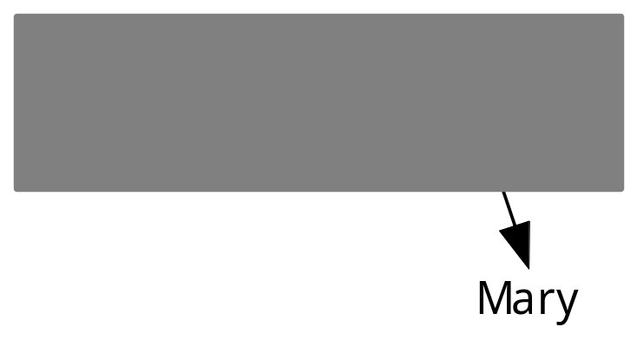
Schema-Free Query Focus
Without knowing the document structure, the user can still specify WHICH nodes should be meaningfully related:

Slide 17
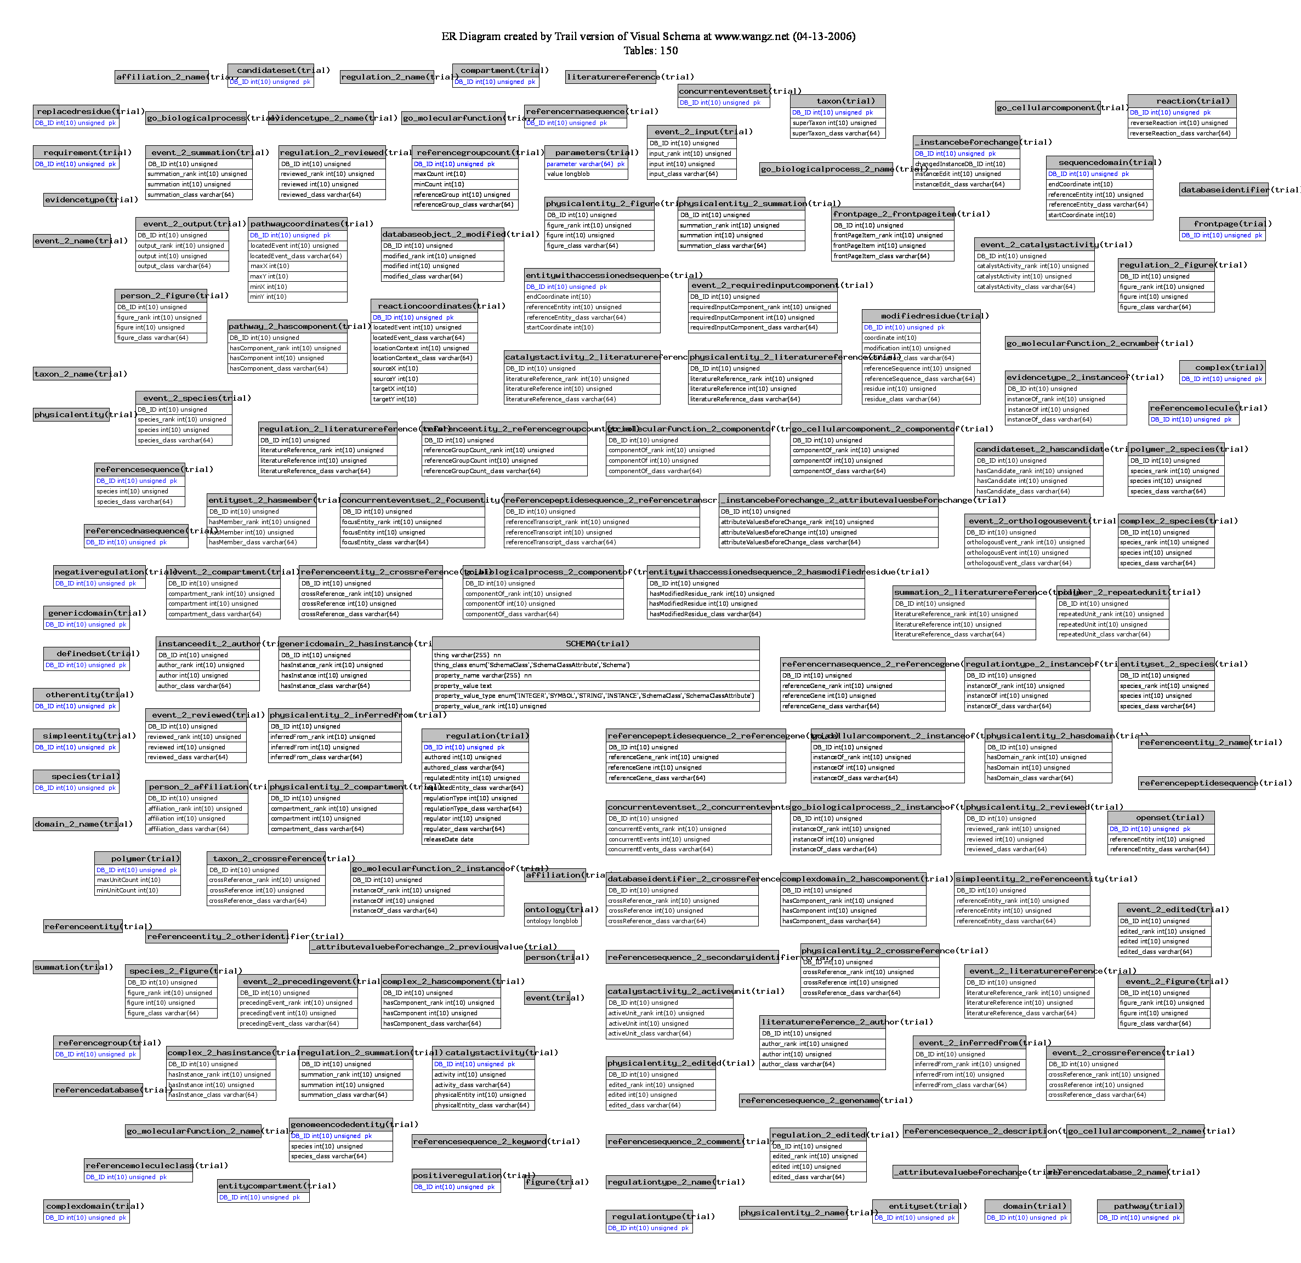
Challenge: Complex Schema
Source | Type | # of Elements
BioWarehouse | Relational | 382
MiMI | XML | 289 and counting
Reactome | Relational | 679
MAGE-ML | XML | 1,581
ATDG | Relational | 2,177

Slide 18
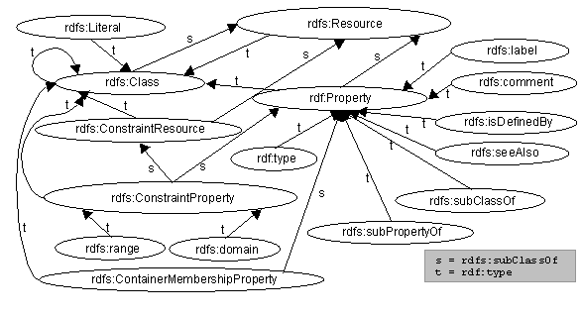
Schema Summarization: Cong Yu
Schema are often too large and too complex.
Can we present the user with an informative summary?
Can the user effectively query the database using this summary alone?
VLDB 06
VLDB 07

Slide 19
Schema Summarization
Basic Idea:
  Represent the original complex schema with a smaller and conceptually simpler schema – a summary of the original schema.
  Each element in the summary naturally corresponds to a subschema of the original schema.
Helps users explore the schema:
  Illustrates the main topics of the database.
  Filters away irrelevant parts of the schema.

Slide 20
Schema Summary
warehouse
Summary is a schema:
  Contains abstract elements and abstract links;
  Smaller in size.
Abstract element:
  Represents a subschema, i.e., a group of original elements.
Abstract link:
  Connects abstract elements.
state*
authors
@name
store*
author*
author*
contact
book*
book*
@id
@name
@name
isbn
price
@address
title
author*

Slide 21
Challenge: Unknown Data Values
warehouse
state*
for $a in doc()//author,
$s in doc()//store
let $b in $s/book
where
$s/contact/@name = “Amazon” and $b/author = $a/id
return { $a/name, count($b) }
authors
store*
@name
Amazon Inc.?
AMZN?
amazon.com?
author*
contact
book*
@id
@name
@name
isbn
price
@address
title
author*

Slide 22
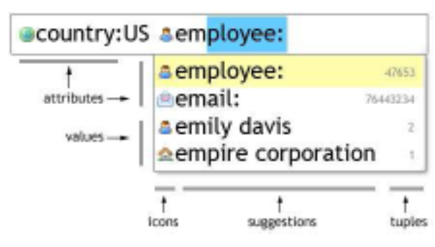
Autocompletion: Arnab Nandi
Help the user along with “instant” feedback as they type.
Provide insights into schema, data and familiar syntax during query formulation.
Guide them to perform better queries, correctly.
VLDB 07
SIGMOD 07
(Demo)

Slide 23
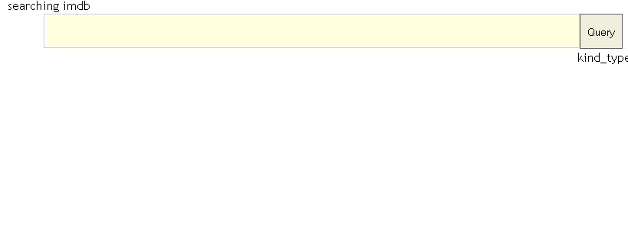
Autocompletion Demo

Slide 24
Autocompletion Demo

Slide 25
Challenge: Unknown Provenance
Seuss | 23
Smith | 755
Wang | 1233
for $a in doc()//author,
$s in doc()//store
let $b in $s/book
where
$/contact/@name = “Amazon” and $b/author = $a/id
return { $a/name, count($b) }
Is that one prolific Smith?
Or is this the summation of multiple authors with the same name?

Slide 26
Provenance Management: Adriane Chapman
Capture:
  What actions did a user take?
  What actors (sensors, equipment, etc) created this data?
  What query generated this view?
  Where did this data come from?
Storage and Querying:
  Provenance information can quickly grow larger than data size
    The MiMI dataset is 270MB
    The Provenance for MiMI is 6GB
  Provenance information must be queriable with the underlying data for use in the scientific community
SIGMOD 06
Tech Report

Slide 27
Outline
Some challenges we have tackled
A research agenda for the future
  Some points of pain
  Some directions for success

Slide 28
Pain Points
Too many joins
Too many options
Lack of explanation
No direct manipulation
Difficulty of defining structure for data

Slide 29
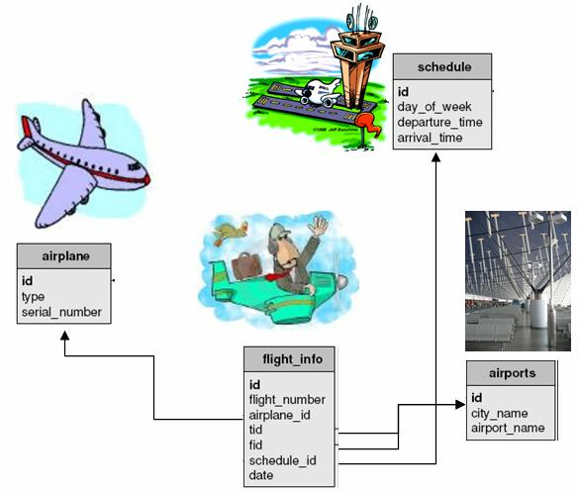
Painful Relations

Slide 30
Single user concept (Flight) has been normalized into four tables.

Slide 31
id
tid
Names of tables and attributes are not self-explanatory, particularly where references are involved (fid, tid).

Slide 32
Find departure times for flights from Beijing to Detroit.
SELECT s.departure_time
FROM schedule AS s,
flight_info AS f, airports AS d,
airports AS a
WHERE s.id = f.schedule_id
AND f.fid = d.id
AND d.city_name = “Beijing”
AND f.tid = a.id
AND a.city_name = “Detroit”
Even simple queries are not easy to express.

Slide 33

Not Just Relations!
Relational value joins may be the worst offender.
But XML joins are bad too:
  ID/IDREF
  Structural

Slide 34

1. No Joins
The typical user will only be able to express selection/projection: no joins.

Slide 35
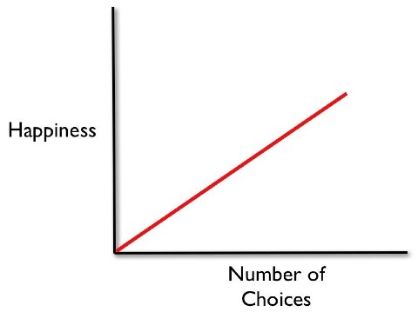
Painful Options
What a software designer thinks is true

Slide 36

Too Many Options
First of all, there were so many choices...maybe too many. I was paralyzed by indecision the first hour we were there. I would just stand there mumbling to myself, "Maybe red, no purple, no aqua-marine...Wait what are my feelings about teal?"

Slide 37
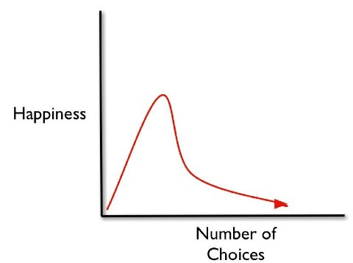
The Fallacy of Greater Choice
Barry Schwartz, The tyranny of choice. Scientific American, April 2004, pp. 71-75

Slide 38
Less is More!
Commercial database systems provide a zillion tuning knobs and ensure full employment for an army of expensive DBAs.
The most popular interfaces to databases today are forms-based, greatly limiting user choice (and hiding schema details, such as joins).

Slide 39

2. Limited Options
An ideal system will provide just enough options for the user to get their work done, but no more.
Or provide a gradual migration path with more options for the more advanced user.

Slide 40
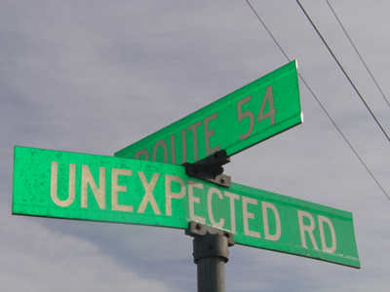
Unexpected Pain
Real systems will produce unexpected results at times.
Good systems must be able to explain why.

Slide 41
Unexpected Behavior
Unable to query
Inconsistent results using two query paths
E.g. (in MiMI)
“For the query ovo AND organism:dro*, I get back a result;
For the query organism:dro*, I get back a long list, but if I search for ovo within that list, it is not present.”

Slide 42
Unexpected Results
Often important (lead to discovery)
But more often anomalous
E.g. (in MiMI)
  The molecule record of p53 says that it interacts with 308 other molecules.
  But only 298 interaction records involving p53 exist

Slide 43
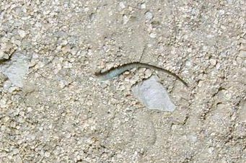
3. Adequate Explanation
Losing his tail was probably painful and unexpected for the lizard. Why did it happen?
Explanation: Someone wanted him for lunch, so his tail detached allowing him to escape. Therefore, while painful and unexpected, the behavior was reasonable.
A query for “cheap flights” returns: Los Angeles $75, Boston $100, San Francisco $400. Why is SF in this list?
Explanation: $400 was less than half the average price for a ticket to San Francisco.

Slide 44
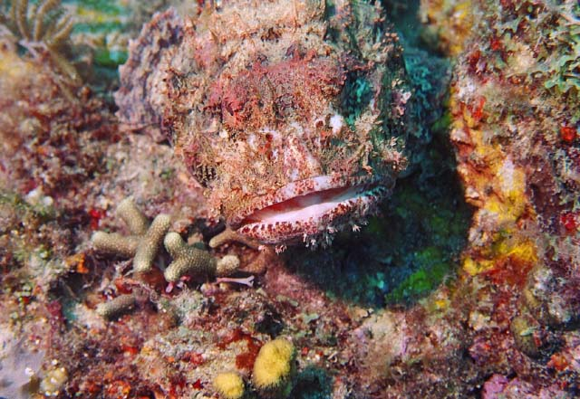
Invisible Pain

Slide 45
Which Word Processor Do You Use?
If, like me, you said LaTeX, then you are not a typical user.
Very hard to specify changes in the abstract, programmatically.
Much easier to work with the concrete: click and drag and drop.

Slide 46
Find departure times for flights from Beijing to Detroit.
SELECT s.departure_time
FROM schedule AS s,
flight_info AS f, airports AS d,
airports AS a
WHERE s.id = f.schedule_id
AND f.fid = d.id
AND d.city_name = “Beijing”
AND f.tid = a.id
AND a.city_name = “Detroit”
Even small changes can be difficult to make.

Slide 47
Find departure times for 747 flights from Beijing to Detroit.
SELECT s.departure_time
FROM schedule s,
flight_info AS f, airports AS d,
airports AS a, airplane AS p
WHERE s.id = f.schedule_id
AND f.fid = d.id
AND d.city_name = “Beijing”
AND f.tid = a.id
AND a.city_name = “Detroit”
AND f.airplane_id = p.id
AND p.type = “747”
SELECT s.departure_time
FROM schedule s,
flight_info AS f, airports AS d,
airports AS a
WHERE s.id = f.schedule_id
AND f.fid = d.id
AND d.city_name = “Beijing”
AND f.tid = a.id
AND a.city_name = “Detroit”

Slide 48
4. Direct Manipulation
Do not expect users to write queries in one window and see results in another.
  Even most visual query builders require abstraction.
Allow users to specify the queries iteratively by manipulating the “current” (intermediate) result set shown.

Slide 49

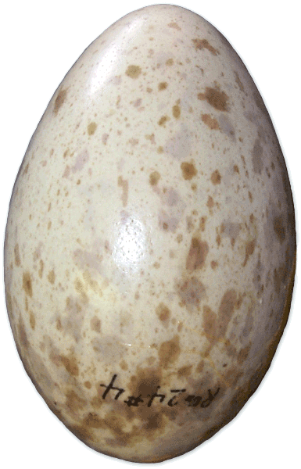
Birthing Pain
Never Again!
Too hard to specify structure.
  May not have the structure figured out in advance.
  Requires abstraction if the structure is to be created before there is data.
Barrier to database adoption by the ordinary users.

Slide 50
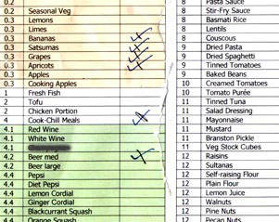

Jane’s Shopping List
The very beginning:
  A simple list with items
Milk
Eggs
Diapers
Pepper
… …

Slide 51
Jane’s Shopping List
During and after the trip to the store:
  More information is now available
 | Price | Bought
Milk | $3.99 | Y
Eggs | $2.99 | Y
Diapers | $9.99 | N
Pepper | $4.99 | Y
… … | … | …
Milk
Eggs
Diapers
Pepper
… …

Slide 52
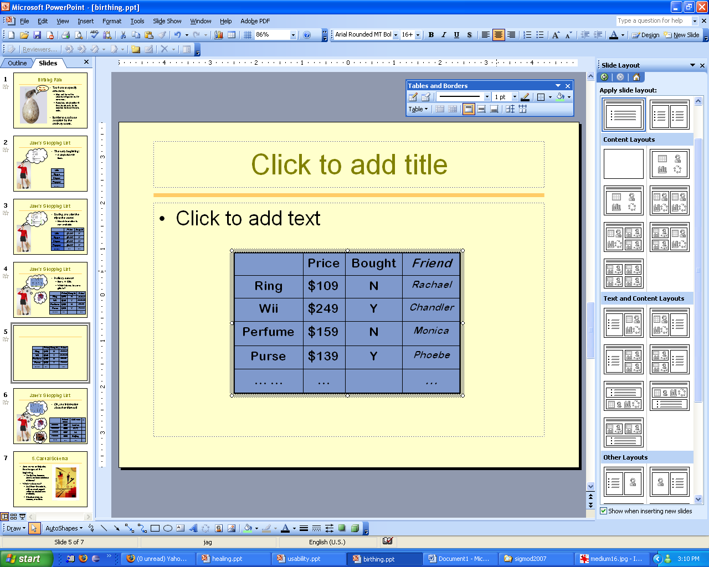

Jane’s Shopping List
Holiday season
  Items → Gifts
  Which friends to send gifts to?
 | Price | Bought | Friend
Ring | $109 | N | Rachael
Wii | $249 | Y | Chandler
Perfume | $159 | N | Monica
Purse | $139 | Y | Phoebe
… … | … |  | …

Slide 53
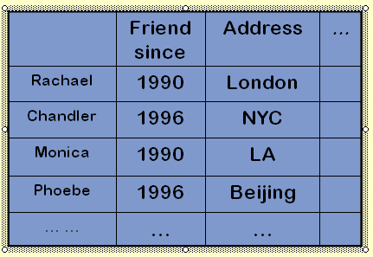

Jane’s Shopping List
Oh, and information about her friends!!
 | Friend since | Address | ...
Rachael | 1990 | London
Chandler | 1996 | NYC
Monica | 1990 | LA
Phoebe | 1996 | Beijing
… … | … | …

Slide 54

5. Casual Schema
Jane never anticipated the changes at the beginning.
  The simple list has evolved into Jane’s de facto database of friends!
What have we learned?
  Just throw the data in, with as much organi-zation as desired and available.
  Structure more, as needed, over time.

Slide 55
Desiderata
No Joins
Limited Options
Adequate Explanation
Direct Manipulation
Casual Schema

Slide 56
Outline
Some challenges we have tackled
A research agenda for the future
  Some points of pain
  Some directions for success

Slide 57
Presentation Data Model
The logical data model provides physical data independence.
  User does not have to worry about indices, file structure, access methods, …
The presentation data model provides logical data independence.
  User does not have to worry about relations, joins, keys, SQL, …
  A conceptually simple view of database.

Slide 58
Presentation Data Model
Layer
Layer
Layer
Presentation
Data Model + Algebra
Data Model + Algebra
Data Model + Algebra
Logical
Physical

Slide 59
Flights Database Logical Schema

Slide 60
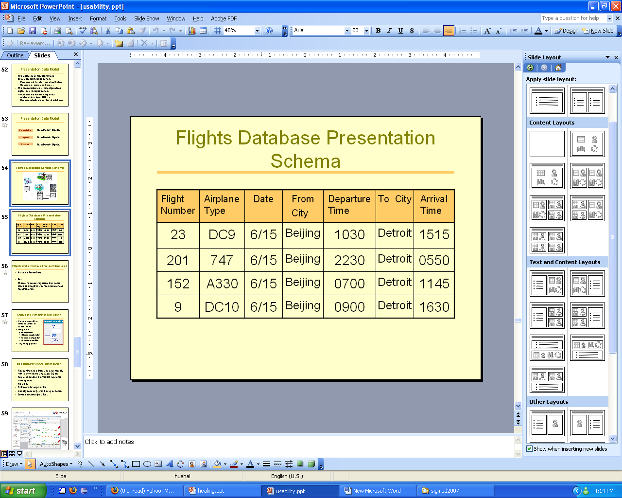
Flights Database Presentation Schema
Comprises multiple presentations.
Flight

Slide 61
Relieving Pain from Relations
User queries the concept of flight in this presentation.
  No need to understand the underlying joins
  No need even to know there are joins
  E.g., “Give me flights from Beijing to Detroit, leaving on June 15th afternoon.”
The system translates the presentation level query into the underlying logical query.

Slide 62
Relieving Pain From Options
The Flights “relation” allows far fewer queries (in a join-free manner) than is possible with arbitrary joins over the logical relations.
User (at most) specifies:
  Selection predicates;
  Attributes retained in projection.
Further restrictions may be appropriate.

Slide 63
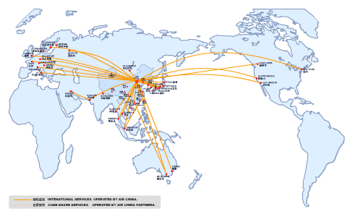
Geographic Presentation
User specifies cities
  Show flights to/from airports around the cities geographically on a map.

Slide 64
Geographic Presentation
User specifies cities
  Show flights to/from airports around the cities geographically on a map.

Slide 65
Relief from Unexpected Pain
Explanations as first class citizens of presentation model.
Analogy with constraints in logical model.
When there are fewer ways of computing results, and these have been carefully selected, there is a lower likelihood for causing confusion.
Need to develop a theory of explanations.

Slide 66
Relief from Invisible Pain
Given a simple presentation model, it becomes possible to specify direct manipulation of results as new queries.
Flight Number | Airplane Type | Date | From City | Departure Time | To City | Arrival Time
201 | 747 | 6/15 | Beijing | 2230 | Detroit | 0550

Slide 67
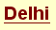
Relief from Invisible Pain
Given a simple presentation model, it becomes possible to specify direct manipulation of results as new queries.

Slide 68
Relief from Invisible Pain
Given a simple presentation model, it becomes possible to specify direct manipulation of results as new queries.
Flight Number | Airplane Type | Date | From City | Departure Time | To City | Arrival Time
275 | 767 | 6/15 | Beijing | 1000 | Delhi | 1345
277 | 767 | 6/15 | Beijing | 1800 | Delhi | 2150

Slide 69
Relief from Birthing Pain
Presentation schema also allows independence from the logical schema.
  User can manipulate the concept whenever necessary, and delay the materialization of the concept in the underlying logical schema.

Slide 70
Relief from Birthing Pain
Presentation Schema Evolution
Logical Schema Evolution
flight
001
flight
001

Slide 71
Relief from Birthing Pain
Presentation Schema Evolution
Logical Schema Evolution
flight | attribute name | attribute value
001 | from airport | PVG
001 | … | …
001 | arrival time | 2200
…
flight | from airport | to airport | depart time | arrival time
001 | PVG | DTW | 1000 | 2200
… | … | … | … | …
flight
001
flight
001

Slide 72
Relief from Birthing Pain
Presentation Schema Evolution
Logical Schema Evolution
flight | from airport | to airport | schedule
001 | PVG | DTW | P01
… | … | … | …
flight | attribute name | attribute value
001 | from airport | PVG
001 | … | …
001 | arrive time | 2200
…
flight | from airport | to airport | depart time | arrival time
001 | PVG | DTW | 1000 | 2200
… | … | … | … | …
schedule | depart time | arrival time
P01 | 1000 | 2200
… | … | …

Slide 73
Relieving the Birthing Pain
Presentation schema also allows independence from the logical schema.
  The user can manipulate the concept whenever necessary, and delay materialization of the concept in the underlying logical schema.
The logical schema evolves for better performance and data organization; the presentation schema evolves for better user interaction.

Slide 74
What a Presentation Model Is Not
Not an API definition
  Driven by human user interaction
Not user model, not conceptual model
  Not just something in the user’s head
  Computed, precise specification
Not just a set of views
  Has additional properties
Need not be relational, for an RDBMS.

Slide 75
Open Questions
Are all presentations for a database in the same data model?
If not, how do we manage consistency between presentations?
Can users modify presentations or define new presentations?
The value of a presentation layer for application program “users”, as opposed to human users.

Slide 76
Which systems have this architecture?
No one in its entirety.
But
There are several systems that come close and begin to address some of our requirements.

Slide 77
Forms as Presentation Model
Provide user with a limited number of useful “views”.
Not perfect:
  No real model;
  Little or no explanation;
  No direct manipulation;
  No structure creation.
Yet, wildly popular.

Slide 78
Multidimensional Data Model
Recognized as a first class data model, with its own query language, UI, etc.
Key to Executive Information Systems
  widely used.
No joins.
Drill down for explanation.
Usually read only, with heavy schema.
Some direct manipulation.

Slide 79
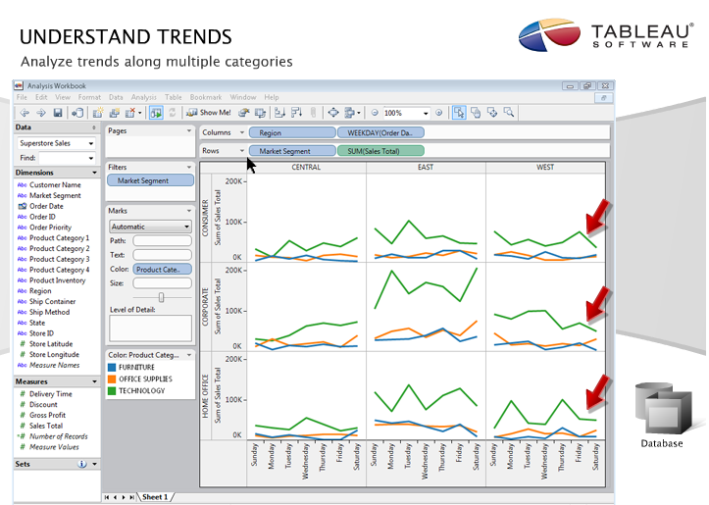

Slide 80
Spreadsheet Presentation
Immensely popular for simple data representation and manipulation.
Desired UI for multidimensional systems.
Join-free.
Direct manipulation.
Somewhat extensible structure.
Limited explanation.
Still too many options.

Slide 81
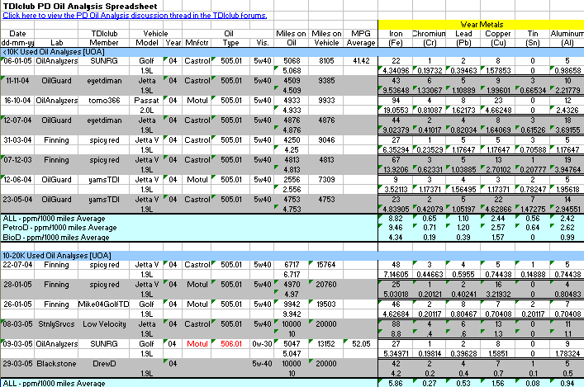
A Spreadsheet

Slide 82
Many Other Models
Network presentation
Geographic presentation
  Mash-ups
…

Slide 83
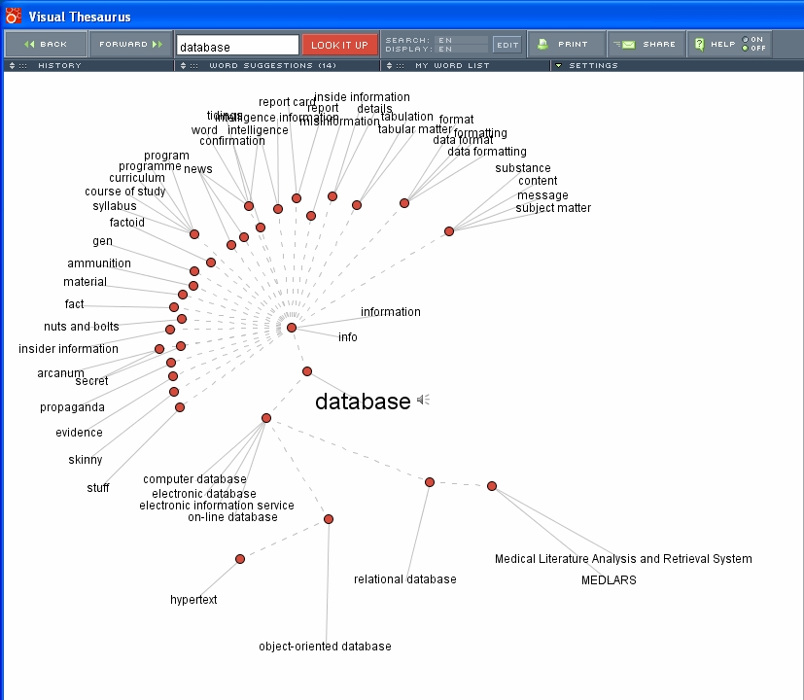
Network Presentation Model

Slide 84
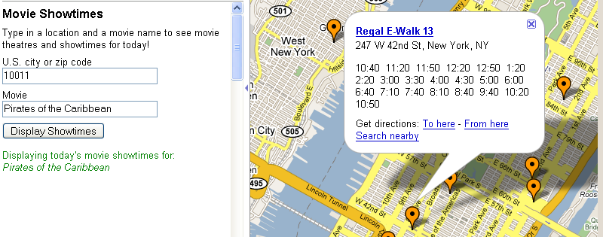
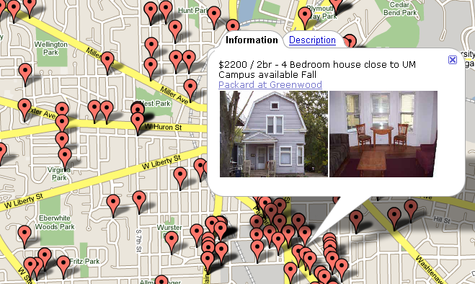
Geographic Presentation
Google Mapplet
Craigslist
Notes:
Movie Showtimes : Now available at “Google Mapplet” inside Google Maps. Other source is from “MapsKrieg”, clone of Housingmaps.com

Slide 85
Many Other Models
Network presentation
Geographic presentation
  Mash-ups
…
Usually not fully developed models.
Don’t meet all desiderata.
But are good starting points.

Slide 86
Usability is not HCI
Human factors are important for usability.
But core system architecture is much more important.

Slide 87

Usability Testing is Important
But …

Slide 88
A Research Agenda
There are intellectually challenging problems to solve in building usable information systems.
Solving these problems requires a deep understanding of data management principles.
So let us get to it …

Slide 89
Conclusion
A usable data management system must have, at the presentation level:
  No joins
  Limited options
  Adequate explanation
  Direct manipulation
  Casual schema

Slide 90
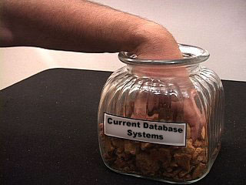
Getting at Information Today
Hard to get exactly the pieces you want.
The unexpected can happen – e.g. hand can get stuck.

Slide 91
Conclusion (contd.)
Making our systems usable is perhaps the most important thing we can do to enhance the impact of our work.
An explicit, full-fledged, presentation data model can help in this regard.

Slide 92


Acknowledgments
Adriane Chapman
Aaron Elkiss
Magesh Jayapandian
Yunyao Li
Arnab Nandi
Cong Yu
Mark Ackerman
Ben Liu
Barbara Mirel
Brian Noble
Jignesh Patel
Nuwee Wiwatwattana
Glenn Tarcea
Neamat el Tazi
Mike Wellman
Huahai Yang

