Slide 1
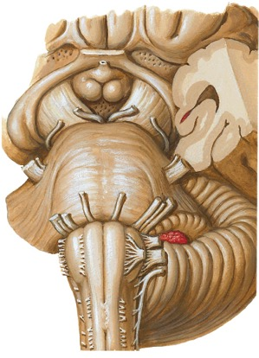
Brain Stem Sections
Objectives:
Learn to differentiate seven levels of the brain stem by external and internal anatomical
landmarks on myelin-stained histologic sections.
Recognize at each level the medial vs. lateral groups of cranial nerve nuclei and major
fiber tracts.
Specimens Required:
Rubber brain stem model
Hemisected whole brain
7
6
5
4
3
2
1
LEVELS:
optic tract
crus cerebri
IV
V
middle cerebellar
peduncle
VIII
VII
Olive
rootlets of XII
pyramid
pyramidal decussation
III
VI
ventral
surface
[Netter Presenter Image Copyright 2003,
Icon Learning Systems. All rights reserved]

Slide 2
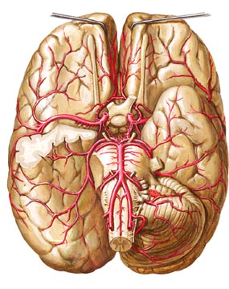
Brain Stem Sections
Vascular lesions can selectively damage the medial vs. lateral areas of the brain stem.
Medial Brain Stem
Direct branches of the basilar,
vertebral, and anterior spinal
arteries supply the medial
part of the brain stem.
Lateral Brain Stem
Lateral branches of the
vertebral and basilar
arteries supply the lateral
areas of the brain stem.
Posterior Cerebral A.
Superior Cerebellar A.
Basilar A.
Anterior Inferior Cerebellar A.
Vertebral A.
Posterior Inferior Cerebellar A.
Anterior Spinal A.
[Netter Presenter Image Copyright 2003,
Icon Learning Systems. All rights reserved]

Slide 3
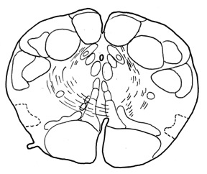
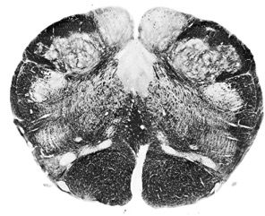
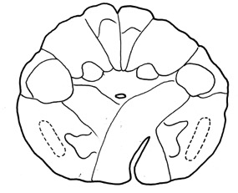
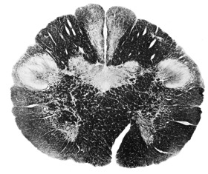
Brain Stem Sections
Motor and Sensory Decussations in the Medial Closed Medulla Pyramidal and lemniscal system fibers cross in the medial part of the closed medulla.
nucleus solitarius
nucleus gracilis
nucleus cuneatus
dorsal motor
nucleus of X
LEVEL 2
hypoglossal
nucleus
medial lemniscus
pyramid
SENSORY DECUSSATION
fasciculus and
nucleus gracilis
fasciculus and
nucleus cuneatus
LEVEL 1
pyramid
PYRAMIDAL (MOTOR) DECUSSATION
(Fig 40, 41. From Structure of the Human Brain: A Photographic Atlas,
3/E by SJ DeArmond and MM Fusco and MD Dewey, 1974, 1976, 1989
by Oxford University Press, Inc. Used by permission of Oxford University Press, Inc.)

Slide 4
Brain Stem Sections
Pain Systems in the Lateral Closed Medulla
Pain fibers from the ipsilateral face and contralateral body are more lateral in the closed medulla.
spinal tract of V
LEVEL 2
spinal nuc of V
anterlateral system
SENSORY DECUSSATION
spinal tract of V
LEVEL 1
spinal nuc of V
anterlateral system
PYRAMIDAL (MOTOR) DECUSSATION
(Fig 40, 41. From Structure of the Human Brain: A Photographic Atlas,
3/E by SJ DeArmond and MM Fusco and MD Dewey, 1974, 1976, 1989
by Oxford University Press, Inc. Used by permission of Oxford University Press, Inc.)

Slide 5
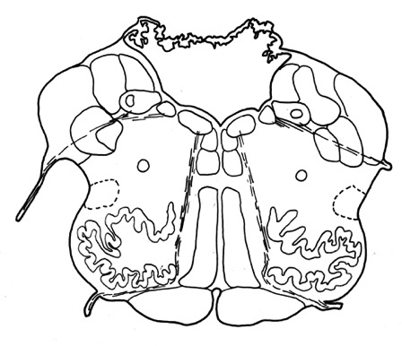
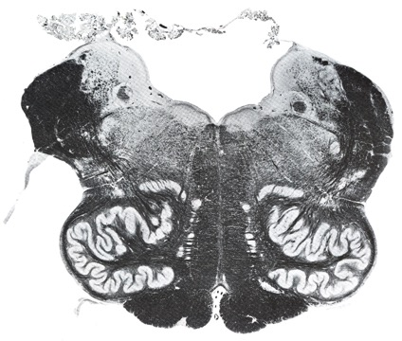
Brain Stem Sections
Medial Structures of the Open Medulla
LEVEL 3
Hypoglossal nucleus
(XII)
Olive
(The olivary nucleus
inside the olive is
a landmark of the
upper, or open, medulla.)
pyramid
hypoglossal
nerve rootlet
(XII)
medial
lemniscus
(Fig 44.. From Structure of the Human Brain: A Photographic Atlas,
3/E by SJ DeArmond and MM Fusco and MD Dewey, 1974, 1976, 1989
by Oxford University Press, Inc. Used by permission of Oxford University Press, Inc.)
= ANTERIOR SPINAL AND VERTEBRAL ARTERIES

Slide 6
Brain Stem Sections
Lateral Structures of the Open Medulla
nucleus solitarius
& solitary tract
spinal tract
and nucleus
of V
LEVEL 3
vagus nerve
rootlet
(X)
anterolateral
system
= POSTERIOR INFERIOR CEREBELLAR ARTERY
(Fig 44.. From Structure of the Human Brain: A Photographic Atlas,
3/E by SJ DeArmond and MM Fusco and MD Dewey, 1974, 1976, 1989
by Oxford University Press, Inc. Used by permission of Oxford University Press, Inc.)

Slide 7
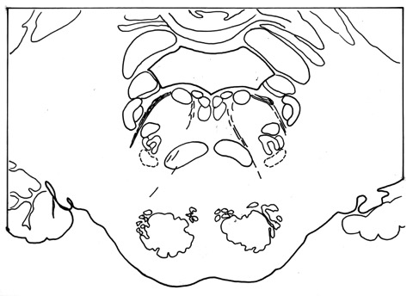
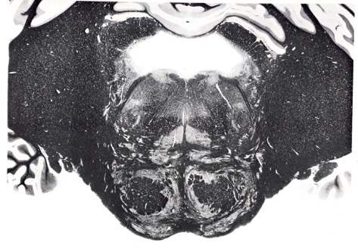
Brain Stem Sections
Lower Pons
IV ventricle
The level of the abducens (VI) and
facial (VII) cranial nerve nuclei and
nerve roots in the tegmentum of
the pons
superior
cerebellar
peduncle
tegmentum
of pons
middle
cerebellar
peduncle
basal
pons
LEVEL 4
(Fig 48. From Structure of the Human Brain: A Photographic Atlas,
3/E by SJ DeArmond and MM Fusco and MD Dewey, 1974, 1976, 1989
by Oxford University Press, Inc. Used by permission of Oxford University Press, Inc.)

Slide 8

Brain Stem Sections
Medial Lower Pons
Lateral Lower Pons
nucleus and fibers of VI
medial lemniscus (ML)
corticospinal fibers (CoSp)
nucleus and fibers of VII
snterolateral system
spinal tract and nucleus of V
LEVEL 4
VI
spinal tract of V
spinal nucleus of V
VII
ML
anterlateral system
VI fibers
CoSp
= BASILAR ARTERY
= ANTERIOR INFERIOR CEREBELLAR ARTERY

Slide 9
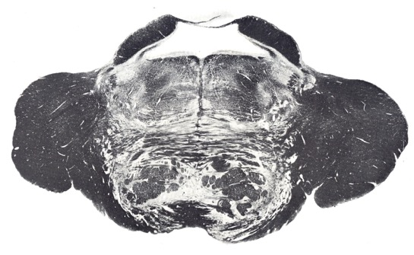
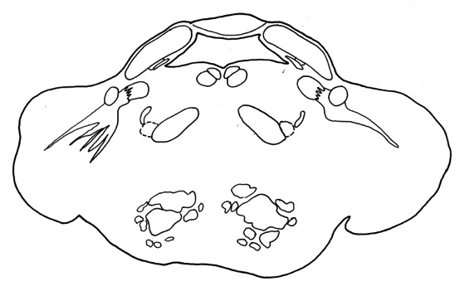
Brain Stem Sections
(Fig 49. From Structure of the Human Brain: A Photographic Atlas,
3/E by SJ DeArmond and MM Fusco and MD Dewey, 1974, 1976, 1989
by Oxford University Press, Inc. Used by permission of Oxford University Press, Inc.)
The Upper Pons
(level of the principal sensory, motor,
and mesencephalic nuclei and the root
fibers of the trigeminal nerve)
LEVEL 5
Medial Upper Pons:
medial lemniscus (moving laterally as it ascends)
corticospinal tracts
pontine nuclei
mesencepnalic tract
and nucleus of V
IV Ventricle
motor nucleus of V
principal sensory nucleus of V
root
of V
Lateral Upper Pons:
principal sensory nucleus of V
motor nucleus of V
mesencephalic nucleus of V
root fibers of V
anterolateral system
middle cerebellar peduncle
ML
CoSp
anterolateral system
= SUPERIOR CEREBELLAR ARTERY
= BASILAR ARTERY
=
ANTERIOR INFERIOR CEREBELLAR ARTERY

Slide 10
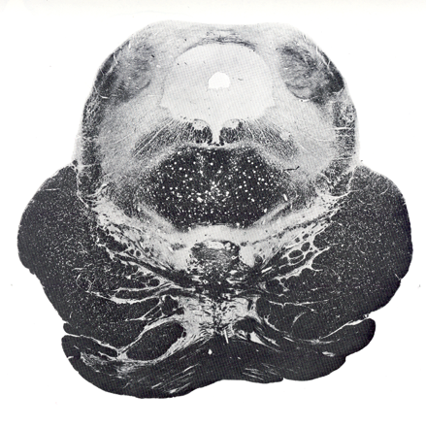
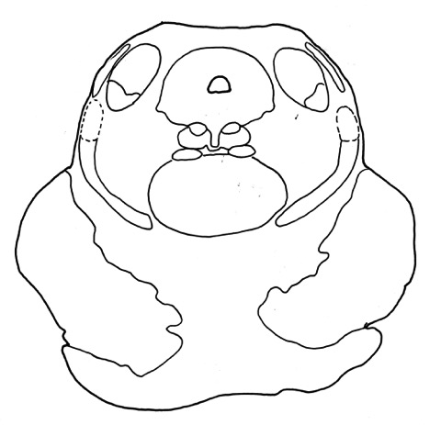
Brain Stem Sections
Inferior Colliculus in the Lower Midbrain
(level of the trochlear nerve and the decussation
of the superior cerebellar peduncles)
LEVEL 6
Medial Lower Midbrain:
Lateral Lower Midbrain:
brachium of the
Inferior colliculus (IC)
trochlear
nucleus
IC
lateral
lemniscus
decussation of
the superior
cerebellar
peduncles
anterolateral
system
medial
lemniscus
crus
cerebri
(Fig 52. From Structure of the Human Brain: A Photographic Atlas,
3/E by SJ DeArmond and MM Fusco and MD Dewey, 1974, 1976, 1989
by Oxford University Press, Inc. Used by permission of
Oxford University Press, Inc.)
corticospinal
fibers in the
crus cerebri
pontine fibers
= BASILAR ARTERY
= SUPERIOR CEREBELLAR ARTERY

Slide 11
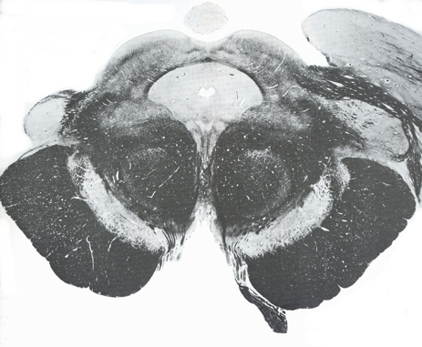
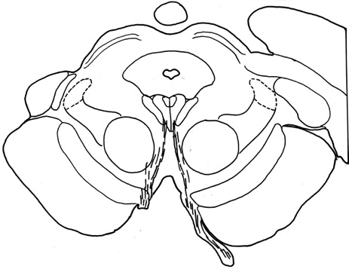
Brain Stem Sections
Superior Colliculus in the Upper Midbrain
(level of the oculomotor nucleus and fibers
and the red nucleus)
pineal
LEVEL 7
pulvinar
medial
geniculate
nucleus
Medial Upper Midbrain:
Lateral Upper Midbrain:
superior
colliculus
oculomotor
nucleus
ML
red
nucleus
(This histologic section was cut at the level of
the transition between the midbrain and the
diencephalon. The medial geniculate nucleus
and the pulvinar of the thalamus are lateral to
the midbrain. The pineal gland is dorsal to
the superior colliculi.)
corticospinal fibers
in the
crus cerebri
anterolateral
system
oculomotor nerve
(Fig 54. From Structure of the Human Brain: A Photographic Atlas,
3/E by SJ DeArmond and MM Fusco and MD Dewey, 1974, 1976, 1989
by Oxford University Press, Inc. Used by permission of
Oxford University Press, Inc.)
= BASILAR ARTERY
= POSTERIOR CEREBRAL
ARTERY

Slide 12
Question 1
Match each of the cranial nerve nuclei (1 - 10) with the brain stem level (or levels)
(A - F) in which it is located.
_____1. Oculomotor nucleus
_____2. Abducens nucleus
_____3. Hypoglossal nucleus
_____4. Trigeminal motor nucleus
_____5. Spinal nucleus of V
_____6. Trochlear nucleus
_____7. Facial nucleus
_____8. Dorsal motor nucleus of X
_____9. Principal sensory nucleus of V
_____10. Nucleus solitarius
Closed medulla
Open medulla
Lower Pons
Upper Pons
Lower Midbrain
Upper Midbrain

Slide 13
Question 2
Match each of the brain stem structures (1 - 10) with the brain stem area (or areas)
(A - F) in which it is located.
_____1. Oculomotor nucleus
_____2. Abducens nucleus
_____3. Hypoglossal nucleus
_____4. Trigeminal motor nucleus
_____5. Red nucleus
_____6. Trochlear nucleus
_____7. Pyramid
_____8. Spinal nucleus of V
_____9. Anterolateral system
Medial Medulla
Lateral Medulla
Medial Pons
Lateral Pons
Medial Midbrain
Lateral Midbrain

Slide 14
Answers
Question 1
F
C
A, B
D
A, B, C
E
C
A, B
D
A, B
Question 2
E
C
A
D
E
C
A
B, D
B, D, F

