Slide 1
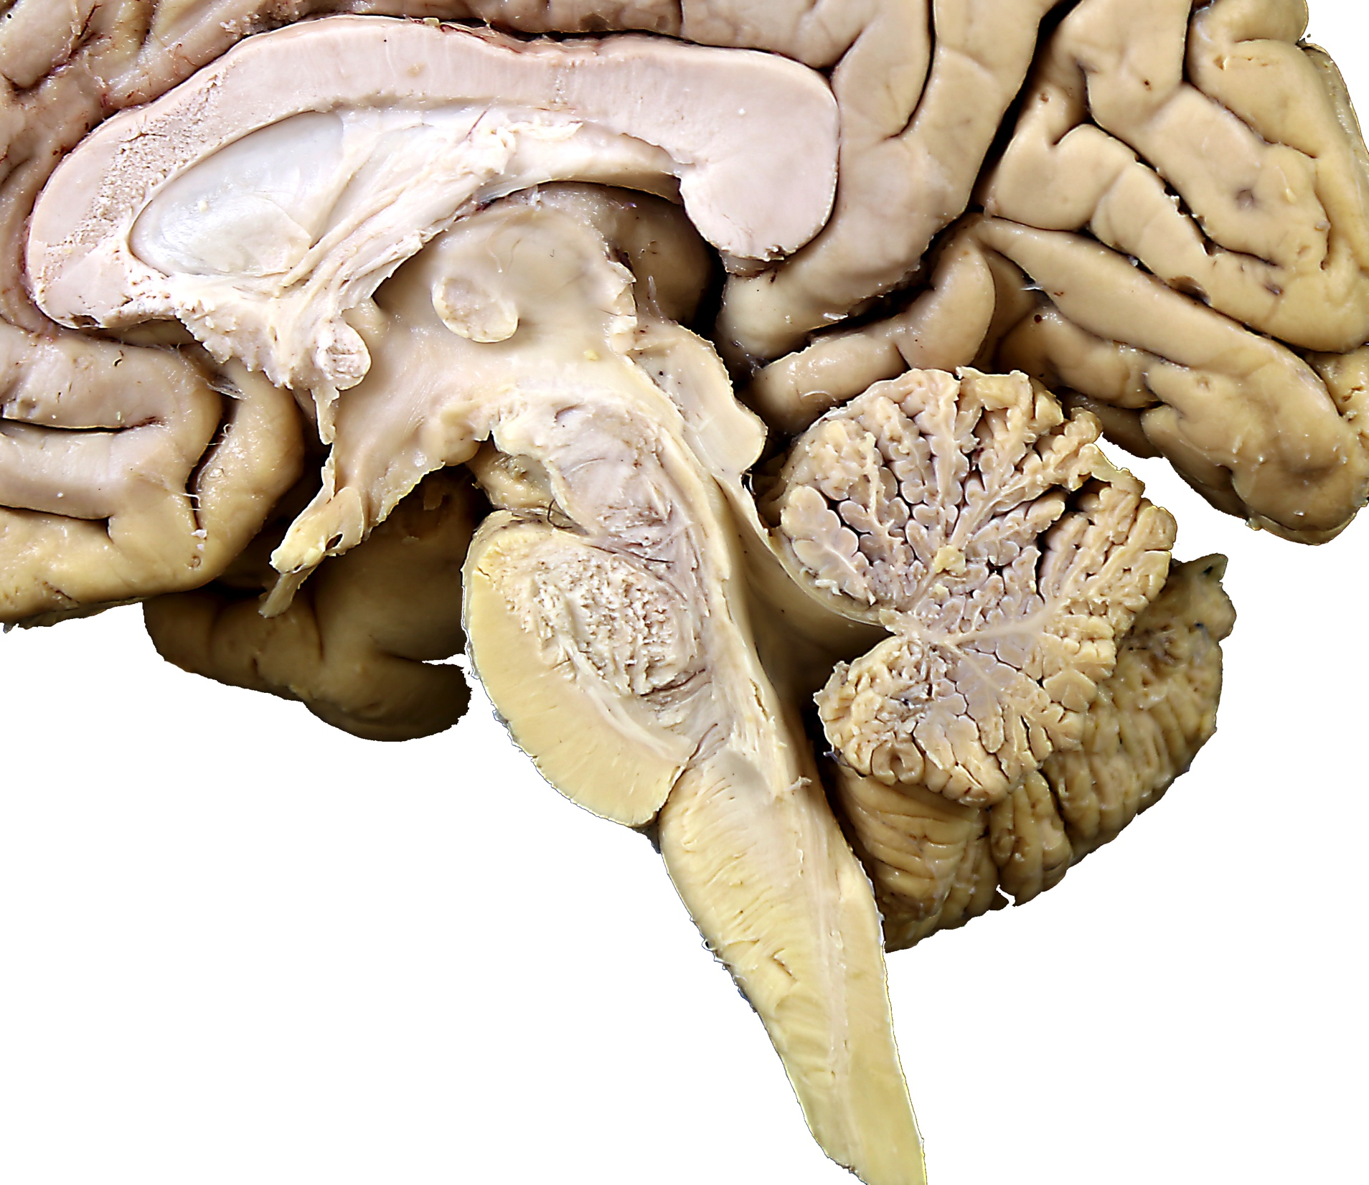

Cerebellum
Objectives:
Identify the lobes and divisions
of the cerebellum
Identity the cerebellar peduncles
Specimens Required:
Rubber brain stem model
Hemisected whole brain
Whole and hemisected cerebelli
Cerebellum

Slide 2
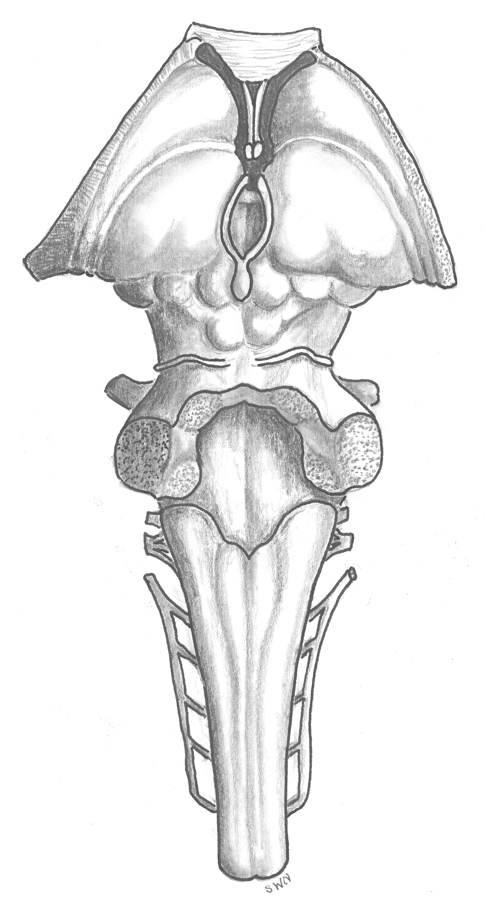
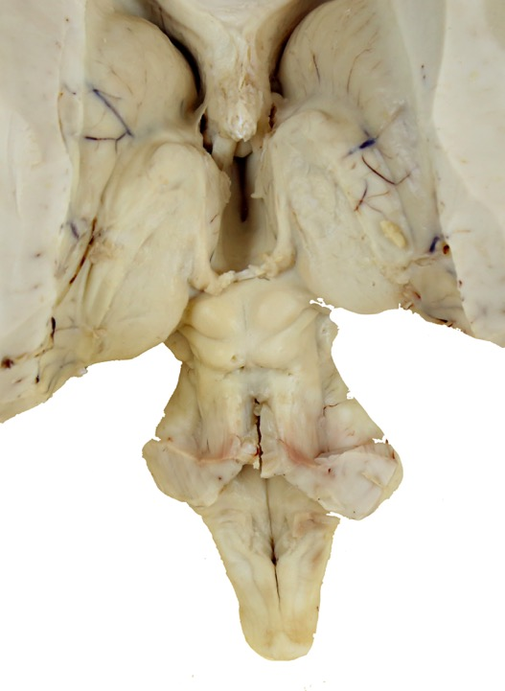
Cerebellar Peduncles
The cerebellum is removed from the brain stem by cutting through the:
Superior cerebellar peduncle (fibers to the midbrain)
Middle cerebellar peduncle (fibers from the pons)
Inferior cerebellar peduncle (fibers from the medulla and spinal cord)
S
M
I
M
S
I

Slide 3
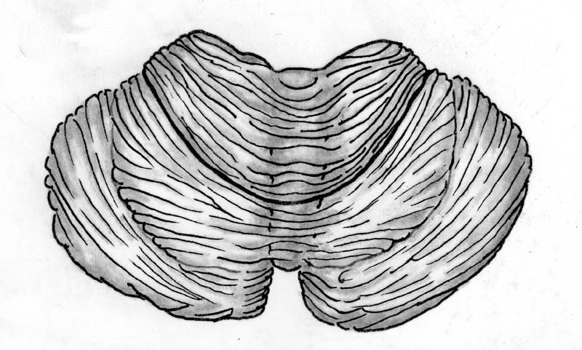
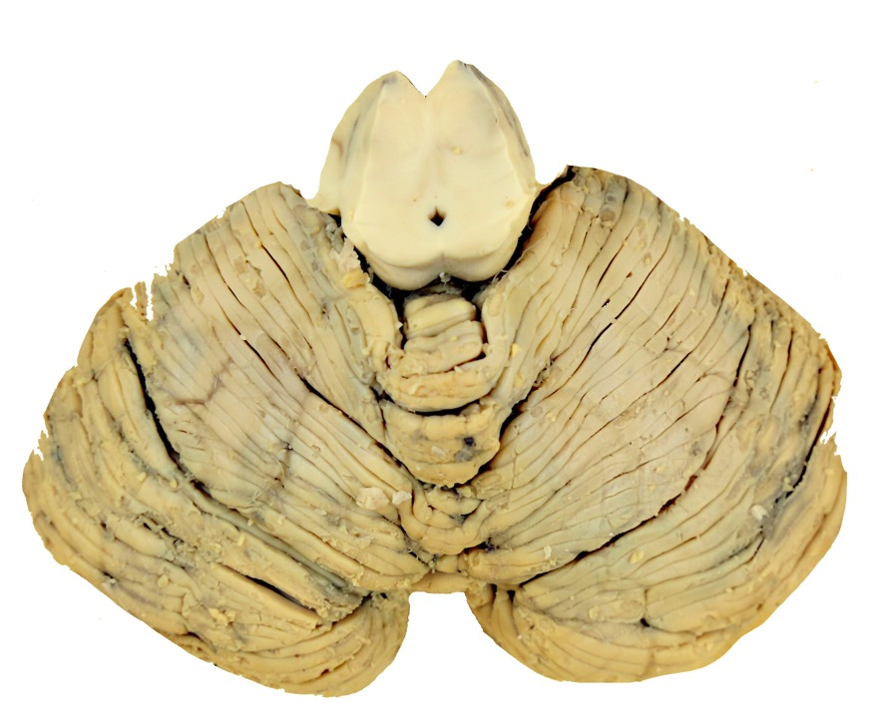
Superior Surface
primary
fissure
vermis
anterior lobe
hemishpere
The superior surface of the cerebellum lies under the occipital lobes and is separated
from them by the tentorium cerebelli.
posterior lobe
The midline region of the cerebellum
is the vermis. The much larger left and right hemispheres of the cerebellum flank the vermis.
The anterior lobe and posterior lobe of the cerebellum are separated by the primary fissure.
vermis

Slide 4
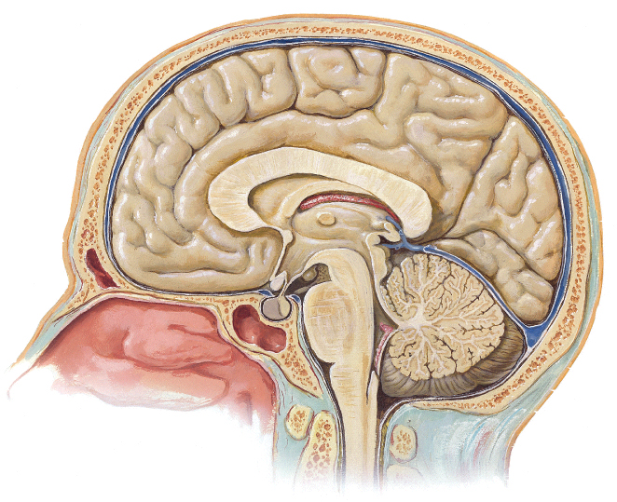
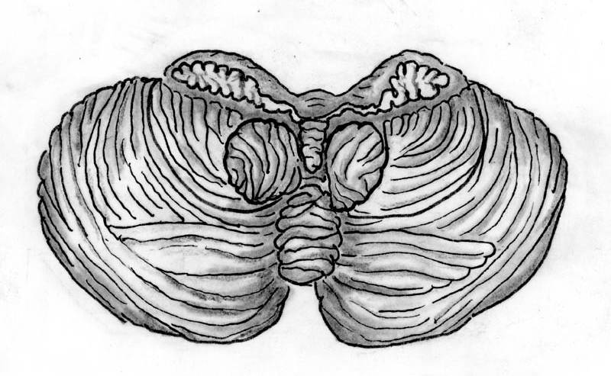
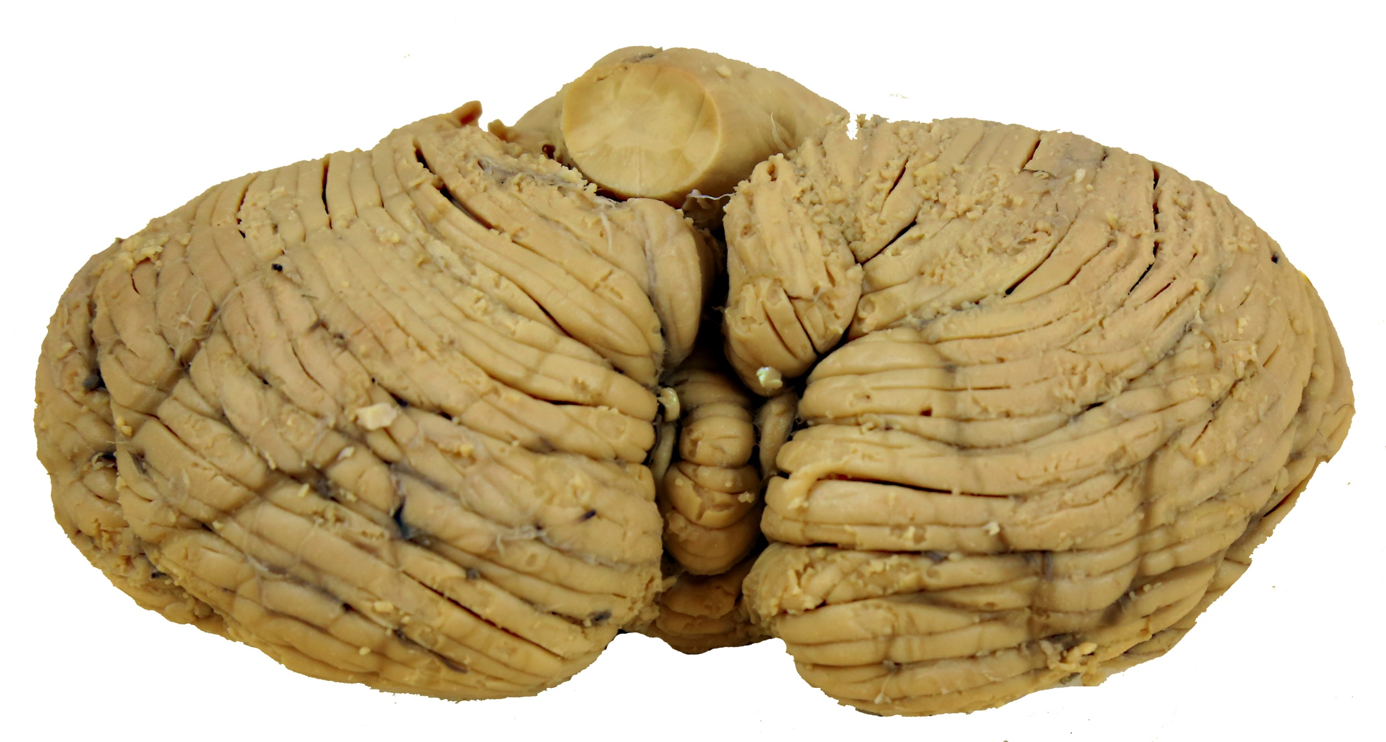
Inferior Surface
tonsils
The inferior surface of the cerebellum lies on the floor of the posterior cranial fossa.
vermis
tonsils
posterior lobe
The tonsils are lobules of the posterior lobe that lie above the foramen magnum. They can be herniated through the foramen
by increased intracranial pressure.
vermis
posterior lobe

Slide 5
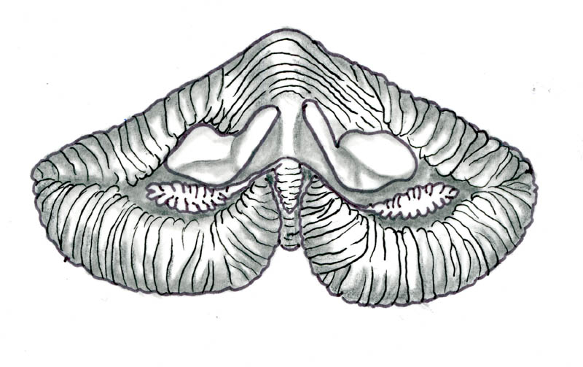
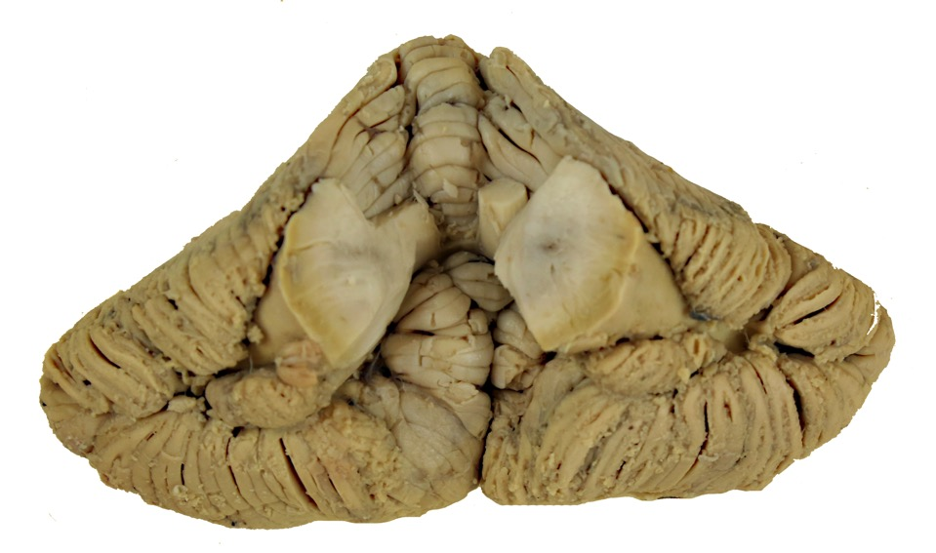
Cerebellar Peduncles
A view from the floor of the IV ventricle
In this view we see the cut surfaces of the cerebellar peduncles and the flocculonodular lobe.
cerebellar peduncles:
superior surface
superior
middle
inferior
Inferior surface
flocculus
nodulus
flocculus

Slide 6
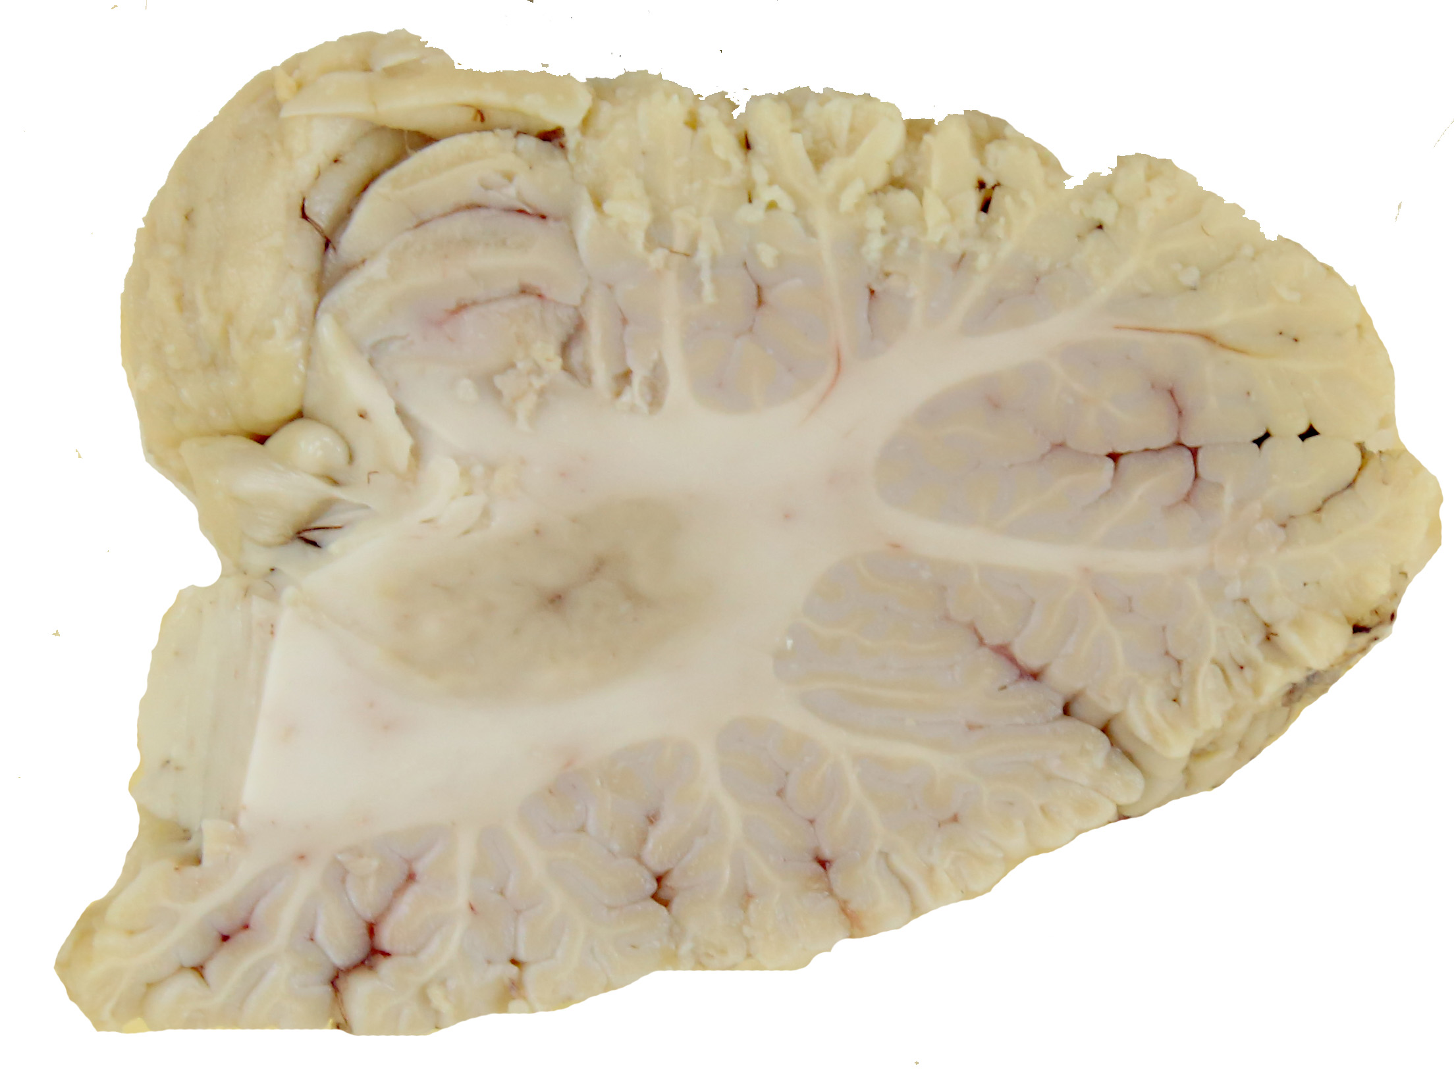
Parasagittal Section
C
The cerebellar cortex, white matter and deep nuclei are easily observed In a parasagittal section of the cerebellum.
W
D

Slide 7
Cerebellum
Question I
Choose the one best answer:
The three major lobes of the cerebellum are the:
anterior, posterior and tonsilar
anterior, vermal and posterior
anterior, posterior and superior
anterior, posterior and flocculonodular
anterior, vermal and flocculonodular
True/False
II. ___ The anterior lobe of the cerebellum lies directly beneath the tentorium cerebelli.
III. ___The tonsils of the cerebellum may herniate underneath the tentorium cerebelli.

Slide 8
Cerebellum
ANSWER SHEET
Question I D
Question II T
Question III F

