Slide 1
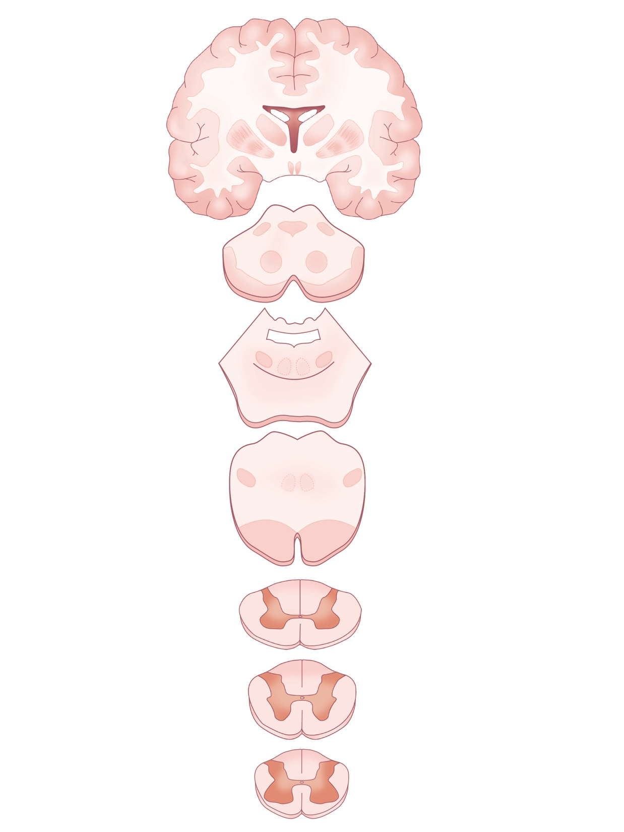
Corticospinal Tracts
Objectives:
To learn the course of the corticospinal tracts
through the central nervous system from the
cerebral cortex to the spinal cord.
To identify the structures through which these
tracts pass on coronal and horizontal slices of
the plastinated brain.
Specimens Required:
Hemisected brain
Coronal and horizontal sections
Rubber brain stem model

Slide 2
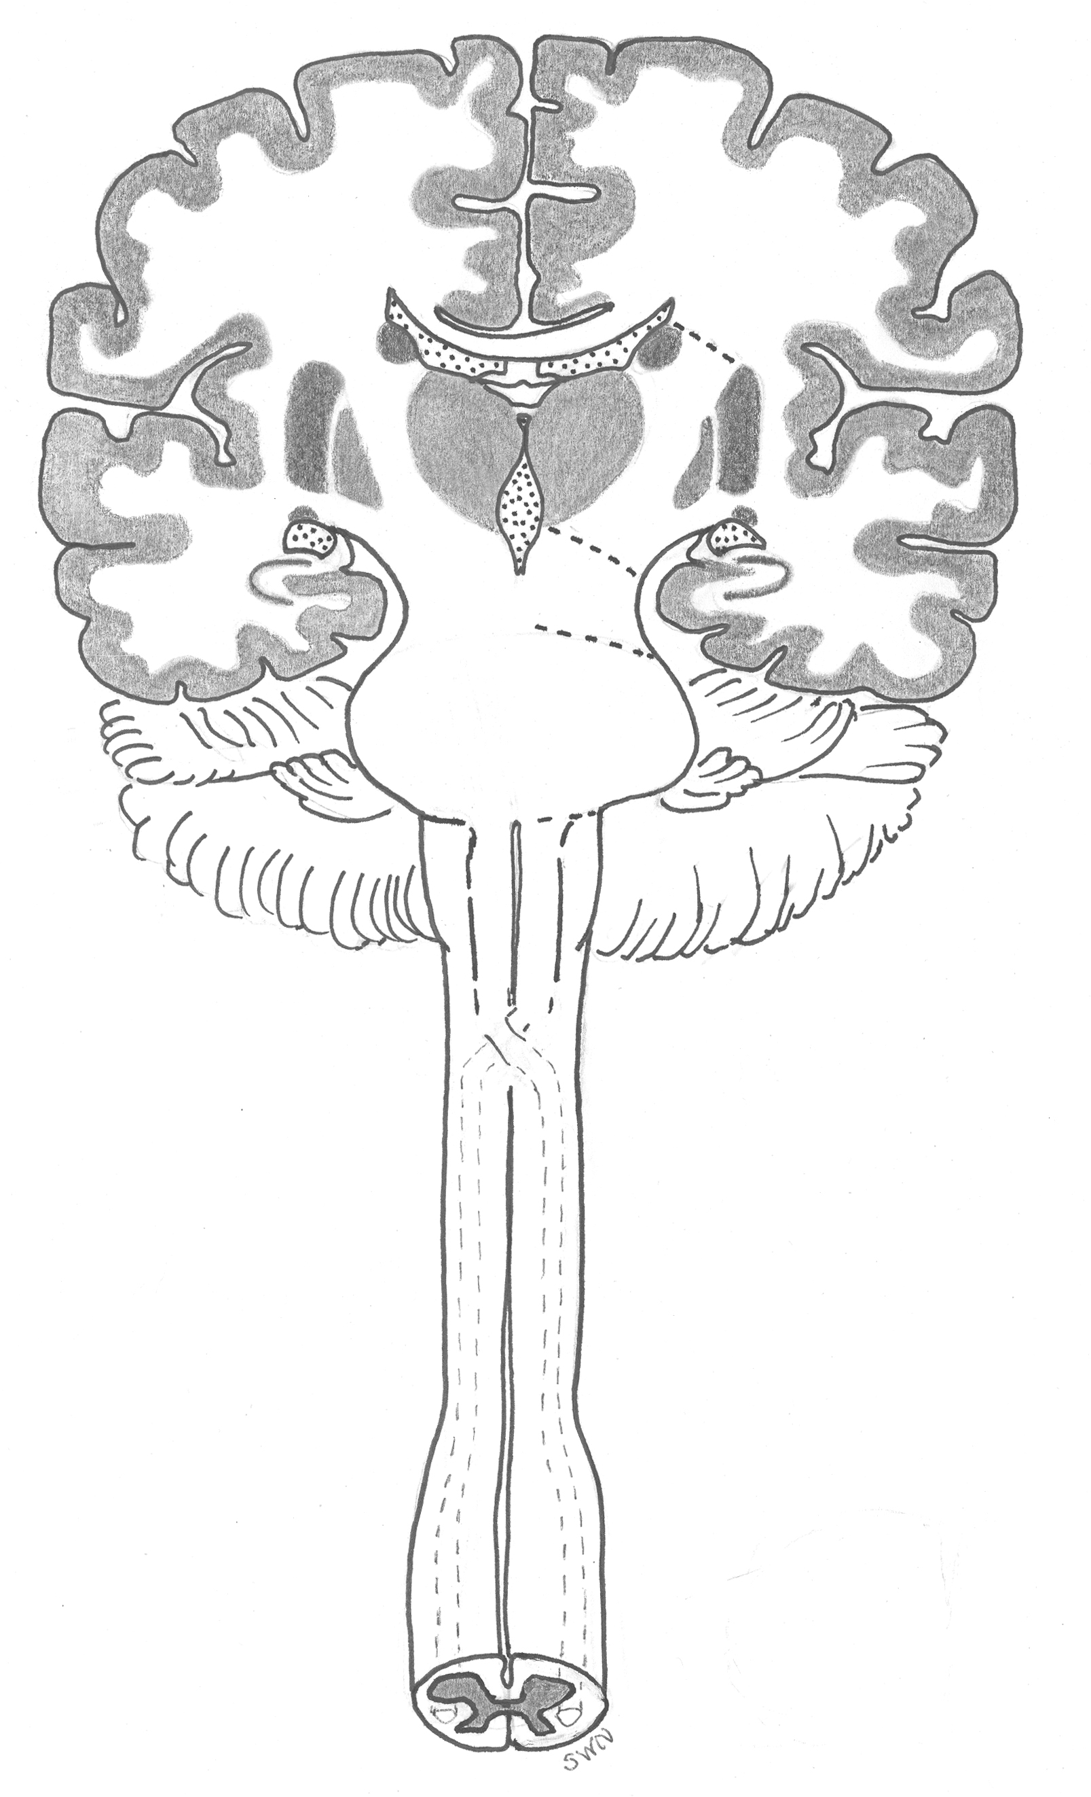
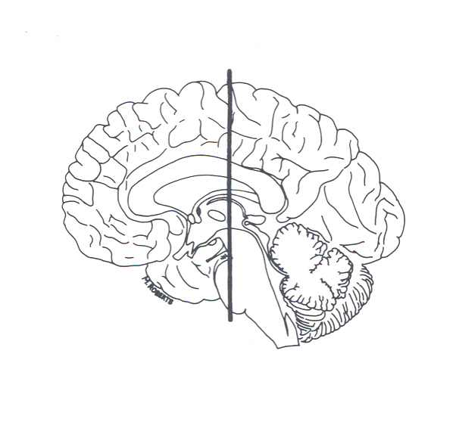
Corticospinal Tracts
A
primary motor cortex
Diagram A represents the brain and the
cervical spinal cord cut in a coronal section through the primary motor cortex, the base of the midbrain, and the base of the pons. The location of this section is shown on diagram B.
base of
midbrain
base of pons
ventral surface of the
medulla
ant
post
ventral surface of the
cervical spinal cord
B

Slide 3
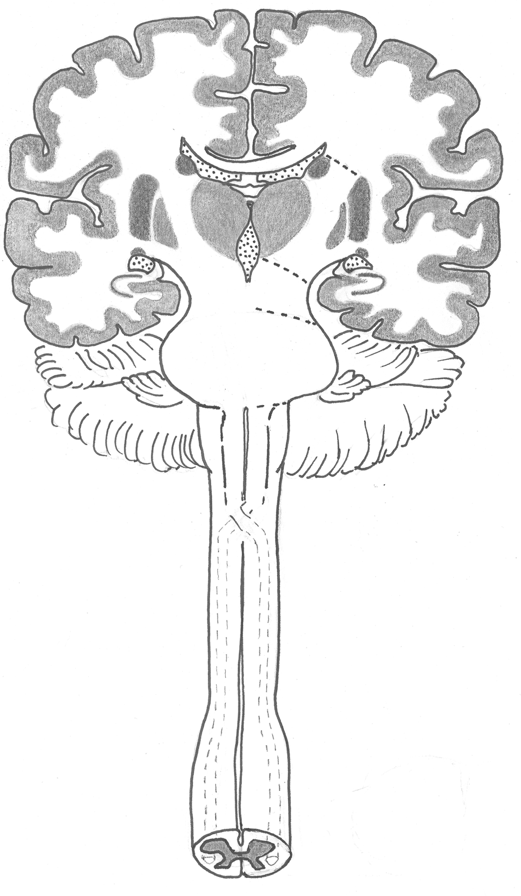
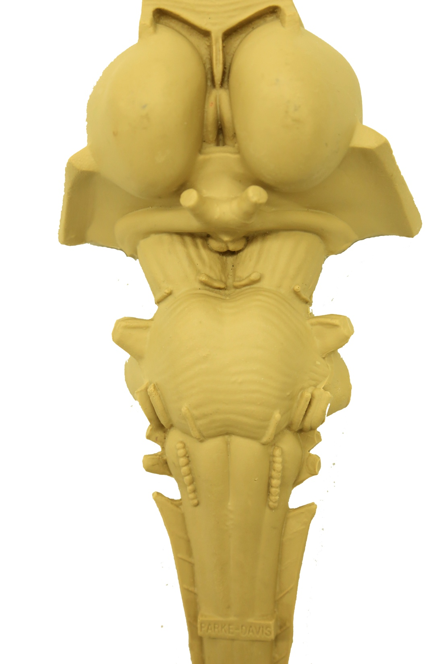
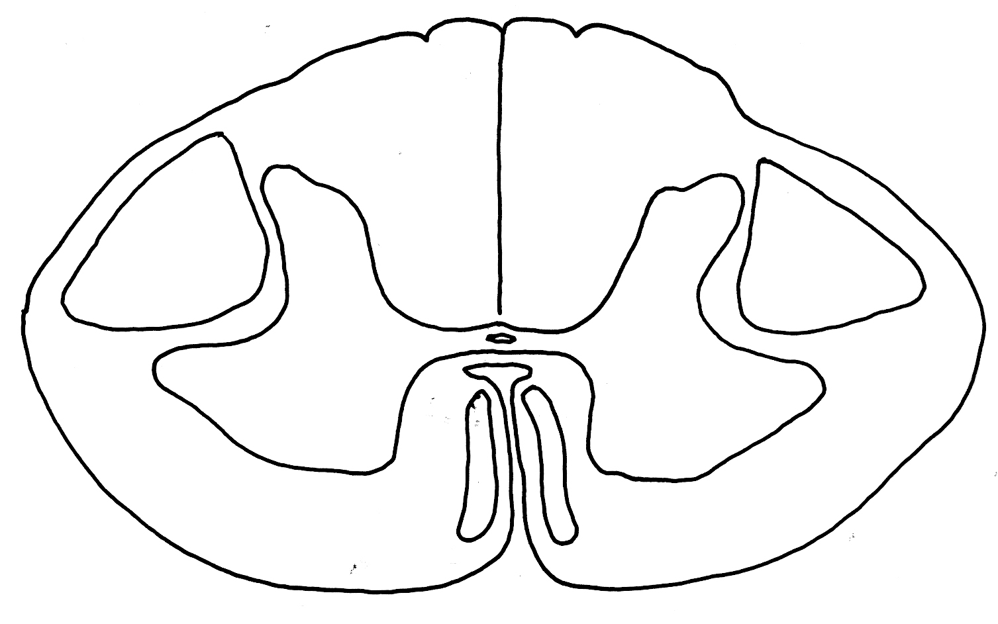
Corticospinal Tracts
sensorimotor cortex
The Corticospinal tract contains the axons of motor cortex neurons. These axons pass through the corona radiata (white matter beneath the cortex) and the posterior limb of the internal capsule and continue through the crus cerebri in the base of the midbrain, the base of the pons, and the pyramid of the medulla.
corona
radiata
internal
capsule
crus cerebri
base of pons
pyramid
LCoSpT
decussation of the pyramids
lateral corticospinal tract
crus cerebri
R
L
ventral corticospinal tract
base of pons
VCoSpT
pyramid
R
L
decussation of
the pyramids

Slide 4
Corticospinal Tracts
sensorimotor cortex
Before they enter the spinal cord,
most of these fibers (usually 80-90%) cross the midline in the decussation of the pyramids. They enter the lateral funiculus of the spinal cord white matter and form the lateral corticospinal tract (LCoSpT). The uncrossed fibers descend as the ventral corticospinal tract (VCoSpT) in the ventral funiculus of the cord.
The decussation of the pyramidal tracts defines the border between the medulla and the spinal cord.
corona
radiata
internal
capsule
crus cerebri
base of pons
pyramid
LCoSpT
decussation of the pyramids
lateral corticospinal tract
L
R
ventral corticospinal tract
VCoSpT
R
L

Slide 5
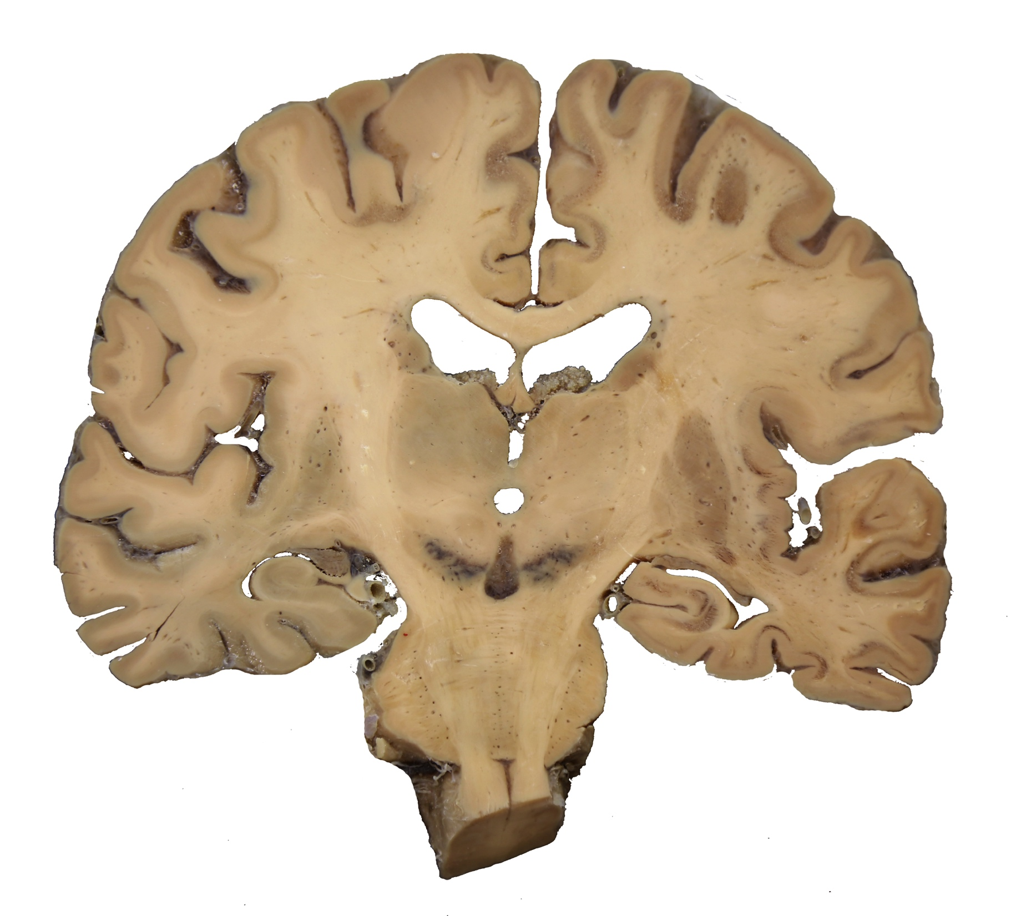
Corticospinal Tracts
cr
cr
ic
ic
crc
crc
bp
bp
This coronal brain section demonstrates the structures through which the corticospinal tract fibers pass from the cortex to pons:
corona radiata (cr)
internal capsule (ic)
crus cerebri (crc)
base of the pons (bp)

Slide 6
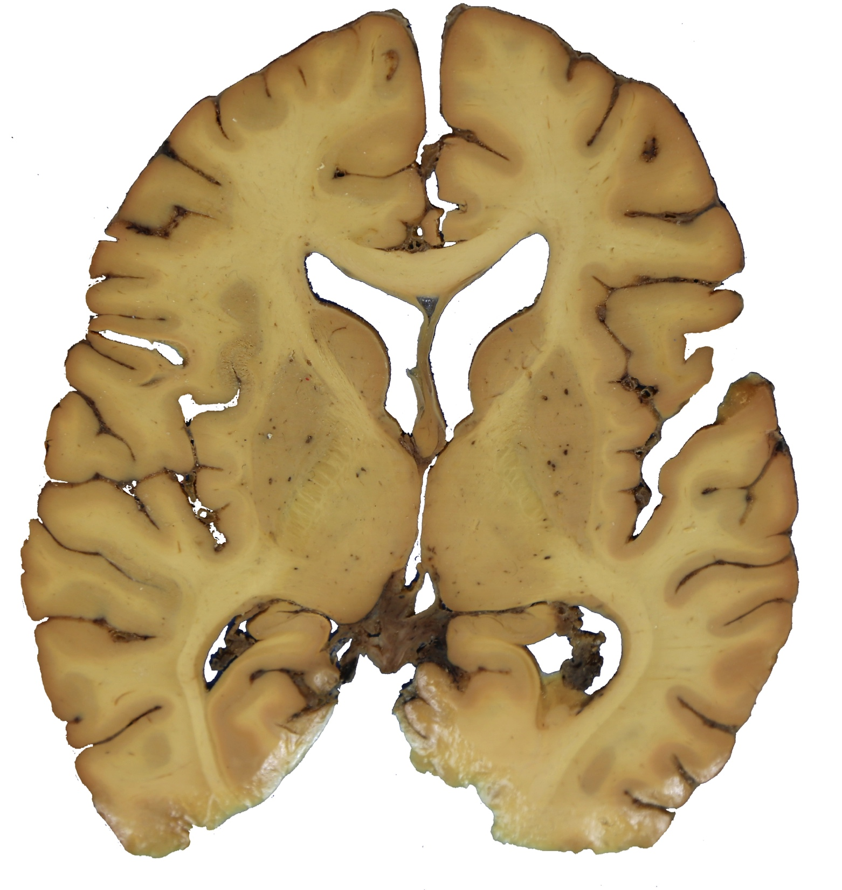
Corticospinal Tracts
ant
The parts of the
internal capsule:
p
anterior limb
th
ic
genu
p
posterior limb
th
post
A horizontal section through the forebrain at the level of the arrow indicates the location of a corticospinal fiber in the posterior limb of the internal capsule. The posterior limb of the internal capsule passes between the thalamus and the putamen.

Slide 7
Question
Question 1
The corticospinal tract passes through all of the following structures except the
A. internal capsule
B. thalamus
C. corona radiata
D. pyramid
E. spinal cord
Question 2
Corticospinal tract fibers cross the midline in which of the following regions?
A. Diencephalon
B. Midbrain
C. Pons
D. Medulla
E. Spinal cord

Slide 8
Answer
Question 1 B
Question 2 D

