Slide 1
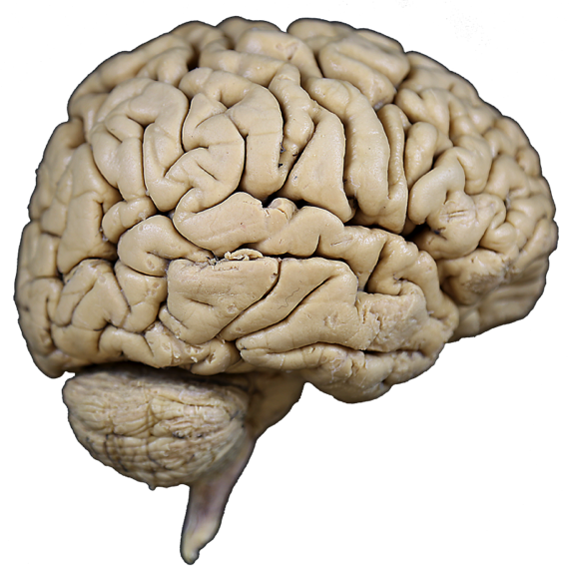

Internal Brain Structures
A coronal section through the forebrain reveals its internal structure.
Objectives:
To identify internal structures of the forebrain on coronal and horizontal sections.
Specimens Required:
Coronal and horizontal brain sections
lateral fissure
Lateral view of right
cerebral hemisphere

Slide 2
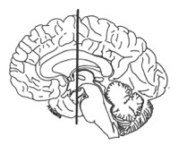
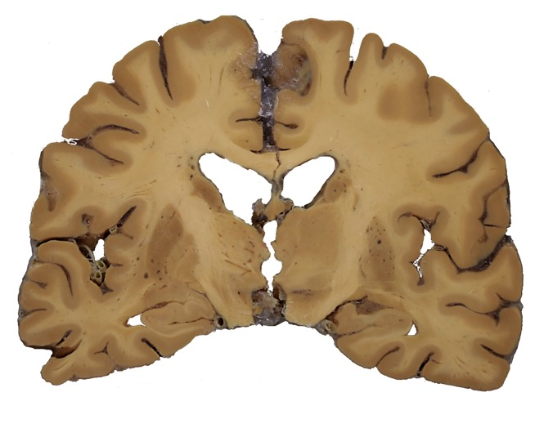
Internal Brain Structures
The cerebral cortex forms the surface of each cerebral hemisphere. The subcortical white matter is contains axons connecting the cortex with other parts of the nervous system. Axons connecting the cortical areas of the two hemispheres through the corpus callosum while axons connecting the cortex to deeper structures are contained in the internal capsule.
The basal ganglia (nuclei) and diencephalon are visible deep to the white matter.
medial surface of the right half of the brain
C
White
matter
CC
IC
D
BG

Slide 3
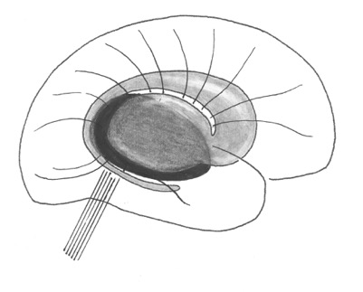
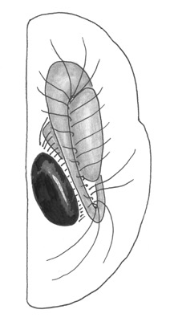
Internal Brain Structures
The telencephalon and diencephalon make up the forebrain. The telencephalon consists of the cerebral cortex and the deep telencephalic nuclei of the basal ganglia: the caudate (c) the putamen and the globus pallidus nucleus.
The diencephalon is located medial to the basal ganglia within the cerebral hemisphere (see dorsal view).
The internal capsule separates the diencephalon and caudate (medially) from the globus pallidus and putamen (laterally). Axons of the internal capsule connect the overlying cerebral cortex to areas of the basal ganglia, diencephalon, brain stem and spinal cord.
p
c
lateral view of the right cerebral hemisphere
c
gp
ic
p
d
dorsal view of the right cerebral hemisphere

Slide 4

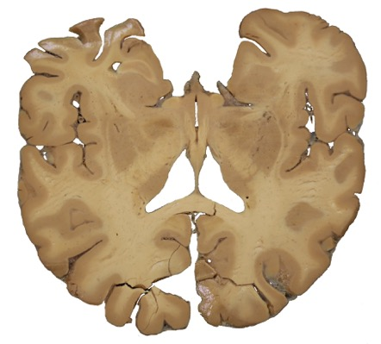

Internal Brain Structures
In a coronal section, the diencephalon and caudate nucleus are visible. The diencephalon includes the thalamus and hypothalamus. The caudate nucleus and thalamus are always medial to the internal capsule.
The lentiform nucleus is composed of the putamen and the globus pallidus. These structures are always lateral to the internal capsule.
B
A
A
Insular cortex
B
p
c
c
ic
ic
p
p
th
gp
gp
h

Slide 5
Internal Brain Structures
Coronal sections reveal the body and the inferior horns of the lateral ventricles (LV). The body of each LV is roofed by the corpus callosum. Its walls are the caudate and the septum pellucidum (sp). Its floor is the fornix (f). The walls of the third ventricle are formed by the hypothalamus and thalamus
B
A
Lateral ventricle, body
sp
A
B
p
c
c
ic
f
f
th
h
Third
ventricle
Third ventricle
Lateral ventricle, inferior horn
Lateral ventricle, inferior horn

Slide 6

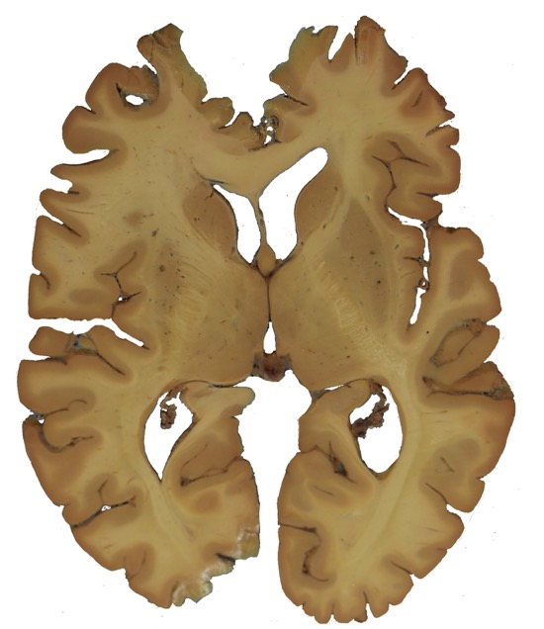
Internal Brain Structures
post
ant
anterior
This horizontal section includes the corpus callosum, the caudate nucleus, the putamen and globus pallidus. The lateral ventricles anterior horn and trigone are also visible. The interventricular foramen (if) on each side opens from the lateral ventricle into the third ventricle.
anterior
LV
anterior horn
cc
c
p
ic
f
gp
th
III
LV
trigone
posterior

Slide 7
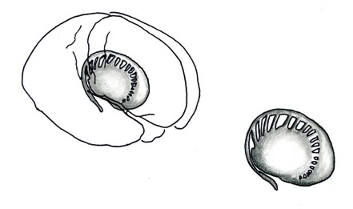
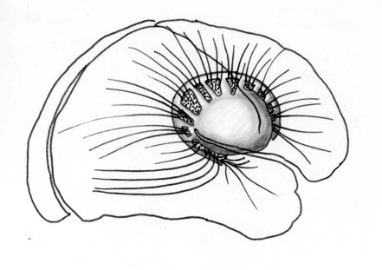
Internal Brain Structures
The caudate nucleus and the putamen of the basal ganglia are connected by narrow cell bridges.
Fiber bundles that pass between these cellular collectively make up the internal capsule. (All of the fibers illustrated here are part of the internal capsule.)
Axons of the internal capsule connect the overlying cerebral cortex to areas of the basal ganglia, diencephalon, brain stem and spinal cord.
frontal lobes
caudate
nucleus
putamen
parietal lobe
fiber bundles
of the internal capsule
frontal lobe
occipital
lobe
temporal lobe

Slide 8
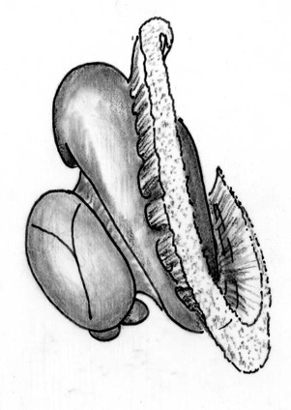
Internal Brain Structures
Examples of specific thalamocortical projections (or thalamic radiations) are shown here in the anterior, posterior, sublenticular, and retrolenticular limbs of the internal capsule.
NOTE:
In addition to to the thalamic radiations illustrated here, the internal capsule contains:
corticopontine fibers connecting the cortex to the cerebellum
corticobulbar fibers in the genu
corticospinal fibers in the posterior limb.
Anterior Limb:
Anterior thalamic radiations
Frontopontine fibers
cingulate
gyrus
Genu:
Corticobulbar fibers
Caudate
Posterior Limb:
Central thalamic radiations
Corticospinal fibers
Parietopontine fibers
S1
Thalamus
Sublenticular Limb:
Auditory radiations
Ant
A1
VPL
LGN
MGN
V1
Retrolenticular Limb:
Visual radiations
Lenticular refers to the relative position to the lentiform nucleus (globus pallidus + putamen. Retrolenticular = behind the lenticular nucleus, Sublenticular = below the lenticular nucleus

Slide 9
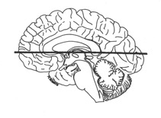
Internal Brain Structures
anterior limb
The genu of the internal capsule is the bundle of fibers that passes adjacent to the interventricular foramen at the anterior border of the thalamus.
Corticobulbar (corticonuclear) axons that innervate the motor nuclei of the cranial nerves travel in the genu.
genu
th
posterior limb

Slide 10
Question 1
Match each of the terms below (1 - 9) with the appropriate structure (A – M) on the coronal brain sections. (You will use the letters more than once)
1. Caudate nucleus 6. Insular cortex
2. Corpus callosum 7. Internal capsule
3. Fornix 8. Putamen
4. Globus pallidus 9. Thalamus
5. Hypothalamus
L
K
F
J
M
E
I
N
D
H
C
G
B
A

Slide 11

Question 2
Question 2
E
F
Match each of the terms below (1 - 6) with the appropriate structure (A – F) on the horizontal brain section.
Caudate nucleus
Corpus callosum
Internal capsule, anterior limb
Internal capsule, genu
Internal capsule, posterior limb
Putamen
Thalamus
D
G
F
C
B
A

Slide 12
Answers
Question 1
E, K
F, L
A
G, I
B
N
D, J
C, H
M
Question 2
E
F
D
C
B
G
A

