Slide 1
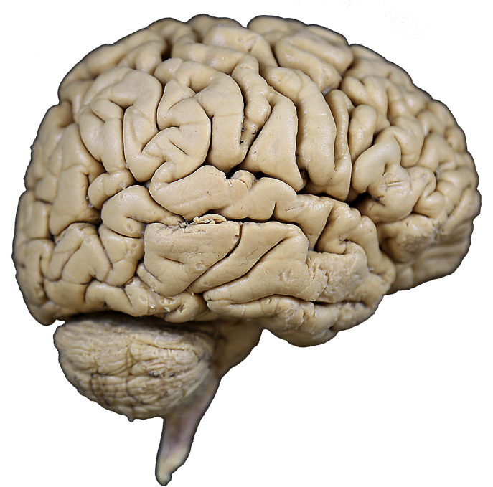

Cortical Lobes
Objectives:
To learn the names, locations and boundaries of six lobes of the cerebral cortex
Specimens Required:
Whole brains
Hemisected brains
Insular dissections

Slide 2

Cortical Lobes
Central Sulcus
Precentral
Gyrus
Postcentral
Gyrus
The outer surface of the hemisphere, the cerebral cortex, is folded into ridges called gyri, shallow grooves called sulci, and a few deeper grooves, called fissures.
For example, the central sulcus is flanked by the precentral gyrus and postcentral gyrus.
frontal
pole
occipital
pole

Slide 3
Cortical Lobes
.
Central Sulcus
Precentral
Gyrus
Postcentral
Gyrus
frontal pole
Four landmarks define the boundaries of the cortical lobes on the lateral surface of the cerebral hemisphere
1. Central Sulcus
2. Lateral Fissure
3. Preoccipital Notch
4. Parieto-occipital Sulcus
(Only its superior end
is seen on the lateral
surface. This sulcus
is on the medial surface
of the hemisphere.)
Central Sulcus
Lateral
Fissure
Lateral Fissure
Preoccipital
Notch
occipital
pole

Slide 4
Cortical Lobes
Central Sulcus
Precentral
Gyrus
1. The frontal lobe is bounded by the central sulcus and the lateral fissure.
2. The parietal lobe is bounded by the central sulcus and by two lines: one that connects the parieto-occipital sulcus
with the preoccipital notch and one that connects this line with the lateral fissure.
3. The temporal lobe is bounded by these two lines and the lateral fissure.
4. The occipital lobe is separated from the parietal and temporal lobes by the
line between the parieto-occipital sulcus and the preoccipital notch.
Postcentral
Gyrus
frontal pole
Central Sulcus
Parieto-occipital
Sulcus
Parieto-occipital
Sulcus
Parietal Lobe
Frontal Lobe
Occiptial Lobe
Temporal Lobe
Lateral
Fissure
Lateral Fissure
Cerebellum
Preoccipital
Notch
Preoccipital
Notch
Preoccipital
Notch
occipital
pole

Slide 5
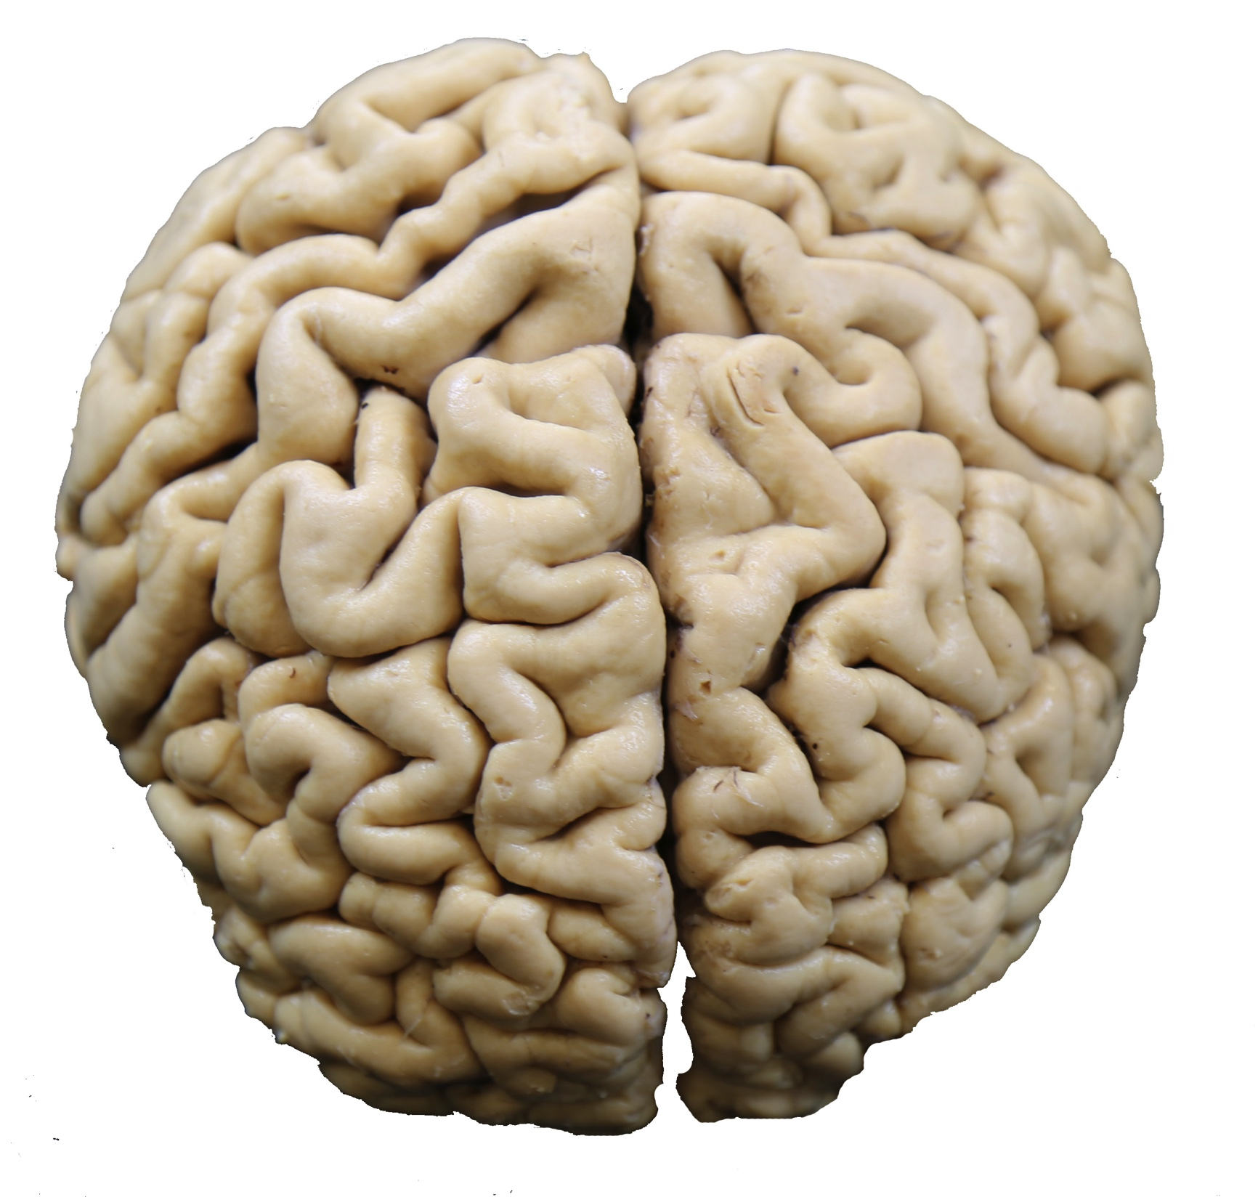
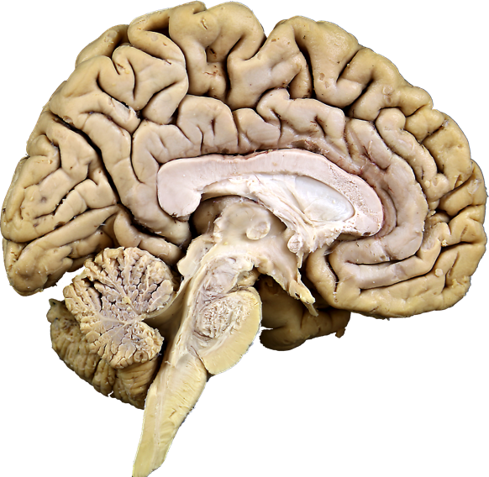
Cortical Lobes
posterior pole
Superior sagittal sulcus
Longitudinal fissure
Dorsal surface
of the whole brain
The medial surface of the hemisphere is viewed by cutting a sagittal section through the whole brain.
1. The brain is cut from the anterior pole to the posterior pole n the plane indicated by the red line.
2. This requires cutting through the corpus callosum, diencephalon and brain stem.
FRONTAL
LOBE
anterior pole
posterior
pole
anterior
pole
C
D
medial surface of the left
cerebral hemisphere
BS

Slide 6
Cortical Lobes
*Paracentral Lobule
Parieto-occipital sulcus
On the medial surface of the left hemisphere we see only the superior end of the central sulcus but a full view of the parieto-occipital sulcus.
At the superior end of the
central sulcus, the precentral
and postcentral gyri come
together to form the
paracentral lobule.
The parieto-occipital sulcus
divides the parietal and
occipital lobes on the
medial surface.
* *
Parietal
Lobe
C
Occiptial
Lobe
Frontal
Lobe
D
BS
Cerebellum

Slide 7
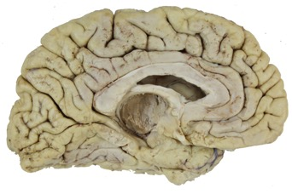
Cortical Lobes
To view the fifth lobe of the cortex we remove the diencephalon, brain stem and cerebellum.
This view allows us to see the limbic lobe, a continuous ring of cortex surrounding the corpus callosum and diencephalon.
Its boundaries are the cingulate sulcus and the collateral sulcus.
CINGULATE
SULCUS
Cingulate sulcus
Frontal Lobe
Parietal
Lobe
Limbic Lobe
Occiptial
Lobe
Collateral sulcus

Slide 8
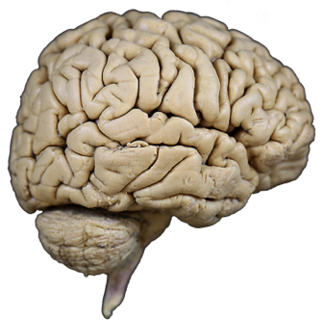
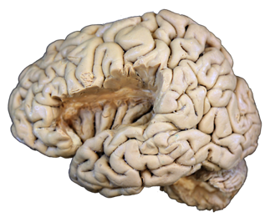
Cortical Lobes
Parietal
Lobe
Frontal
Lobe
The sixth lobe of the cerebral cortex is the insula, or island lobe.
This lobe is covered by the
growth of the frontal, parietal and temporal lobes during fetal development, so that in the adult brain, it is only visible by pulling or cutting away the overlying edges (opercula) of these lobes.
The insula is essentially the floor of the deep lateral fissure.
Temporal Lobe
Insular Lobe
Lateral fissure

Slide 9
Question I
A
B
C
D
For each cortical lobe (1 - 6), indicate the view(s) of the brain (A - D) on which all or part of this lobe is seen.
1.Temporal ___________________
Parietal ___________________
Limbic ___________________
4. Occipital ___________________
5. Frontal ___________________
6. Insular ___________________

Slide 10
Cortical Lobes
Question II
Match the following cortical landmarks (A - D) with the descriptions of cortical lobe boundaries (1 - 6). A landmark may serve as a boundary in more than one of these descriptions or none of them.
Lateral Fissure
Parieto-occipital sulcus
Collateral sulcus
Preoccipital notch
Central sulcus
Cingulate sulcus
_____ 1. Separates the limbic lobe from the frontal lobe
_____ 2. Separates the limbic lobe from the temporal lobe
_____ 3. Separates the frontal lobe from the temporal lobe
_____ 4. Separates the occipital lobe from the parietal lobe
_____ 5. Separates the limbic lobe from the parietal lobe
_____ 6. Separates the frontal lobe from the parietal lobe

Slide 11
Cortical Lobes
Question I
1. A, C, D
2. A, B, C, D
3. B, C
4. A, B. C, D
5. A, B, C, D
6. D
Question II
1. F
2. C
3. A
4. B
5. F
6. E

