Slide 1
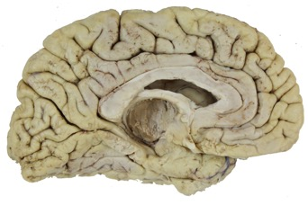

Limbic Lobe, Hippocampal Formation, Amygdala
Objectives:
Identify the gyri and sulci that comprise the limbic lobe of the cerebral cortex.
Locate the hippocampal formation, fornix and amygdala in dissected specimens and brain sections.
Learn the basic subdivisions of the hippocampal formation.
Specimens Required:
Limbic dissected hemisphere
Coronal sections
Cingulate sulcus
Frontal Lobe
Parietal
Lobe
Limbic Lobe
Occiptial
Lobe
Collateral sulcus

Slide 2
Limbic Lobe, Hippocampal Formation, Amygdala
medial view of
the left cerebral
hemisphere
The limbic lobe of the cortex consists primarily of the cingulate and
parahippocampal gyri.
The fornix connects the hippocampal formation with the hypothalamus.
From the temporal lobe, the fornix curves around the thalamus and approaches the midline under the caudal part of the corpus callosum.
Cingulate gyrus
Frontal Lobe
Parietal
Lobe
Fornix
cc
Thalamus
Occiptial
Lobe
Parahippocampal gyrus

Slide 3
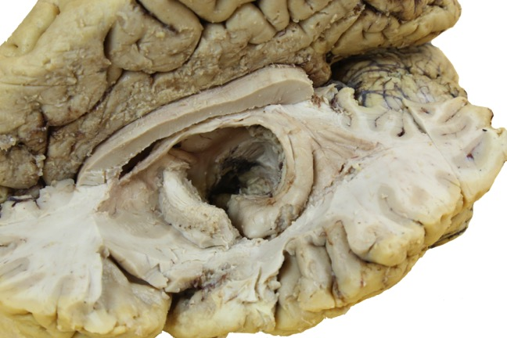
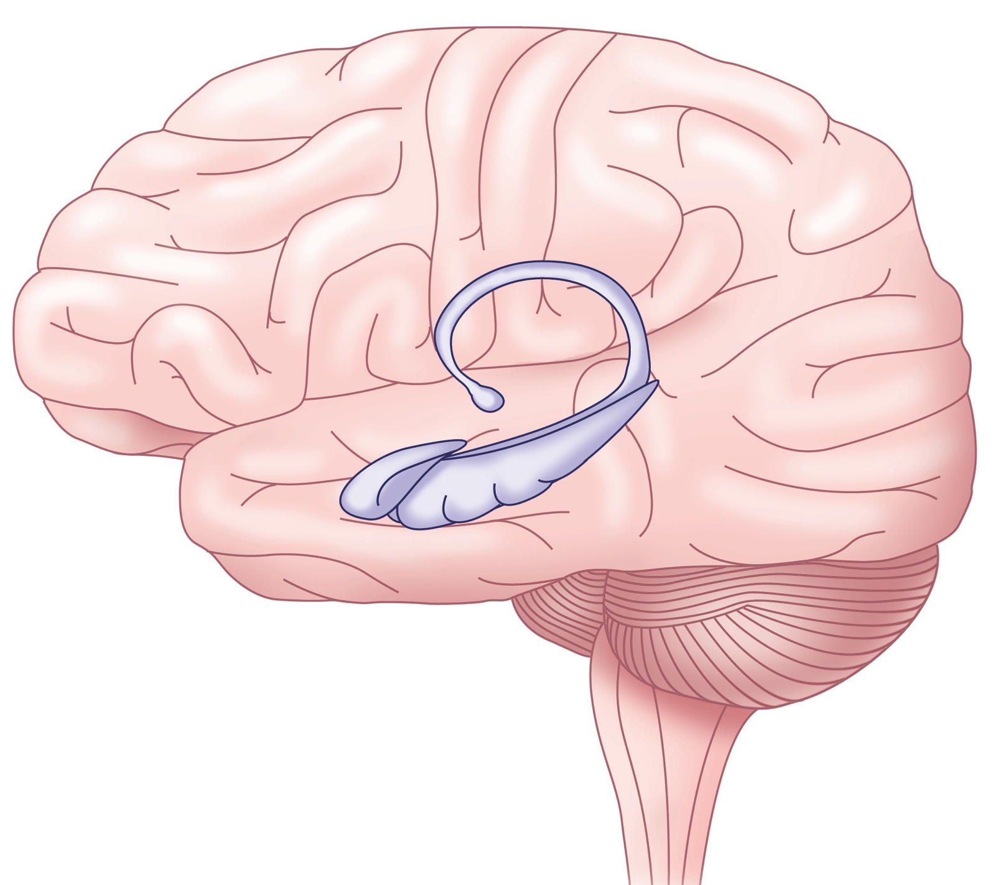
Limbic Lobe, Hippocampal Formation, Amygdala
The hippocampal formation and the amygdala are often described as being “inside” the telencephalon.
The hippocampal formation may be viewed in the floor of the inferior horn of the lateral ventricle. f = fornix
f
f
ac
a
h
h
In this dissection, the amygdala is obscured by the anterior commisure.

Slide 4
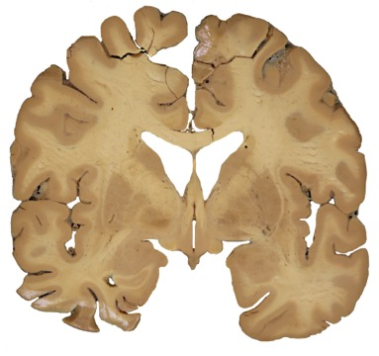
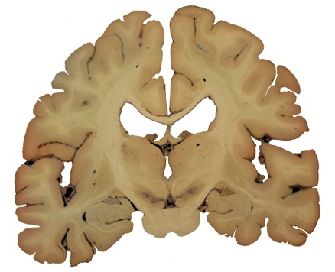
However, the amygdala and hippocampal formation
are cortical areas that are continuous with
surface cortical structures.
A
A
B
amygdala
fornix &
mammillary
body
B
amygdala
hippocampal
formation
fornix
hippocampal formation

Slide 5
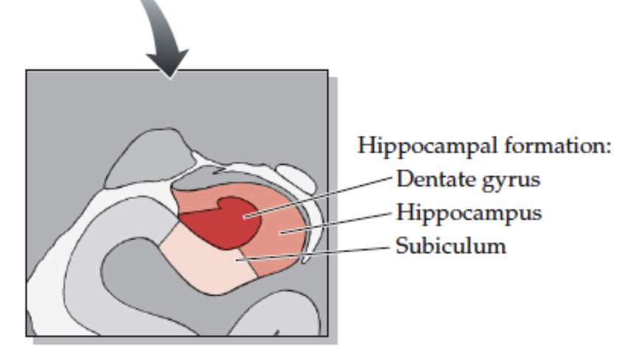
Hippocampal Formation
The hippocampal formation
has three parts. These are
cortical areas that are folded
into one another at the
medial edge of the
parahippocampal gyrus.
dentate gyrus
hippocampus
subiculum

Slide 6
Amygdala
A coronal slice through the brain reveals the amygdala.
The amygdala is a matrix of many nuclei divided into two “divisions”:
Basolateral (BL)
Corticomedial (CM)
The BL and CM nuclei differ
in their connections (and therefore
their functions) and in their neurotransmitters.
(Note that this section cuts through the fornix as it enters the hypothalamus in the
wall of the third ventricle.)
fornix
CM
BL
amydgala
uncus of the
parahippocampal gyrus

Slide 7
Question
For questions 1-4, indicate whether the statement is true (T) or false (F).
____ 1. The hippocampal formation is in the cingulate gyrus.
____ 2. The hippocampal formation is a cortical structure.
____ 3. The amygdala is deep to the uncus.
____ 4. The amygdala is a cortical structure.
____ 5. The paraphippocampal gyrus is one of the subdivisions of the hippocampal
formation.
____6. What are the 3 components of the hippocampal formation?

Slide 8
Answers
F
T
T
T
F
Hippocampus, subiculum, dentate gyrus

