Slide 1
Introduction to Virology

Slide 2
What is a virus?
viral particle (aka virion; show some photos)
  nucleic acid
  protein coat
  (envelope)
can only replicate in a living cell

Slide 3
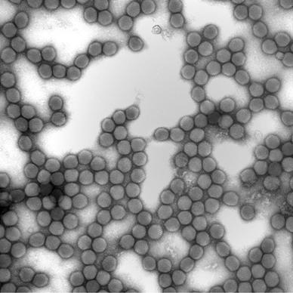
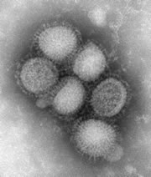
adenovirus
influenza A virus

Slide 4
Viral genome
DNA or RNA
single- or double-stranded
single segment or multi-segmented

Slide 5
Viral structural proteins
histone-like proteins that coat the genome
proteins involved in binding and entry into cells
proteins that are required to begin genome replication

Slide 6
Terminology
core: genome plus histone-like proteins
capsid: structural proteins that give virus its characteristic shape
nucleocapsid: core plus capsid
envelope: lipid bilayer derived from host cell that surrounds the nucleocapsid

Slide 7
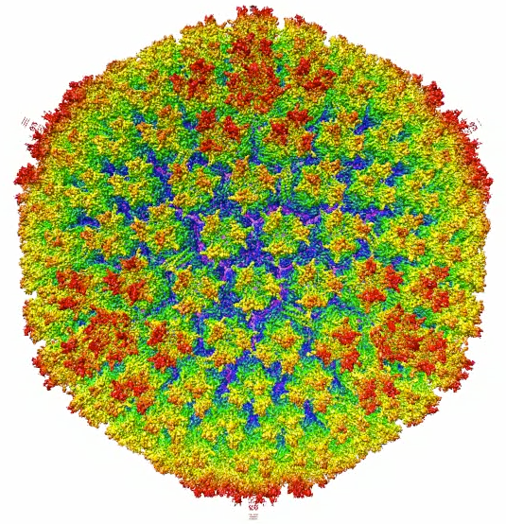
Capsids
usually symmetric
metastable structures
  stable enough to persist outside cell
  unstable enough to disassemble upon infection of new cell

Slide 8
Virus classification
complicated
  type of genome
  morphology
  replication mechanism
viruses in the same family can cause widely different diseases

Slide 9
Viral life cycle
bacteria grow and divide
viruses synthesize parts and assemble

Slide 10
Virus life cycle
binding and entry
protein and genome synthesis
assembly
egress
(will have a figure to illustrate this)

Slide 11
Cellular outcomes
lytic replication
persistence/latency
abortive infection
oncogenic transformation

Slide 12
Pathology of infection - 1
direct effects of virus
  inhibition of host protein synthesis
  apoptosis
  cell lysis

Slide 13
Pathology of infection - 2
indirect effects due to immune response
  cytokine effects
  cell-mediated immunity
  antibody-mediated pathologies

Slide 14
Immune response
innate
humoral
cytokines
cell-mediated
viral evasion

Slide 15
Host outcomes
local replication and clearance
viremia
persistent infection
  latency
  chronic infection
oncogenesis
systemic disease

Slide 16
Transmission
major routes
  respiratory
  sexual
  fecal-oral
  parenteral
  insect vectors

Slide 17
Diagnostic tests
serology
PCR
cell culture-based assays
ELISA

