Slide 1

ICPC
What is it and how do I participate?

Slide 2
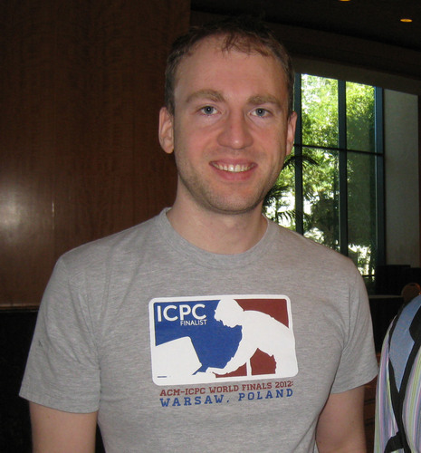
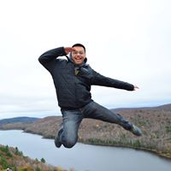
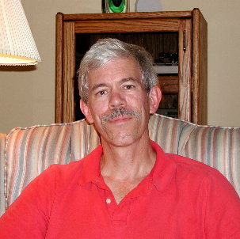
Coaching Staff
Dennis Matveyev (Alumnus)
Shang-En Huang (Ph.D. grad student)
Kevin Compton (Professor Emeritus)

Slide 3
International Collegiate Programming Contest
Sponsored by Association for Computing Machinery (largest computer science professional organization)
Programming contest for undergrads and first-year grad students
International – Universities from every continent except Antarctica participate

Slide 4
Three Stages
Regional Contest – East Central North America (ECNA) Region: Lower Michigan, Ohio, Indiana, Pennsylvania and Ontario
North American Contest (NAC) -- first held 2020. Top teams from North American Regionals (including UM)
World Finals – UM qualified for Prague 2004, Shanghai 2005, Harbin (China) 2010, Orlando 2011 (gold medal), Ekaterinburg (Russia) 2014, Marrakech (Morocco) 2015, Rapid City (South Dakota) 2017, Beijing 2018

Slide 5
Contest Format
3 students per team using one computer, 5 hours
At the Regional: multiple teams from a university At NAC and World finals: at most one team per university
10 to 12 problems. Team working most problems wins. Tie breaker: least time (with wrong submission penalty)
C++ (with STL), Java, Python

Slide 6
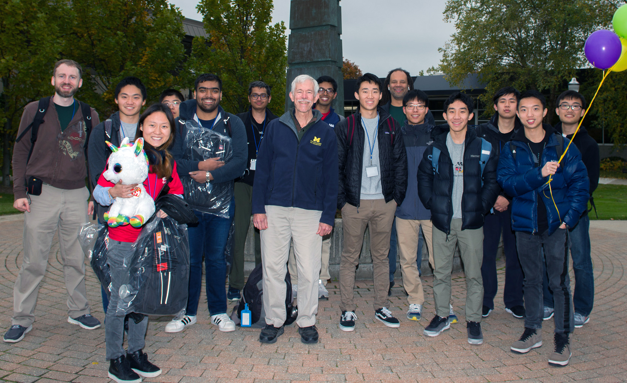
Regional Contest
Usually late Oct or early Nov. Covid delay: Winter sem.
Usually travel and overnight. Probably not this time.
Usually 5 teams from UM.
Much still unknown this year.

Slide 7
A Typical (Easy) Problem
See the PDF

Slide 8
What We Will Do This Semester?
Practice, practice, practice.
Practice contests, first solo. At some point we will have team tryouts and then practice as teams.
Tutorials on problem solving and tricks of the trade (from the master, Shang-En).
Possible other materials from ICPC Foundation and Jet Brains

Slide 9
What You Need to Do
Let us know (at any time) if you want us to take your name off our email list
Otherwise, you will receive instructions within the next day or so on how to use Code Forces (for the first two contests), then Kattis (the official contest system) for the others
There will be an online practice contest at 6 pm Friday (Oct 2). Simple problems – this is to get used to the system and the compiler version used.
This is a work in progress. More announcements later.

Slide 10
THANKS FOR ATTENDING!
Questions?

