Slide 1


ENDPOINT PROTECTION
EDR
Detection and response to threats
Improving visibility of threats.
Detection
Investigation
Response
IDENTITY LLC · +998 78 555-11-75 · identity-uz.com

Slide 2
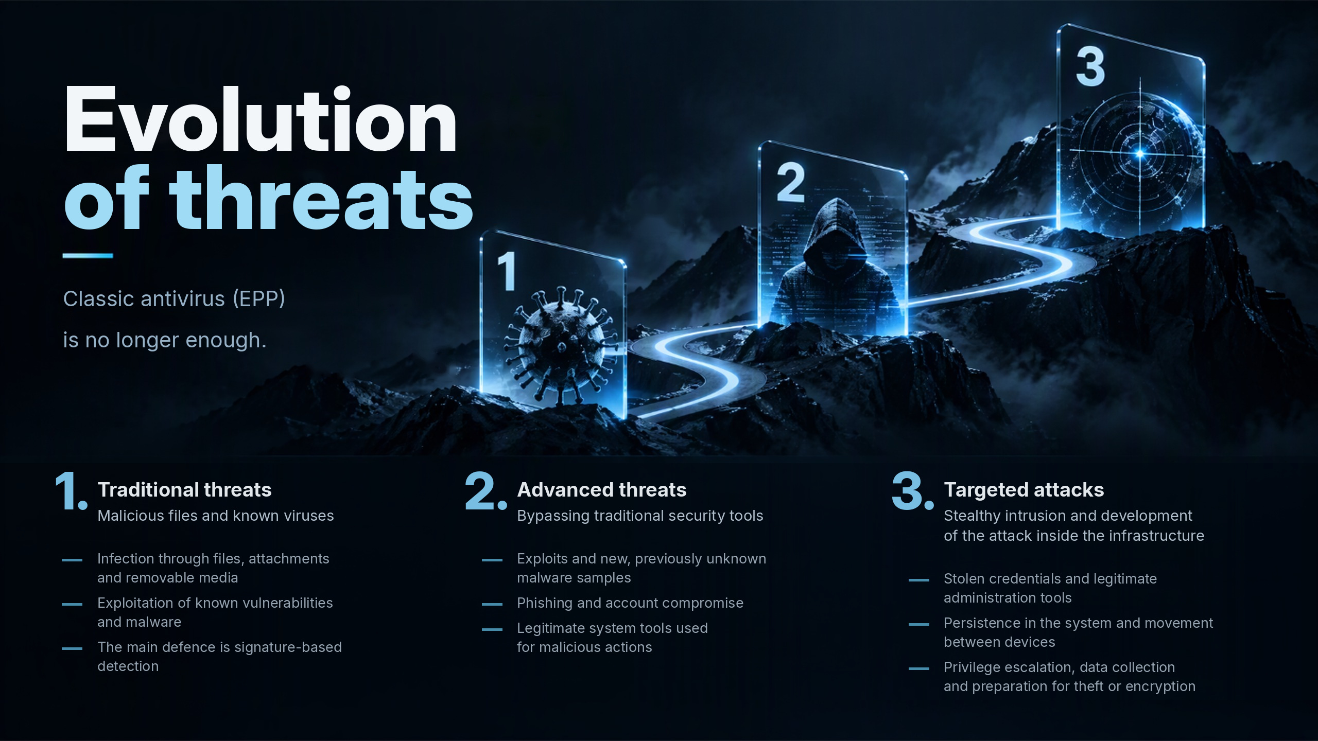






Slide 3









OBJECTIVES
Why you need EDR
1
2
3
4
Detection
Investigation
Response
Risk reduction
Identifying suspicious behaviour and hidden threats
Reconstructing the chain of events and finding the root cause
Isolating devices and stopping malicious activity
Limiting damage and improving security efficiency
IN SUMMARY
Lower risk of downtime for critical workstations and servers
Confidential data protected from unauthorised access and theft
Better visibility of information security events
Faster investigations thanks to centralised event data
3 / 14 EDR

Slide 4




SOLUTION ARCHITECTURE
EDR components
Telemetry and local control
Incident analysis and attack containment
Administration and integration
1
EDR agent
4
Analytics and correlation
8
Integrations
Collects data on processes, files, network and user actions
Links separate events into a single picture of the attack
Data exchange with SIEM, SOAR, ITSM, user directories
2
Telemetry collection
5
Incident investigation
9
Access control
Records security events and sends them for analysis
Timeline of events, processes, files and attacker actions
Roles, user rights, security policies, action audit
3
Threat detection
6
Threat response
10
Centralised management
Suspicious behaviour, indicators of compromise, attack techniques
Device isolation, process termination, file quarantine
Policy setup, agent management, device status
7
Monitoring and reporting
Incidents, alerts, statistics and results
4 / 14 EDR

Slide 5

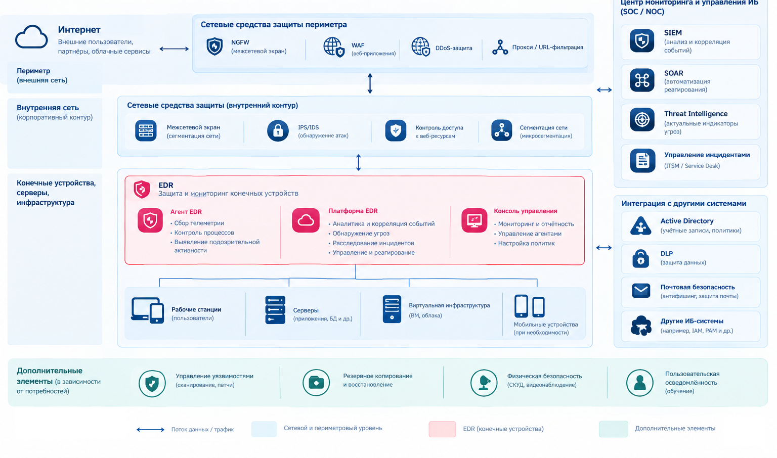



SECURITY ARCHITECTURE
EDR in the security architecture
Perimeter and network
NGFW, WAF, IPS/IDS protect the network — but do not see what happens on the device
EDR — endpoints
Agent, platform and console: visibility and response on every device
SOC and integrations
SIEM, SOAR, ITSM, Active Directory, DLP — a single perimeter
5 / 14 EDR

Slide 6

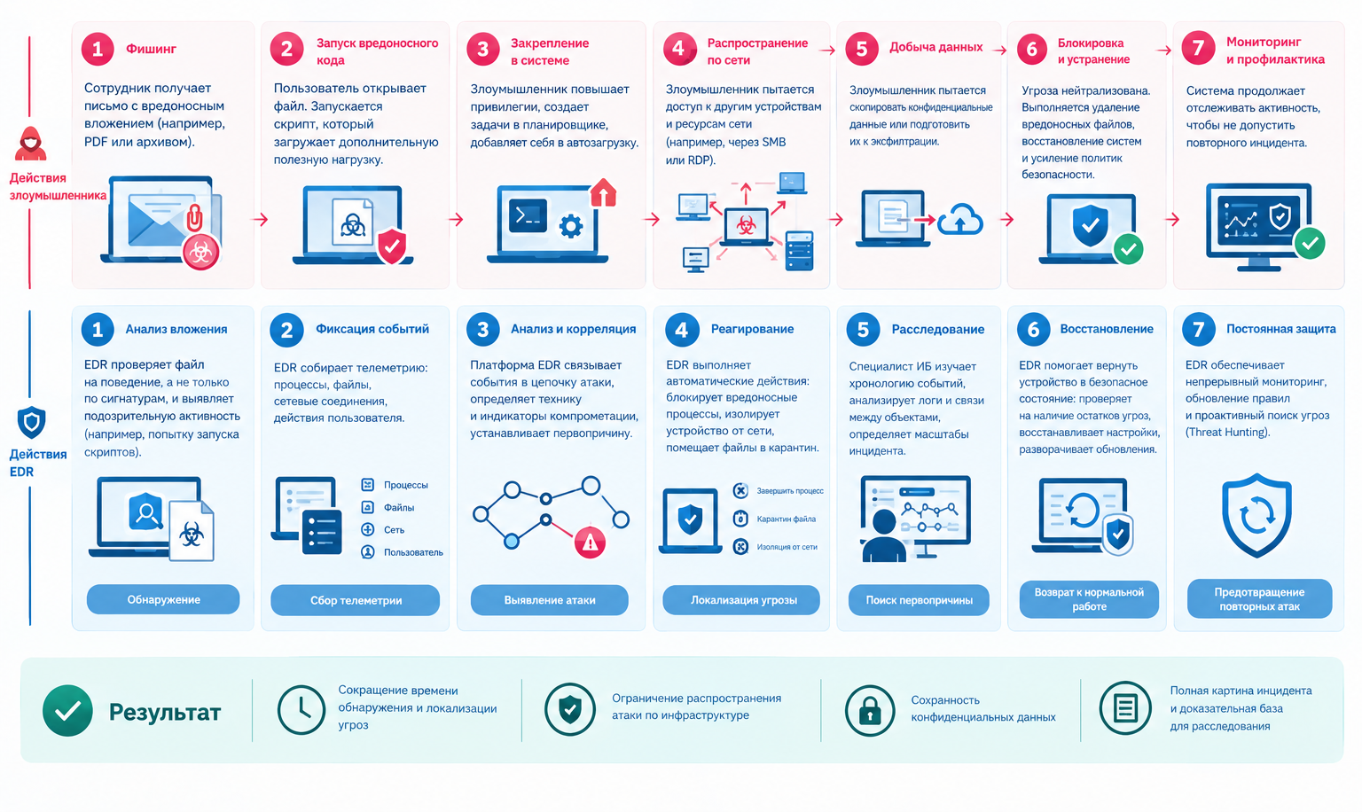




EXAMPLE
Attack and defence scenario
RESULT
Less time to detect and contain a threat
The attack is kept from spreading across the infrastructure
Confidential data stays safe
A full picture of the incident and an evidence base
6 / 14 EDR

Slide 7







CAPABILITIES
Functional capabilities
Continuous monitoring
Threat detection
Attack chain analysis
Investigation
Uninterrupted control of endpoints
Including fileless attacks
Events linked into a single picture
Timeline and root cause of the incident
Response
Centralised management
Integration
Alerts and reports
Device isolation and process termination
Policies and agents from a single console
Data exchange with other security systems
Notifications and incident reporting
7 / 14 EDR

Slide 8


KEY ASPECTS
Detection, response, manageability
Detection of new attack types
Automatic response
Manageability
Fileless attacks
Ransomware
Exploitation of vulnerabilities
Attacks using legitimate tools (PowerShell and others)
Attempts to steal accounts
Persistence in the system and lateral movement
Terminating a suspicious process
Quarantining a suspicious file
Blocking malicious files from running
Isolating a device from the network
Running pre-configured playbooks
Control of agents on endpoints
Control of security policies
Control of events and incidents
Control of administrator actions
8 / 14 EDR

Slide 9






IN PRACTICE
Threats and countermeasures
THREAT
EDR CAPABILITY
RESULT
Ransomware launch
Detection of suspicious behaviour, blocking or isolation
Less potential damage
PowerShell used in an attack
Analysis of the process and command chain
Suspicious activity identified
Workstation compromise
Event investigation and device isolation
The attack is kept from spreading
Long attacker dwell time
Threat hunting and retrospective analysis
Previously unnoticed activity identified
9 / 14 EDR

Slide 10







VALUE
Benefits for customers
MTTD / MTTR
Complex and targeted attacks
Less damage
days → minutes
Detection of attacks that other tools miss
Infected devices isolated and processes stopped
Less time to detect and respond to incidents
Financial and reputational risks
Business continuity
Minimising the consequences of successful attacks, including ransomware
Critical workstations and servers protected from downtime
Less load on L1/L2
Provable investigations
Routine analyst work is automated
A managed process and a full picture of every incident
10 / 14 EDR

Slide 11





SOLUTIONS
Proposed solutions
Pilot project
Launch on a limited group of devices: effectiveness assessed on the real infrastructure
CHOOSING A PLATFORM
An EDR platform from a leading vendor for your infrastructure
Turnkey implementation
The solution is chosen based on:
Design, deployment, response rules and integrations, training
The fleet of workstations and servers and the operating systems in use
Deployment on the customer's servers (on-premise)
Integration with SIEM, SOAR, ITSM and Active Directory
Regulator requirements and internal security policies
Support
Technical support, policy updates and help with incident investigation
11 / 14 EDR

Slide 12




IMPLEMENTATION
Implementation stages
1
2
3
4
Pilot project
Assessment
Design
Response rules
Understanding how the system works
Inventory of workstations and servers, review of existing security tools
Deployment of the management platform, setting up interaction
Incident priorities and escalation rules
5
6
7
Integration
Testing and acceptance
Production operation
With the existing perimeter: SIEM, SOAR, ITSM
Checking how the system and response scenarios work
Training, scaling to all devices, operational documentation
12 / 14 EDR

Slide 13

NEXT STEPS
Ways to get to know the system
OPTION 1
OPTION 2
RECOMMENDED
Demonstration
Pilot on a test stand
Pilot in the customer's infrastructure
Getting to know the capabilities and interface of the system
Checking key functions under controlled conditions
Running on real workstations and servers
WHAT IS INCLUDED
WHAT IS INCLUDED
WHAT IS INCLUDED
Demo on a test stand
Walkthrough of detection and response scenarios
Answers to questions from security specialists
A stand with agents on test devices
Simulation of typical attacks
Assessment of how convenient the console is
A limited group of devices
Real telemetry and incidents
A final report and implementation plan
13 / 14 EDR

Slide 14




CONTACTS
Let's discuss protecting your devices
We will run an assessment, launch a pilot and choose an EDR solution for your infrastructure
IDENTITY LLC
+998 78 555-11-75
info@identity-uz.com
Submit a request: identity-uz.com

