Slide 1

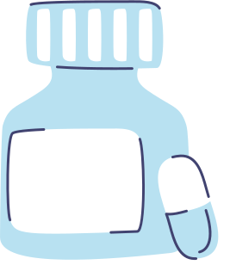




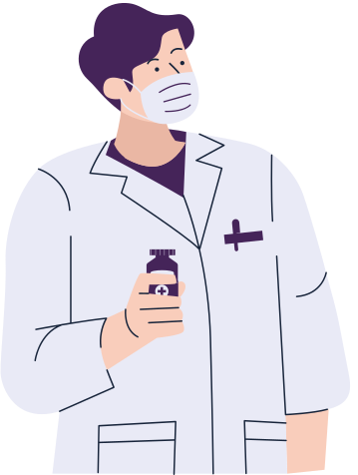
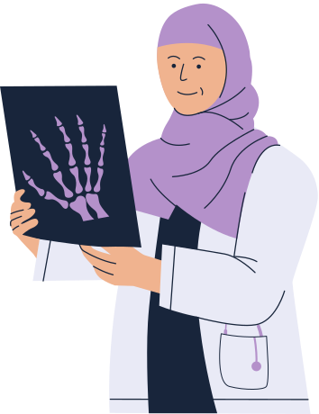
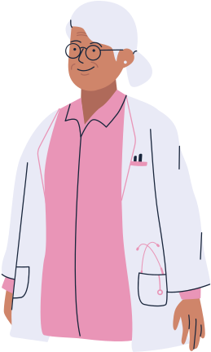

OOP
in Hospitals

Slide 2
Brainstorming
Step 1
Step 2
Undestanding requirements of the task. Requirements:
Inheritance, Polymorphusm, Encapsulation, Templates
Exploring and identifying similarities among the optional sample ideas presented—such as a CRM or IT system for a company, a shopping mall, a logistics operation, or a taxi service.
Step 3
Step 4
Finding several different variants by using requirements and sample ideas, then choosing the best one
Discussing all system features and classes. Creating a UML diagram on paper

Slide 3
OUR IDEA
System for Hospital
Classes:
Person Medicine Record
Doctor Disease
Patient Room
Relationship between classes
Doctor is‐a Person
Patient is‐a Person
Patient has‐a list of Disease
Patient has‐a list of Medicine
Patient has‐a Room

Slide 4
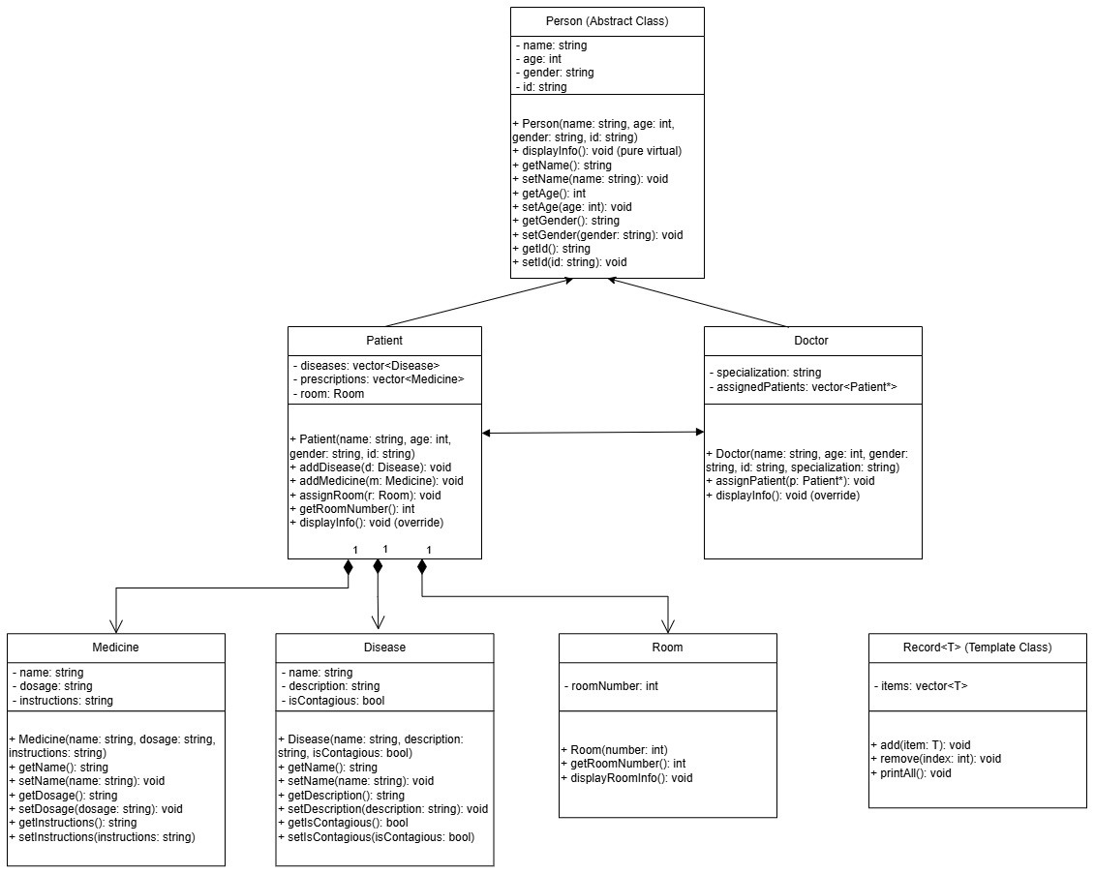
UML DIAGRAM

Slide 5
Contributions of each group member
Jahongir
Kamronbek
Umidjon
Person
Doctor
Room
UML
Patient
Muhammadaziz
Jahongir
Disease
Medicine
Main

Slide 6
Challenges
Communication
(Finding comfortable time)
Brainstorming
(Finding idea for project)

Slide 7
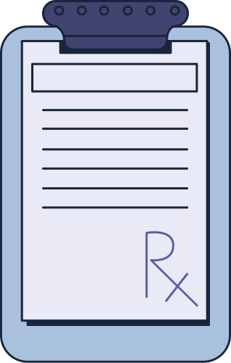
Conclusion
Each communication method has its own role.
We have used several methods of communication, including face-to-face interactions, chatting, and audio. Each method has its own advantages and disadvantages. For effective communication, it is best to use all of them.
We love coding
All of our team members are Computer Science students. Four are Cybersecurity students, and one is a Software Engineering student. This small project showed us what it is like to code collaboratively.

