Slide 1
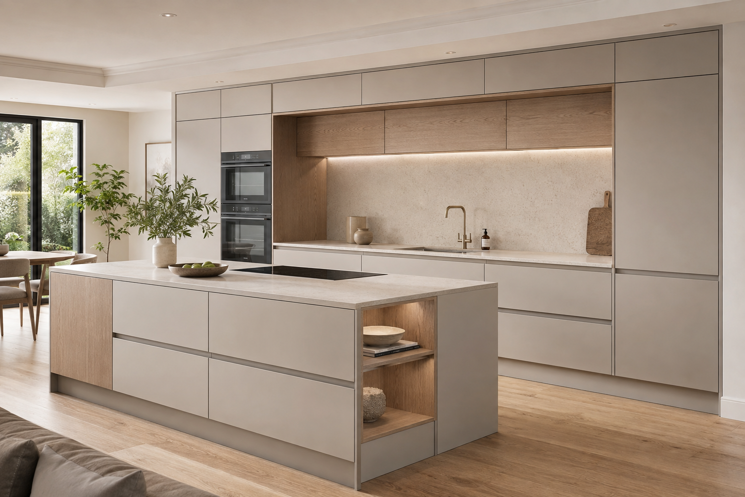
Kitchen product page
Structure for review
Option 01: Signature
25 October 2026
Please comment on the section order, layout and content requests on the following slides.
Kitchen reference image. Final project photography to follow.
CASEN DOORS Kitchen page review
01
Notes:
Meeting source: https://notes.granola.ai/t/4ade12de-b629-402c-a375-4e67a93b7442-009c2hma
Reference page: https://casen-doors.com/products/luxury-exterior-doors-casen-series-2
Door-page screenshots show layout references. Kitchen copy, claims and technical specifications require William's approval. The exact page used during the call has not been independently confirmed.

Slide 2
Proposed page order
01 Kitchen photograph and configurator
02 Four feature images and specifications
03 Colour options PDF
04 Why Invest in a Kitchen
05 Previous work
06 Guarantee and linked document
07 FAQ
08 Google Reviews
09 You May Also Like
10 Footer
Order Process: optional section. Position to confirm.
William’s comments: section order and Order Process position
CASEN DOORS Kitchen page review
02
Notes:
Meeting source: https://notes.granola.ai/t/4ade12de-b629-402c-a375-4e67a93b7442-009c2hma
Reference page: https://casen-doors.com/products/luxury-exterior-doors-casen-series-2
Door-page screenshots show layout references. Kitchen copy, claims and technical specifications require William's approval. The exact page used during the call has not been independently confirmed.

Slide 3
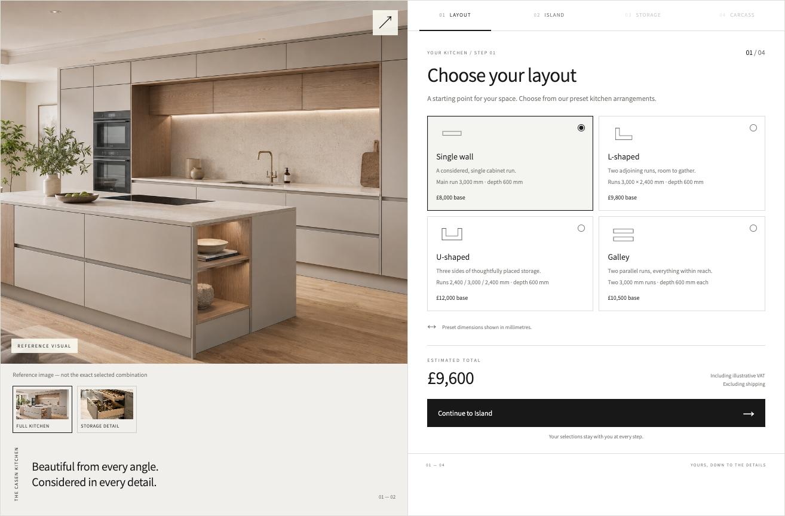
01 Kitchen photograph and configurator
Product title above the main content.
Large kitchen image beside the four configuration steps.
Running price and quotation action.
Needed: exact title, introduction, catalogue and approved prices.
Option 01 prototype. Prices, dimensions and images are illustrative.
William’s comments: title, image position and configuration controls
CASEN DOORS Kitchen page review
03
Notes:
Meeting source: https://notes.granola.ai/t/4ade12de-b629-402c-a375-4e67a93b7442-009c2hma
Reference page: https://casen-doors.com/products/luxury-exterior-doors-casen-series-2
Door-page screenshots show layout references. Kitchen copy, claims and technical specifications require William's approval. The exact page used during the call has not been independently confirmed.

Slide 4
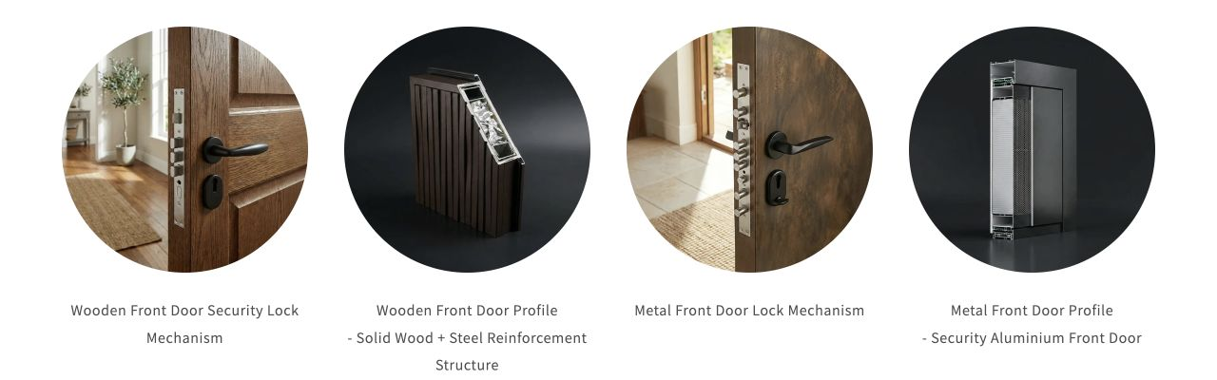
02 Features and specifications
Four circular images with short headings and descriptions.
Needed: four kitchen images and approved copy.
Please identify where carcass and door materials and thicknesses should appear.
Existing door page: four circular feature images.
William’s comments: four feature topics and standard specifications
CASEN DOORS Kitchen page review
04
Notes:
Meeting source: https://notes.granola.ai/t/4ade12de-b629-402c-a375-4e67a93b7442-009c2hma
Reference page: https://casen-doors.com/products/luxury-exterior-doors-casen-series-2
Door-page screenshots show layout references. Kitchen copy, claims and technical specifications require William's approval. The exact page used during the call has not been independently confirmed.

Slide 5

03 Colour options
Downloadable kitchen colour PDF in the same format.
Needed: final kitchen colour file and link label.
This is a document download. A colour selection step has not been agreed.
Existing door page: downloadable colour charts.
William’s comments: PDF title, number of files and placement
CASEN DOORS Kitchen page review
05
Notes:
Meeting source: https://notes.granola.ai/t/4ade12de-b629-402c-a375-4e67a93b7442-009c2hma
Reference page: https://casen-doors.com/products/luxury-exterior-doors-casen-series-2
Door-page screenshots show layout references. Kitchen copy, claims and technical specifications require William's approval. The exact page used during the call has not been independently confirmed.

Slide 6
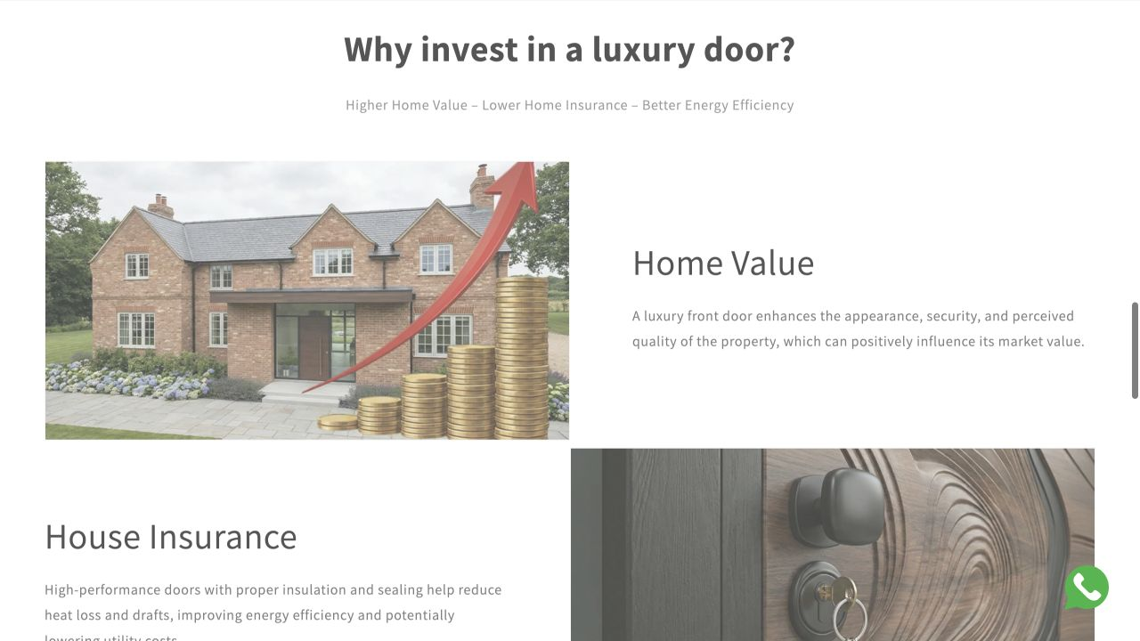
04 Why Invest in a Kitchen
Alternate image and text positions between blocks.
Needed: kitchen-specific headings, photographs and approved descriptions.
Please confirm the number of blocks.
Existing door page: alternating image and text blocks.
William’s comments: block count, headings and image order
CASEN DOORS Kitchen page review
06
Notes:
Meeting source: https://notes.granola.ai/t/4ade12de-b629-402c-a375-4e67a93b7442-009c2hma
Reference page: https://casen-doors.com/products/luxury-exterior-doors-casen-series-2
Door-page screenshots show layout references. Kitchen copy, claims and technical specifications require William's approval. The exact page used during the call has not been independently confirmed.

Slide 7
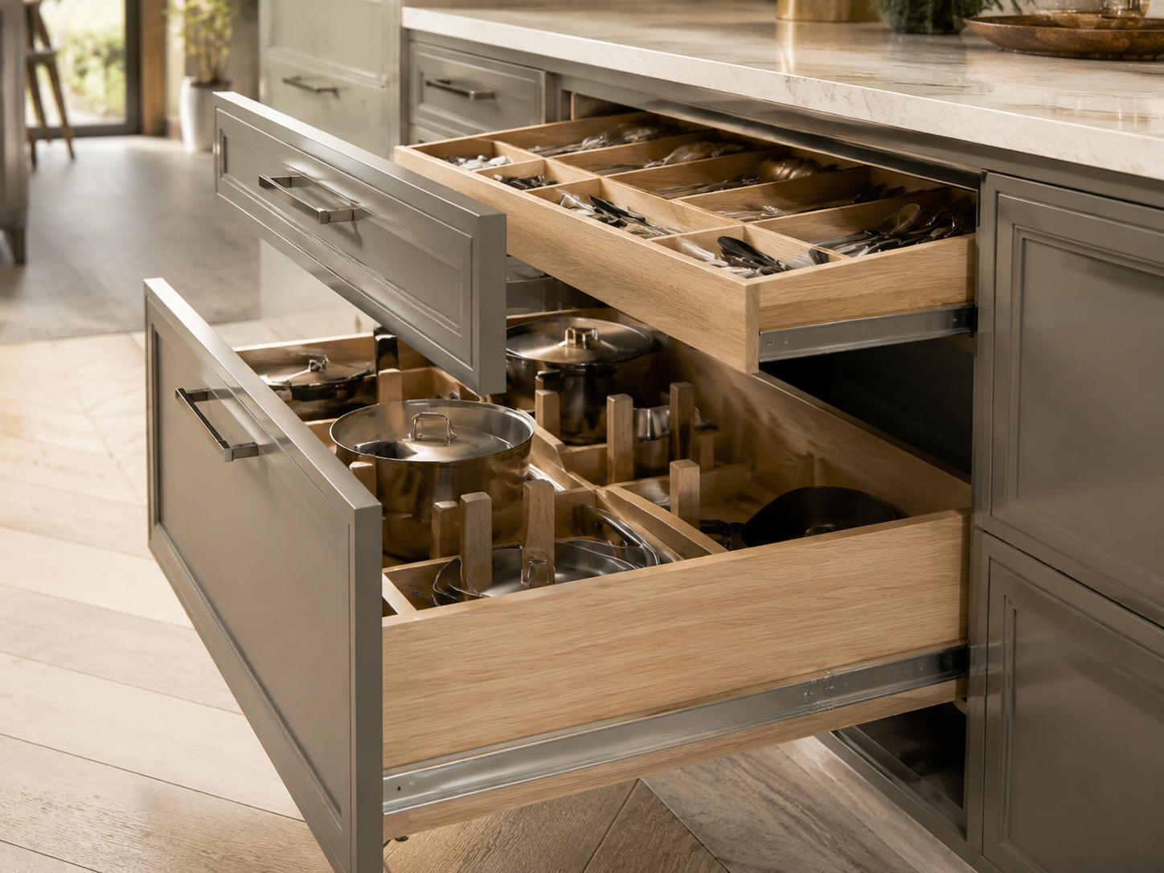
05 Previous work
Kitchen project photographs with short descriptions.
Follow the alternating image and text format.
Needed: projects to feature, images and approved captions.
Reference detail image. Client project photography is still needed.
William’s comments: projects to feature and image permissions
CASEN DOORS Kitchen page review
07
Notes:
Meeting source: https://notes.granola.ai/t/4ade12de-b629-402c-a375-4e67a93b7442-009c2hma
Reference page: https://casen-doors.com/products/luxury-exterior-doors-casen-series-2
Door-page screenshots show layout references. Kitchen copy, claims and technical specifications require William's approval. The exact page used during the call has not been independently confirmed.

Slide 8
06 Guarantee
10-year guarantee
Needed from William
Approved kitchen guarantee terms
Functionality guarantee wording
Downloadable document
Link label and contact details
Proposed heading from the meeting. Kitchen coverage and wording require confirmation.
William’s comments: coverage, exclusions and linked document
CASEN DOORS Kitchen page review
08
Notes:
Meeting source: https://notes.granola.ai/t/4ade12de-b629-402c-a375-4e67a93b7442-009c2hma
Reference page: https://casen-doors.com/products/luxury-exterior-doors-casen-series-2
Door-page screenshots show layout references. Kitchen copy, claims and technical specifications require William's approval. The exact page used during the call has not been independently confirmed.

Slide 9
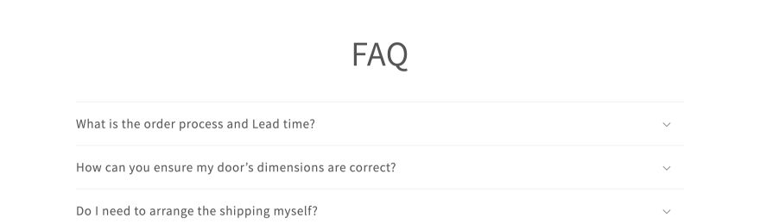
07 Frequently asked questions
Use the same accordion format as the door page.
Needed: kitchen questions and approved answers.
Suggested topics: ordering, quotation confirmation, delivery, installation and care.
Existing door page: expandable FAQ rows.
William’s comments: FAQ topics, answers and order
CASEN DOORS Kitchen page review
09
Notes:
Meeting source: https://notes.granola.ai/t/4ade12de-b629-402c-a375-4e67a93b7442-009c2hma
Reference page: https://casen-doors.com/products/luxury-exterior-doors-casen-series-2
Door-page screenshots show layout references. Kitchen copy, claims and technical specifications require William's approval. The exact page used during the call has not been independently confirmed.

Slide 10
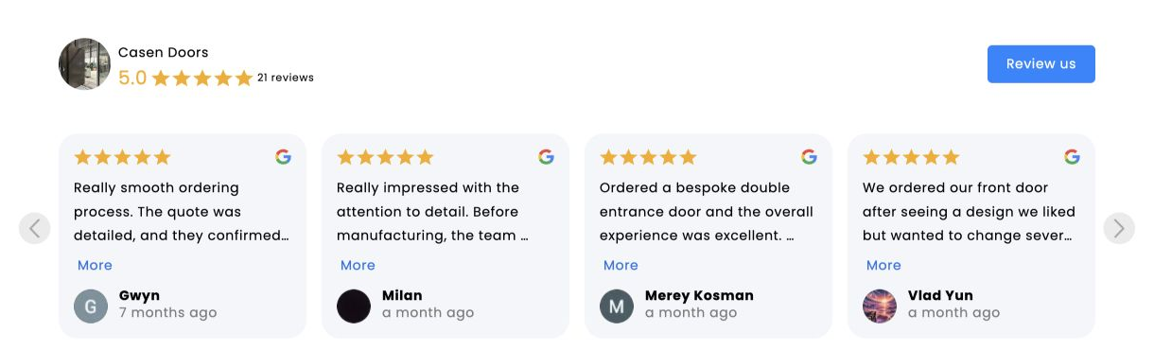
08 Google Reviews
Reuse the existing Shopify plugin where compatible.
Confirm which reviews should appear on the kitchen page.
Keep the live rating and review content managed by the plugin.
Existing Shopify reviews widget. Displayed reviews concern the current store.
William’s comments: store-wide reviews or kitchen-specific reviews
CASEN DOORS Kitchen page review
10
Notes:
Meeting source: https://notes.granola.ai/t/4ade12de-b629-402c-a375-4e67a93b7442-009c2hma
Reference page: https://casen-doors.com/products/luxury-exterior-doors-casen-series-2
Door-page screenshots show layout references. Kitchen copy, claims and technical specifications require William's approval. The exact page used during the call has not been independently confirmed.

Slide 11
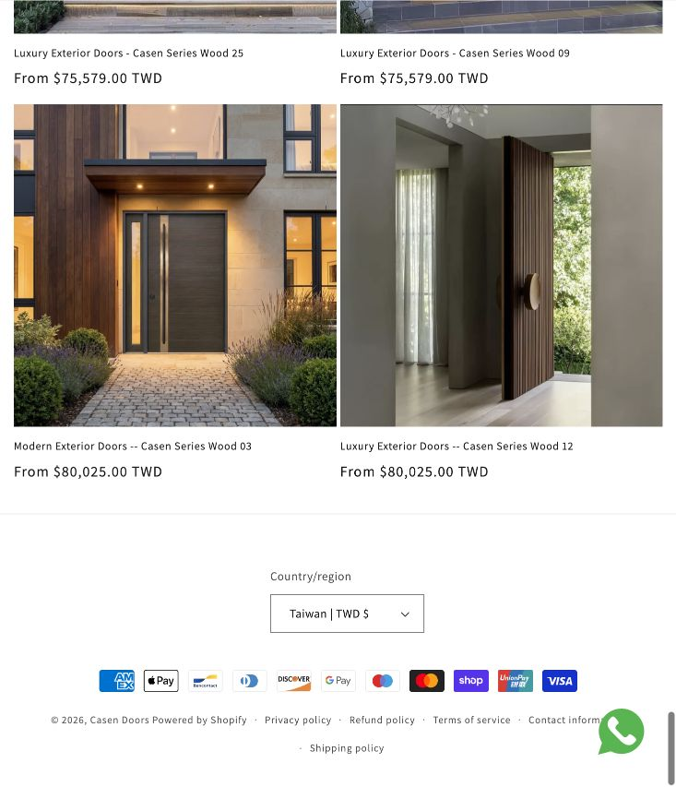
09–10 Related products and footer
You May Also Like: four products.
Needed: product links or the preferred recommendation rule.
Reuse the existing footer.
Add Kitchen to the main navigation.
Existing product recommendations and footer, shown at a narrower viewport.
William’s comments: four products, navigation label and destination
CASEN DOORS Kitchen page review
11
Notes:
Meeting source: https://notes.granola.ai/t/4ade12de-b629-402c-a375-4e67a93b7442-009c2hma
Reference page: https://casen-doors.com/products/luxury-exterior-doors-casen-series-2
Door-page screenshots show layout references. Kitchen copy, claims and technical specifications require William's approval. The exact page used during the call has not been independently confirmed.

Slide 12
Optional Order Process
Proposed steps for discussion
Please confirm whether to include this section and where it should sit.
William to provide the approved process and any lead-time wording.
1 Choose a kitchen configuration
2 Open or download the provisional quotation
3 Contact the team for confirmation
4 Agree the next steps with Casen Doors
William’s comments: include or omit, position and final process
CASEN DOORS Kitchen page review
12
Notes:
Meeting source: https://notes.granola.ai/t/4ade12de-b629-402c-a375-4e67a93b7442-009c2hma
Reference page: https://casen-doors.com/products/luxury-exterior-doors-casen-series-2
Door-page screenshots show layout references. Kitchen copy, claims and technical specifications require William's approval. The exact page used during the call has not been independently confirmed.

Slide 13
Catalogue and content management
Four layouts
Three island choices, including no island
Four storage options
Four carcass options
Content should remain editable.
The page, quotation PDF and email should use the same approved data.
Shopify administration is the baseline. A separate admin interface needs confirmation after the store review.
Please complete the companion input sheet with names, dimensions, prices, materials, images and incompatible combinations.
William’s comments: selection rules and preferred administration workflow
CASEN DOORS Kitchen page review
13
Notes:
Meeting source: https://notes.granola.ai/t/4ade12de-b629-402c-a375-4e67a93b7442-009c2hma
Reference page: https://casen-doors.com/products/luxury-exterior-doors-casen-series-2
Door-page screenshots show layout references. Kitchen copy, claims and technical specifications require William's approval. The exact page used during the call has not been independently confirmed.

Slide 14
Items to confirm
Product title and exact door-page reference
Final section order and Order Process
Catalogue, prices and image delivery dates
Quotation PDF sample and company email
Delivery milestones
Please confirm what is expected in mid-November and in mid-January.
Bedroom page requirements need separate confirmation.
William’s comments: decisions, owners and dates
CASEN DOORS Kitchen page review
14
Notes:
Meeting source: https://notes.granola.ai/t/4ade12de-b629-402c-a375-4e67a93b7442-009c2hma
Reference page: https://casen-doors.com/products/luxury-exterior-doors-casen-series-2
Door-page screenshots show layout references. Kitchen copy, claims and technical specifications require William's approval. The exact page used during the call has not been independently confirmed.

