Slide 1
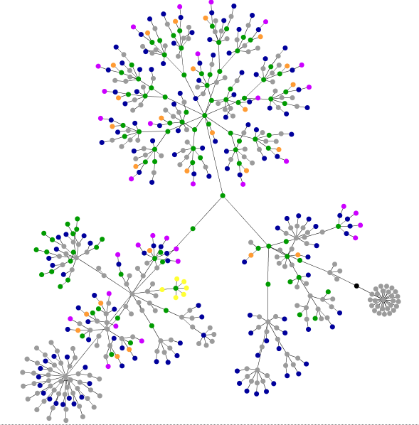
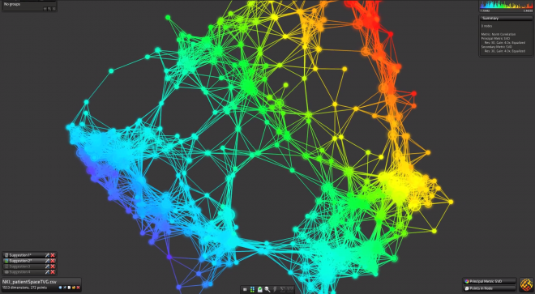
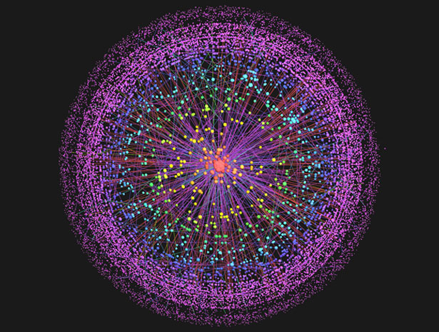
Visualizr

Slide 2
Team Members:
Umit Ceylan (PO)
Jamison Ball
Tyler Smith
Joe Rozo
Joey Lai
Kim Son Nguyen

Slide 3
Project Description:
Visualizr is a data visualization tool that helps its users to read and understand their data better by giving them different visualization options.

Slide 4
Project Release Plan : Sprint 1
As a developer, I want to be able to upload and store data in the database with no problem. (5)
As a developer, I want to be able to quickly update the database(inserting new data and deleting old as necessary). (10)
As a developer, I want a data visualization that captures full context of the data and conveys it as simply as possible. (20)

Slide 5
Project Release Plan : Sprint 2
As a user, I want to see a list of all the uploaded datasets. (6)
As a user, I want to have control and selection over how the data is visualized and displayed. (15)
As a user, I want to be able to choose between two visualizations. (20)
As a user, I want to have an account. (4)
As a user I want a good GUI that is easy to maneuver. (15)

Slide 6
Project Release Plan : Sprint 3
As a user, I want to be capable of leaving comments on the page where the visualization page. (12)
As a user, I want to be able to easily print the visualization page. (18)
As a user, I want to be able to choose between three visualizations.(20)

Slide 7
Project Release Plan: Challenges
This is an ambitious and challenging project, time management will be the key.
Some of us are not familiar with D3.
Don’t know how well Web2Py is geared for parallel coding with data frameworks.
Not all of us know Web2Py (new frameworks).

Slide 8
Project Release Plan: Tools
Web2py/Python
D3 Library
JavaScript
HTML
CSS
Ajax
JQuery
JSon

Slide 9
Questions:
?

