Slide 1

UNeed
Graphical User Interface Presentation
Ümit Yiğit Başaran-Muhammed Emre Yıldız-Yiğit Erkal-Murat Angın-Abdullah Can Alpay-Ahmet Ayberk Yılmaz-Mohammad Elham Amin
g1E

Slide 2
Introduction
UNeed application is based on android system and because of that we designed our user interface on Android Studio with XML. Our main purpose is creating a user-friendly interface for our application based on material design. We try to reduce complexity of menu options in order to prevent difficulties that user might face. With respect to save loading time, login and registration screens are based on a tab-style layout and filter and search options are pop-up style. In filter and sorting part, user can filter items based on title, category and price range. This filter options enable users to find what they want more efficiently. After selecting material user can contact with seller in a private chat room that provided by our message system.

Slide 3
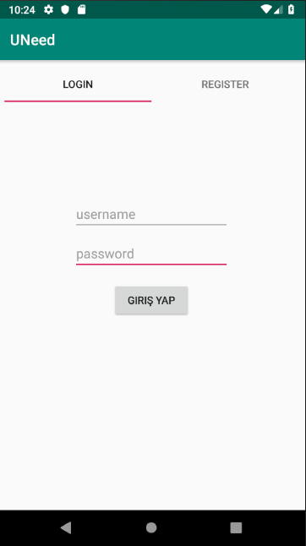
Log-in Screen

Slide 4
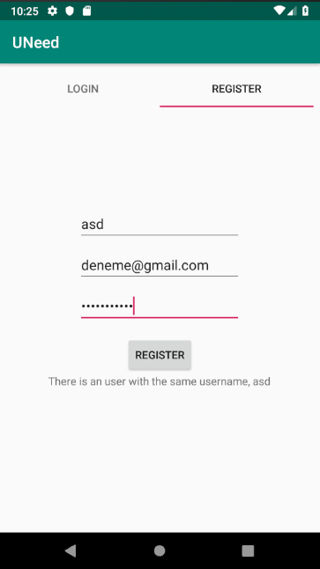
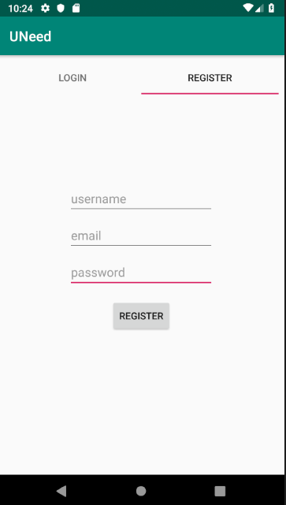
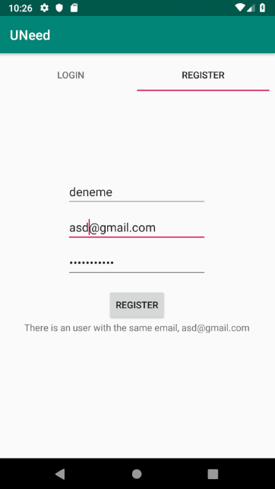
Register Screen
If user tries to enter previously used name.
If user tries to enter previously used email.

Slide 5
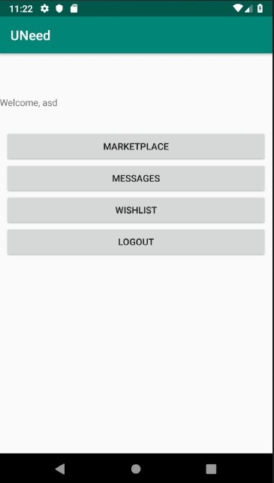
Home Screen

Slide 6
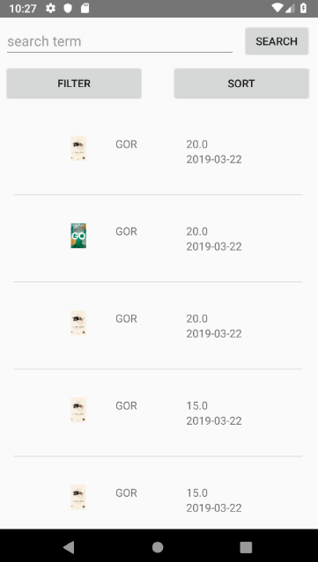
Marketplace

Slide 7
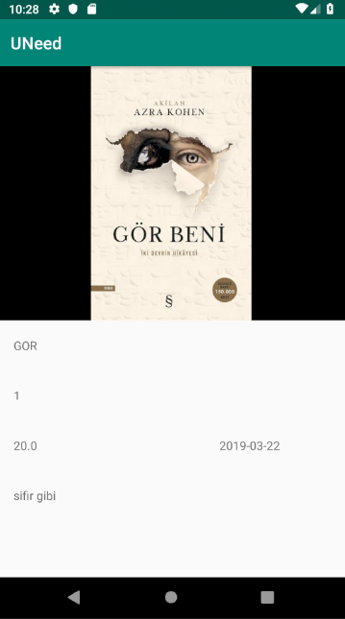

Item Page
$

Slide 8
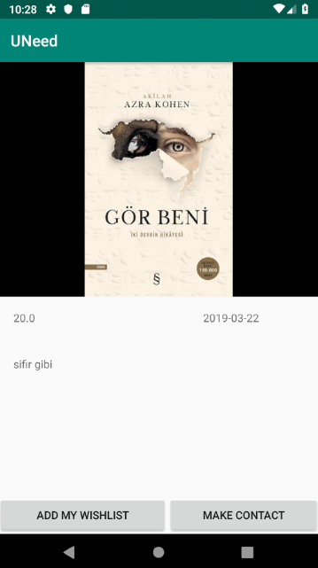
Wishlist
$

Slide 9
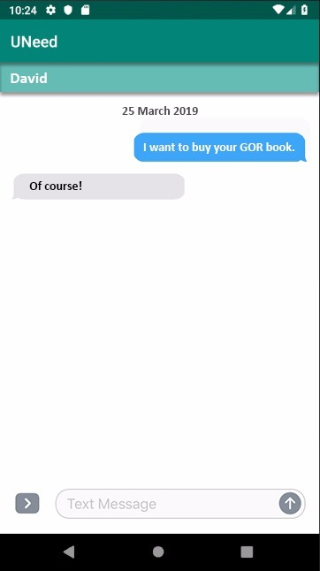
Chat

Slide 10
Summary and Conclusion
Our main purpose is meet the students need in a convenient, basic and efficient way. As it can be seen in screenshots of our application’s user interfaces, it provides a simple and handy system for user.
“What u need is UNeed!”

