Slide 1
CS451r Capstone: dwebble
A class scheduling application
Group 12
Elias Julian Marko Garcia
Ibrahim Saleh AbuAnz

Slide 2
Problem
CSEE department currently has extensive manual intervention for class scheduling
  Professorial schedules and preferences
  Room availabilities
  etc.
Translates to large overhead for administration
  Each semester, every semester

Slide 3
Goals & Objectives
Goals
  Develop application that facilitates the scheduling of the CSEE department by assisting administrators to resolve staff and professorial preferences and personal schedules
Objectives
  Provide an intuitive and simple UI/UX
  Report data that is easily exportable and usable outside of app.
  Application with MVP scheduling algorithm just for professor/staff schedules.

Slide 4
Technical Stack
Development stack
  Driver: Rust programming language
    Rocket Web Framework
  JS/CSS/HTML
    Tera templating engine
    Pure.css
  PostgreSQL
    Diesel ORM
Development Tooling
  Docker
  Git and GitHub

Slide 5





Technical Stack

Slide 6
Project Deliverables
Application
  Elias
  Rust web application with set of defined REST endpoints
    /index (GET, POST)
    /login (GET, POST)
    /new_schedule (GET)
  Relatively well organized project
  Type safety
  Relatively Polished UI

Slide 7
Project Deliverables
Project Documentation
  Ibrahim AbuAnz
    Requirements baseline
    Project Plan
    Test Spec and Documentation
    Architecture Document
    Project Plan
  Elias
    User/System Guide

Slide 8
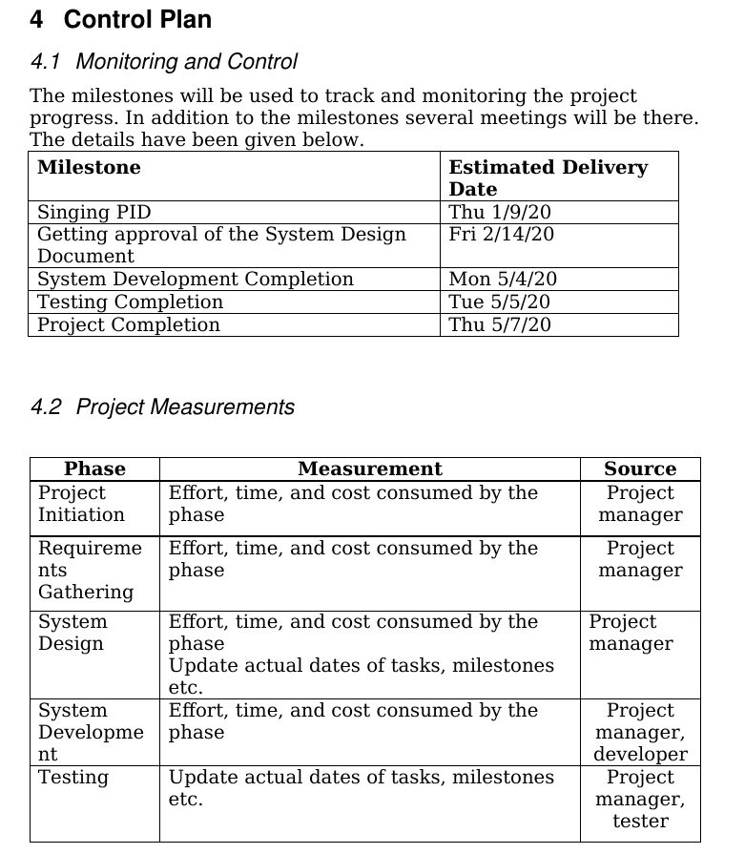
Project Deliverables

Slide 9
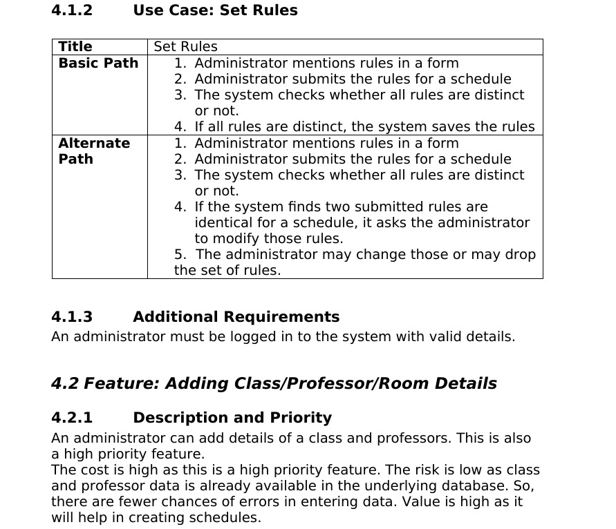
Project Deliverables

Slide 10
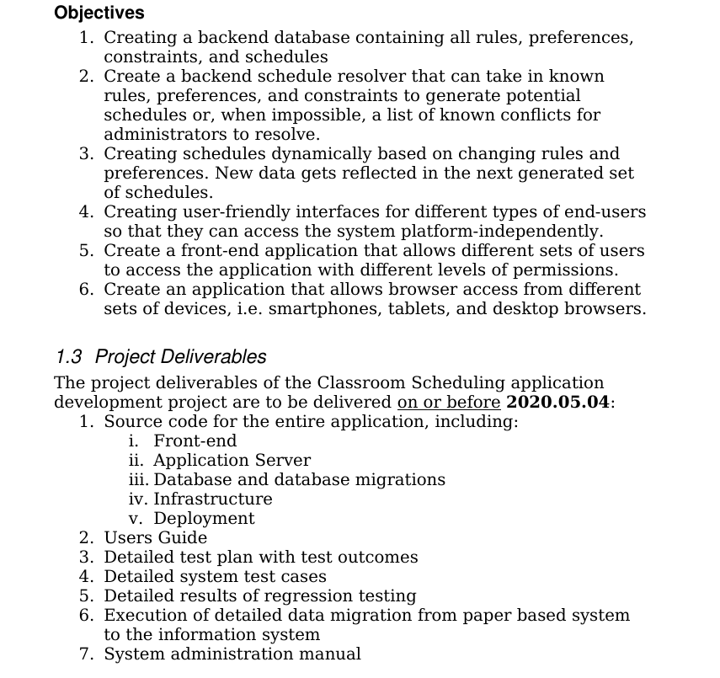
Project Deliverables

Slide 11
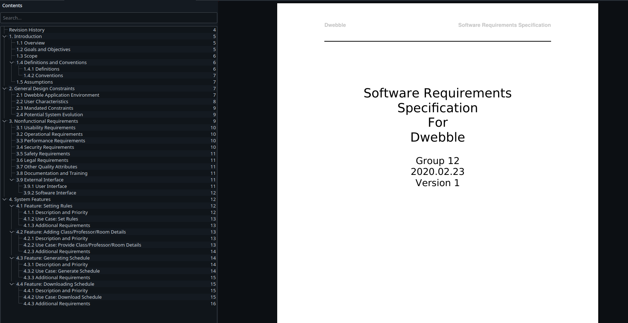
Project Preview

Slide 12
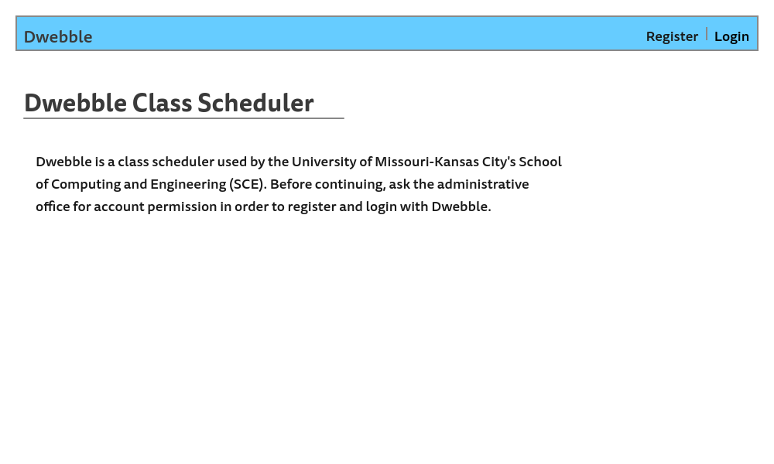
Project Preview

Slide 13
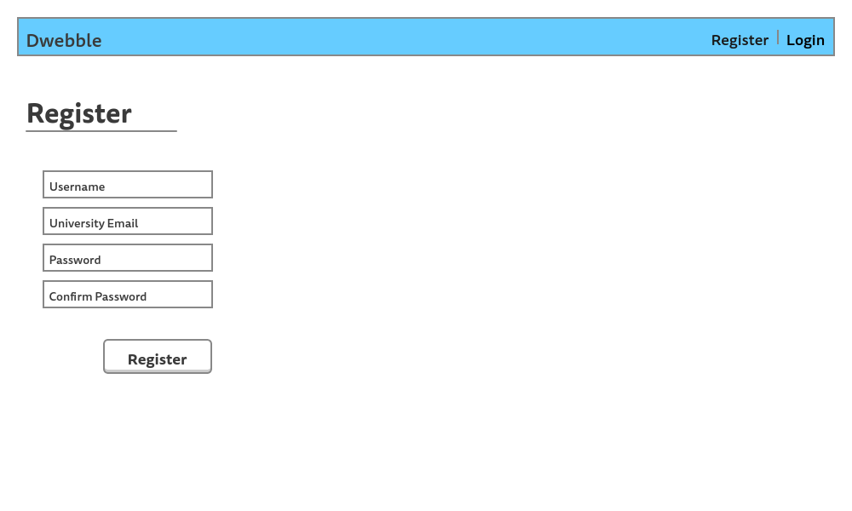
Project Preview

Slide 14
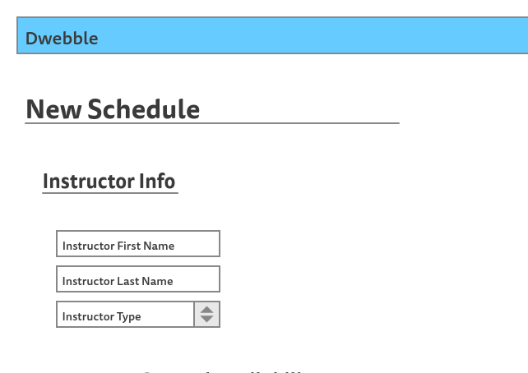
Project Preview

Slide 15
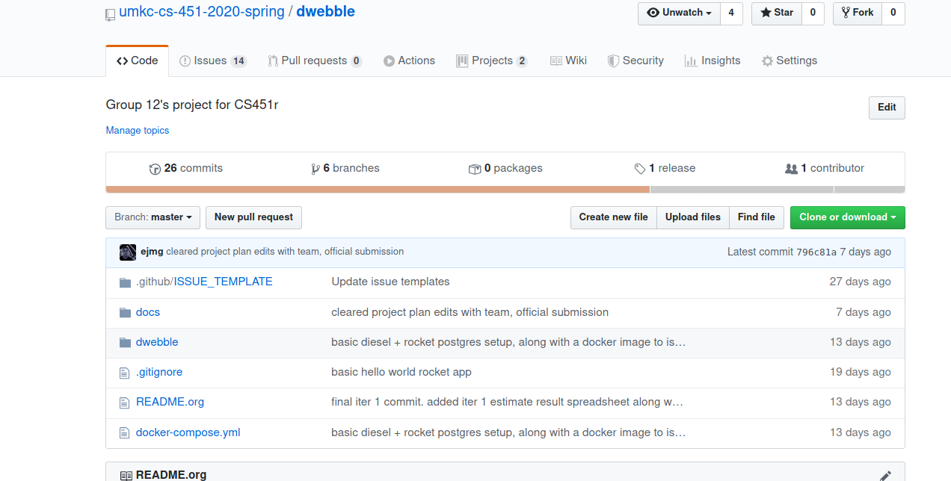
Project Preview

Slide 16
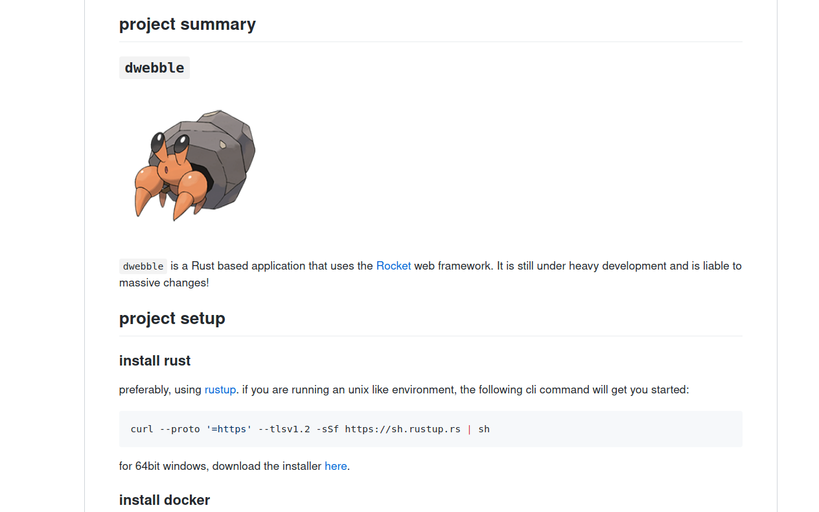
Project Preview

Slide 17
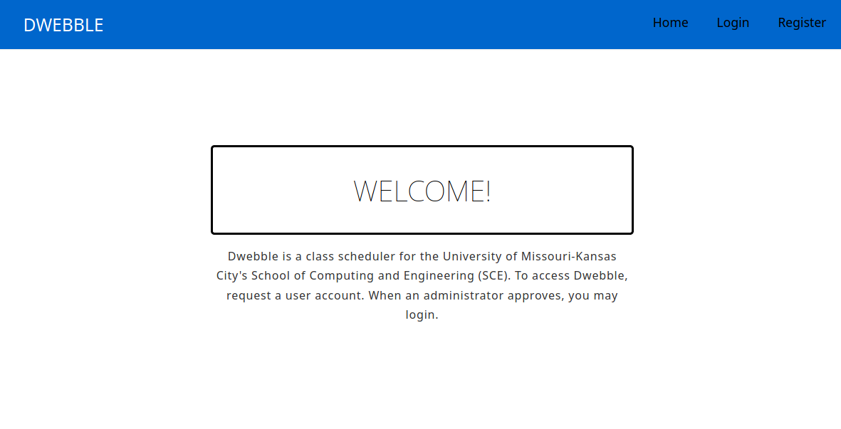
Project Preview

Slide 18
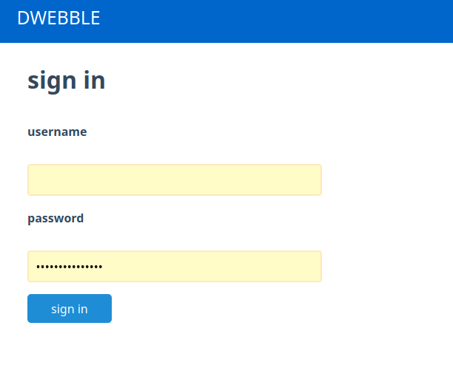
Project Preview

Slide 19
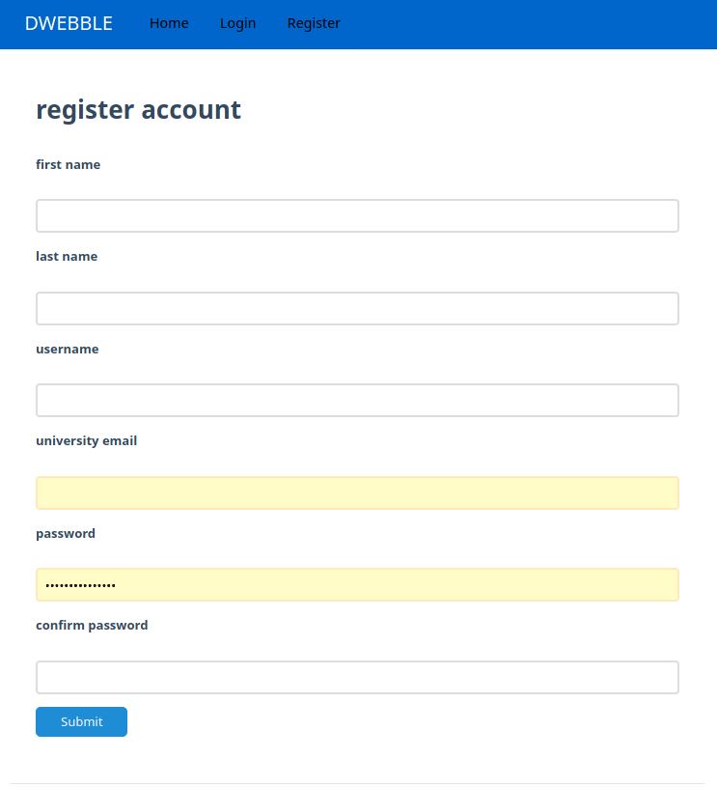
Project Preview

Slide 20
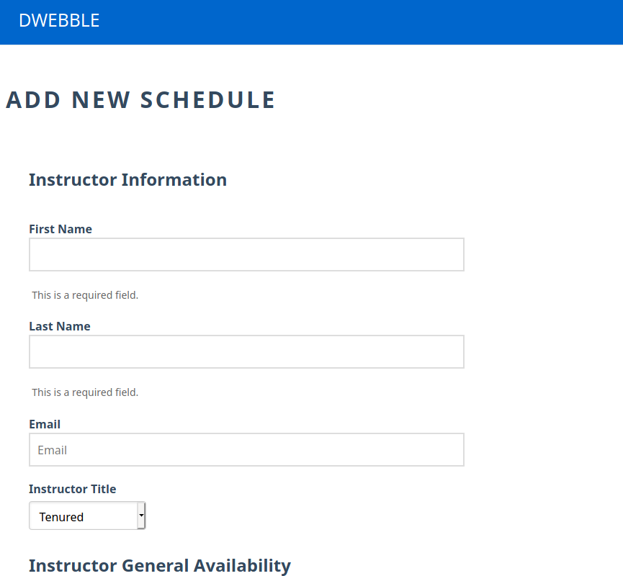
Project Preview

Slide 21
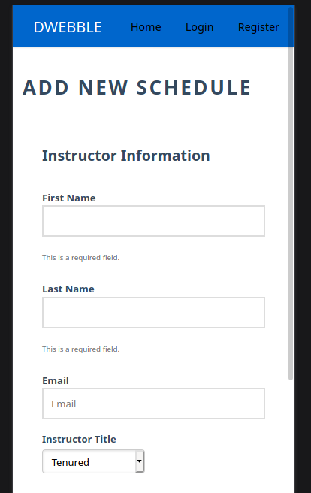
Project Preview

Slide 22
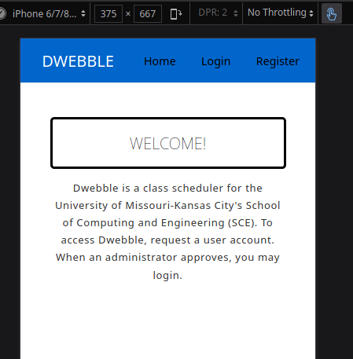
Project Preview

Slide 23
Lessons Learned
Very hard problem
  No, you don’t get it.
    It’s very Hard

Slide 24
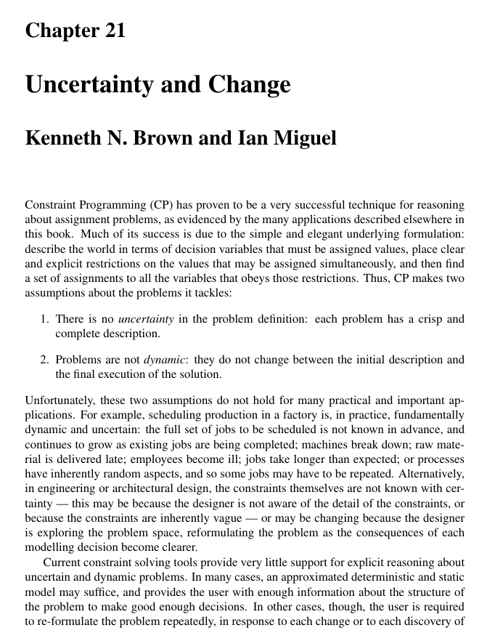
Lessons Learned

Slide 25
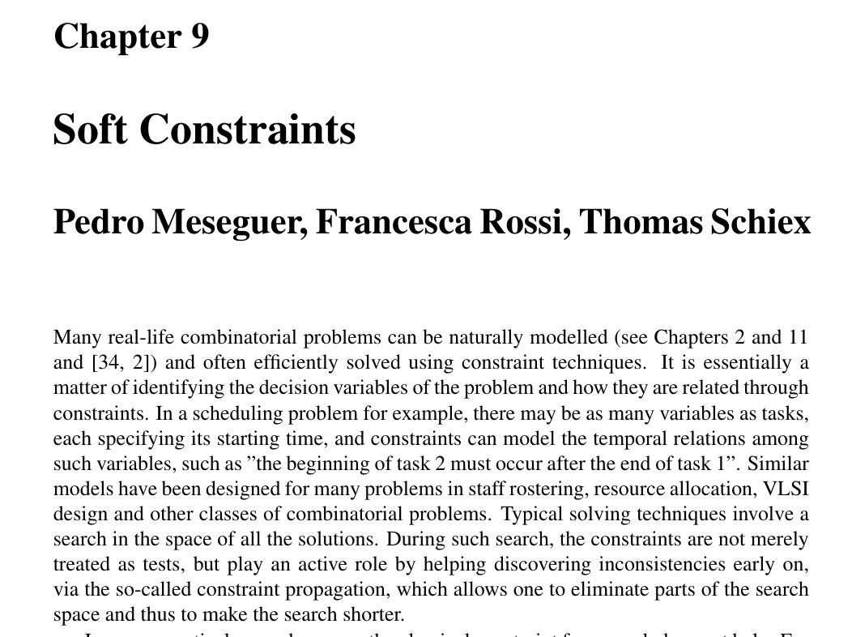
Lessons Learned

Slide 26
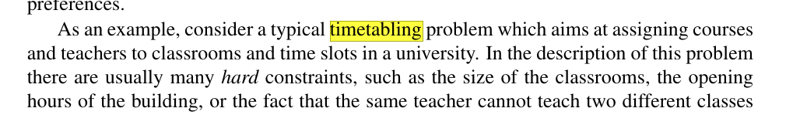
Lessons Learned

Slide 27
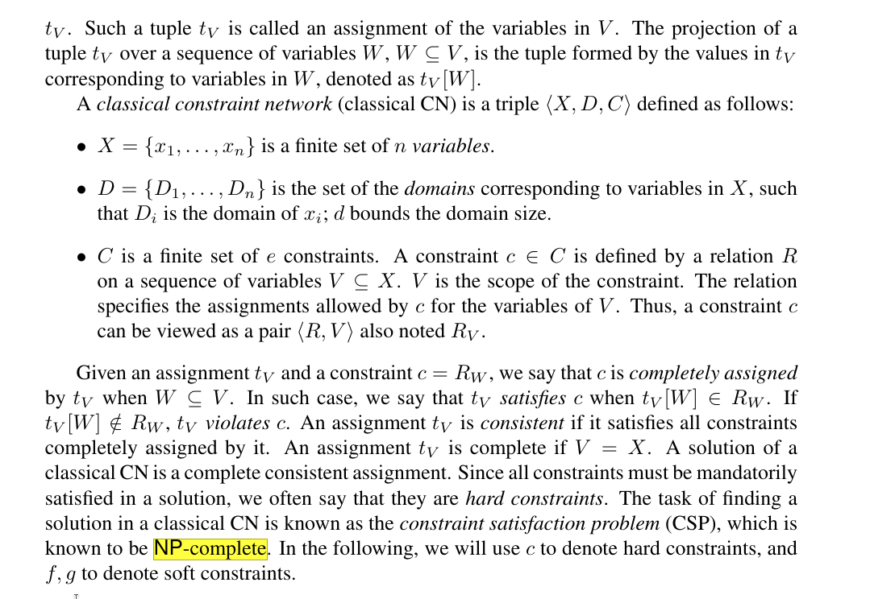
Lessons Learned

Slide 28
Lessons Learned
Things that went well:
  Learned a whole bunch about everything
    Database stuff
    UI Stuff
    Rust
    Web programming
  Documentation
    Ibrahim AbuAnz helped really well here
Things that went badly
  Delivery basic scheduler
  One teammate ghosted for the entire semester
    Work distribution
  Spreading out load and work over semester

Slide 29
Moving Forward
Might try to keep working on it
  Almost there!
    Actually very hard problem!
    Multi-dimensionally NP-Complete
Web-app aspects of it are largely done, however
  Some tweaking to routes
  Some improvement on DB ↔ app interaction

