Slide 1
Keep the Grade
An Android Application developed by Adam Gaudreau, Ashley Hale, and Tim Larocque

Slide 2
About our app
Effortlessly keep track of your progress through all your classes in a semester.
- Add/remove semesters, classes, and grades.
Visual aids such as charts and colors help prioritize your learning.
- Charts are provided via the Google Charts API.
- Each class is color coded based on your progress in the course.
Calculations of grades are accurate due to the inclusion of weights.
Ability to store completed grades from previous semesters.

Slide 3
The Database

Slide 4
The Database
The Database schema is as follows:
Semesters(id, season, year);
Classes(id, sem_id, name, grade);
Grades(class_id, name, type, grade);
Weights(class_id, exam, quiz, homework, final);
The contents of Semesters is displayed in the drawer in MainActivity.
The contents of Classes is displayed in a ListView in the MainActivity based on which semester is selected.
The contents of Grades is displayed in ClassActivity after a class has been selected.
Weights is never displayed, however it is used when calculating the total grade in each class.

Slide 5
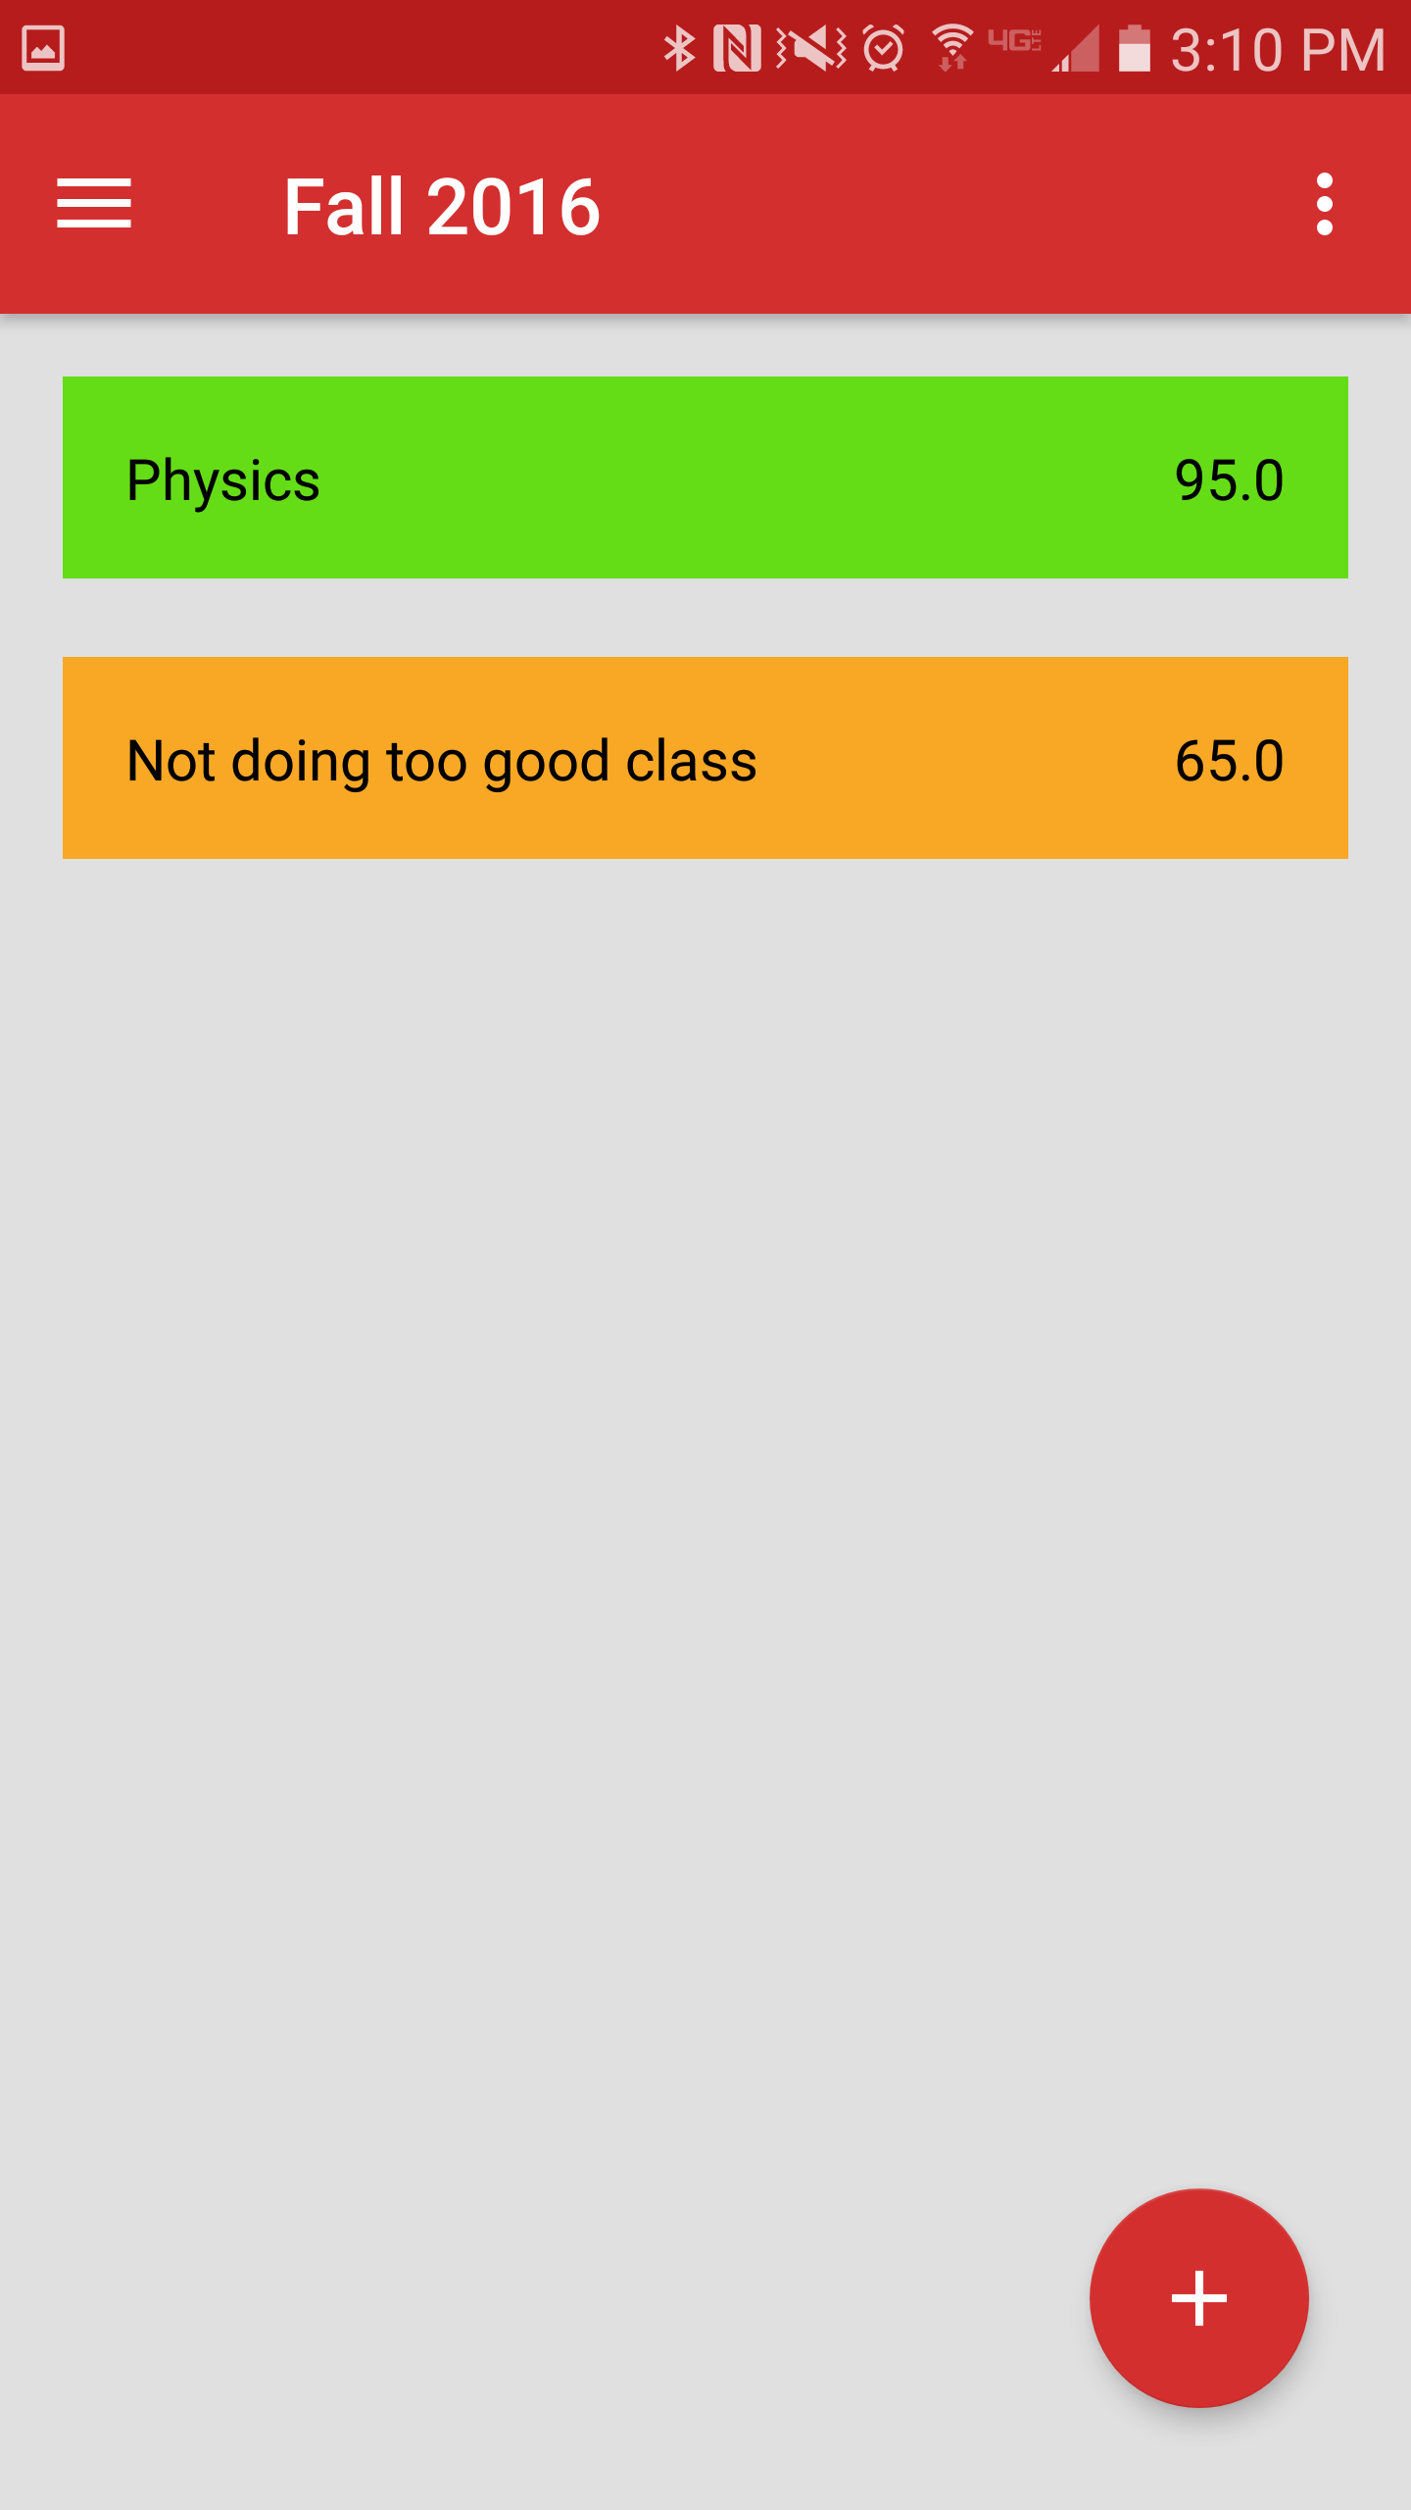
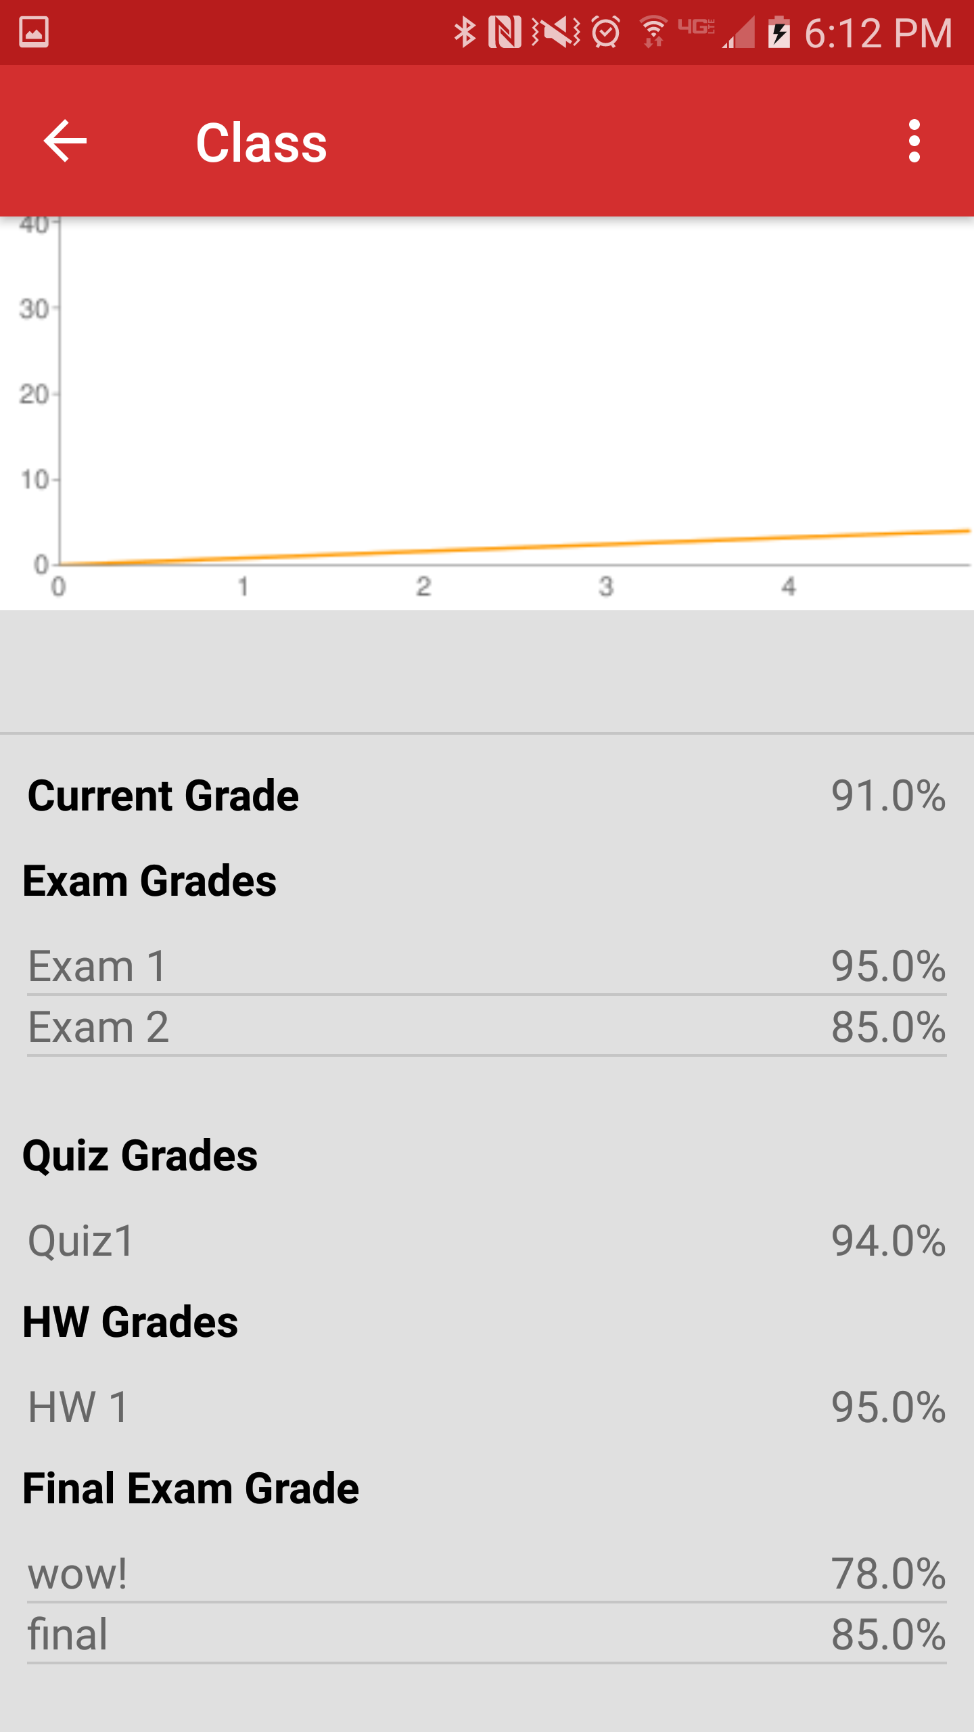
Semesters
id | season | year
1 | Fall | 2016
Classes
id | sem_id | name | grade
1 | 1 | Physics | 95.0
2 | 1 | N.d.t.g.c. | 65.0
Weights
class_id | exam | quiz | hw | final
1 | 20 | 40 | 20 | 20
2 | 30 | 10 | 40 | 20
Grades
class_id | name | type | grade
1 | Exam 1 | Exam | 95.0
1 | Exam 2 | Exam | 85.0
1 | Quiz 1 | Quiz | 94.0
1 | HW 1 | Hw | 95.0
1 | wow! | Final | 78.0
1 | Final | Final | 85.0

Slide 6
User Inteface

Slide 7
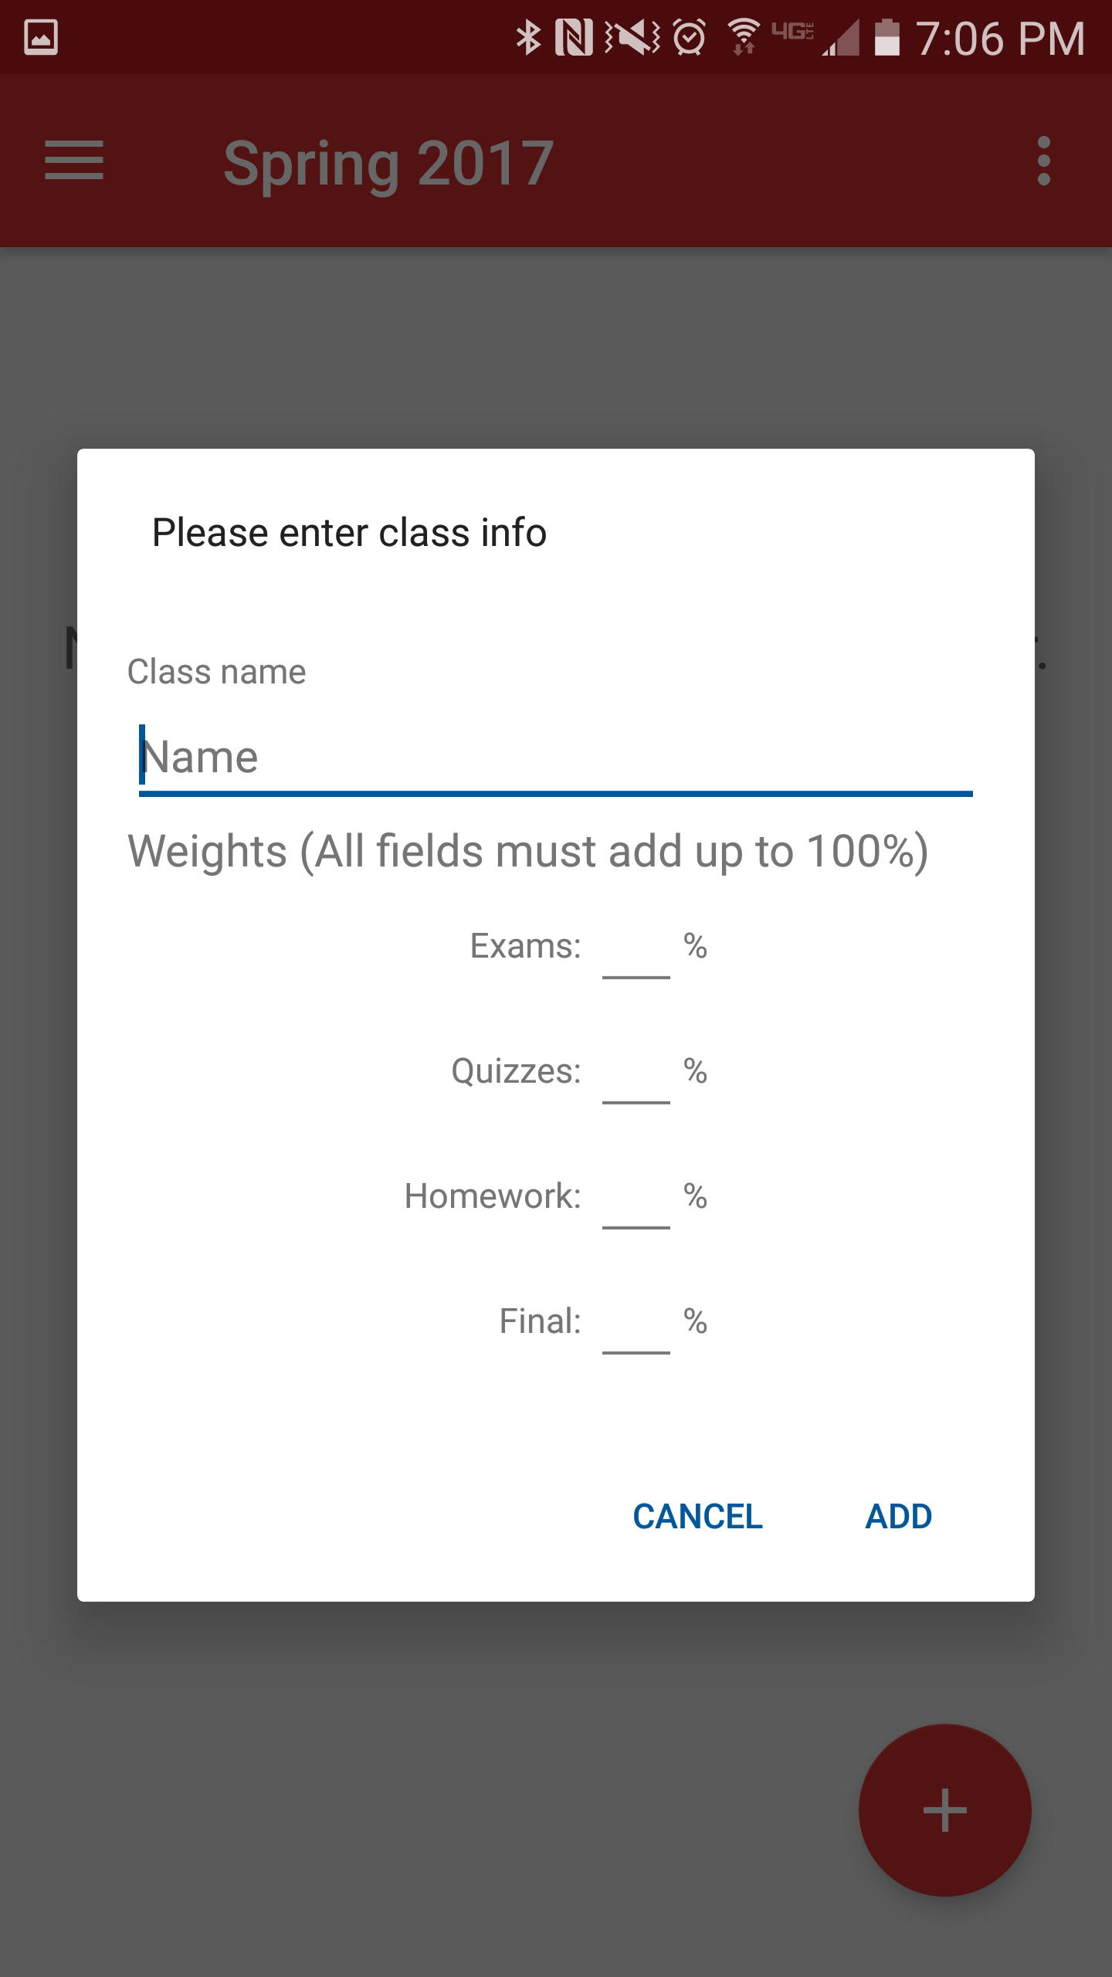
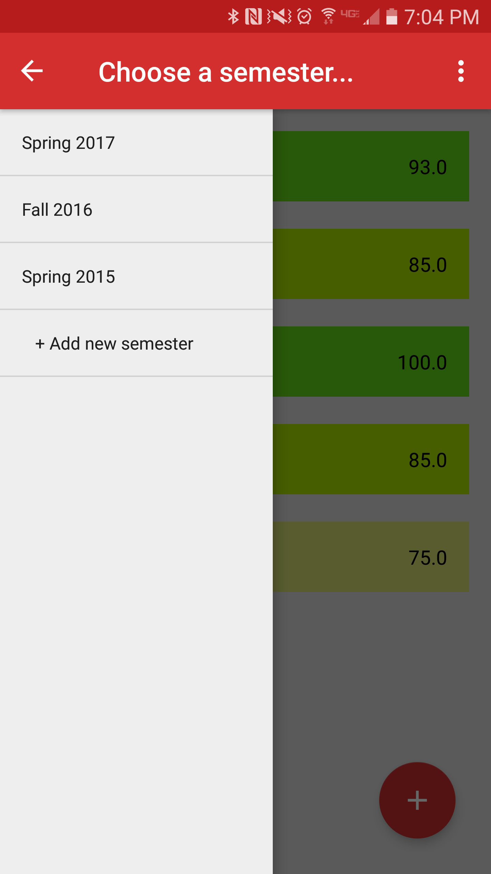
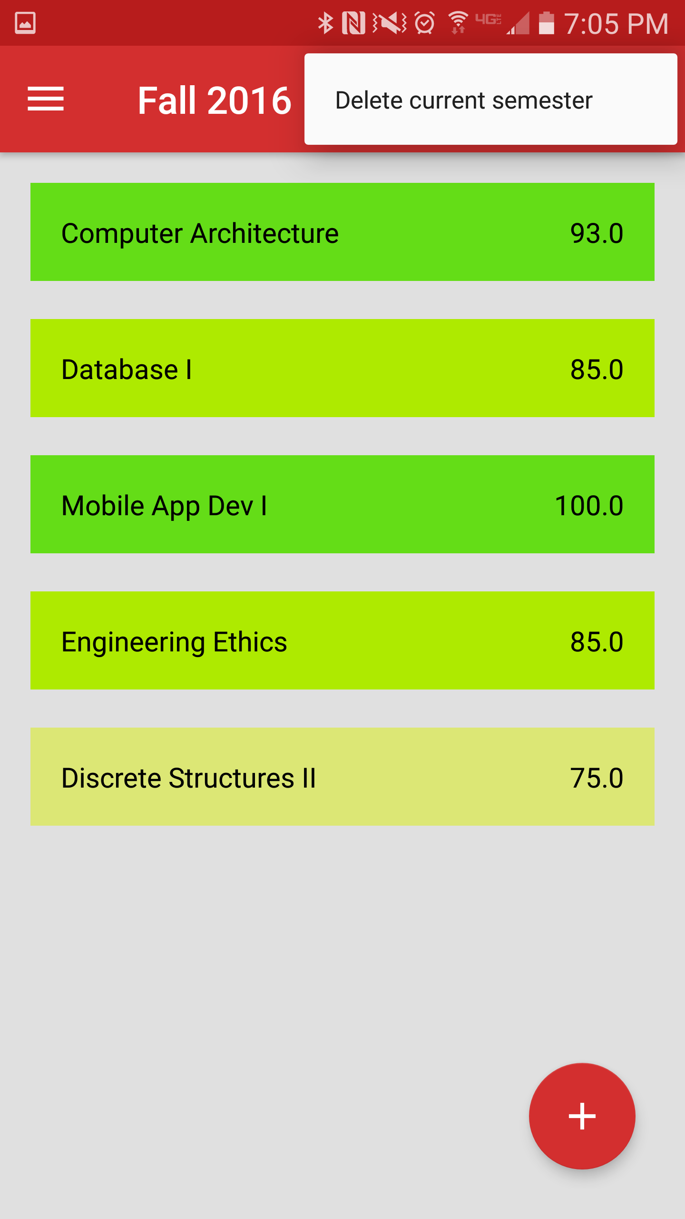
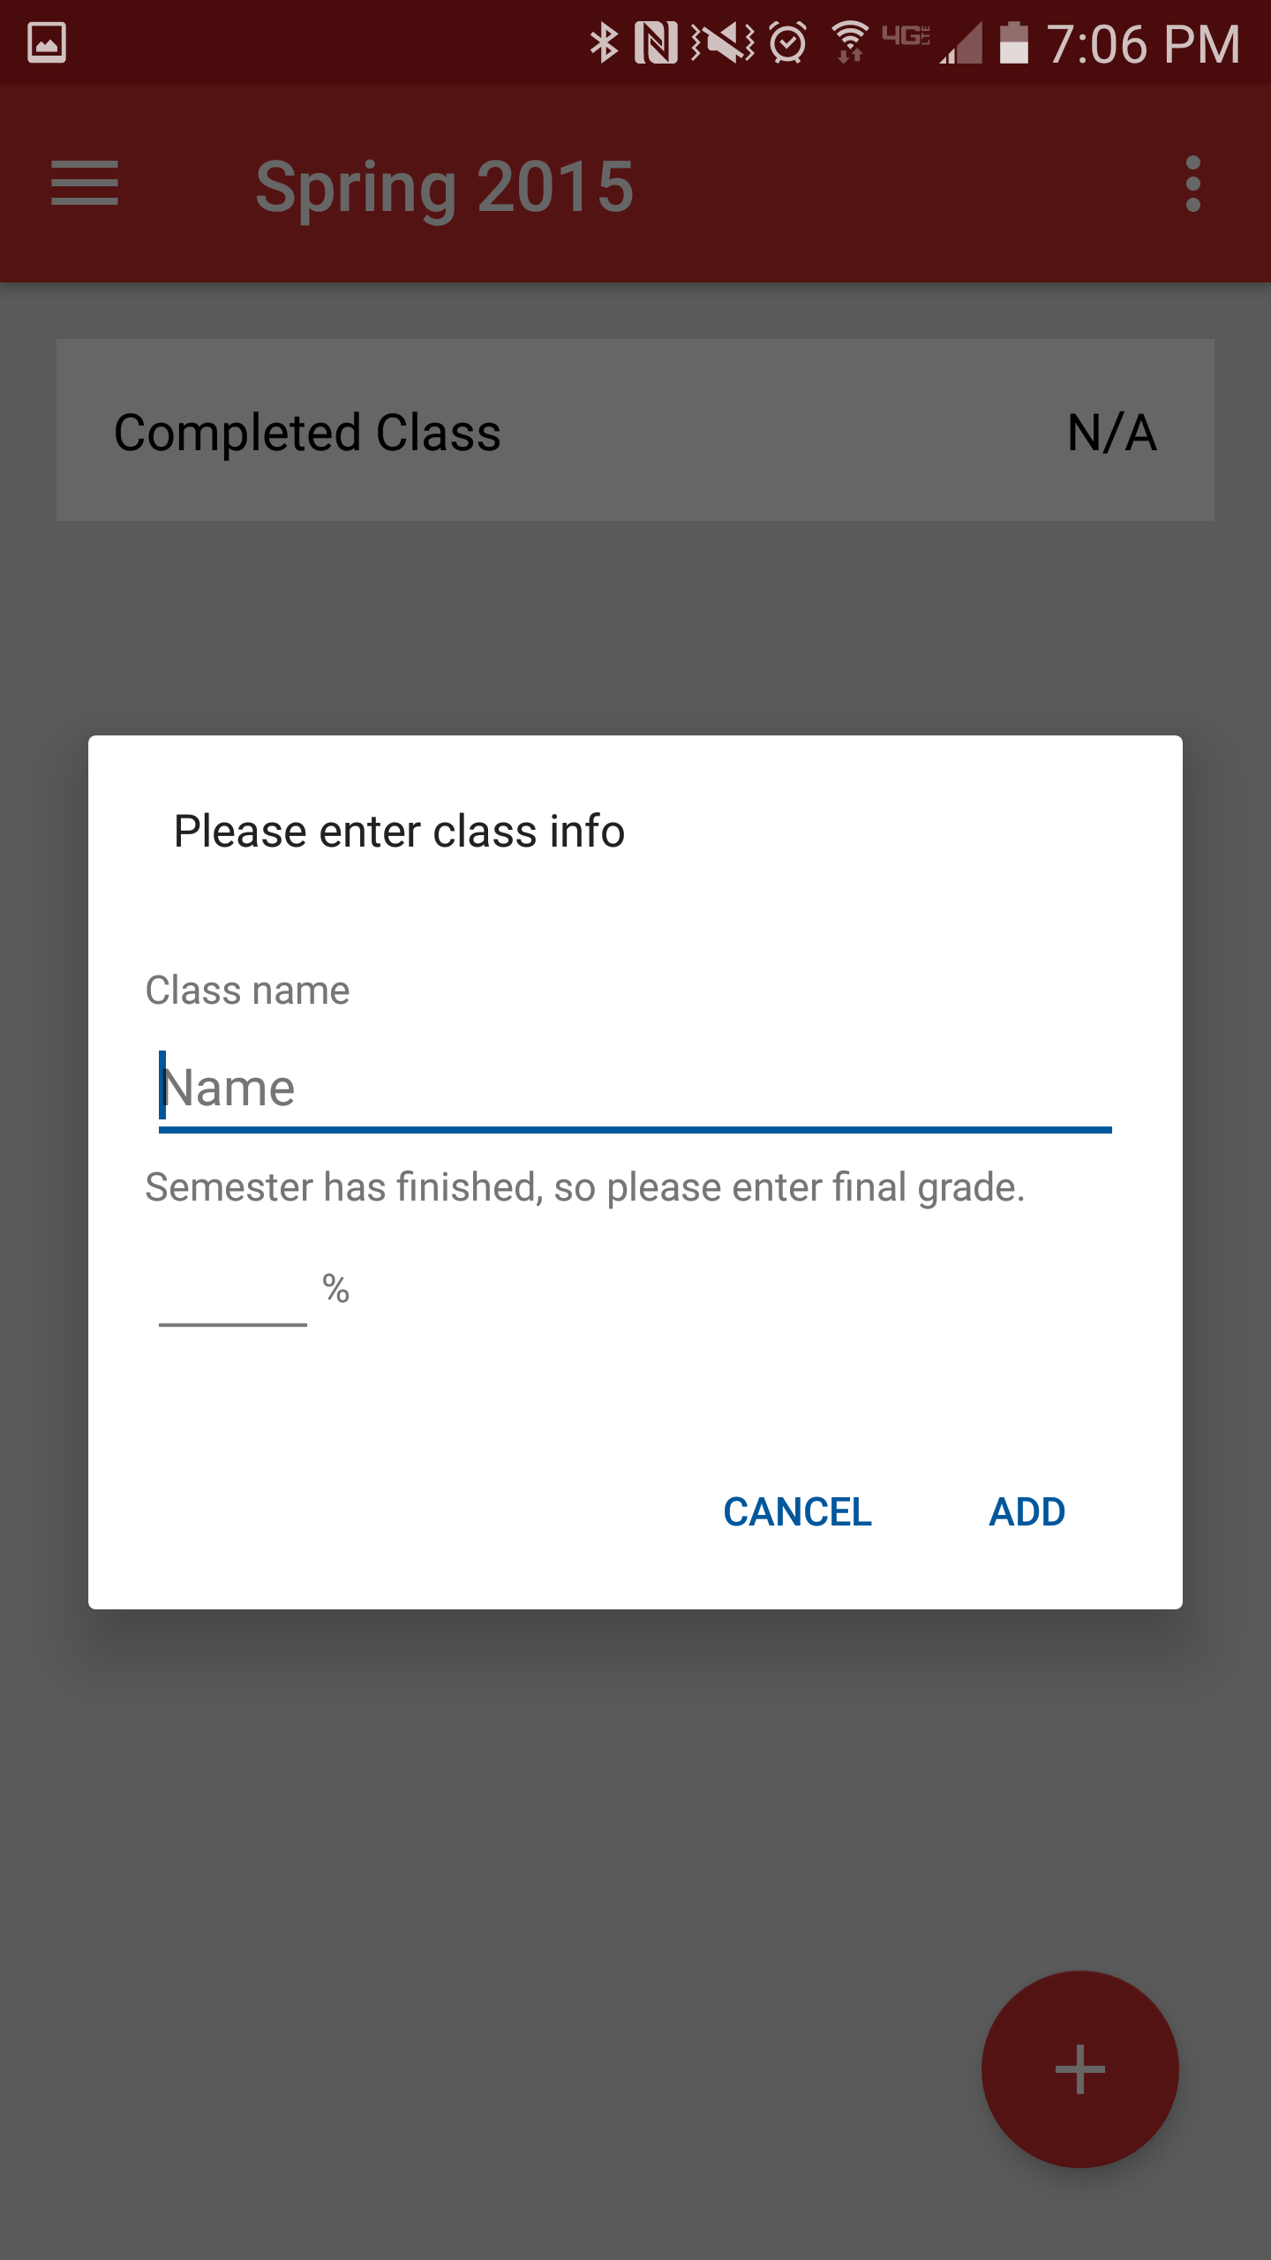
MainActivity
Options menu
Drawer Layout
List view inside for different semesters
Contains a Relative Layout
FAB pressed, current semester
With drawer opened
With options menu selected
FAB pressed, completed semester

Slide 8
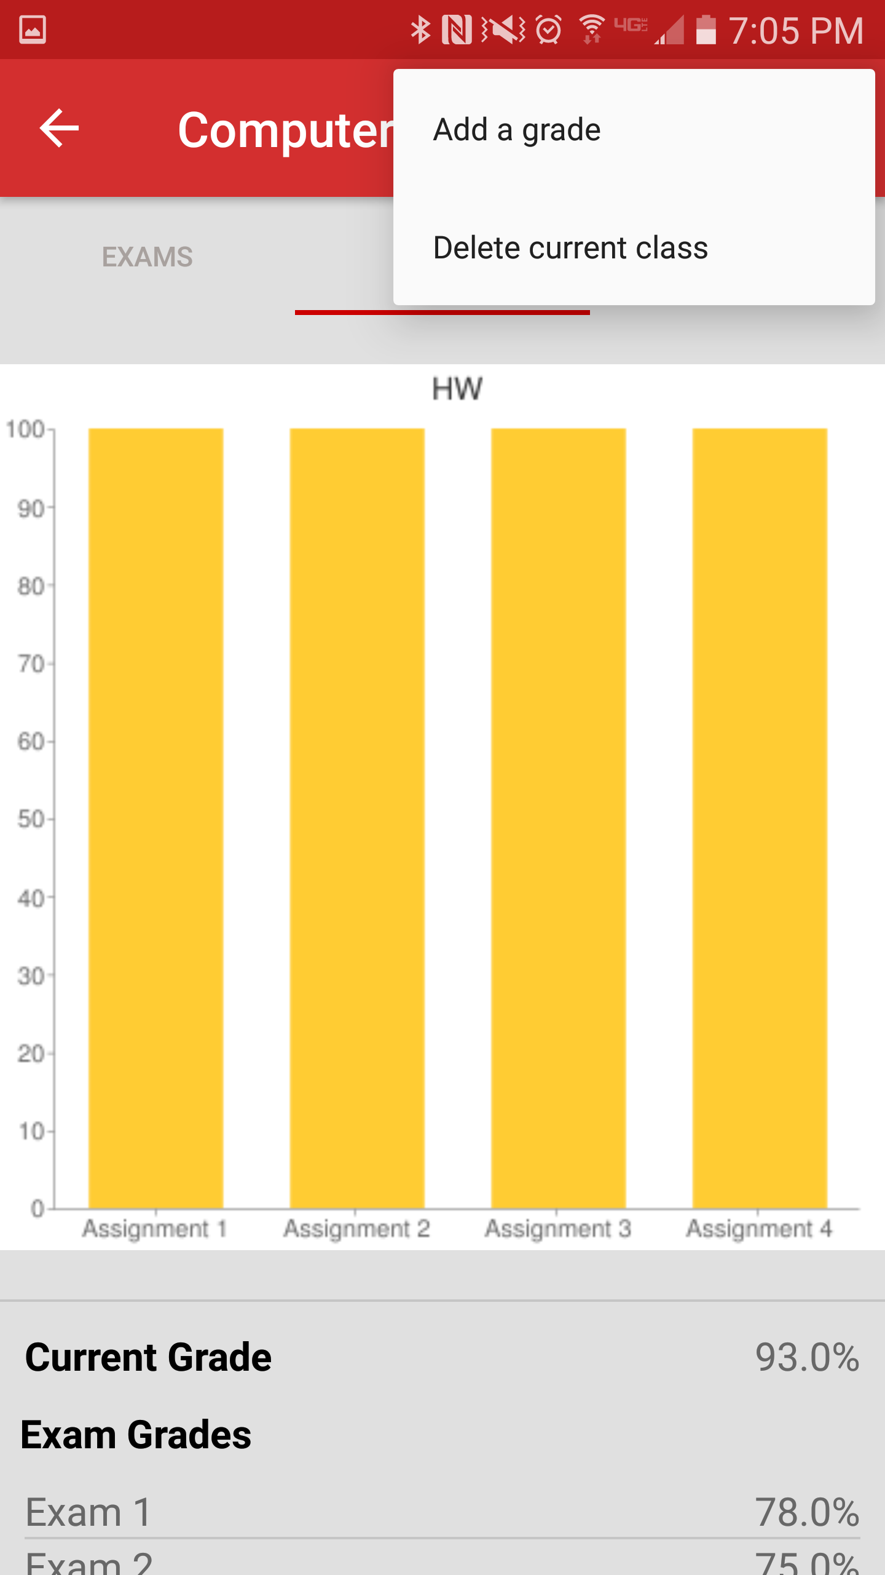
ClassActivity
Overall linear layout
Charts are a tab layout
Grades are displayed in a list view

Slide 9
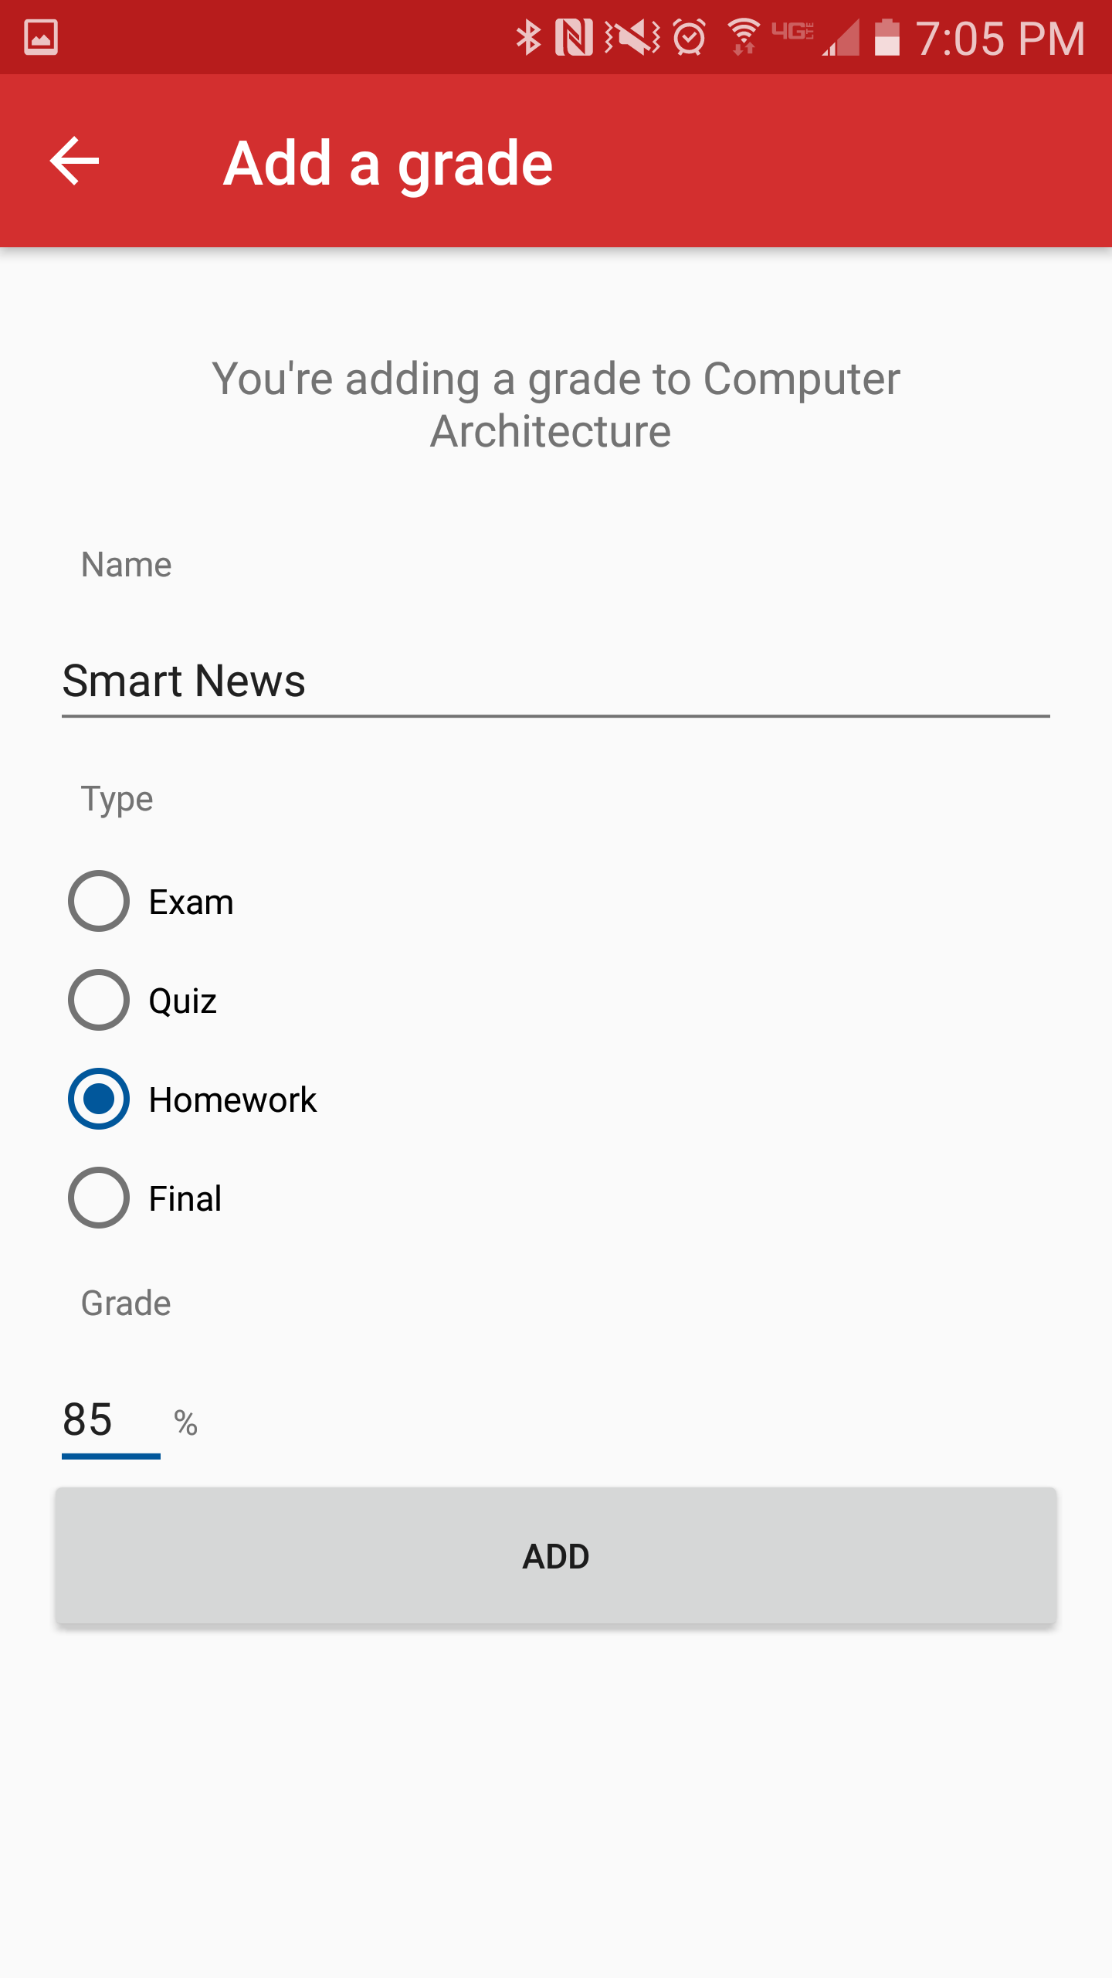
AddGradeActivity
A Form for the user to fill out
The fields are used for entering an entry into the Database

Slide 10
Google Image Charts API

Slide 11
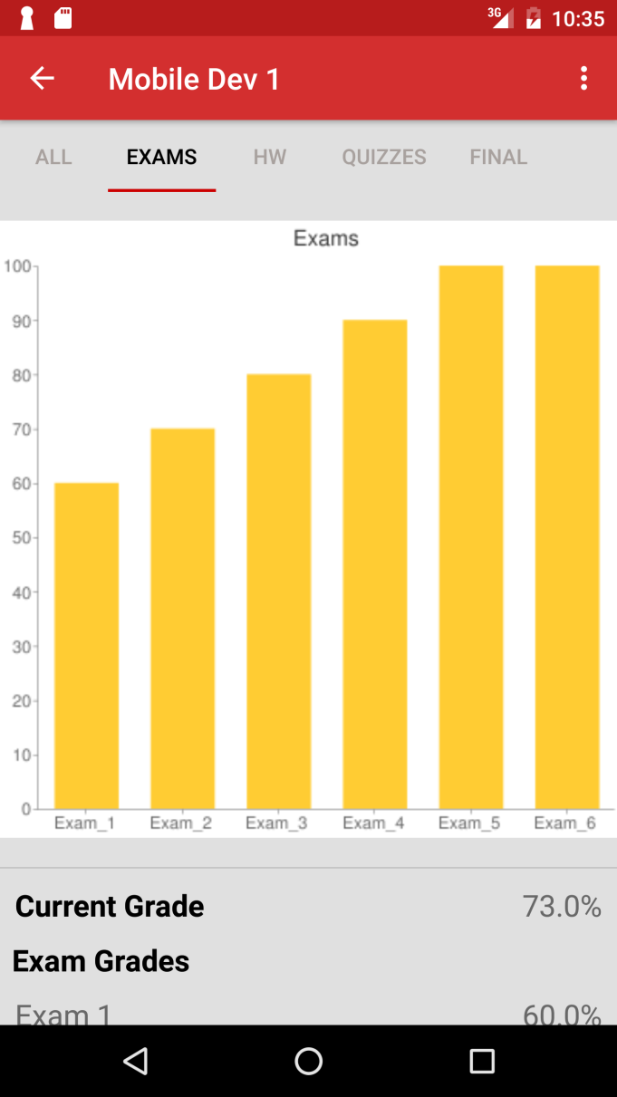
Google Image Charts API
Google Image Charts API is used to make graphical representations of each Exam, Homework, and Quiz scores
Files used:
Chart.java
ChartAdapter.java
CategoryAdapter.java
MySingleton.java
item_list.xml

Slide 12
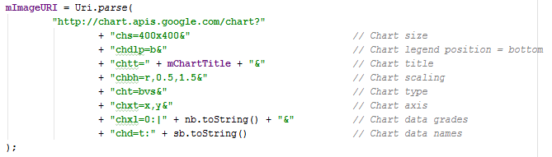
The API Call

Slide 13
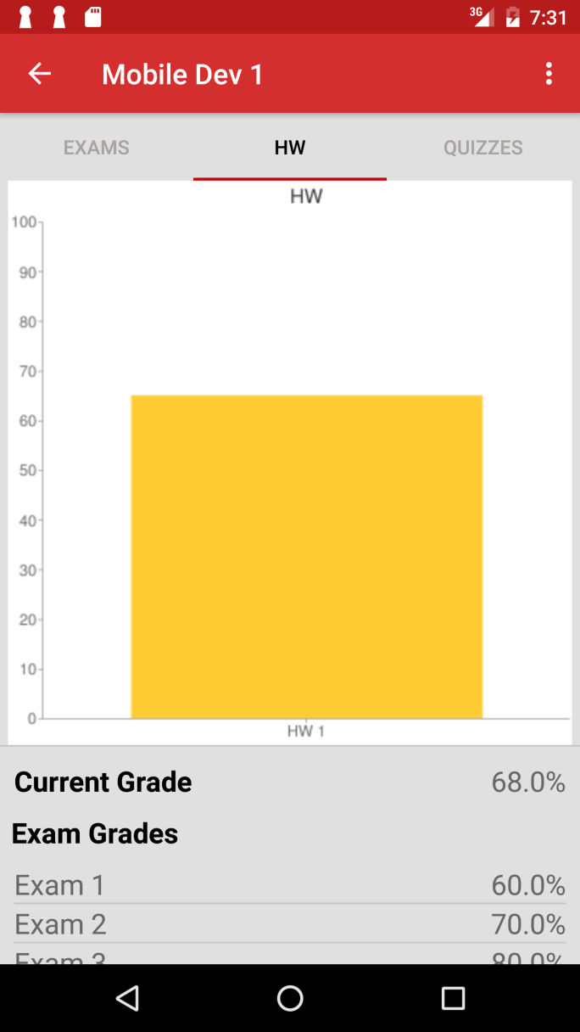
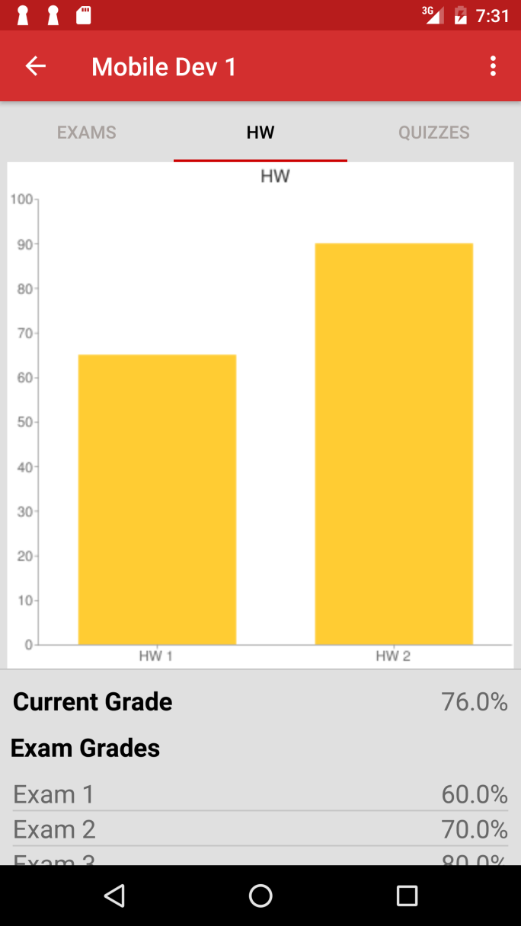
The program is able to scale the graphs depending on how many scores there are

