Slide 1
GG-GPG Design and Overview
Matt Wolf

Slide 2
Class Descriptions
gpg.py
Shell commands to interface with the gpg tool.
sender.py
a TCP client which connects to server and sends a message
server.py
listens on its port and logs data it receives to a file
config.py
interprets the settings in a config file
util.py
wrappers around subprocess and misc functions
Main.py
runs config, then fires off server and sender processes.

Slide 3
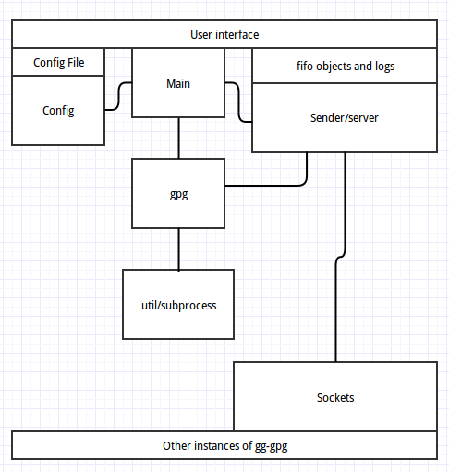
Interactions diagram

Slide 4
No Third Party Dependencies
Easy to clone and get started
No setup time – most linux systems come with python2 and gpg. Create your keys and config and go.
Python didn't make everything easy: sockets
Third party libraries would reduce time solving invent-the-wheel like problems

Slide 5
Shortcomings of low level sockets
Sockets in python exhibited weird behavior that went against all documentation on them.
Multiple calls to receive per socket connection would fail mysteriously, citing bad file descriptors on the sockets.
File transfer was not possible to implement for any reasonable size file because of this.

Slide 6
Successful Features
Channel implementation: one channel's sender can hook up to many servers/keys.
Data transfer between channels or from one way channels.
Fast reset – edit config file, kill main process, restart. (as fast as the OS will let you)
Transfer of very small files

Slide 7
Lessons for the Future
Scope of project – see the forest through the trees
Test code as it is written

