Slide 1
Students Information System.
Questionnaire Summary
Chris Dimaio
Jishnu Menon
Ting li
Vivek Kumar

Slide 2
Questionnaire Formulation and Execution
We have made a total of 10 questions that includes objective type questions, questions to rate a service in the system and also questions that can have elaborate answer.
We made a google form to send out to people to collect their responses.
We also asked our friends and family to answer the questionire in person.

Slide 3
Making sense from all the Data
We combined all the data the we got from the google form and the in person Questionnaire.
We had some interesting findings.

Slide 4
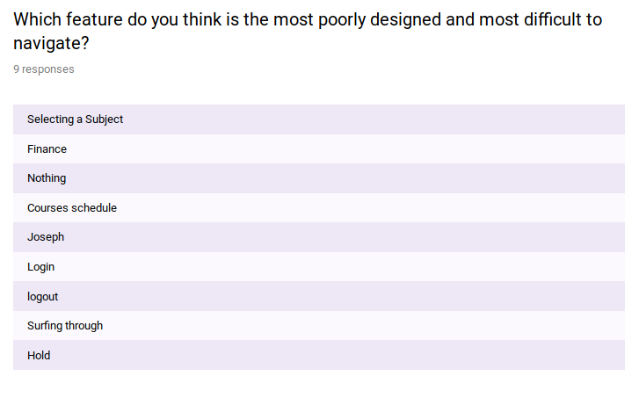

Slide 5
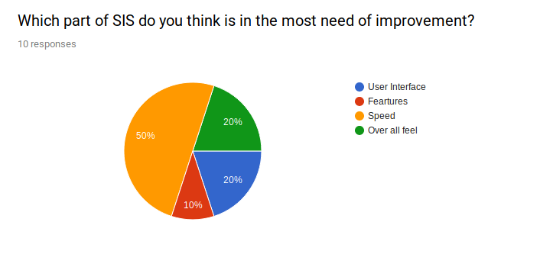

Slide 6
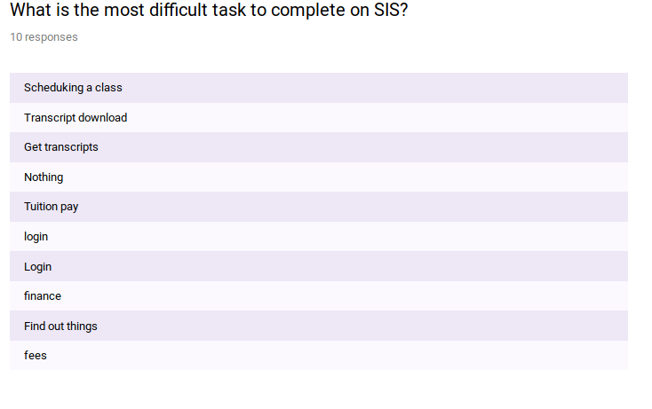

Slide 7
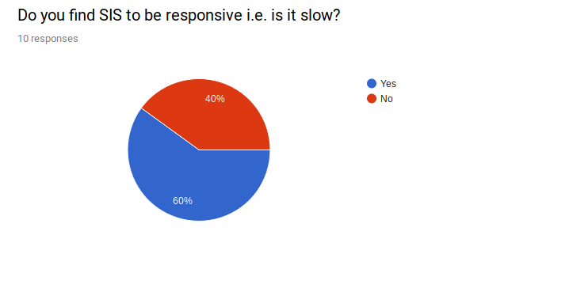

Slide 8
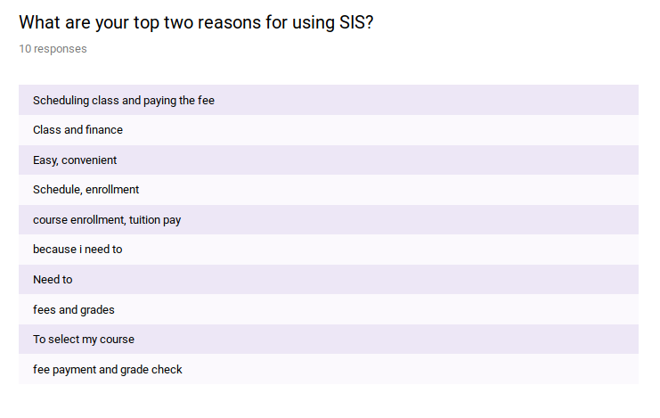

Slide 9
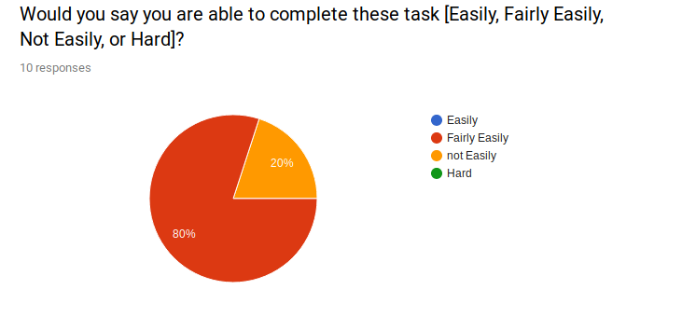

Slide 10
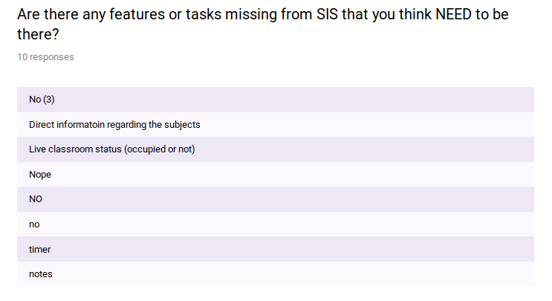

Slide 11
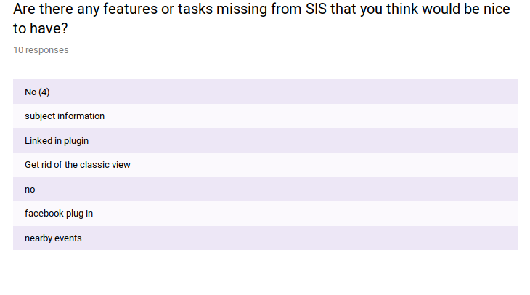

Slide 12
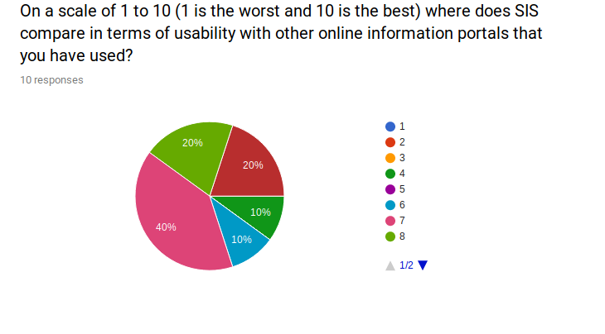

Slide 13
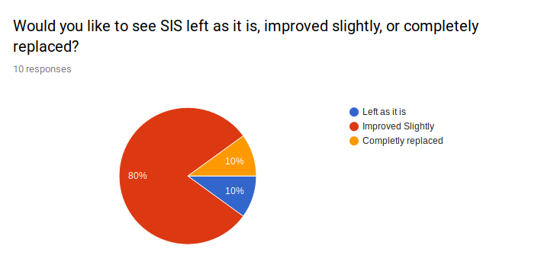

Slide 14
Conclusion

