Slide 1
Student Information System
Final Project Phase 2
Chris Dimaio
Jishnu Menon
Ting Li Shen
Vivek Kumar

Slide 2
Structured Interview
Predetermined Questions
Same questions are used with each participant

Slide 3
Questions
Which feature do you think is the most poorly designed and most difficult to navigate? How and why does it make you think that? What would be an ideal solution like?
Would you say you are able to complete tasks on SIS [Easily, Fairly Easily, Not Easily, or Hard]? How and why does it make you think that?
Are there any features or tasks missing from SIS that you think would be nice to have? How and why does it make you think that? What would be an ideal solution like?
Which part of SIS do you think if it gets improved, you will find SIS more enjoyable to use? How and why does it make you think that? What would be an ideal solution like?

Slide 4
Analysis of Data Collected for first question
Following are the features which are poorly designed according to the participants
Enrollment or Adding New Class(Suggested Solution:- Description of the course, Shopping cart for Course selected)
Login screen problem(Auto Logout )
Invoice or Paying Bills(Make system more stable)
Finding Transcript(Better User interface)

Slide 5
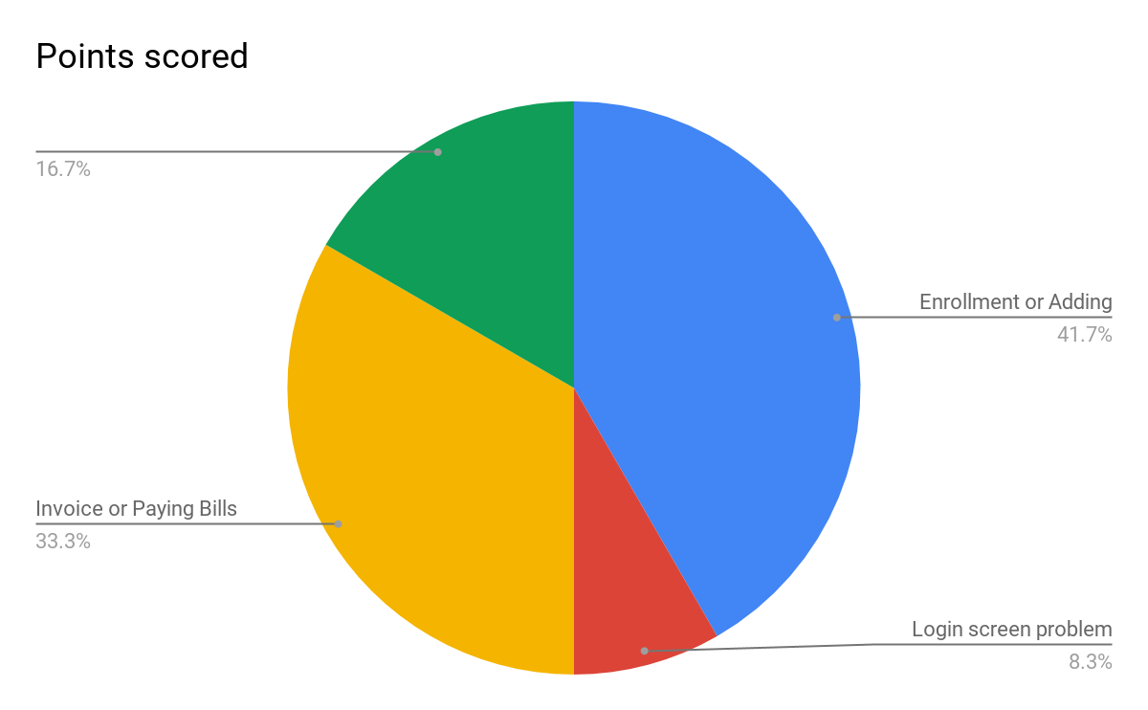
Continue….

Slide 6
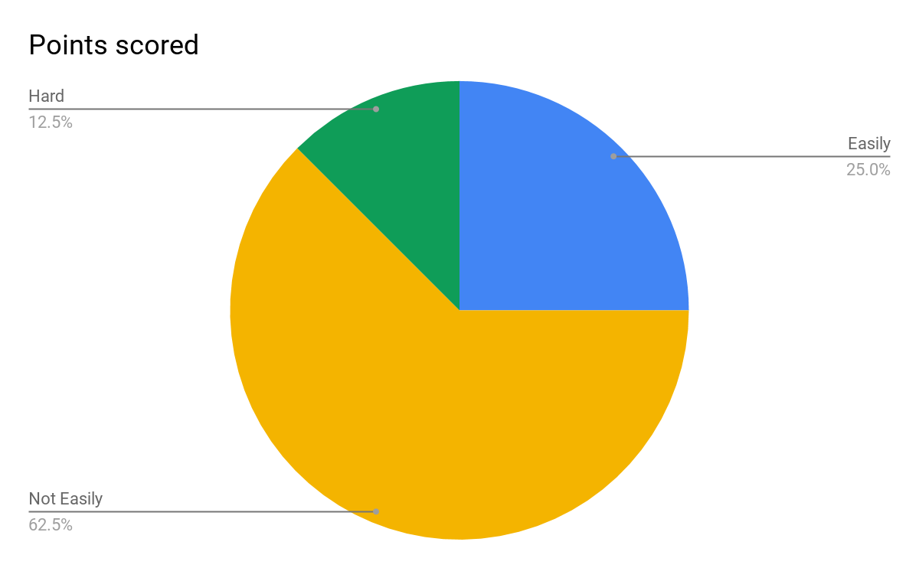
Analysis of Data Collected for second question

Slide 7
Analysis of Data Collected for Third question
We found that participants thought SIS should include some of the following features...
A place to find required physical examinations or vaccinations
A student forum to discuss coursework and student activities.
Calendar with exam and homework due dates as well as university deadlines.
Notification or alert for any student related events happening on campus.
Ability to see their requirements for graduation and also to have a facility to check classroom availability and call dibs.

Slide 8
Analysis of Data Collected for Fourth question
Features that should be improved from the participants’ are following
Separate desktop and mobile user interfaces
Interface should be more interactive and user friendly
Navigability, organization, and performance

