Slide 1
Smart Fridge
By:-
Vignesh Dhamodaran
Ragarsha Velmula
Anvesh Reddy Pundru

Slide 2
About the App
Smart Fridge is an Monitoring Application to See who is using your fridge and when.
The App uses your smart phone mounted on a fridge to monitor your activity.
The app senses when the door opens and start the camera and track who is using the Fridge.
On the Background it Uploads the images saved when a face is detected to the backend.
You Can monitor the Activity Using the Web App.

Slide 3
Design Flow
Sensor Calibration and Door Open Detection
Face Detection and Image Upload
Web Application

Slide 5
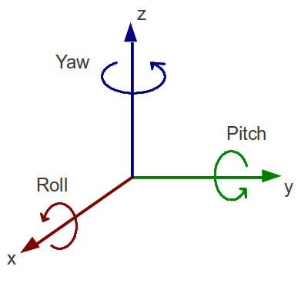
Sensor Calibration and Door Open Detection
Sensors Used
Accelerometer
Magnetometer
Formula’s used
Yaw = atan2(Mat[4], Mat[0])
Pitch = acos(-Mat[8])
Roll = atan2(Mat[9], Mat[10])

Slide 6
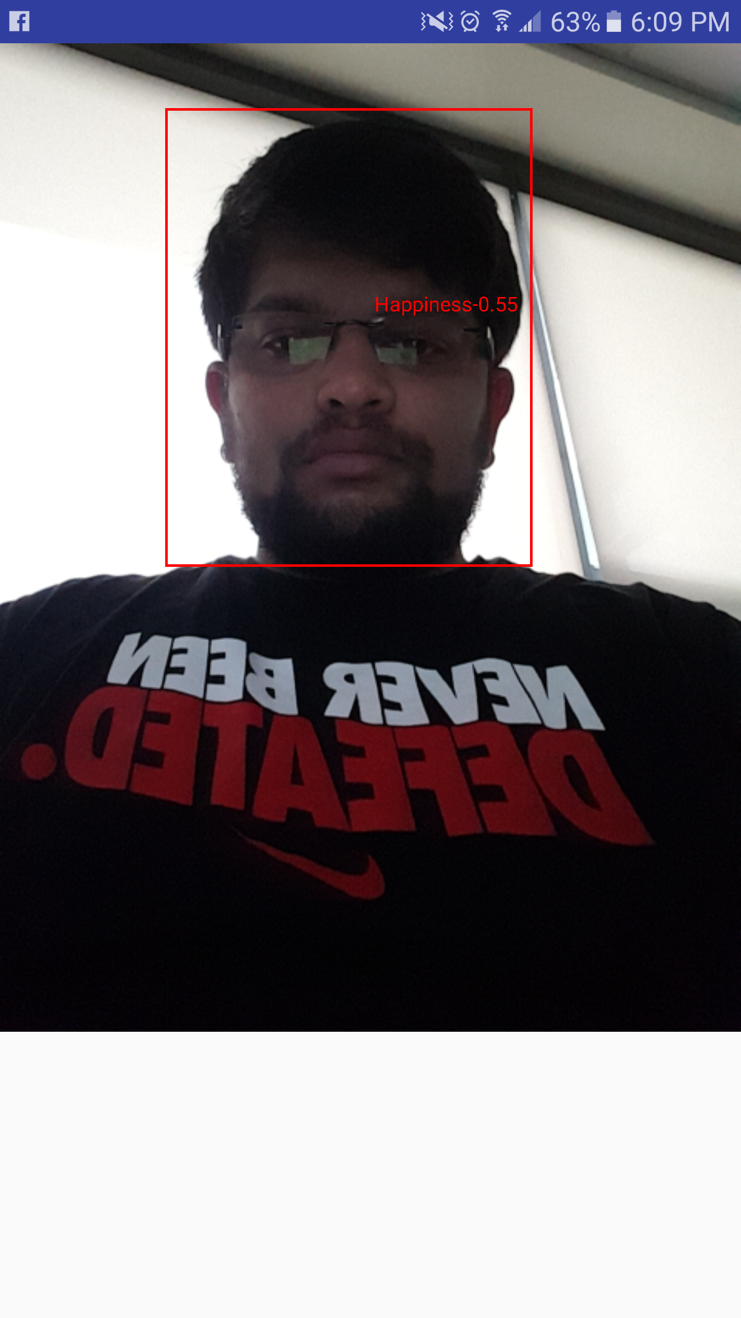
Face Detection and Image Upload
Face Detection is Done using Google Mobile Vision API
Why no OpenCV?
Features like happiness probability can be extracted using
the detected Face
Images are converted into bitmap and sent to backend via
a HTTP post.

Slide 7
Web Application for image access
Angular JavaScript framework for the Front-end development
Node.js as backend and MySQL for database.
Android backend making a post call into the Web app.
Sending the image captured as a bitmap image

Slide 8
Demo of the Project
https://youtu.be/GB-xDLorPS0

Slide 9
Learning from the project
Using android Studio
Google Vision API
Using GIT
Angular
Node
Handling Background Services

