Slide 1

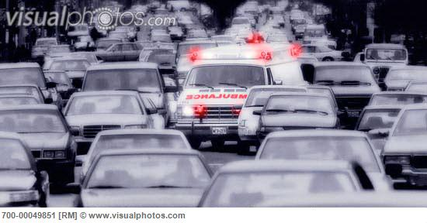
AmbiHelp - save time, save life.
Introduction
Poor traffic management coupled with increasing number of vehicles has lead to congested roads.
These congested roads make it difficult for the ambulance to go through.
Due to this the ambulance is delayed severely, which causes poor response time.
Our aim is to ensure the ambulance reaches its destination on time without any hassle.
Using RFID technology with GPS we plan to achieve this goal.
Problem Definition
High traffic density in developing countries.
Poor traffic management leading to congestion.
Average speed of vehicles during rush hour is 7mph.
Lack of communication among the commuters to make way for the ambulance.
Shortage of time for the commuters to clear the path.
Increase in the wait time for the ambulance.
Loss of golden hour for the patient.
Solution
Ambulance identifies the best route from source to destination.
Identifies the alert poles en route from source to destination.
Activates the alert poles 10 minutes prior to the arrival of the ambulance using RFID tags and GPS.
The alert poles alert the traffic using sound and light to make way for the approaching ambulance.
The path is cleared before the ambulance reaches a particular lane.
After the ambulance crosses the alert poles, it will turn it off.
Members
Pavaman Abbur Dwarkanath
May 2017
Computer Science
Anthony Ittiyera Vazhappilly
May 2017
Computer Science
Hetali Shah Gala
May 2018
Computer Science

