Slide 1
Final Presentation: Advanced Models, Insights, and Interpretation
Predicting NBA next-season performance from player-season data, 1996-2022
Victor Um
MATH 494
Final project focus: advanced modeling, explainability, and real-world interpretation
Today's roadmap
1) Compare advanced and baseline models 2) Explain why the best model wins 3) Interpret player archetypes and practical meaning
Victor Um | MATH 494 | NBA player performance modeling

Slide 2
From Baseline Models to Advanced Models
Why move beyond Presentation 2?
Presentation 2 showed that next-season PTS is fairly predictable with linear models.
But the diagnostics also suggested nonlinear structure, overlapping predictors, and some heteroskedasticity.
That motivates models that can learn interactions and nonlinear patterns automatically.
In this final stage, I compare baseline linear models to Random Forest and Gradient Boosting.
What I want to know
Does a more flexible model improve prediction enough to justify losing some interpretability?
Main target
Next-season points per game (next_pts). I also built saved models for next REB, AST, and TS% for the terminal prediction tool.
Victor Um | MATH 494 | NBA player performance modeling

Slide 3
Advanced Models Chosen and Why
Performance versus interpretability
Gradient Boosting
Builds many shallow trees sequentially, each one correcting previous errors. Strength: often strong predictive accuracy. Trade-off: harder to interpret than linear models.
Random Forest
Averages many decision trees built on random subsets of features and rows. Strength: handles nonlinearities and interactions. Trade-off: can overfit less than a single tree, but still loses transparency.
LASSO benchmark
My best linear benchmark. It shrinks weaker coefficients toward zero. Strength: interpretable and stable with correlated predictors. Trade-off: can miss nonlinear patterns.
For this final comparison, I keep one strong linear benchmark and compare it to two tree-based advanced models.
Victor Um | MATH 494 | NBA player performance modeling

Slide 4
Side-by-Side Model Comparison
All models predict next-season PTS
Model | Test RMSE | Test R² | CV RMSE | CV R² | Overfit Gap
Gradient Boosting | 2.852 | 0.780 | 2.825 | 0.784 | 0.199
LASSO Regression | 2.884 | 0.775 | 2.864 | 0.778 | 0.034
Ridge Regression | 2.895 | 0.773 | 2.878 | 0.775 | 0.078
Linear Regression | 2.969 | 0.761 | 2.952 | 0.764 | 0.214
Random Forest | 3.206 | 0.722 | 3.180 | 0.726 | 0.427
Headline result
Best overall model: Gradient Boosting Test RMSE = 2.852 Test R² = 0.780 Best linear model: LASSO Random Forest was worst and had the largest overfitting gap.
Victor Um | MATH 494 | NBA player performance modeling

Slide 5
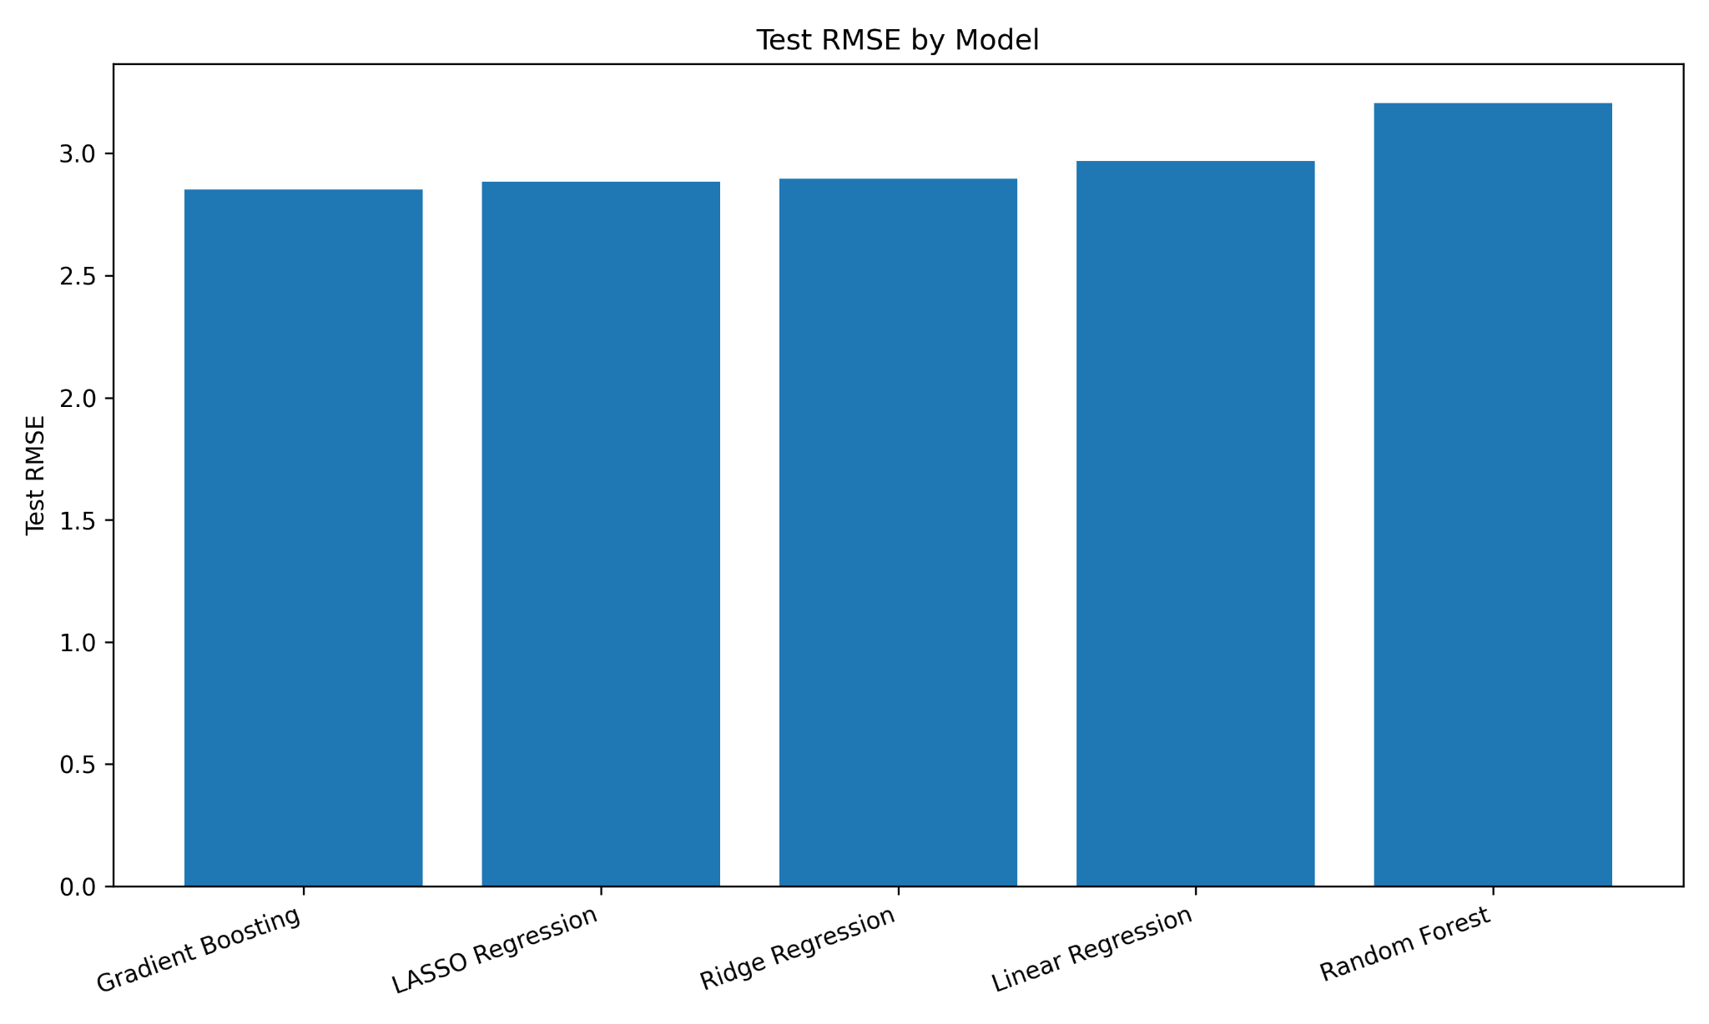
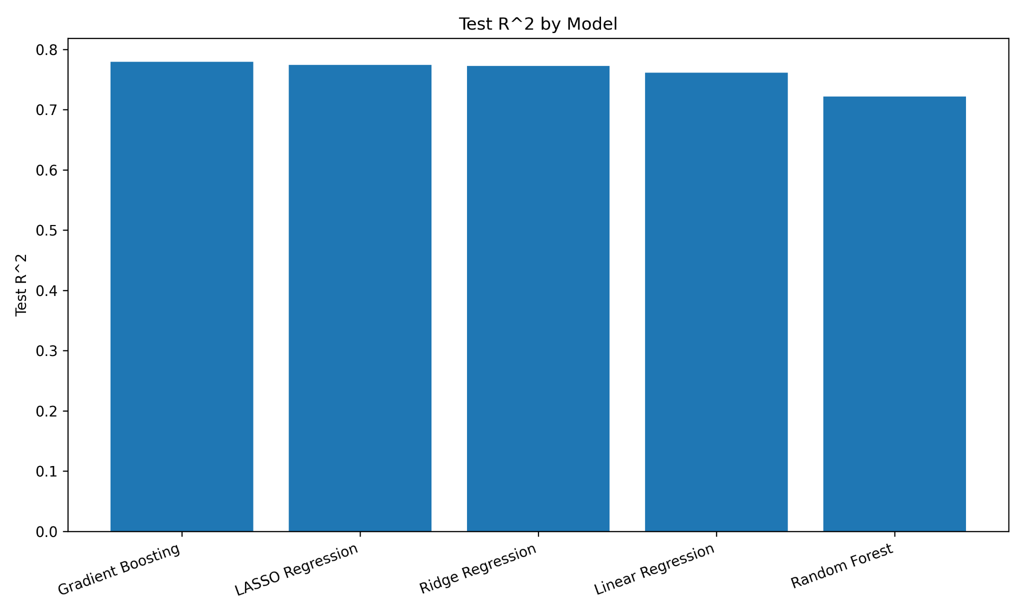
Test-Set Performance
How the models compare on the holdout set
Interpretation
Gradient Boosting is best on both test RMSE and test R², but the margin over LASSO and Ridge is not huge.
Victor Um | MATH 494 | NBA player performance modeling

Slide 6
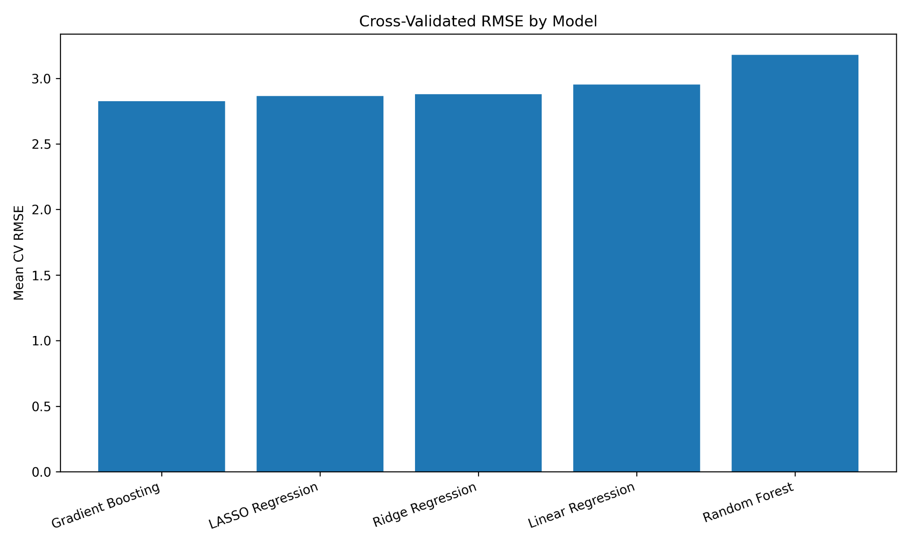

Cross-Validation: Does the Improvement Generalize?
A stronger check than a single train/test split
Why this matters
Gradient Boosting improves average CV RMSE over plain linear regression by 0.127 points per game and improves CV R² by 0.020.
Victor Um | MATH 494 | NBA player performance modeling

Slide 7
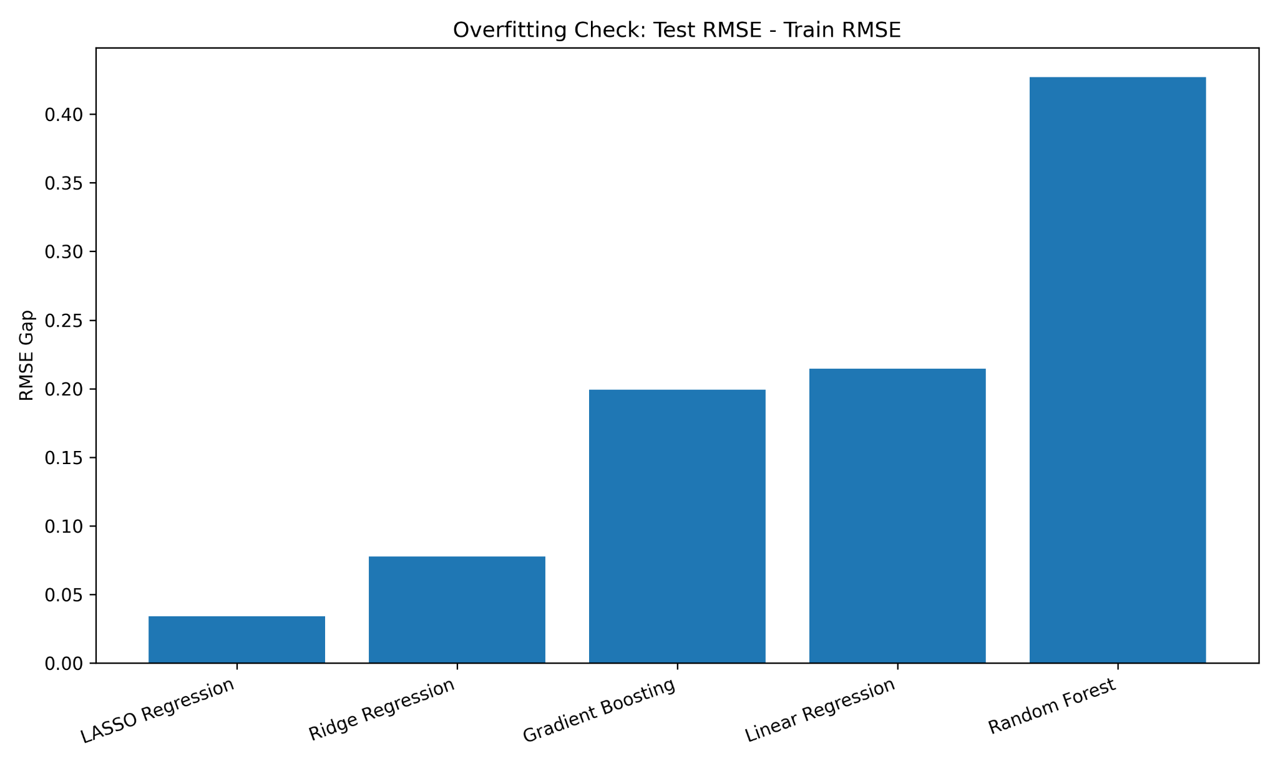
Overfitting Discussion
Better accuracy is only useful if the model still generalizes
LASSO has the smallest RMSE gap (0.034), so it is the most stable.
Gradient Boosting has a moderate gap (0.199), which is acceptable given its best overall accuracy.
Random Forest has the largest gap (0.427), so it appears to overfit the most.
This is why model selection should balance accuracy with robustness.
Victor Um | MATH 494 | NBA player performance modeling

Slide 8
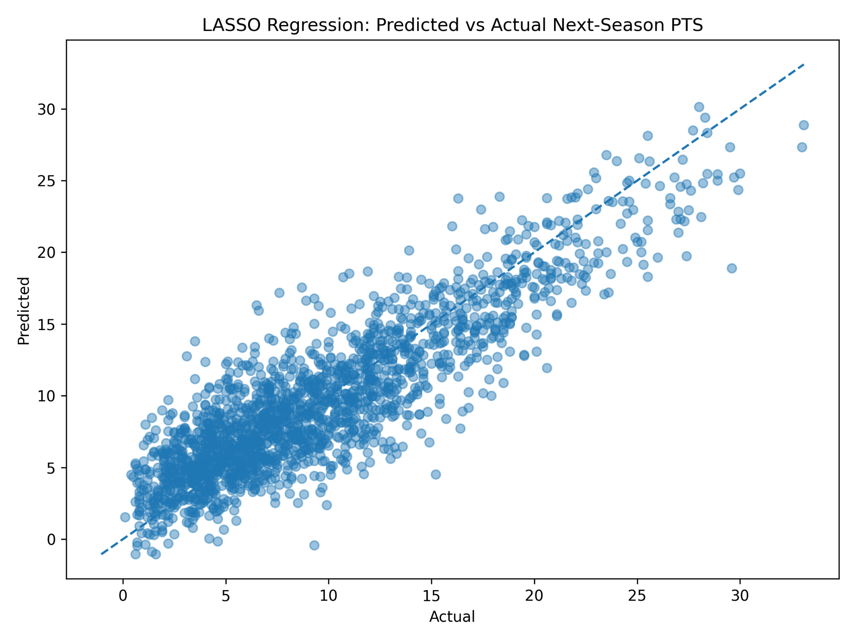
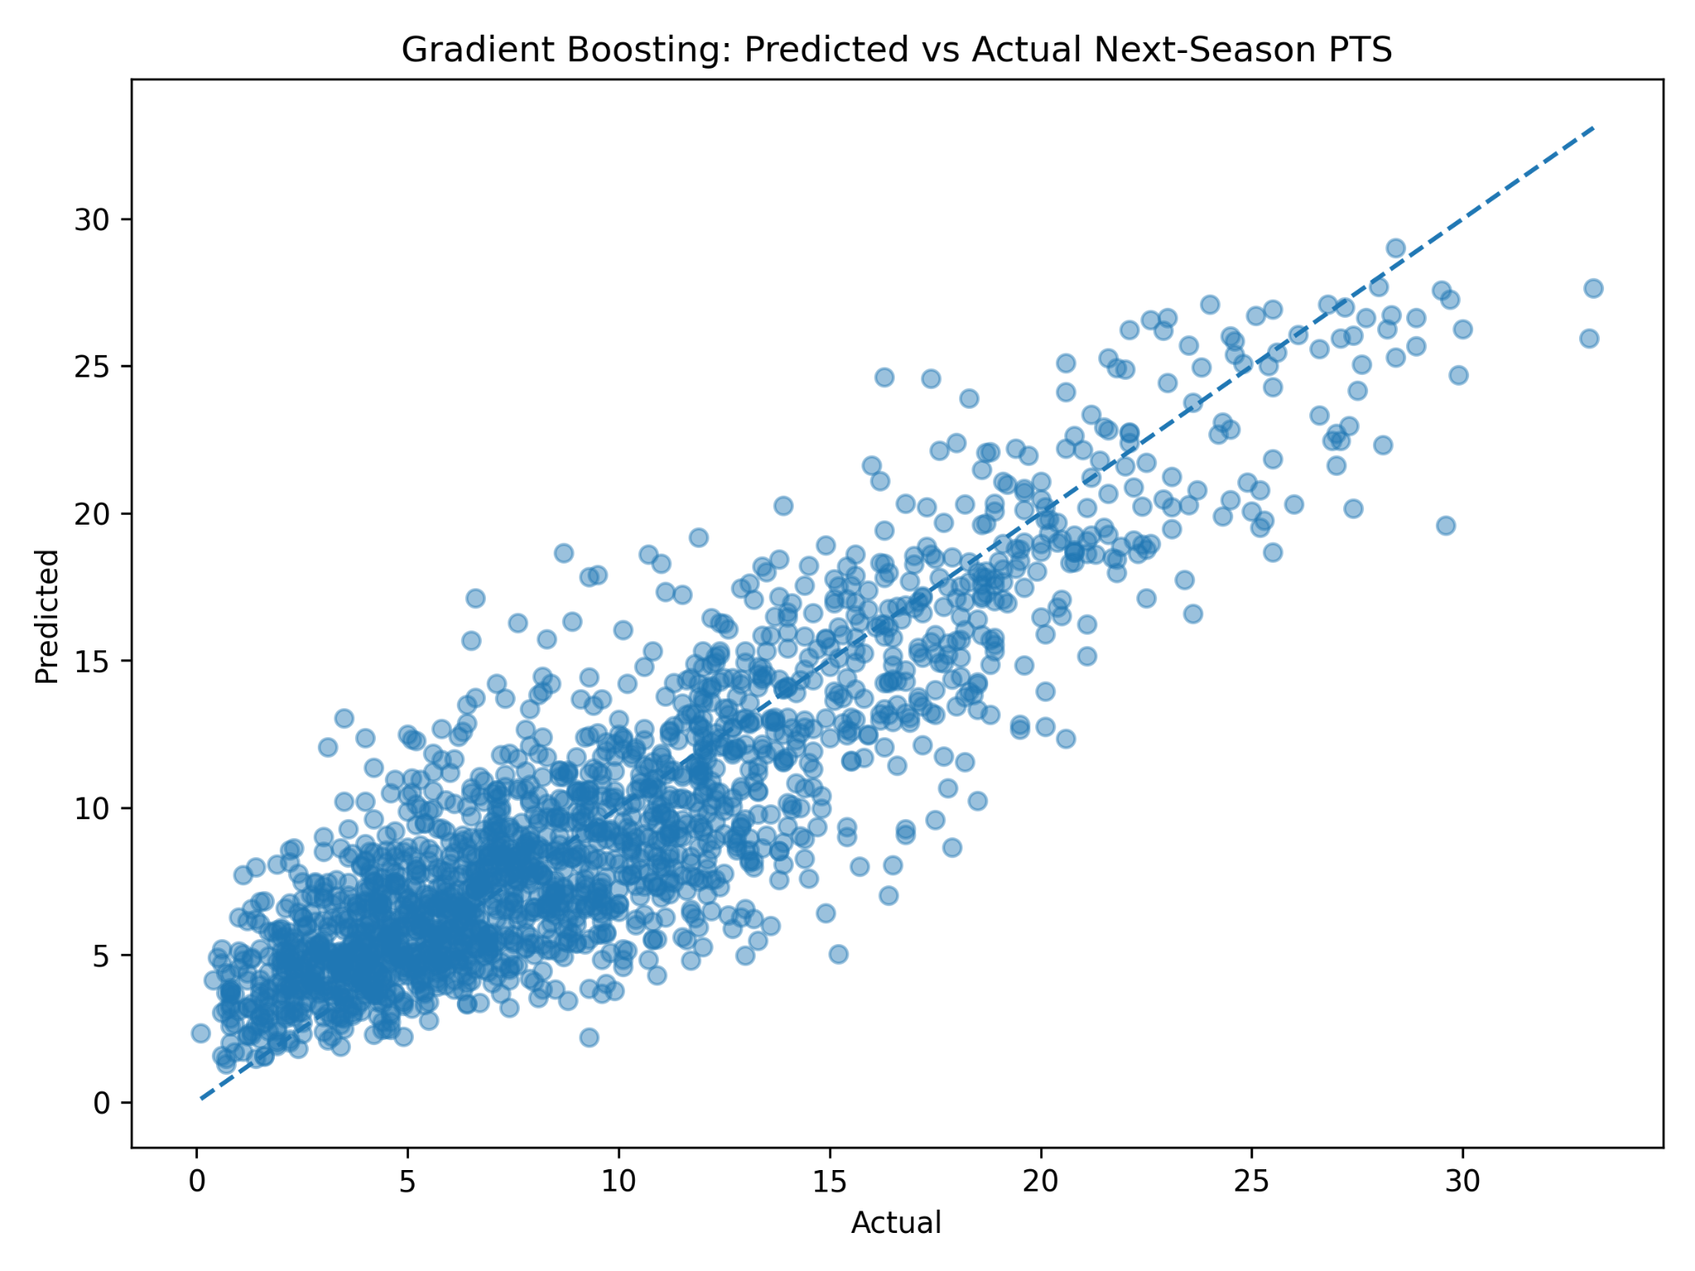
Visual Fit: Best Linear Model vs Best Advanced Model
LASSO versus Gradient Boosting
Takeaway
Both models track the diagonal well, but Gradient Boosting is slightly tighter overall, especially in the middle-to-upper scoring range.
Victor Um | MATH 494 | NBA player performance modeling

Slide 9
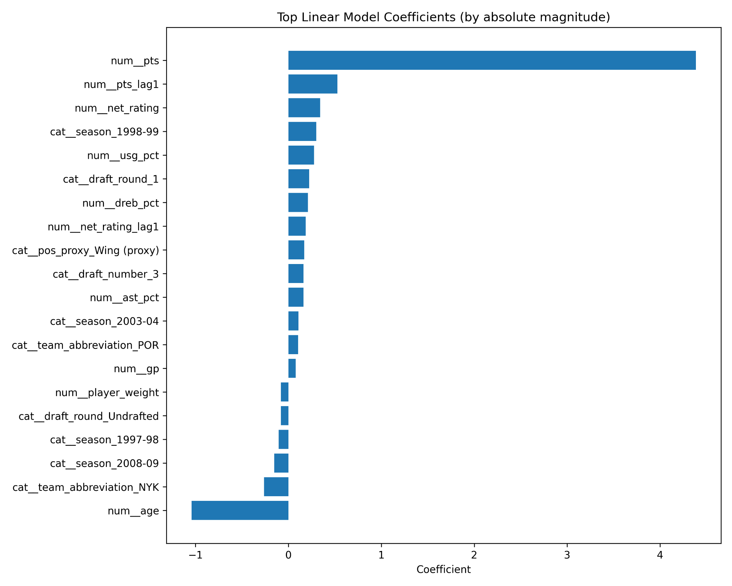
Explainability 1: Best Linear Model Coefficients
LASSO gives the clearest coefficient-based interpretation
Current PTS is the strongest positive signal.
Age is the largest negative coefficient.
Lagged PTS and net rating also matter.
Because numeric predictors were standardized, these coefficients show relative influence, not raw one-unit effects.
Victor Um | MATH 494 | NBA player performance modeling

Slide 10
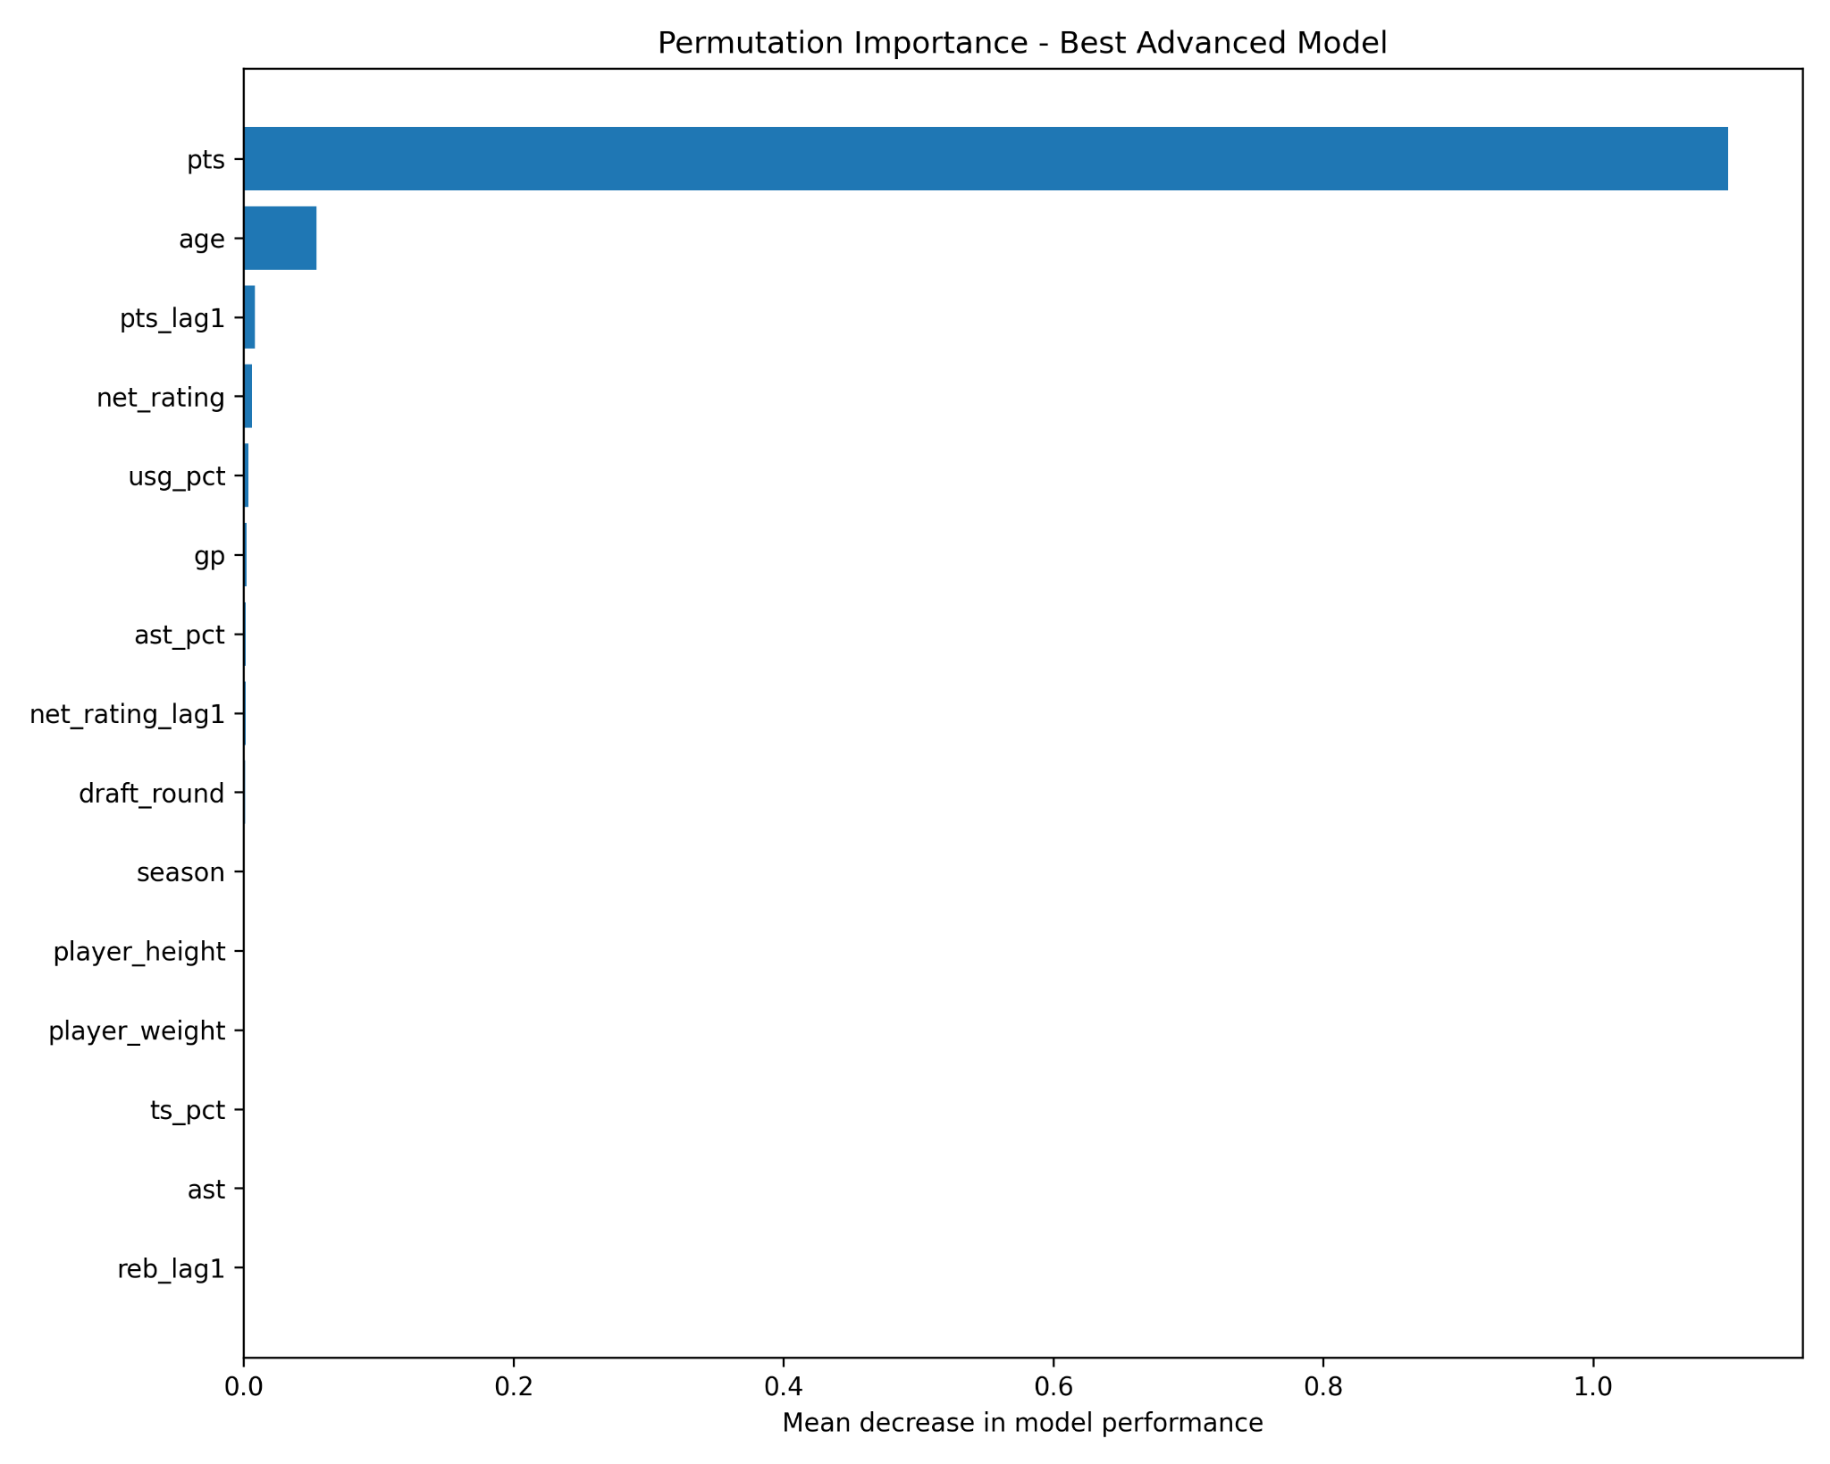
Explainability 2: Permutation Importance for Gradient Boosting
What hurts performance the most when shuffled?
Current PTS dominates the importance ranking.
Age is a clear second-tier feature.
PTS_lag1 and net_rating contribute, but much less.
Importance concentrates in a few variables because many basketball features overlap.
Victor Um | MATH 494 | NBA player performance modeling

Slide 11
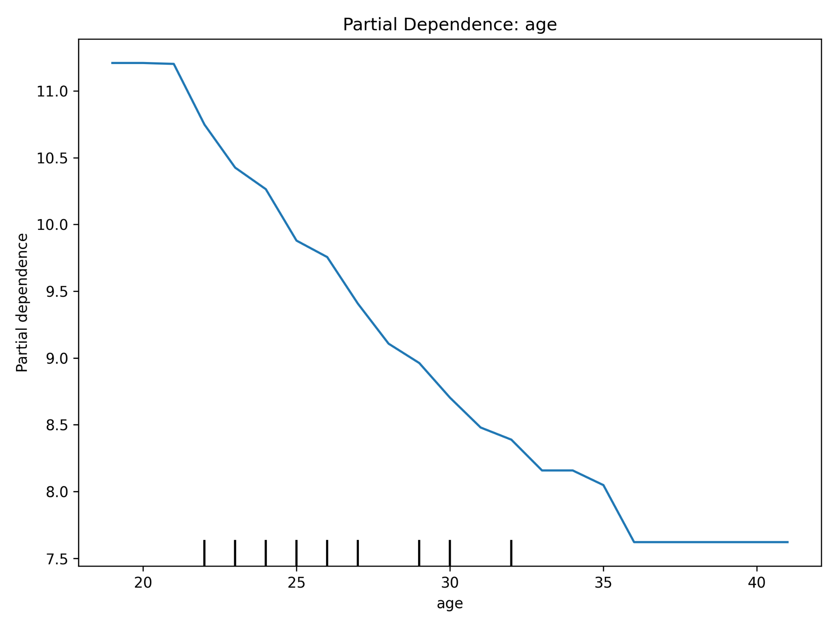
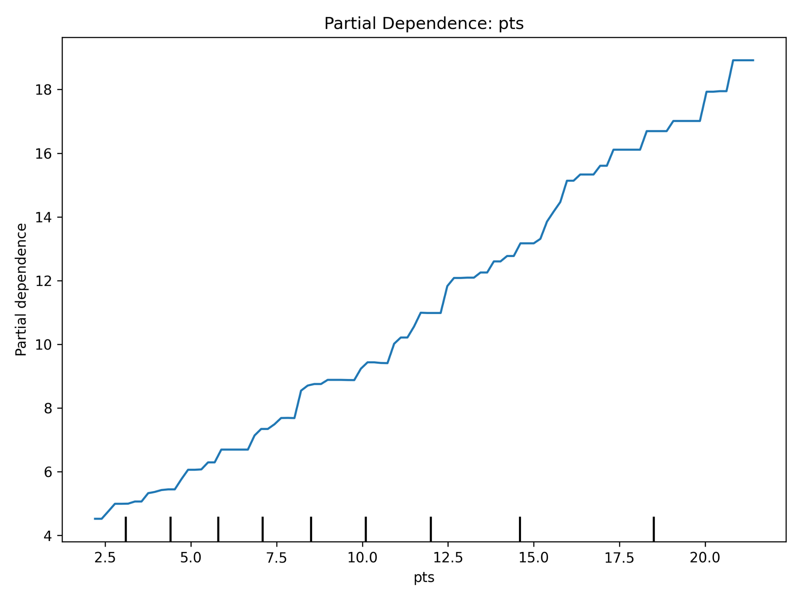
Partial Dependence: How Key Features Change the Prediction
Holding the rest of the feature distribution fixed
Interpretation
As age increases, predicted next-season scoring falls. As current PTS rises, predicted next-season PTS rises strongly and almost monotonically.
Victor Um | MATH 494 | NBA player performance modeling

Slide 12
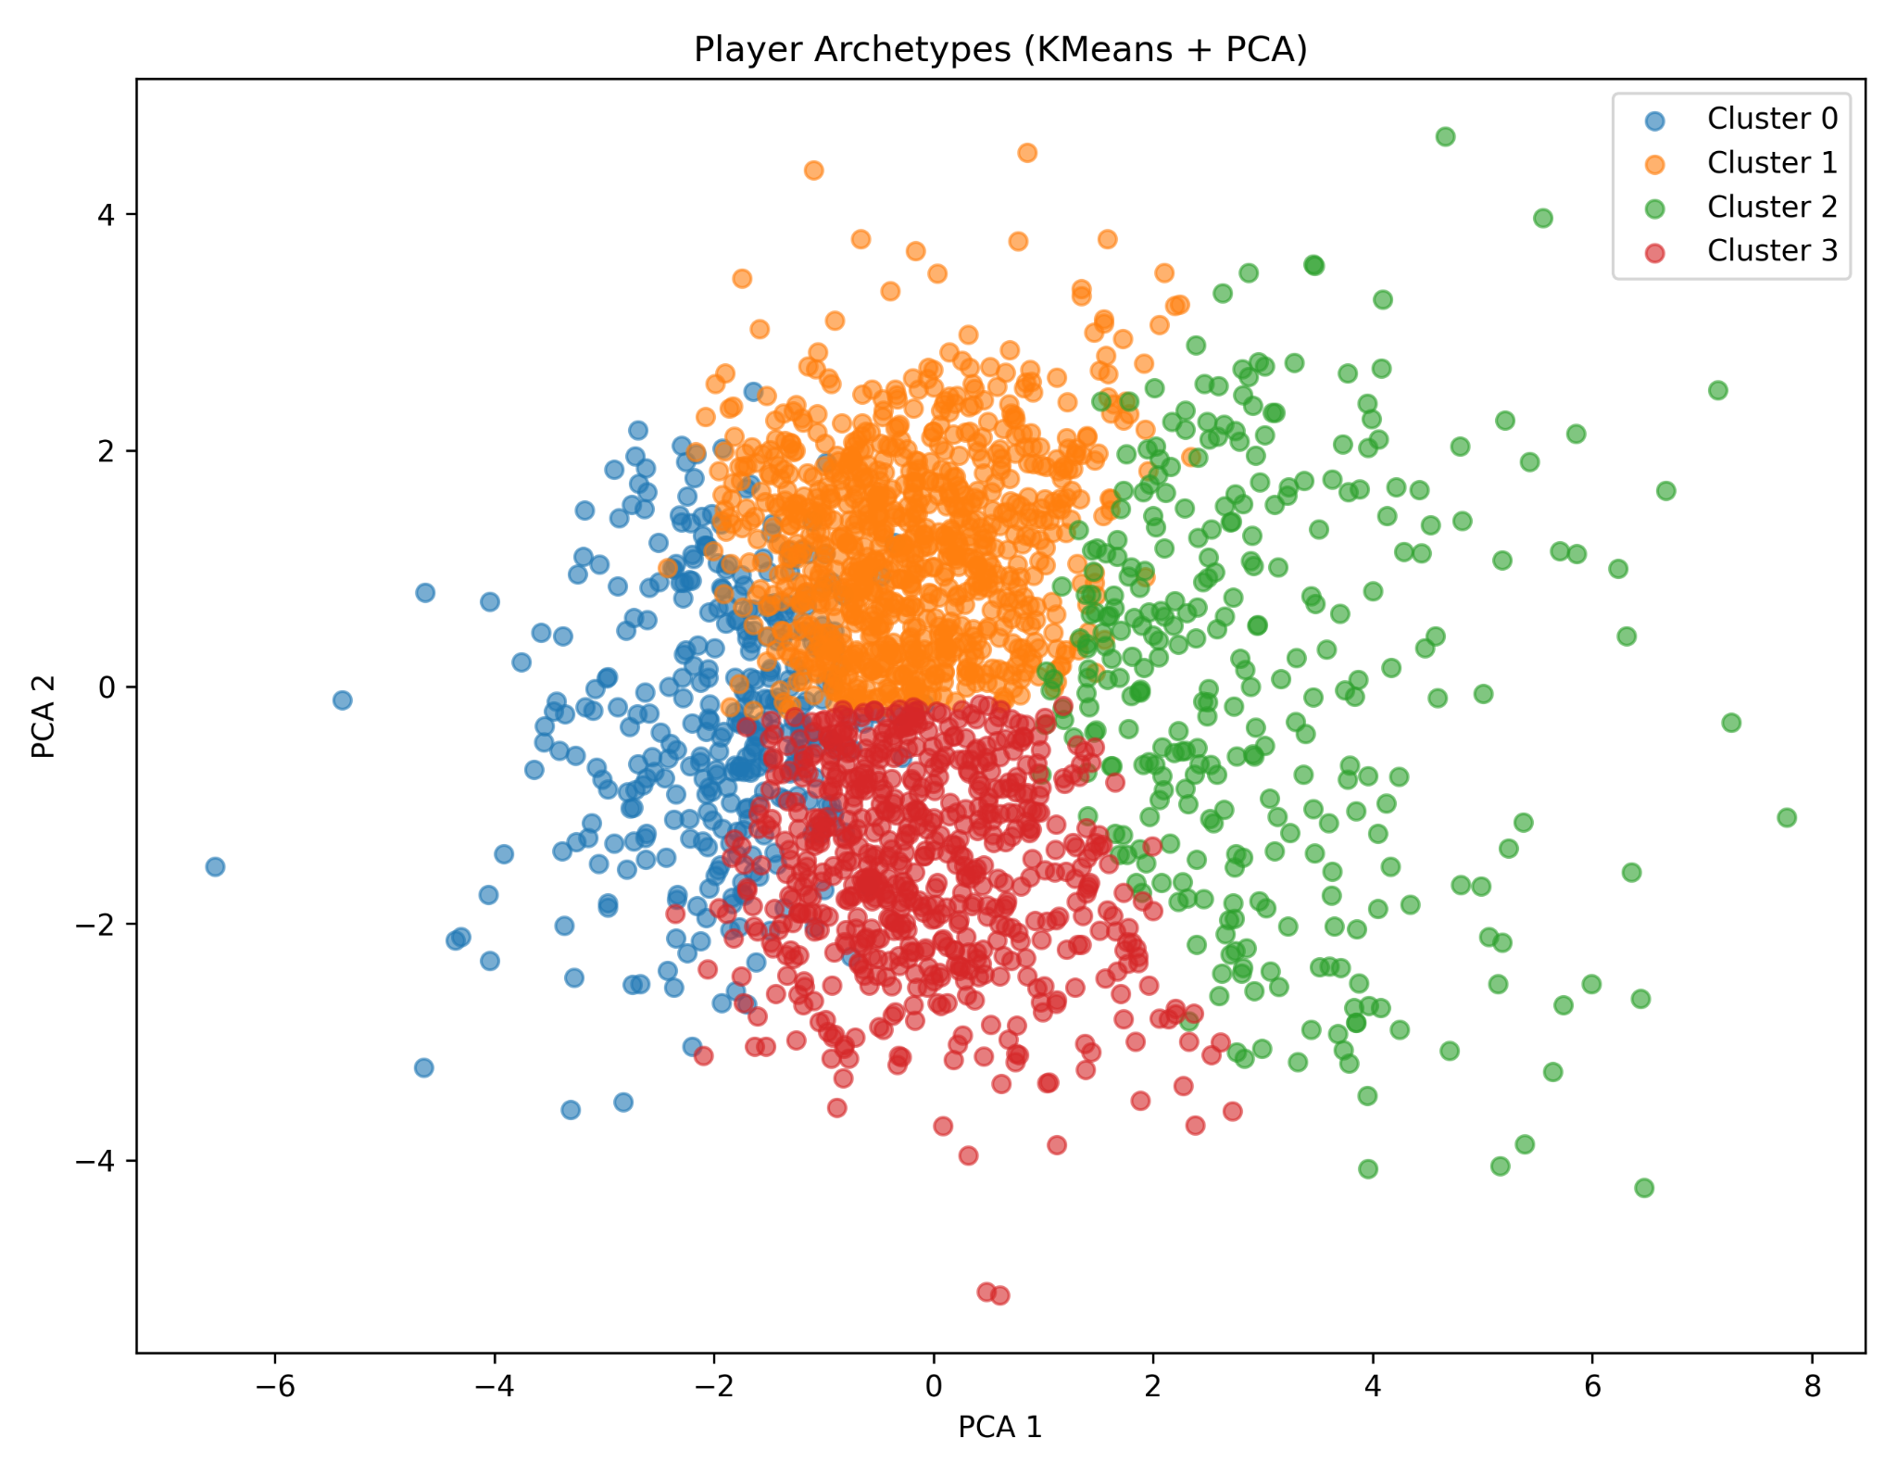
Player Archetypes from Clustering
KMeans on player-level averages, then PCA for visualization
Cluster 0: fringe or low-production bench players
Cluster 1: stable role-player veterans
Cluster 2: primary scorers and star-level players
Cluster 3: guards and secondary creators
Note: silhouette was highest at k=2 (0.250), but I used k=4 (0.206) because it produced more interpretable basketball roles.
Victor Um | MATH 494 | NBA player performance modeling

Slide 13
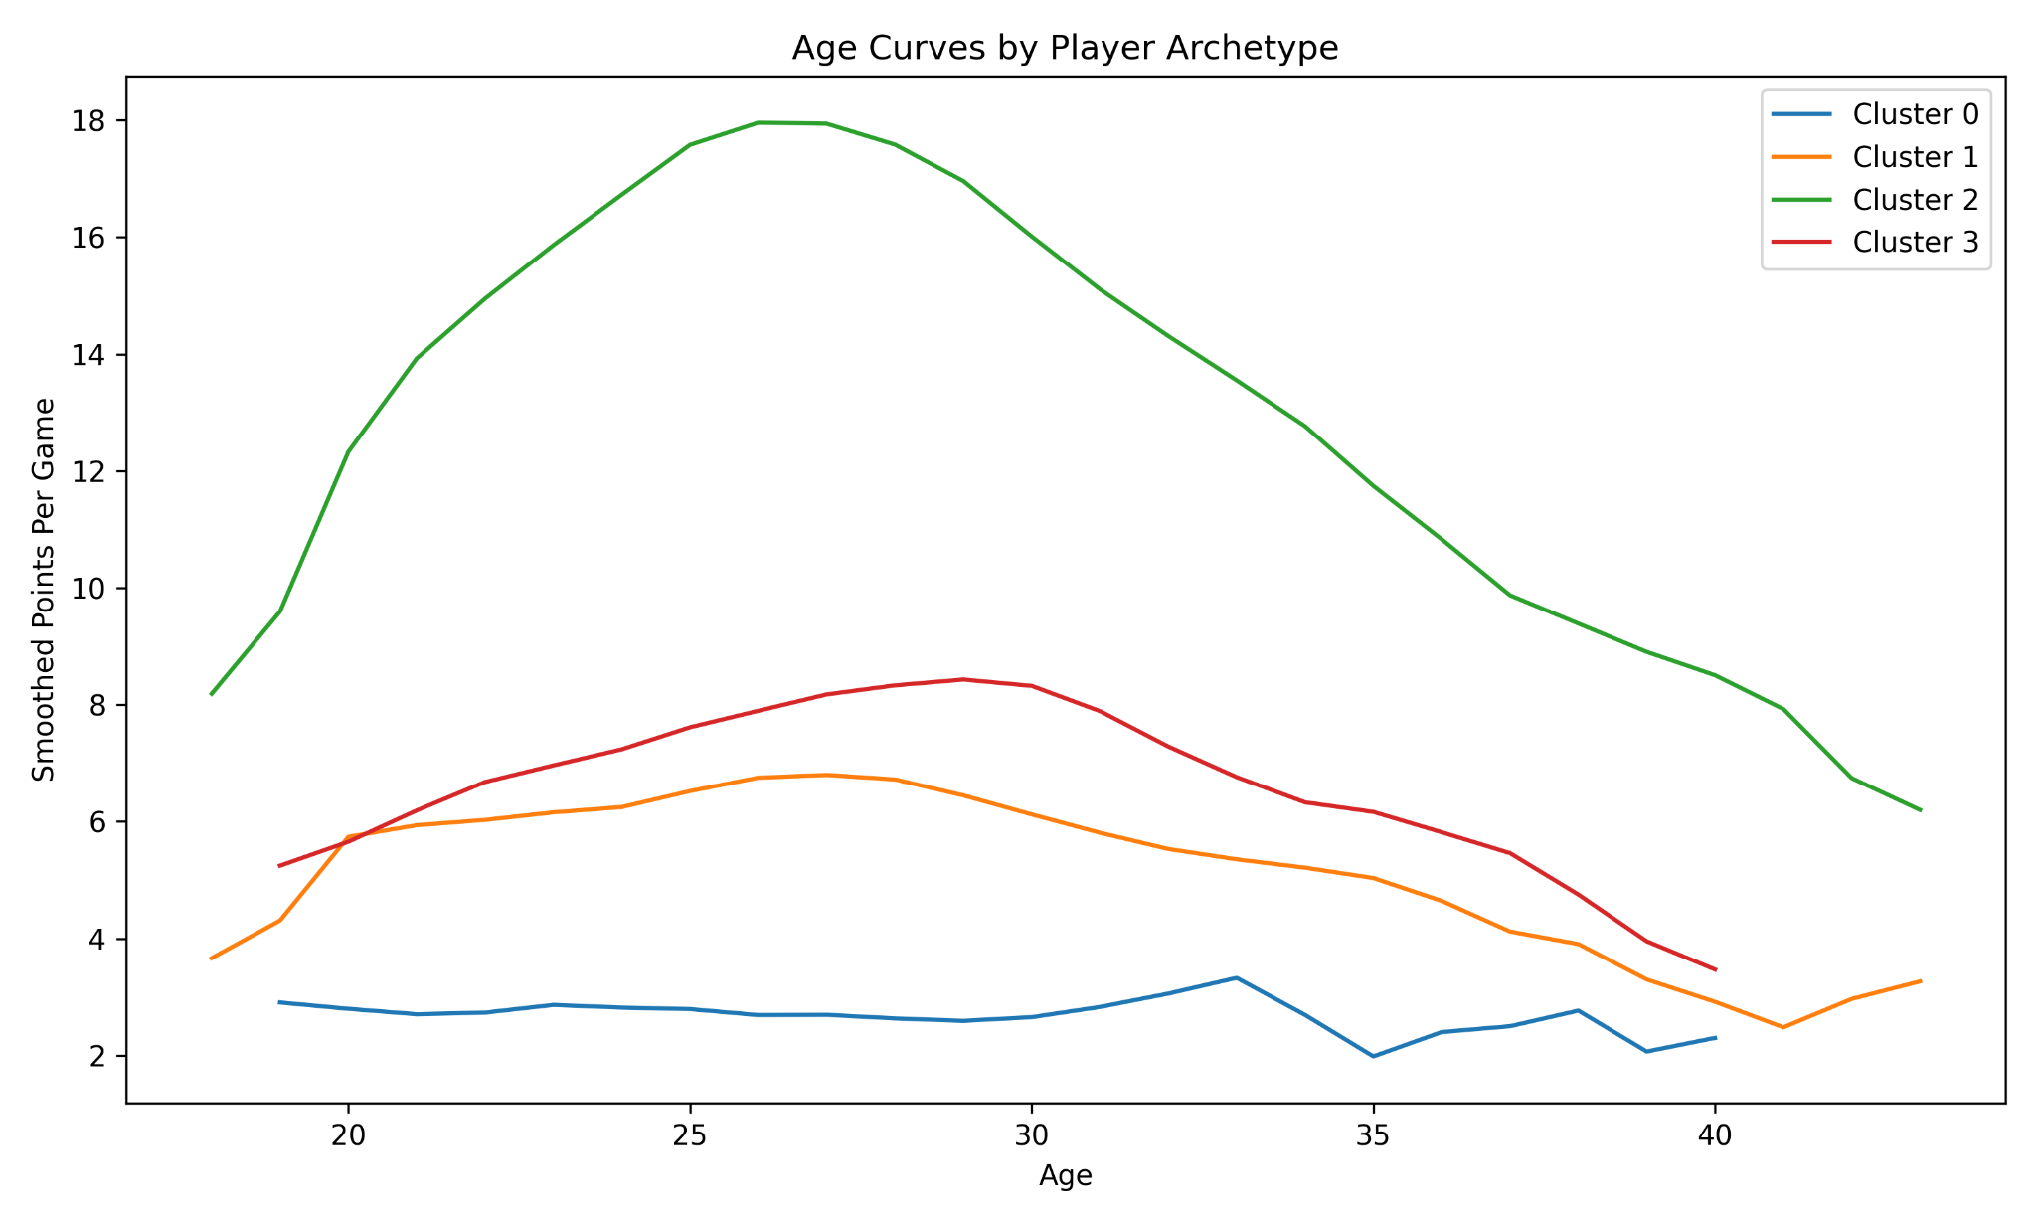
Aging Curves by Archetype
Different player types age differently
Cluster 2: Primary scorers / star-level players
Highest-usage, strongest all-around scorers; about 15.3 PPG, 5.6 rebounds, and 3.3 assists. Examples include LeBron James, Dirk Nowitzki, and Kobe Bryant.
Cluster 3: Guards and secondary creators
Smaller guards and secondary creators; about 6.2 PPG and 2.0 assists. Examples include Jason Terry, Lou Williams, and D.J. Augustin.
Cluster 1: Stable role-player veterans (bigs/wings)
Moderate-scoring, larger role players; about 5.4 PPG and 3.4 rebounds. Examples include Tyson Chandler, Trevor Ariza, and Kyle Korver.
Cluster 0: Fringe / low-production bench players
Lowest scoring group; around 2.6 PPG with negative net rating. Examples include Michael Ruffin and Dominic McGuire.
Victor Um | MATH 494 | NBA player performance modeling

Slide 14
Practical Output: Terminal Prediction Tool
From analysis to a usable mini-application
What the tool does
After the final models are trained, the saved bundle lets me type a player name in the terminal and get predicted next-season PTS, REB, AST, and TS%. It uses the player's most recent row in the dataset as the input profile.
python predict_next_season.py
Player name: LeBron James
Outputs:
- Predicted next-season PTS
- Predicted next-season REB
- Predicted next-season AST
- Predicted next-season TS%
Why include this?
It shows the project can move from a research presentation into a simple, user-facing prediction tool.
Victor Um | MATH 494 | NBA player performance modeling

Slide 15
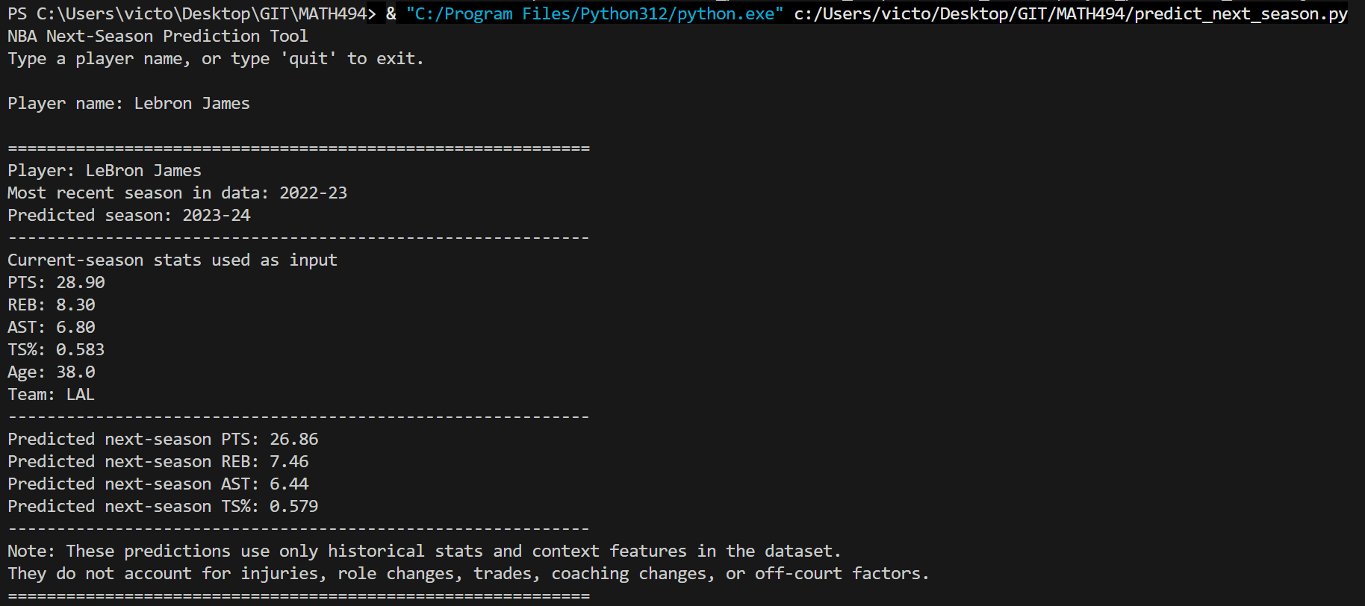
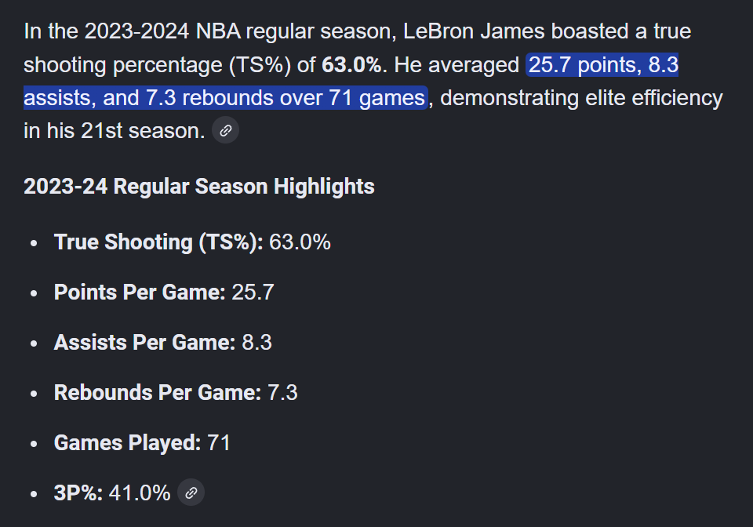
Practical Output: Terminal Prediction Tool
From analysis to a usable mini-application
What the tool does
After the final models are trained, the saved bundle lets me type a player name in the terminal and get predicted next-season PTS, REB, AST, and TS%. It uses the player's most recent row in the dataset as the input profile.
python predict_next_season.py
Player name: LeBron James
Outputs:
- Predicted next-season PTS
- Predicted next-season REB
- Predicted next-season AST
- Predicted next-season TS%
Why include this?
It shows the project can move from a research presentation into a simple, user-facing prediction tool.
Victor Um | MATH 494 | NBA player performance modeling

Slide 16
Limitations and Ethics
Why model performance is not the same as truth
Survivorship bias: older players in the data are often the ones good enough to stay in the league.
Injury gaps: the model does not observe missed development caused by injuries or recovery.
Role changes: trades, teammates, and coaching systems can change opportunity quickly.
Correlated inputs: even good models can make some features look more or less important than they truly are.
Ethical caution
These models should support decisions, not replace human judgment in contracts, roster moves, or development plans.
Why this matters
A small prediction gain does not automatically justify using a less interpretable model in a high-stakes setting.
Victor Um | MATH 494 | NBA player performance modeling

Slide 17
Final Takeaways
What this project shows
Gradient Boosting was the best overall model for next-season PTS, but the improvement over linear regression was modest (0.127 CV RMSE).
LASSO remained a strong benchmark because it was accurate, stable, and much easier to interpret.
Current scoring and age are the most consistent drivers across both linear and advanced explanations.
Clustering showed that different player archetypes follow different aging curves.
The final project ends with both a research result and a simple prediction tool.
Closing message
The best model is not always the most useful model. In this project, performance, explainability, and context all matter.
Victor Um | MATH 494 | NBA player performance modeling

