Slide 1
Implementation of a simple four wheel car using arduino uno
By-
Hosen, Mohammad Uzzal ( 16-32253-2 )
Dola, Shionty Ghosh ( 18-38013-2 )
Shihab ( 18-38172-2 )
Eshan, Sumit Hassan ( 18-38194-2 )
Khadiza, Umma ( 18-38311-2 )
Ziad, Mahmud Shah Md ( 18-38329-2 )
Tabid, MD. Tarek Lehaz 17-34240-1 )
Aziz, S.M. Tarek 18-38182-2 )
Supervised By-
SUJAN HOWLADER (ESSAN) ASSISTANT PROFESSOR

Slide 2
Introduction
Why automated car is important?
The development of self-driving vehicle is a task that have the potential of solving many fundamental problems that drivers face when on the road. atmosphere friendly,reduce accidents,lower fuel consumption,increased lane capacity,reduce travel time & transportation cost,efficient parking,traffic efficiency,disable people can easily use it.
What is the future?
Globally speaking, nearly 1.3 million people die in road crashes each year, on average 3,287 deaths a day.Speeding, talking over phone, drunk driving and breaking traffic rules are the root causes behind these accidents and the statistics are rising day by day .Though human errors can never be eliminated, but accidents can definitely be stopped.And in this case technology has surely come to our rescue.Many companies throughout the world are making a serious and continuous efforts to make driving a safe and risk free process and have started building prototypes for the same. Among these companies are Google, Tesla Mercedes , Kia-Hyundai, Ford, Audi, and Huawei.

Slide 3
Automated Car
What is automated car ?
An Autonomous car is a vehicle capable of sensing its environment and operating without human involvement.A Human passenger is not required to take control of the vehicle at any time, nor is a human passenger required to be present in the vehicle at all.
What is expected from an automated car?
The 3 primary matters that get wherein are need to move while using :
Specific Destination
Directions
Tracking Progress.

Slide 4
Advantages
Roads will be safer and jamless.
Better product quality and efficiency.
Improved safety.
Control from anywhere by updating or artificial intelligence.
Save manpower.

Slide 5
Disadvantages
More expensive to buy than a manual.
The transmission has more moving parts, which leads to greater repair costs.
It's not as fun to drive — though this is subjective.
A transmission with too many gears might shift too often

Slide 6
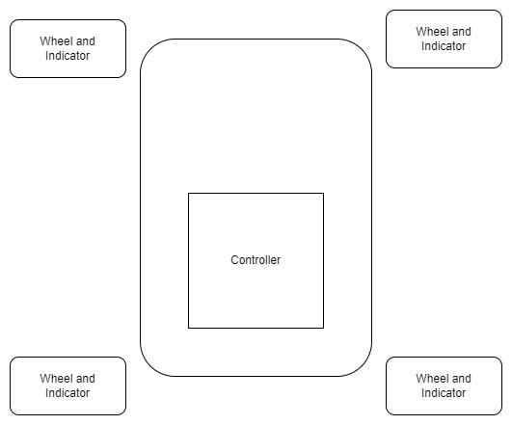
Our Project and what it does
It moves!
Turns Right
Turns Left
Reverse and
Forward

Slide 7
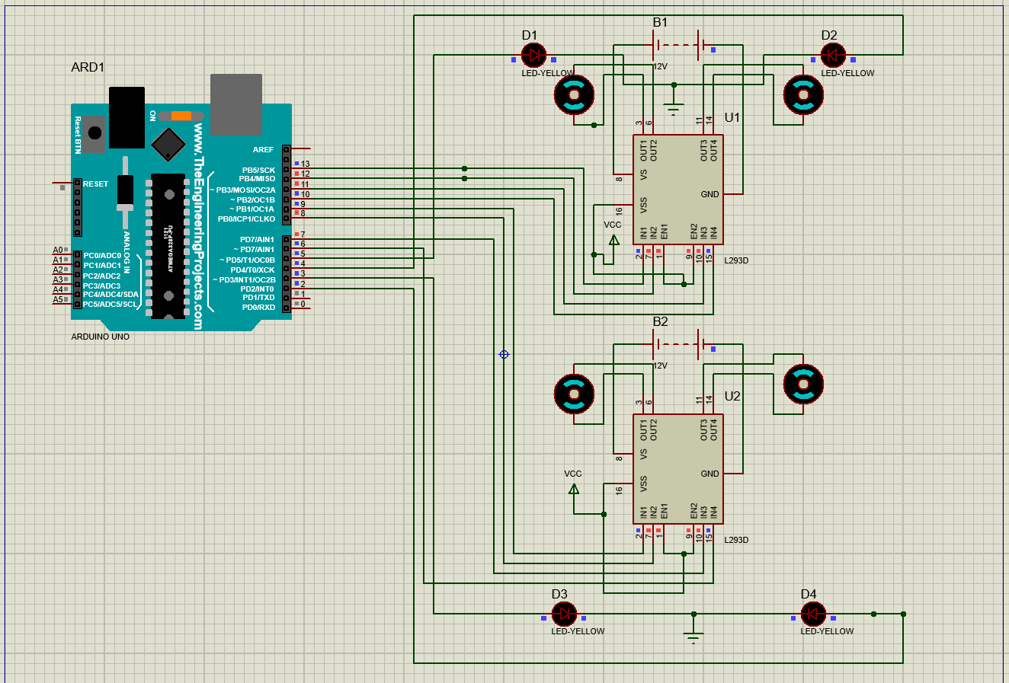
How we did it ?
Collected all the components
Implemented the circuit on Proteus
Compiled the code in Arduino
Schema in Proteus

Slide 8
Future Improvements
Image processing
Adding camera
Adding sensor
Adding remote / bluetooth

Slide 9
Conclusion
We faced some challenges like how to control the four motors, after some research we figured out about the motor driver and that made our work a lot easier.
The pins were not enabled as output first, that took some time to realize that each part in the code is important.
We learned about the limitations and possible future improvement possible.

Slide 10
Thank You
Any Questions ?

