Slide 1
Software Development Project Management
Project Management tools

Slide 2
Our
Team
Mifa, Afia Farjana
18-39114-3
Diya Rahman
18-38282-2
Umma Khadiza
18-38311-2
Omi, Md. Minhazul Islam
17-35811-3

Slide 3



Project Management software
1
2
3

Slide 4
Alternative to Microsoft Projects Open source

Slide 5
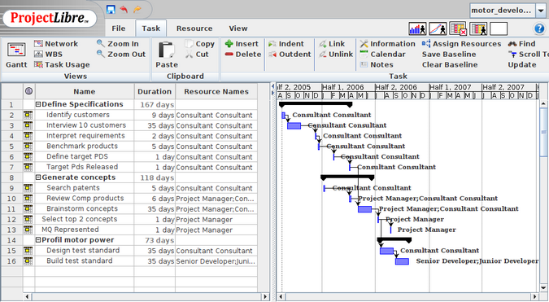
About The Software
ProjectLibre
ProjectLibre is a project-management software company with both a free open-source desktop and an upcoming Cloud version.
ProjectLibre desktop is a free and open source project
management software system intended ultimately as a
standalone replacement for Microsoft Project.
ProjectLibre has been downloaded 5,000,000 times in 200
countries and translated into 29 languages
ProjectLibre is perfectly suitable for planning and executing small or midsized projects. However, it's missing some advanced
features in MS-Project, and its GUI is not the prettiest.

Slide 6
Features
Compatibility with Microsoft Project
Resource Histograms
Gantt Chart
Task usage reports
WBS/RBS charts
Earned Value Costing

Slide 7
Pros
Its open source and has a free version
It is easy to use and cost-effective project management tool
Handles task assignments and task scheduling with the utmost ease
Helps its customers with videos and articles available online
Has both desktop and cloud version

Slide 8
Cons
It is not made for newcomers
The free version comes with minor glitches
The user interface is outdated

Slide 9
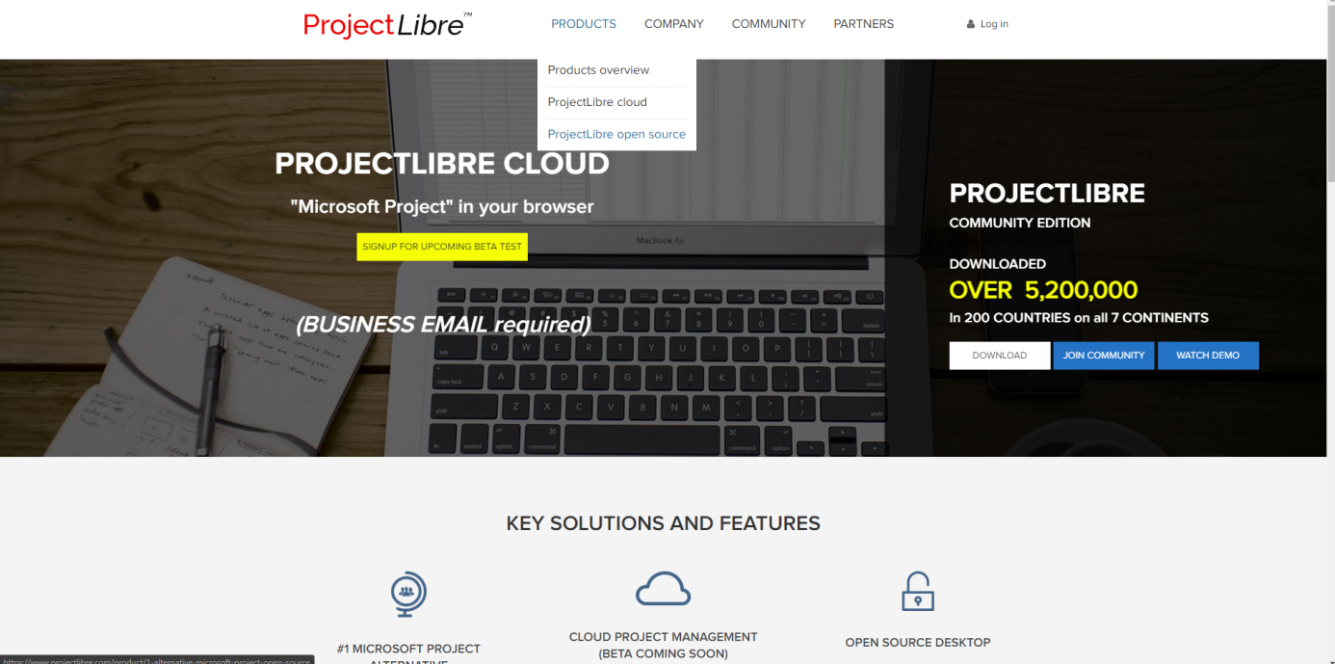
Steps to log in to the software
The projectLibre software can be downloaded from projectLibre’s website at https://projectlibre.com there is option for both desktop version downloading and for using the desktop version. In the homepage we will click on products-> Projectlibre open source. From the next page we can download the software.

Slide 10
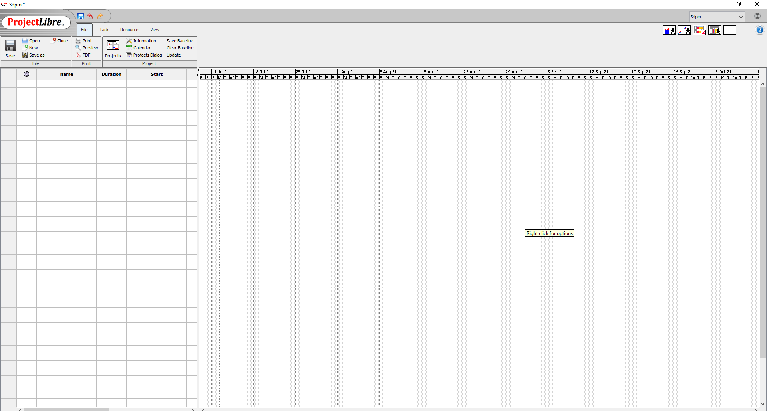
Steps to log in to the software
After downloading and installing we will have to create an account in the website and the run the software in our device. After that we can create a new project or open an existing one and start working

Slide 11
open source enterprise project management
and collaboration tool

Slide 12
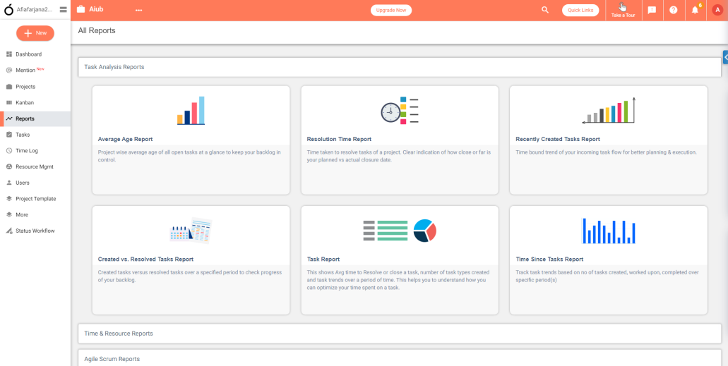
About The Software
OrangeScrum
OrangeScrum is easy and free and open-source project management software for enterprises of all sizes. OrangeScrum allows
companies to organize multi-functional ventures, teams, and
activities, such as Gantt charts, time log, Kanban view, daily
catch-up, recurring tasks, project & task templates, invoicing,
and more. It is an ideal choice for startups and medium-sized
enterprises.

Slide 13
Key Features
Agile methodologies
Time tracking
Resource management
Recurring task management
Multiple billing rates

Slide 14
Pros
Open source & free, provides impressive features and add-ons to its users
It has an easy to use interface in the initial period with a comfortable layout
Gives a quick overview of task status and hours spent on a task
Various charts to represent ongoing work and progress
Has both desktop and cloud version

Slide 15
Cons
Companies can see bugs in an old version of OrangeScrum
Time tracking and user management features are not added to the base pack
Limited functionality and features are available in the free version
The software is currently only available as a desktop application only

Slide 16
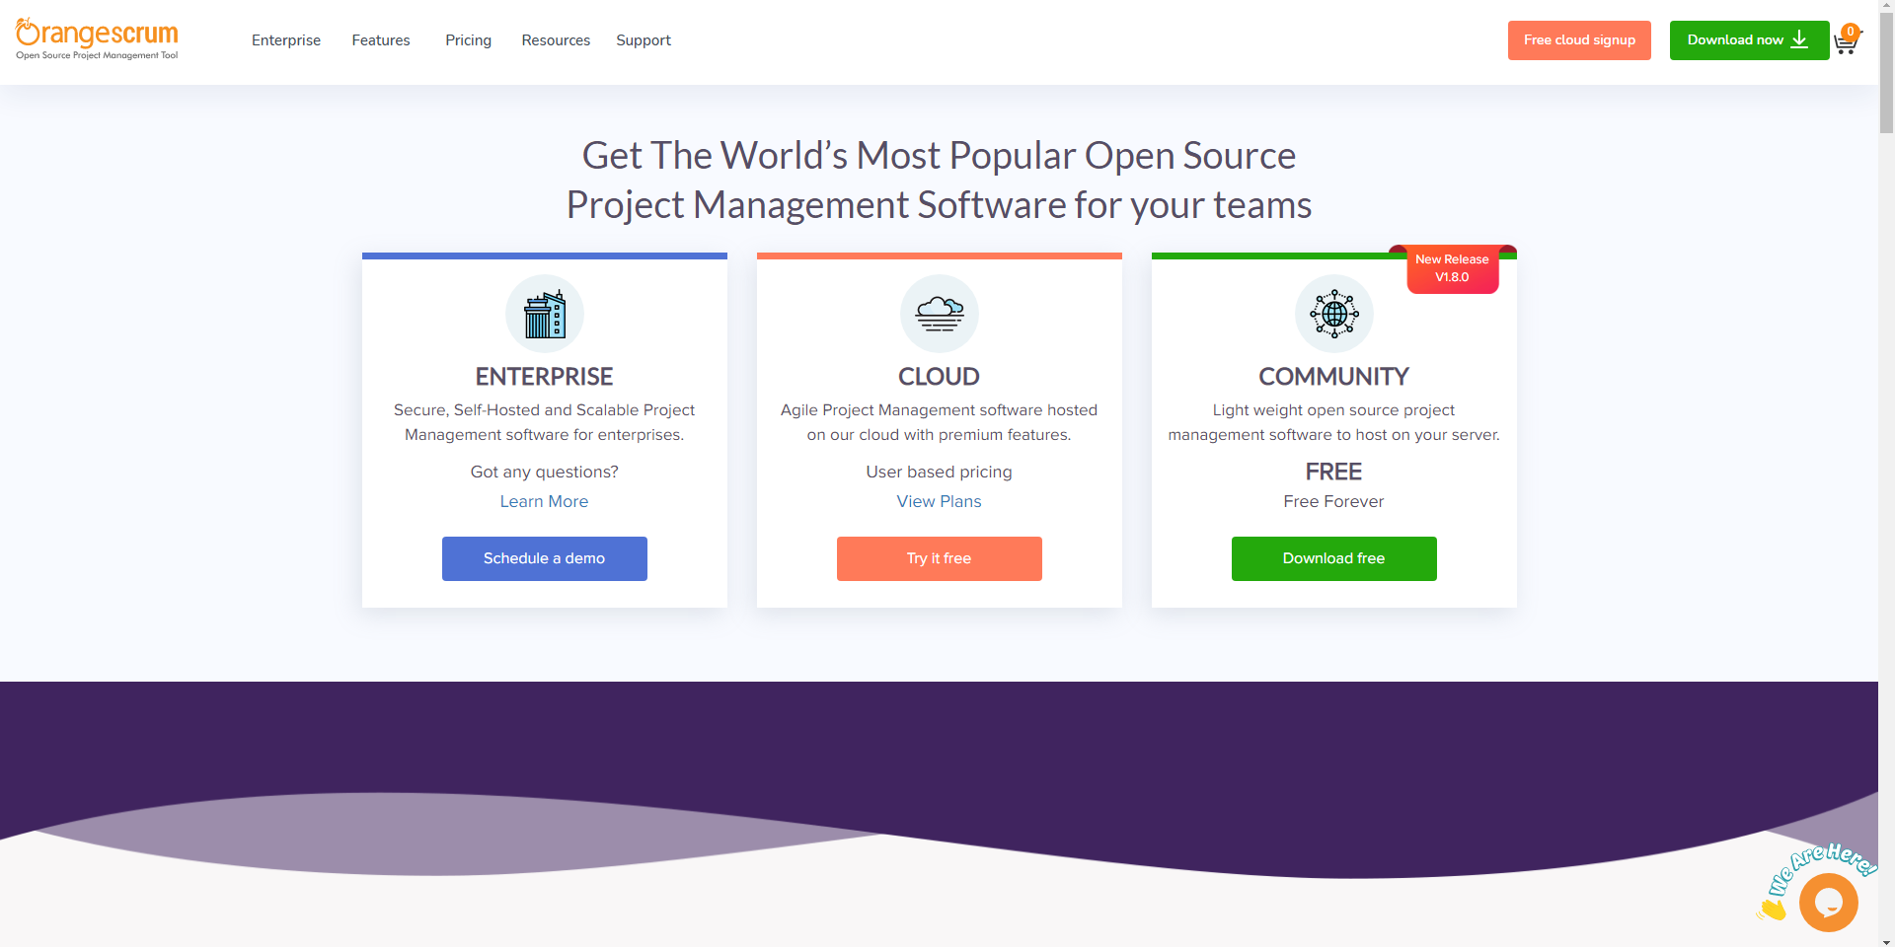
Steps to log in to the software
The software can be used from orangeScrum’s website at https://orangescrum.org there is option for both desktop version downloading and for using the cloud version. Here we will look at the cloud version by clicking at “Free cloud signup” in the upper right corner.

Slide 17
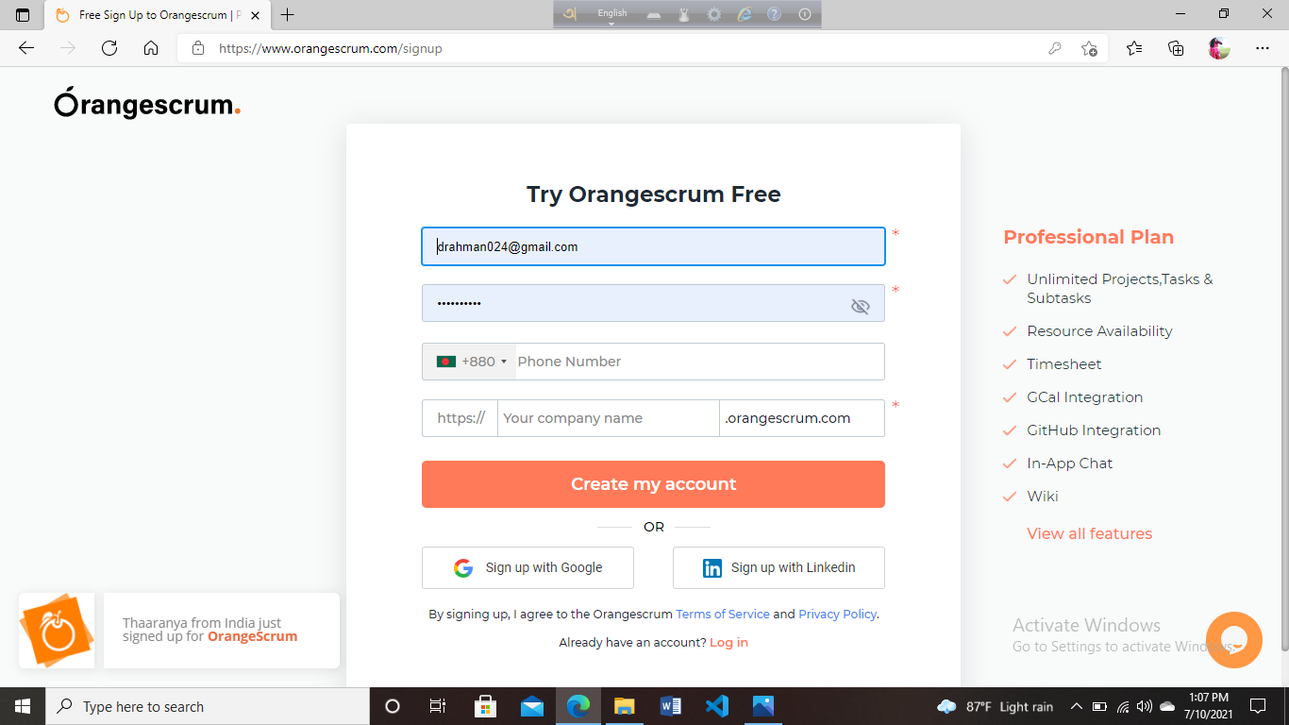
Steps to log in to the software
We can now create a free account to use the free version of orangeScrum

Slide 18
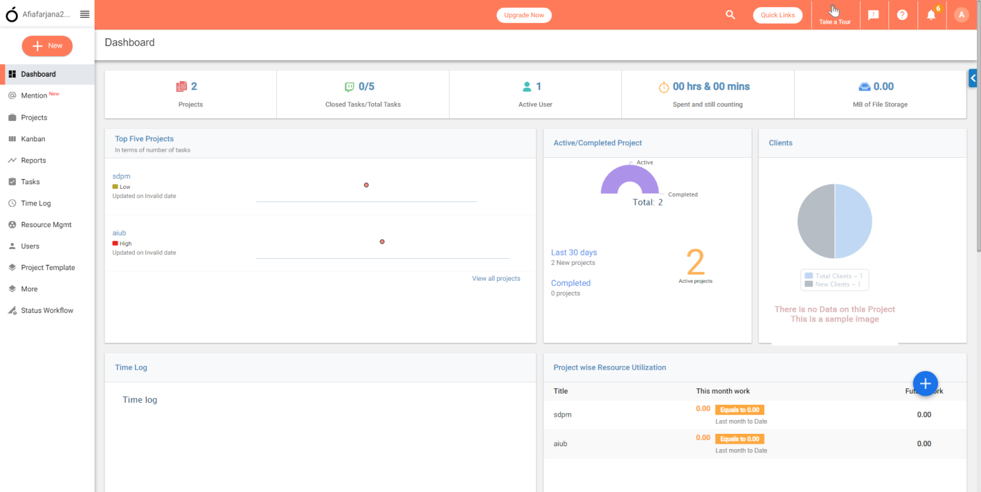
Steps to log in to the software
After signing in the basecamp dashboard looks something like this. Here we can start exploring various options for managing our projects

Slide 19
Project Management and Team Communication

Slide 20
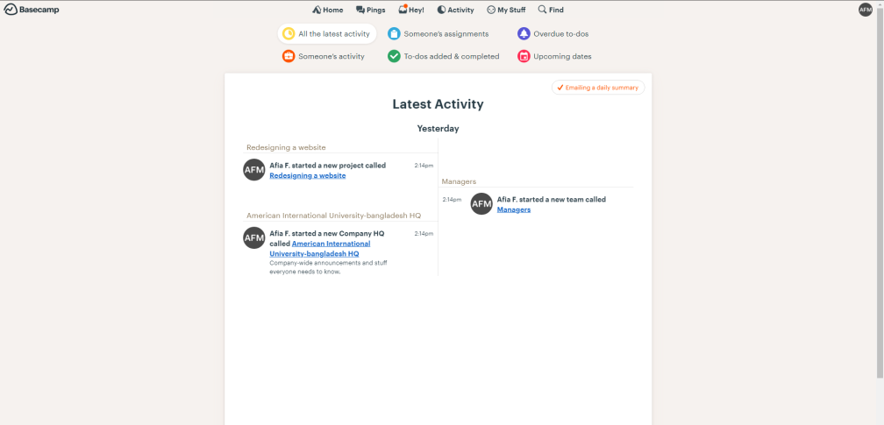
About The Software
Basecamp
Basecamp is a real-time communication tool. It includes to-do
lists, calendars, due dates, and file sharing, which provides a
way for teams to keep track of priorities and actionable items.
With Basecamp, users can create projects, document progress, and manage tasks. It’s web-based software, allowing users to
sign in either through a web browser or through a mobile app.
Basecamp can be used by any organization that needs to
manage a group, including nonprofits, startups, and client
service firms and even freelancers. Subscriptions are scalable, with tiers for varying amounts of storage and numbers of users.

Slide 21
Key Features
Calendar, Task History, To-Do List
Add Recurring Tasks
Interactive Gantt Charts
Resources Allocation and Forecasting
Project Templates
Create Teams/Groups, Forums
Scheduling, issue history
Messaging or Instant Messaging
Document Management

Slide 22
Pros
Has both website and mobile application
Storage of files and documents in one place
Great communication system. Basecamp provides its users with various ways to communicate
Basecamp can be integrated with other software
and apps.

Slide 23
Cons
The UI is not very attractive
Compared to other tools, it doesn’t have all of the basic features necessary for businesses and teams.
No time tracking as of now.
Its only available for free as trial version of 30 days

Slide 24
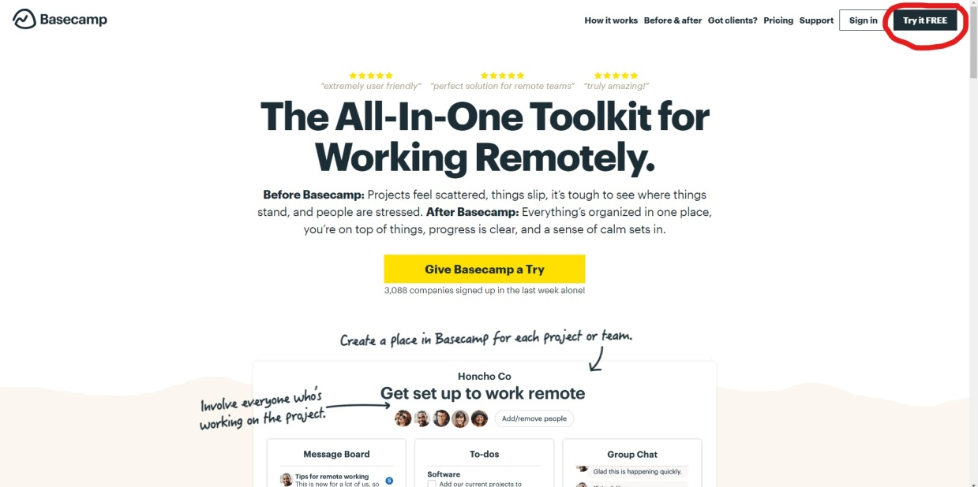
Steps to log in to the software
The software can be used from basecamp website https://basecamp.com then navigate to upper right corner and click on “Try it FREE” to try basecamp

Slide 25
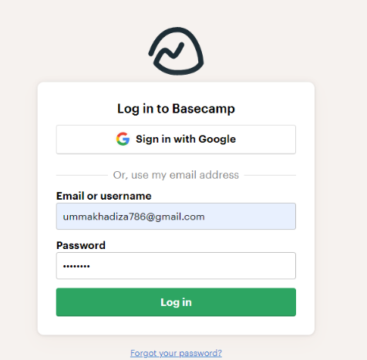
Steps to log in to the software
After following all the steps of creating a free account we can log in to basecamp using our credentials

Slide 26
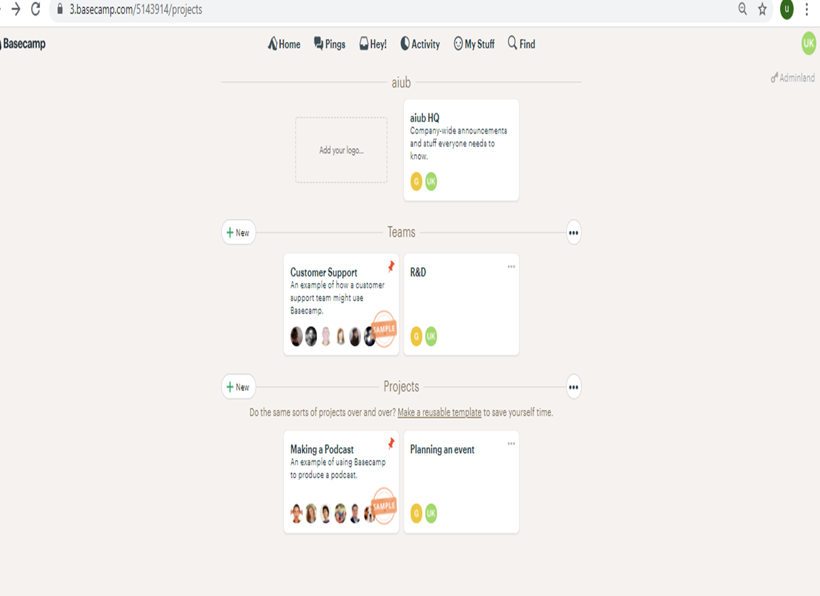
Steps to log in to the software
After logging in the basecamp homepage looks something like this. Here we can start exploring various options for managing our projects

Slide 27
Resources
Official Websites:
https://www.projectlibre.com/
https://www.orangescrum.org/
https://www.basecamp.com/
Tutorials:
https://www.youtube.com/watch?v=bTyAakCMrnY&feature=share
https://www.youtube.com/watch?v=wQT-QIrk-BA
https://www.youtube.com/watch?v=oiVnWX-J5Mo&t=434s

Slide 28
Thank You

