Slide 1
Wireless Metropolitan-Area Network (WMAN)
Presented by:
Umma Kulsum Ashamoni
ID: IT-21050
Supervised by:
Dr. Nazrul Islam
Associate Professor
Dept. of ICT, MBSTU

Slide 2
What is WMAN?
• WMAN stands for Wireless Metropolitan-Area Network.
• Connects multiple LANs within a metropolitan area.
• Provides broadband wireless connectivity over several kilometers.
• Example: WiMAX (IEEE 802.16 standard).

Slide 3
Key Characteristics
• Coverage range: 5 to 50 km.
• Supports high-speed data, voice, and video transmission.
• Uses microwave or RF signals.
• Connects homes, offices, or public hotspots.
• Acts as a bridge between LANs and WANs.

Slide 4
WMAN Architecture
Components:
1. Base Station (BS): Central point transmitting/receiving signals.
2. Subscriber Station (SS): Device used by end users.
3. Backhaul Connection: Links BS to internet backbone.

Slide 5
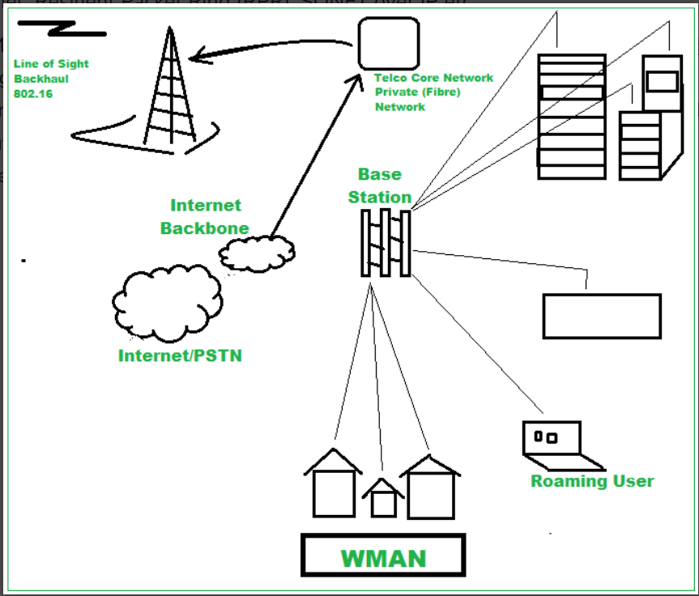
How WMAN Works
• Users connect to nearest
base station.
• BS relays data to metropolitan
network backbone.
• Data travels to other BS or
the Internet.
• Provides continuous city-wide
connectivity.

Slide 6
Technologies Used
• WiMAX (IEEE 802.16)
• LMDS
• MMDS
• 5G Fixed Wireless Access

Slide 7
Advantages
✅ Wide coverage (city-wide)
✅ High-speed broadband
✅ Cost-effective
✅ Easy deployment
✅ Supports mobile users

Slide 8
Disadvantages
Affected by weather/interference
High initial setup cost
LOS issues in some systems
Security risks if weak encryption

Slide 9
Applications
🏙️ City-wide Internet
🏫 University campuses
🏥 Hospital networks
🏢 Business organizations
🚉 Public Wi-Fi zones

Slide 10
Real-World Example
🌐 WiMAX in Seoul, South Korea:
• City-wide broadband service
• Residential and commercial coverage
• High mobility, low latency

Slide 11
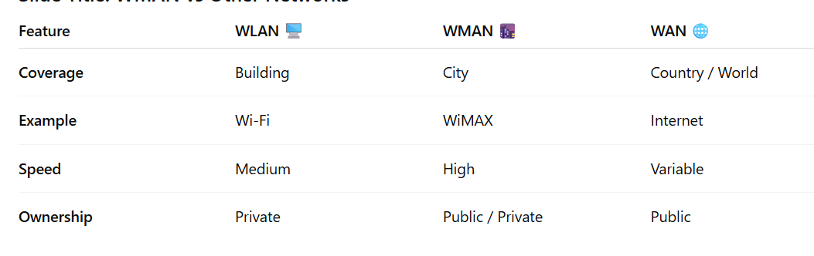
WMAN vs Other Networks

Slide 12
Summary
• WMAN provides city-wide broadband wireless coverage.
• Based on IEEE 802.16 (WiMAX) technology.
• Bridges LAN and WAN.
• Important for smart cities and urban connectivity.

Slide 13
References
• IEEE 802.16 Standard Documentation
• WiMAX Forum Official Website
• Networking textbooks (Tanenbaum, Stallings)

Slide 14
Thank You / Q&A
Thank you for your attention!
Any Questions?
🌆 WMAN – Connecting Cities Wirelessly

