Slide 1


MANGALORE INSTITUTE OF TECHNOLOGY AND ENGINEERING
(An ISO 9001:2015 Certified Institution)
Department of Computer Science & Engineering
Internship Presentation
On
“Java Fullstack Development”
By
UMMARUL KATHAD
USN:4MT22CS417
Under the Guidance of
Mr. SHREEJITH KB
Senior Assistant Professor,
Department of Computer Science & Engineering
Visvesvaraya Technological University
Jnana Sangama, Belgaum-590014

Slide 2
CONTENTS
Company Profile
Weekly Overview
Conclusion

Slide 3
COMPANY PROFILE

Slide 4


Ihub IT Solutions
Ihub IT Solution is a software company delivering high quality, cost effective, reliable result-oriented web and e-commerce solutions.
The company has successfully executed diverse IT projects for demanding, tech-savvy clients worldwide, delivering tailored web solutions that enhance efficiency, drive competitive advantage, and benefit end users.
Konaje, Mangalore

Slide 5
SOFTWARE DEVELOPMENT SERVICES
CUSTOM SOFTWARE DEVELOPMENT
ANDROID APPLICATION
WEB PORTALS
DATA ANALYTICS
CRM SOFTWARES

Slide 6
INDUSTRIES THEY SERVE
REAL ESTATE
TELECOM AND TECHNOLOGY
TRAVEL AND TOURISM
MEDIA
RETAILERS
ACADEMIC

Slide 7
WEEKLY
OVERVIEW

Slide 8
WEEK1 (17-FEB to 21-FEB):
We discussed about the Internship structure with our guide
Discussed about the agile methodology and working in a team.
Started with the Java Fundamental Course.
Covered all the data Structure concepts.

Slide 9
WEEK2 (24-FEB to 28-FEB):
Learnt about the advanced java Concepts and java SE features
Understood collections, sonarlint,
JDBC implementations

Slide 10
WEEK3-4(3-MAR to 14-MAR):
Learnt about the Spring
Understood spring boot framework
Implemented Vehicle Information Task

Slide 11
WEEK4-5 (15-MAR to 28-MAR):
Learnt about the HTML
Completed capstone project
Basics of CSS

Slide 12
WEEK6 (30-MAR to 6-APR):
Responsive Web designs
Completed capstone project
Basics of Javascript

Slide 13
WEEK7-8 (7-APR to 11-APR):
Project Title Submission
User stories generation
Database schema and Data flow diagram
Class diagram

Slide 14
WEEK9-12 (14-APR to 8-MAY):
Project Title: FashionHub
Technology Used:
FrontEnd:
HTML/CSS/Javascript
React
BackEnd:
Spring Framework
Spring Boot
Database
MySql Workbench

Slide 15
PROJECT : FASHIONHUB an Ecommerce Website
User Authentication(Register,Login)
Role Management(User,Admin)
Product Management (Add,Delete,Update)
Cart Management
Order Placement
Payment Integration(Razorpay)

Slide 16
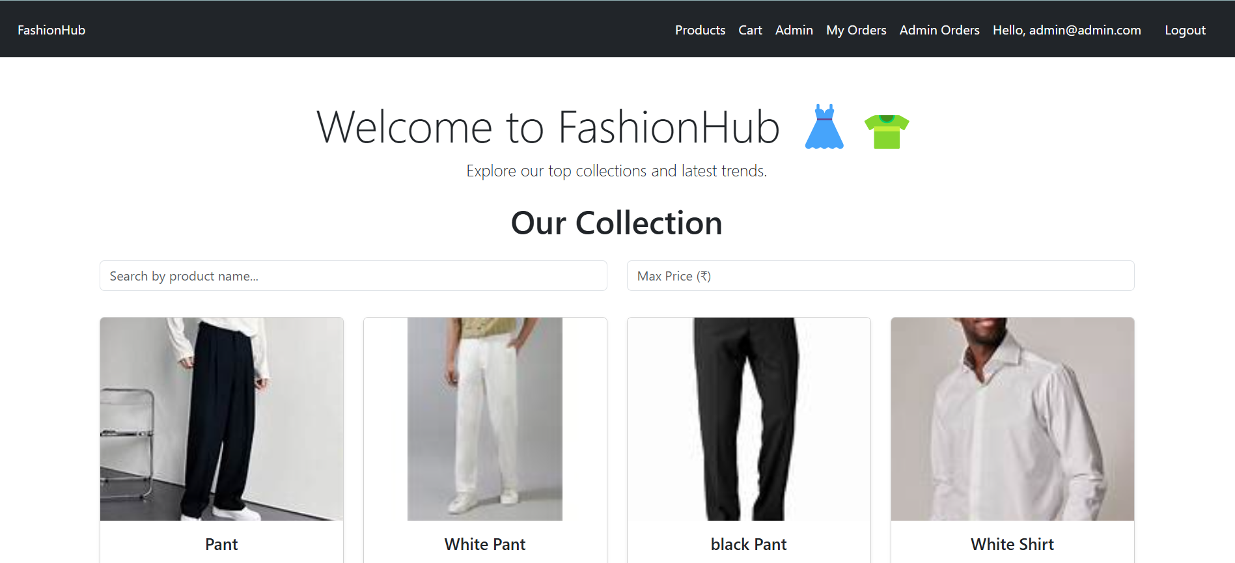

Slide 17
CONCLUSION

Slide 18
Java Fullstack Development
Gained hands on experience in Java Development
Gained Knowledge onto Rest Api
Developed Backend Projects using the spring boot
KEYS

Slide 19
THANK YOU

