Slide 1


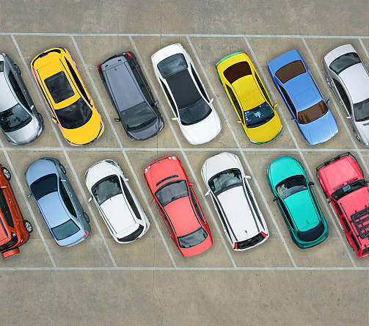
SMART CAR PARKING System
Presented by
Ummatun Khatun
Rifat Jahan Sumaia
Nishat Tasnim Mon

Slide 2
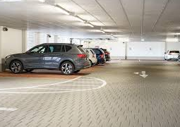
Introduction
The IoT-Based Smart Car Parking System automates parking slot booking and entry/Exit
Uses IR sensors, ESP32, servomotors, and LED.
Reduces parking congestion and enhances efficiency

Slide 3

Problem Statement
  Urban areas face severe parking shortages due to increasing vehicle numbers.
  Traditional parking methods lead to congestion, fuel wastage, and inefficiency.
  Lack of real-time monitoring results in ineffective parking space utilization.
  Security concerns arise due to unauthorized parking and manual management.

Slide 4
Project Overview
The Smart Car Parking System is an IoT-based solution designed to manage parking slots efficiently using ESP32, IR sensors, servos, and the Blynk platform. It aims to automate parking slot bookings, detect vehicle presence, and control entry/exit gates seamlessly. This system enhances convenience, security, and space optimization.

Slide 5
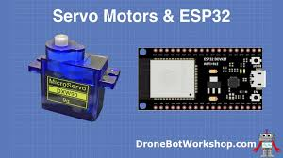
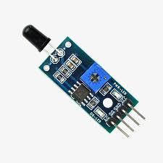
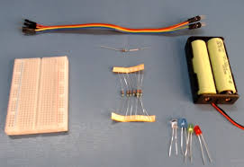
Components
• IR Sensors
• ESP32 Micro-controller
• Servo Motor for Gate Control
• Led
• Register
• Breadboard
• Wire

Slide 6
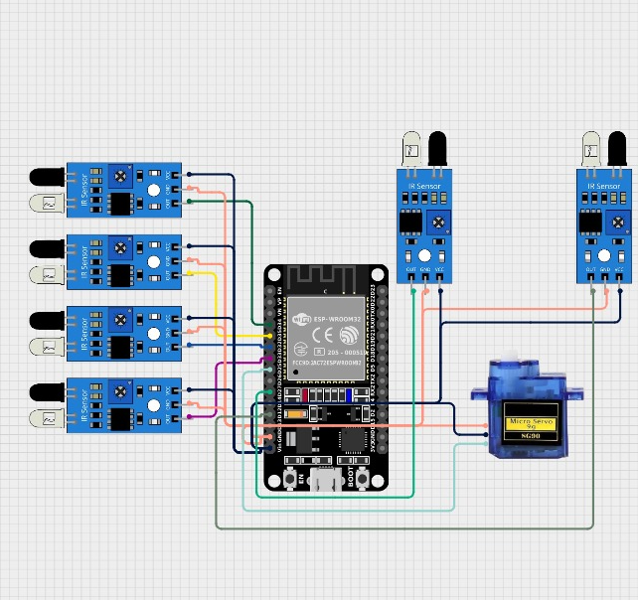
Circuit Diagram
• The circuit consists of ESP32, IR sensors, servo motor, and power supply.
• Shows real-time parking status and slot availability.

Slide 7
Project Demonstration

Slide 8
Advantages
Reduces Parking Congestion
Smart Urban Solution
Enhances Security
Saves Time
Optimized space utilization improves parking efficiency.
Eliminates manual parking allocation and reduces search time.
Prevents unauthorized vehicle entry and usage.
A step towards developing intelligent and sustainable cities.

Slide 9

Conclusion & Q/A
• IoT-based smart parking system improves efficiency and reduces congestion.
• Ensures smooth booking and entry/exit process.
• Any Questions?

Slide 10
THANK YOU

