Slide 1
Apple Tv Simulator
By Keith Wellman and Umme Faheema

Slide 2
Overview & Description
We created the project using HTML and CSS
Files
index.html
Index-search.html
Index-settings.html
Settings.html
All these HTML pages shared one single CSS file which is style.css

Slide 3
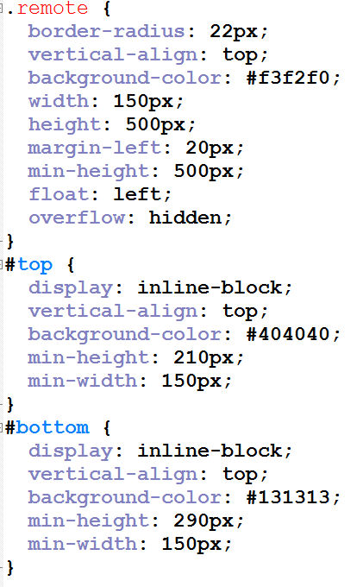
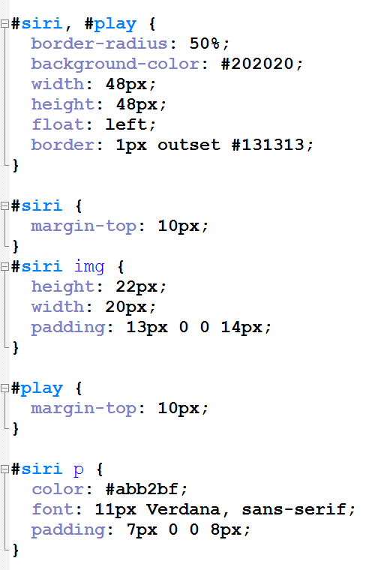
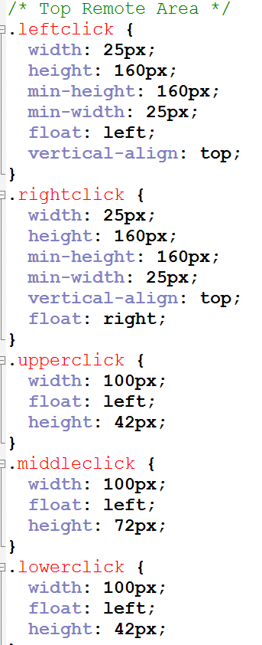
Code Snippet

Slide 4
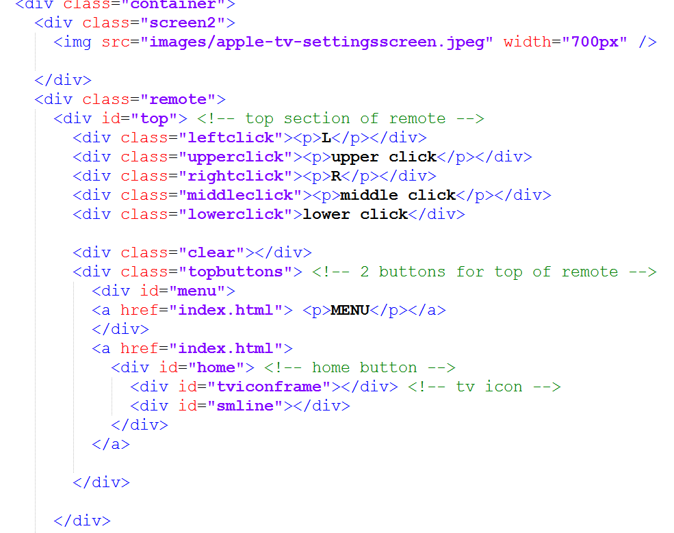
DEMO

