Slide 1

NextHikes IT Solutions
Exploratory Data Analysis of Large-Scale Retail Transaction Data
Using Univariate, Bivariate, and Multivariate Statistical Techniques
By
Ummehani Khan

Slide 2
Project Overview
Univariate Analysis
Outlier Detection
Bivariate Analysis
Correlation Drivers
Multivariate Interaction
Skewness & Kurtosis

Slide 3
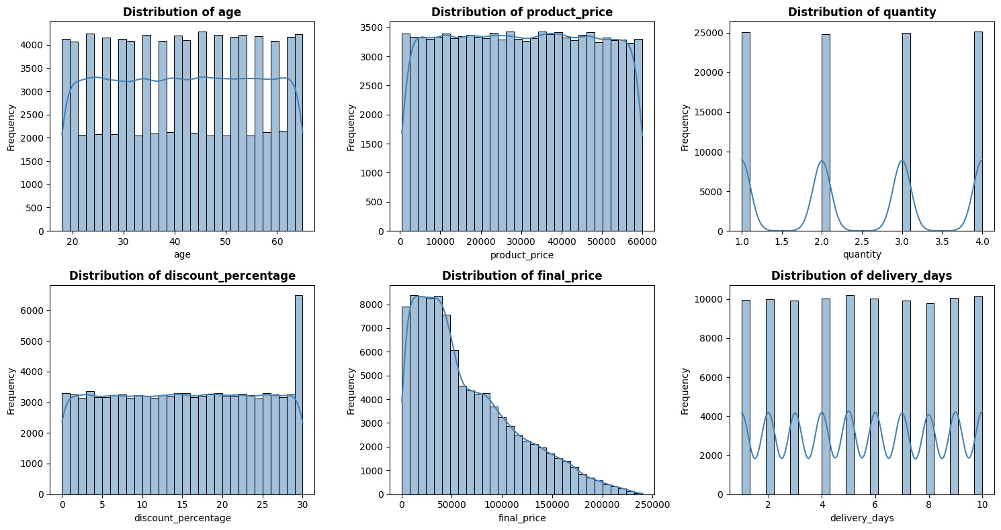
Univariate Analysis

Slide 4
Business Insights:
Customers span ages 20–60 → broad demographic, no single dominant group.
Most products priced below ₹60,000 → mid‑range catalog dominates.
Orders usually 1–4 units → small basket size.
Discounts mostly low, with spikes at 30% → campaigns drive surges.
Final price skewed → majority low‑value, few premium orders.
Delivery cycles 1–10 days → predictable but improvable.
Implication: Marketing should remain broad, but bundles and premium expansion could grow revenue.

Slide 5
Summary
Balanced Customer Base: Gender, segment, and geography are evenly spread → business is not over‑reliant on one group.
Category Strength: Health & beauty products stand out → opportunity to double down on wellness trends.
Operational Flexibility: Payment and shipping preferences are diverse → continue offering multiple options.
Retention Opportunity: 15% returns need investigation → improving delivery speed or product quality could reduce this.

Slide 6
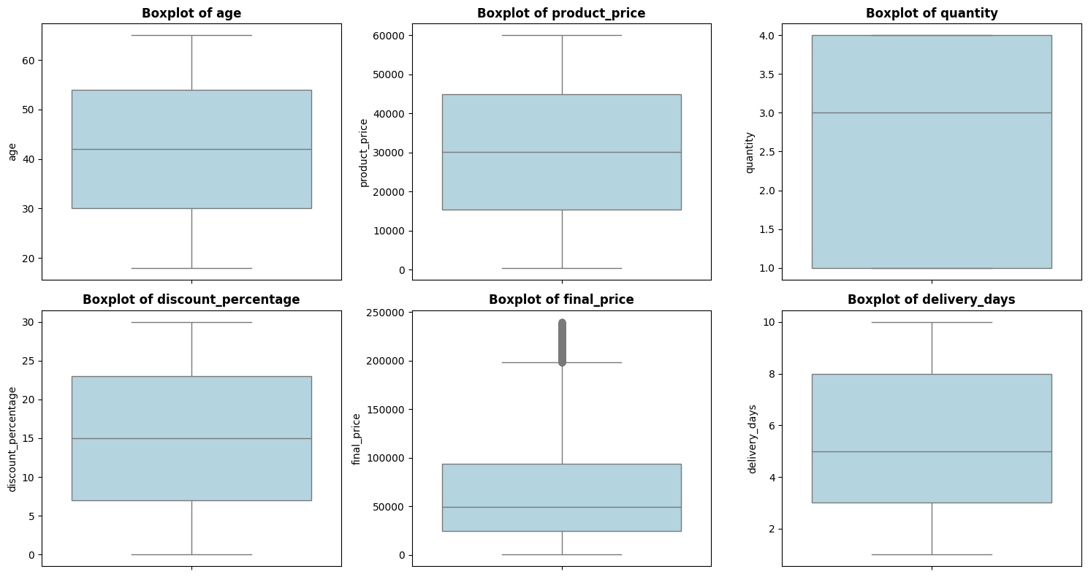
Outlier Detection

Slide 7
age has no detected outliers → No action needed. –
product_price has no detected outliers → No action needed. –
quantity has no detected outliers → No action needed.
discount_percentage has no detected outliers → No action needed. –
final_price has 1.33% outliers → Monitor but may not require immediate action unless business-critical. –
delivery_days has no detected outliers → No action needed.

Slide 8
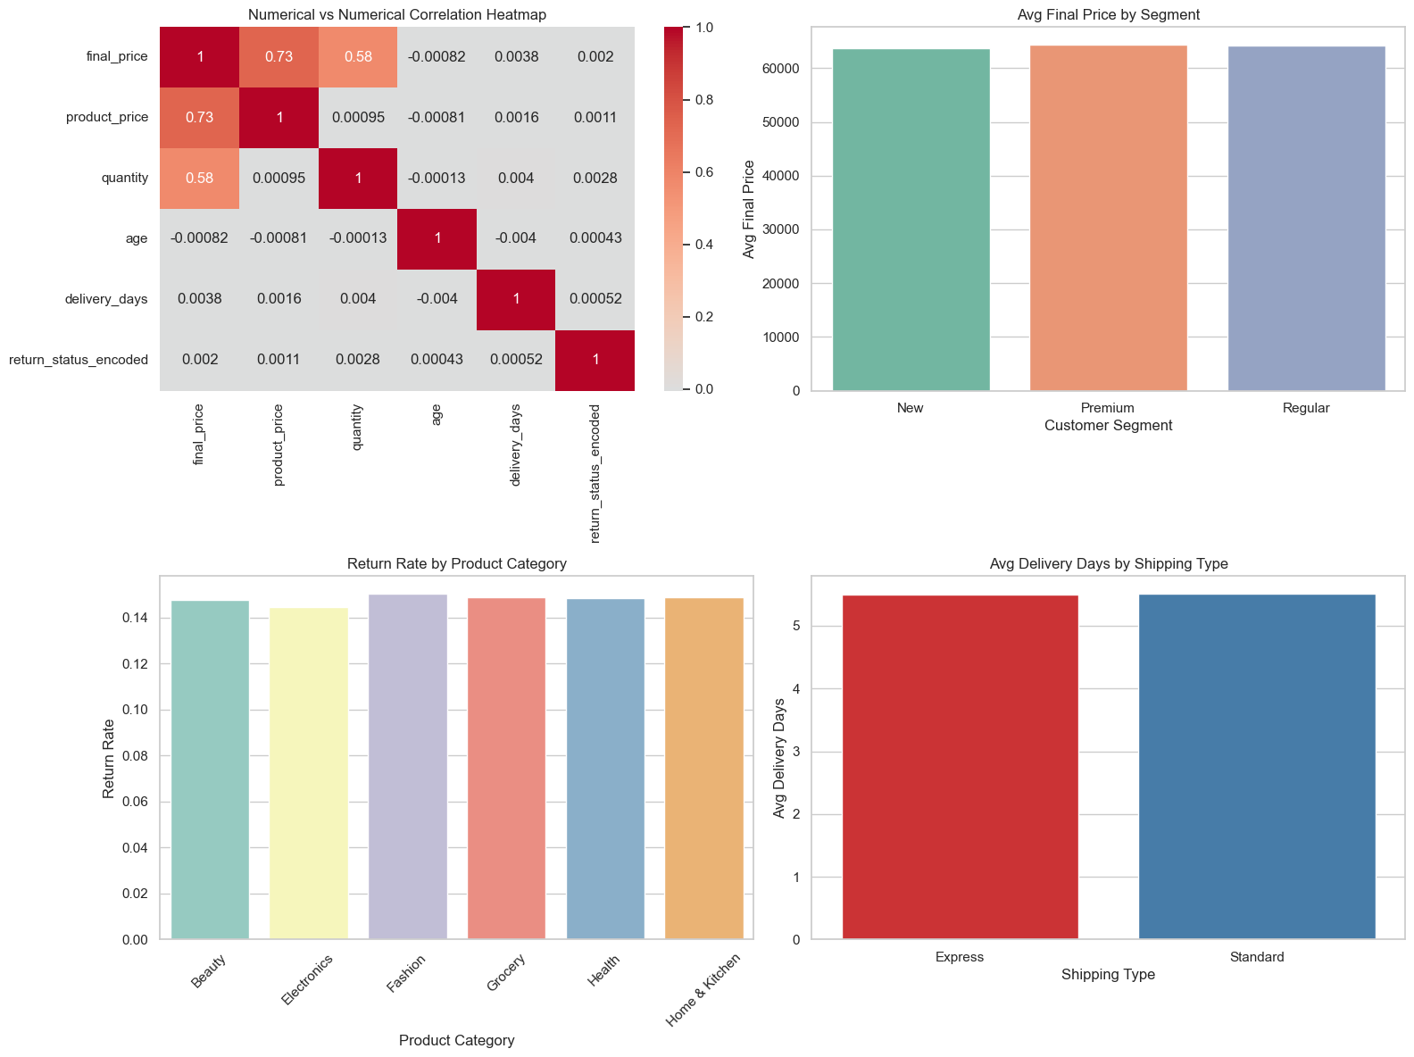
Bivariate Analysis

Slide 9
1. Correlation Heatmap (Top‑Left)
Final price is strongly correlated with product price (0.73) and quantity (0.58) → these are the main revenue drivers.
Discount percentage shows a weak negative correlation with final price → discounts reduce per‑unit margins.
Age and delivery days have negligible correlation with spending → operational factors don’t directly drive revenue.
Implication: Pricing and quantity are the levers for revenue growth, while discounts must be managed carefully.
2. Avg Final Price by Segment (Top‑Right)
All customer segments (New, Premium, Regular) show similar average final prices (~60K).
No segment dominates in terms of average transaction value.
Implication: Segmentation strategies should focus on frequency and loyalty, not just transaction size.
3. Return Rate by Product Category (Bottom‑Left)
Return rates are consistent (~14%) across categories, with only minor variation.
No single category stands out as a return risk.
Implication: Returns are a system‑wide issue, not category‑specific. Improvements should target logistics and customer expectations.
4. Avg Delivery Days by Shipping Type (Bottom‑Right)
Express and Standard shipping both average ~5 days.
No major operational difference in delivery speed

Slide 10
Summary
Sales peaked in 2024-01 with total final price 200,764,028.
- Customers in age group (25, 35] spend the most on average. - Male customers have higher average spending compared to other genders. - Orders with Standard shipping type show the highest average final price.
- Delivery days show a weak correlation (0.00) with final price, indicating little impact.
- Customers using Debit Card tend to spend more.
- Returned orders have an average final price of 64,410, which may indicate higher-value returns.
- Discount percentage correlates -0.00 with quantity, suggesting discounts drive bulk purchases.
- Product category 'Home & Kitchen' has the highest average final price.

Slide 11
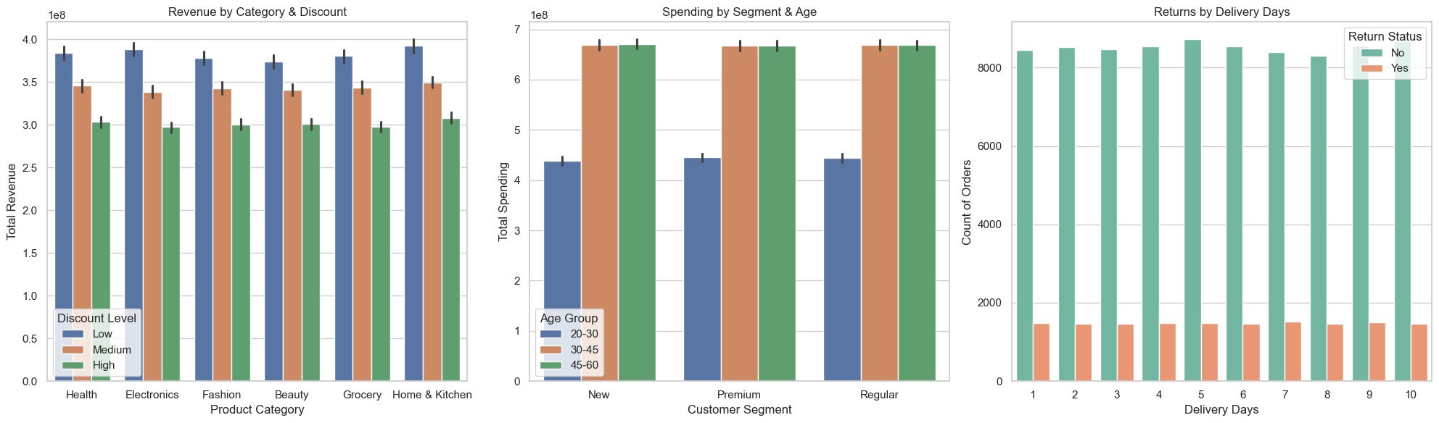
Multivariate Analysis

Slide 12
1. Revenue by Category & Discount (Left Chart)
Across all categories, lower discounts yield higher revenue.
Electronics and Health categories stand out as strong revenue generators even at moderate discounts.
High discounts reduce revenue contribution, showing margin erosion despite volume gains.
Implication: Discounts should be used strategically — moderate levels maximize revenue without sacrificing profitability.
2. Spending by Segment & Age (Middle Chart)
Premium customers aged 30–45 and 45–60 are the highest spenders.
New and Regular customers spend less, especially in the younger 20–30 age group.
Age is a stronger differentiator than segment alone.
Implication: Marketing should prioritize premium mid‑age customers, while nurturing younger segments for long‑term growth.
3. Returns by Delivery Days (Right Chart)
Majority of orders are not returned, showing strong product satisfaction.
Return counts remain steady across delivery days, but longer delivery cycles still pose risk.
Standard shipping is more vulnerable to returns compared to express.

Slide 13
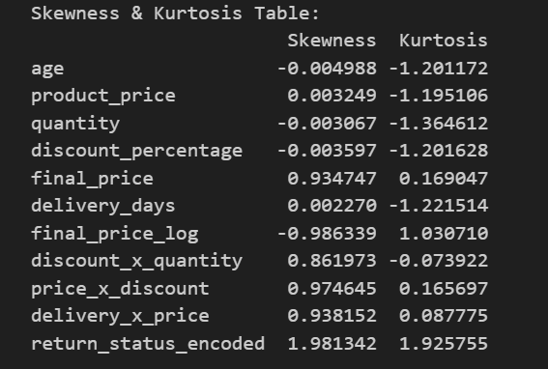
Distribution analysis shows that most variables are fairly symmetric and flat, but revenue‑related fields (final_price, discount interactions) exhibit positive skewness, highlighting bulk purchases and high‑value discounts as outliers. Final_price also shows mild kurtosis, confirming occasional extreme transactions. Discount percentage is uniformly spread, while return_status is highly skewed, reflecting that most orders are not returned. Log transformation of final_price improves normality, making it more suitable for predictive modeling.

Slide 14


